Slide 1
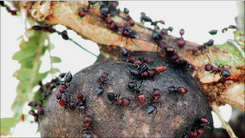

Slide 2
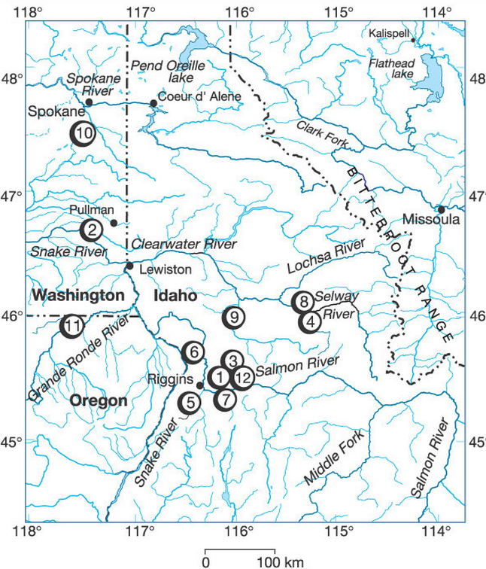
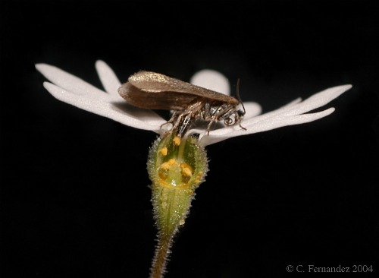

Slide 3


Site A
Site B
Site C
Site D
Site E
Mean Interaction Outcome
from Armas et al. (2004)
Negative RII = better w/o herbivory
Positive RII = better with herbivory

Slide 4
Variation in Interaction Outcome Magnitude
Change in sign of Interaction Outcome
Site A
0
Site A
Site B
1
Site B
Site C
0 or 1
-1
Site C
Site D
-1
Site D
Site E
0
Site E

Slide 5
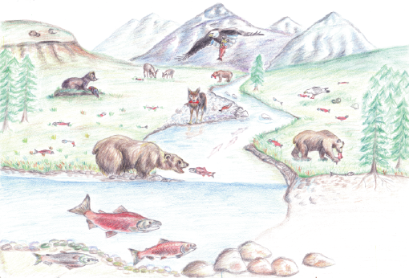
A
A
B

Slide 6
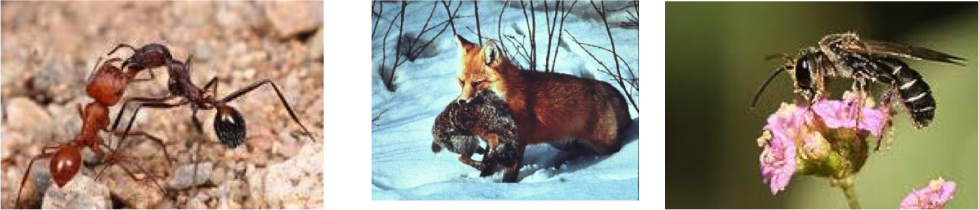
P
C
M

Slide 7
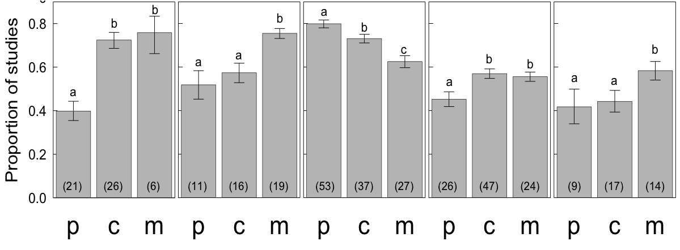
Abiotic
Spatial
Species Identity
Temporal
3rd party

Slide 8
Abiotic
Spatial
Species Identity
Temporal
3rd party

Slide 9
Abiotic
Spatial
Species Identity
Temporal
3rd party

