Slide 1
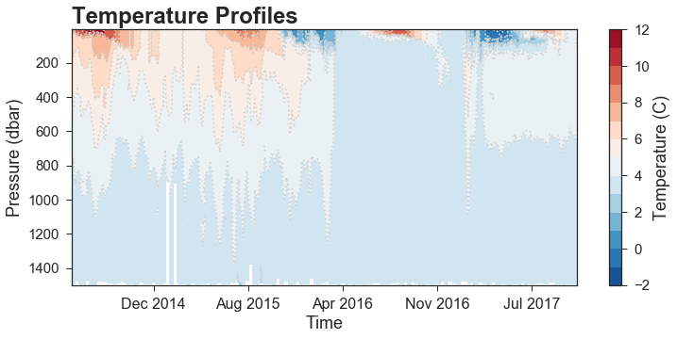
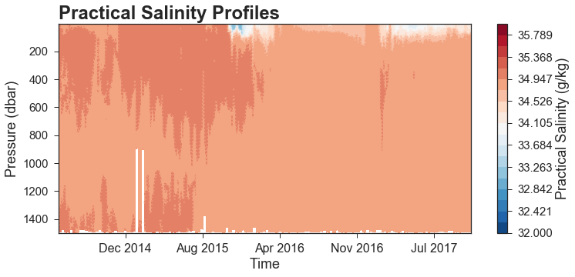
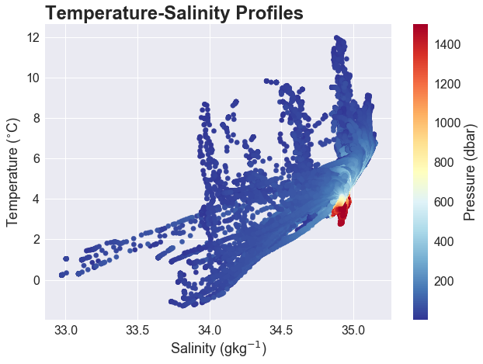
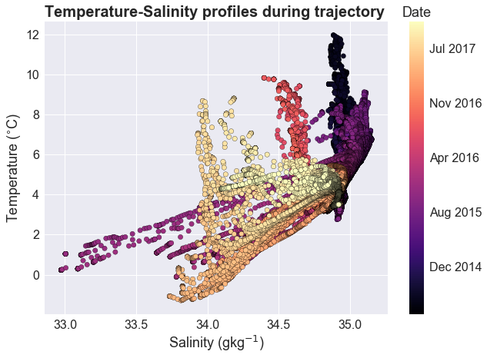
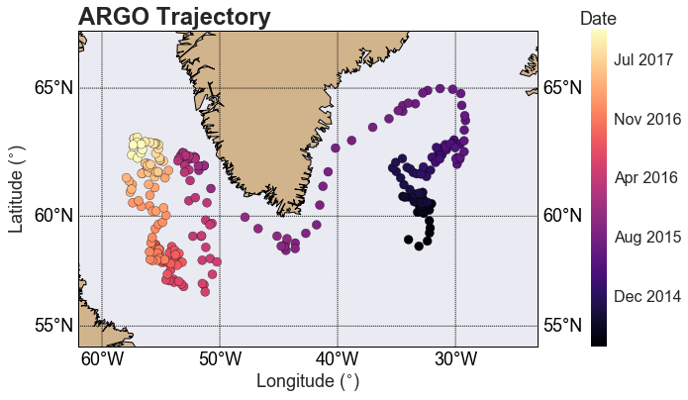
NACW†
LSW
AIW
Suki Wong // 12-05-17
Notes:
NA → Den Straits//Irminger Seas//Lab Sea//Davis Straits//E+W Greenland → Lab Sea

