Slide 1
4925_2017 Homework #4, Vorticity due 16 November. Send your solution [word doc, xls, pdf]
to agordon@ldeo.columbia and to Laura Gruenburg: lkg2133@columbia.edu
What is the width (distance from the non-slip western boundary to the axis of the boundary current) and maximum current at the axis of the Florida Straits Current from a simple Vorticity and transport balance:
§ Wind removal of vorticity over the subtropics (westerlies/trades) = vorticity gain at western boundary;
§ Interior Sverdrup Transport = Western boundary transport.
Assume all this is achieved within upper 800 m, depth of the Florida Straits
∂τ_{x}/∂y = ρk∂v/∂x
M_{y} = -(∂τ_{x}/∂y)/β
Western boundary shear
ρ = 1025
k ~2*10⁻⁶
Interior Sverdrup Transport
Calculate at 26°N (Rapid); approximate the width of the North Atlantic @ 26°N, use reasonable zonal wind stress values
Westerlies = +0.05 newtons/m2
30°N
dτx/dy = constant
26.5°N
Western boundary
Eastern boundary
dv/dx
= constant
My
20°N
Trades = -0.05 newtons/m2
Atlantic Ocean

Slide 2
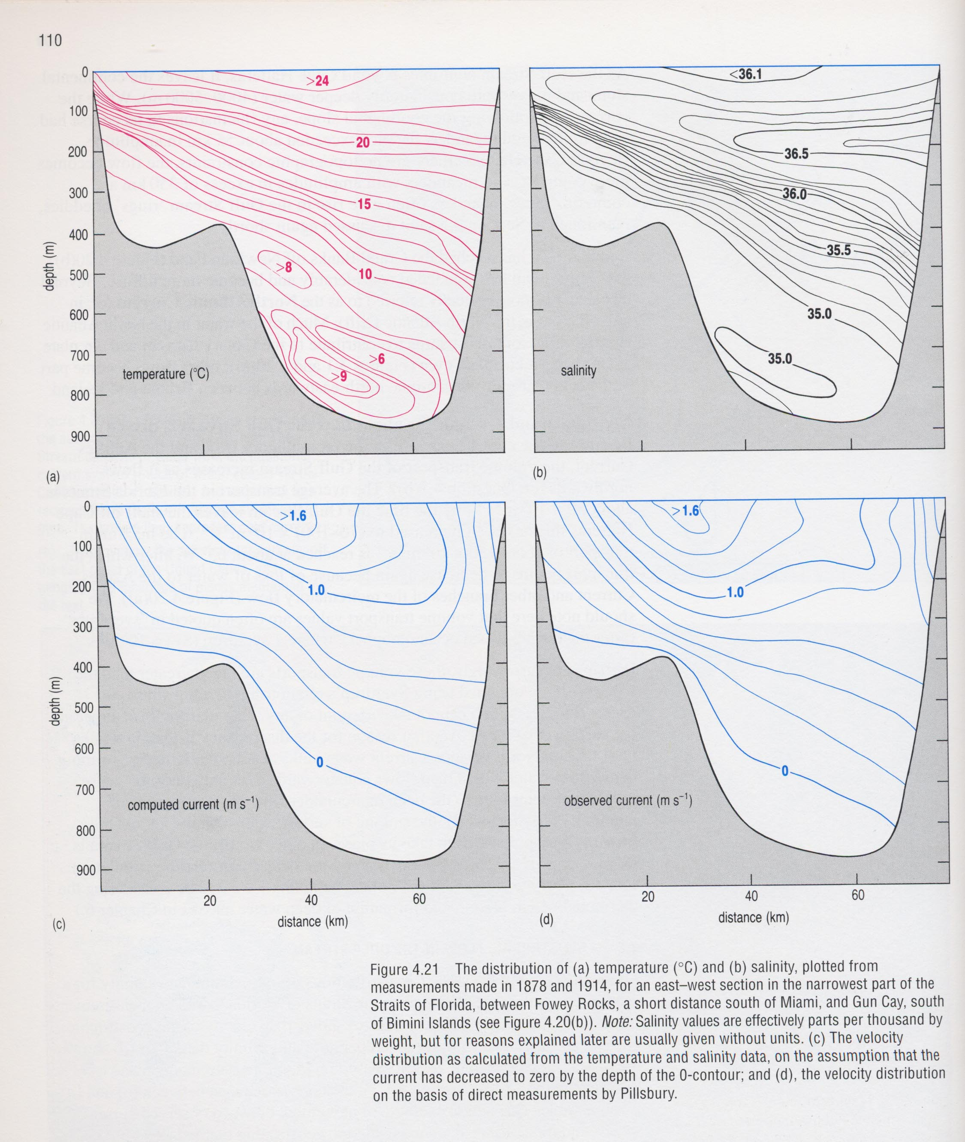
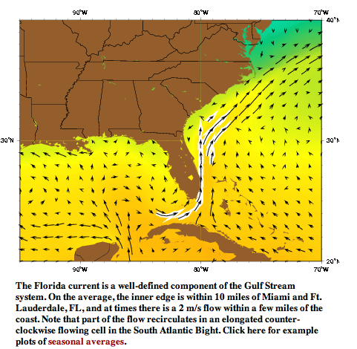
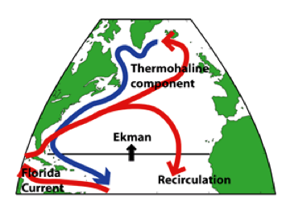
Looking north: note slope down towards east: geostrophy in action; note cyclonic and anti-cyclonic shear zones: side wall vorticity in action
Florida Straits
From: http://oceancurrents.rsmas.miami.edu/atlantic/florida.html
~3 kts
Florida Straits
AMOC lecture and the Rapid Program
Open university. Ocean circulation
Notes:
WÜST, G. (1924) Florida- und Antillenstrom, eine hydrodynamische Untersuchung.
Vero'ft. Inst. ]'. Meereskunde (A) 12, 1-48.

Slide 3
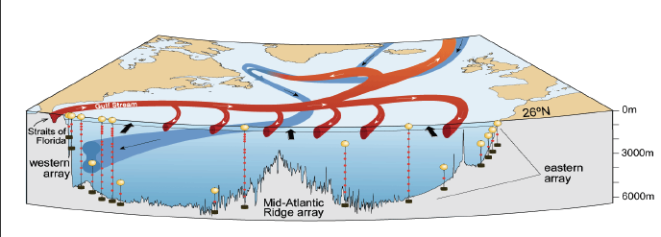
AMOC= Atlantic Meridional Overturning Circulation
RAPID, 26°N
Monitoring changes in the AMOC is important for understanding decadal climate variability and change. The RAPID array across the Atlantic at 26°N has now observed the AMOC continuously for 10 years, and revealed greater variability than expected.
Low AMOC events in 2009-10 and 2010-11 coincided with cold winters in Europe and suggest a previously unsuspected role for the AMOC in climate variability. Understanding this requires a longer time series of observations, so the array will continue until 2020.
http://www.rapid.ac.uk/rapidmoc/
Science vol 317, 17 August 2007
http://www.usclivar.org/meetings/amoc2013 : McCarthy_AMOC_2013

Slide 4
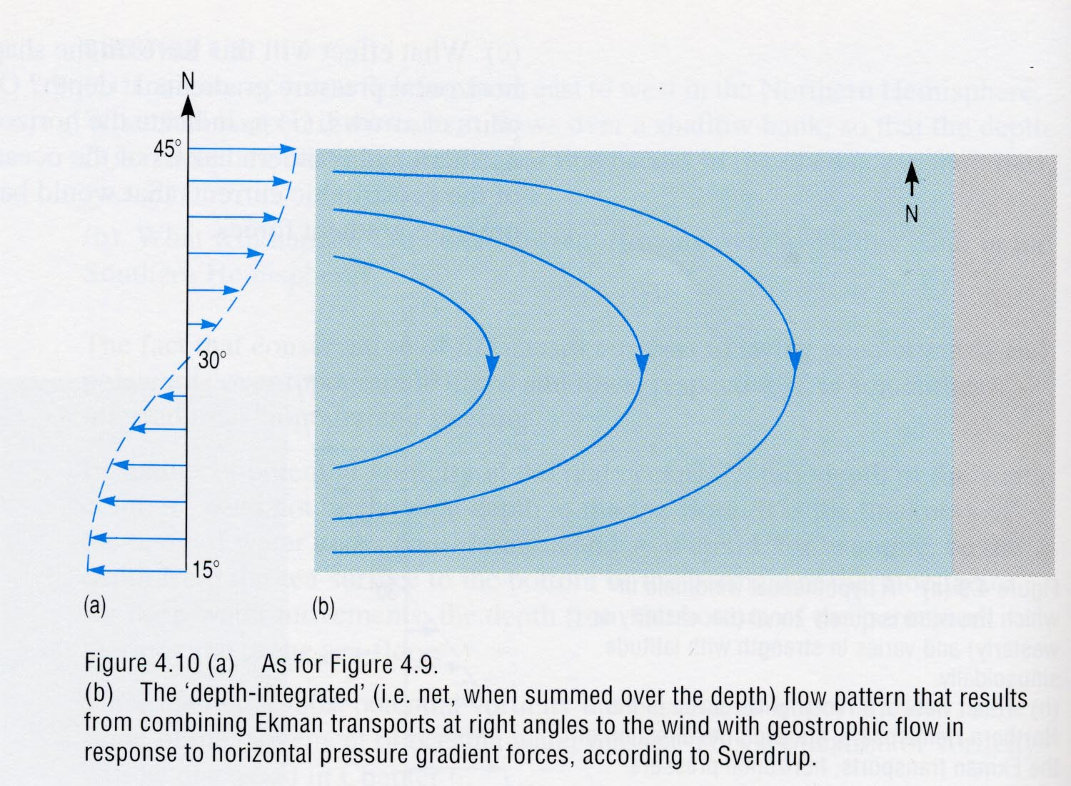
But which lateral boundary: eastern or western?
For water to move towards the north pole it has to pick up counterclockwise rotation [+]…it can do this by frictional interaction with the western boundary, not along the eastern boundary
Zonal flow, dotted arrows, are need to close the loop
hint: this is the answer
westerlies
-
M_{y} Sverdrup
Transport = ∇ x τ₀ /β
Frictional surface, v= 0
+
Can balancemass poleward, but not vorticity
Can balancemass poleward and vorticity
Frictional surface, v= 0
-
My
trades
Right!
Wrong!
Western boundary
Eastern boundary
The wind driven Sverdrup transport across the width of the ocean must be balanced in both transport and vorticity by a western boundary current. The western boundary current thru frictional interaction with the land margin provides the vorticity to balance the wind stress.

Slide 5
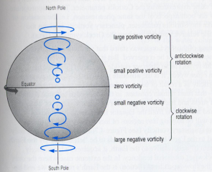
+ rotation
North Pole
Rotation around local vertical
At 60 N: Cos 60 * Earth circumference in 24 hours [~500 miles/hr]
At 30 N: Cos 30 * Earth circumference in 24 hours [~860 miles/hr]
Earth circumference in 24 hours [~1000 miles/hr]
No rotation around local vertical
A disc fixed on the earth surface rotates relative to the stars [counterclockwise in NH; clockwise in SH] this is planetary vorticity = f [the coriolis parameter]

