Slide 1

Control Window
EyeCandy Main Process
Create

Slide 2
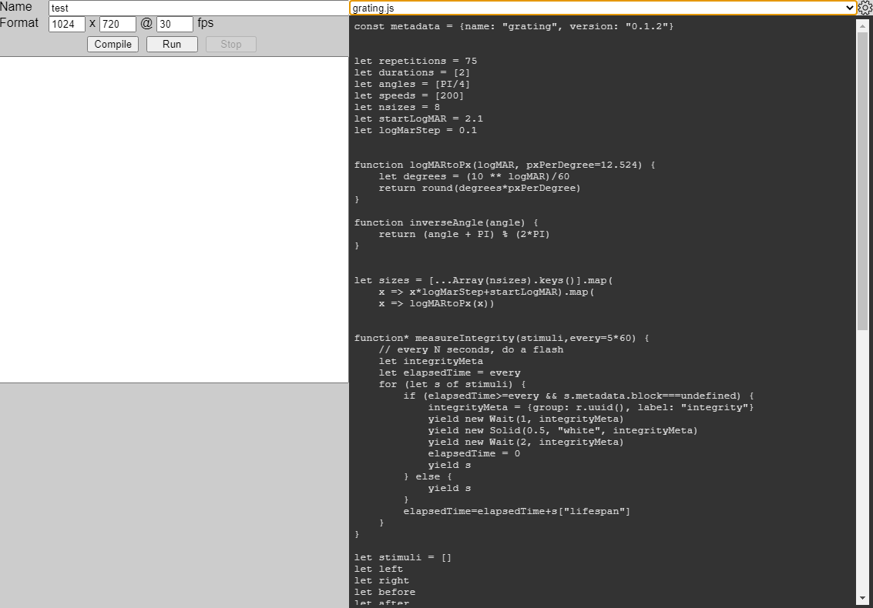

Control Window
EyeCandy Main Process
Eye candy
program (js)
Eye candy
program (js)
Spawn
Create
Stimulus Window
(offscreen)
VM
ffmpeg Process

Slide 3
Control Window
EyeCandy Main Process
Stimuli objects (js)
Stimulus Window
(offscreen)
VM
ffmpeg Process

Slide 4
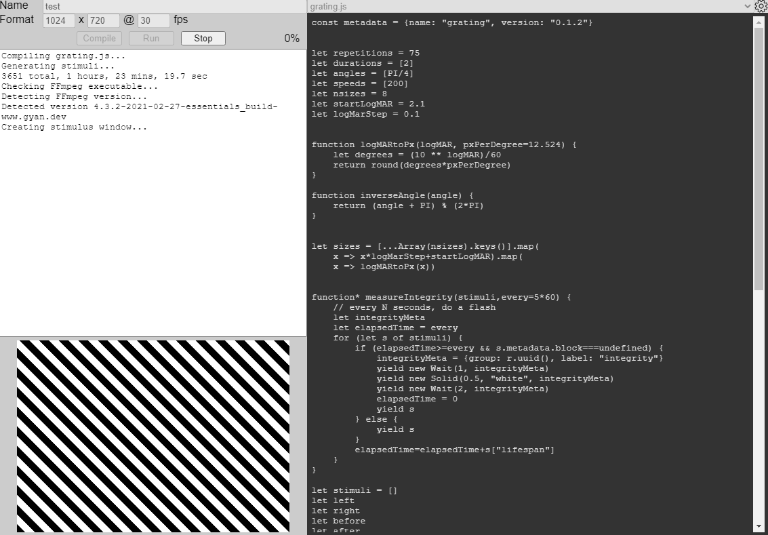
Control Window
EyeCandy Main Process
Stimuli frames (bmp)
Stimulus Window
(offscreen)
VM
ffmpeg Process
video.mp4

Slide 5
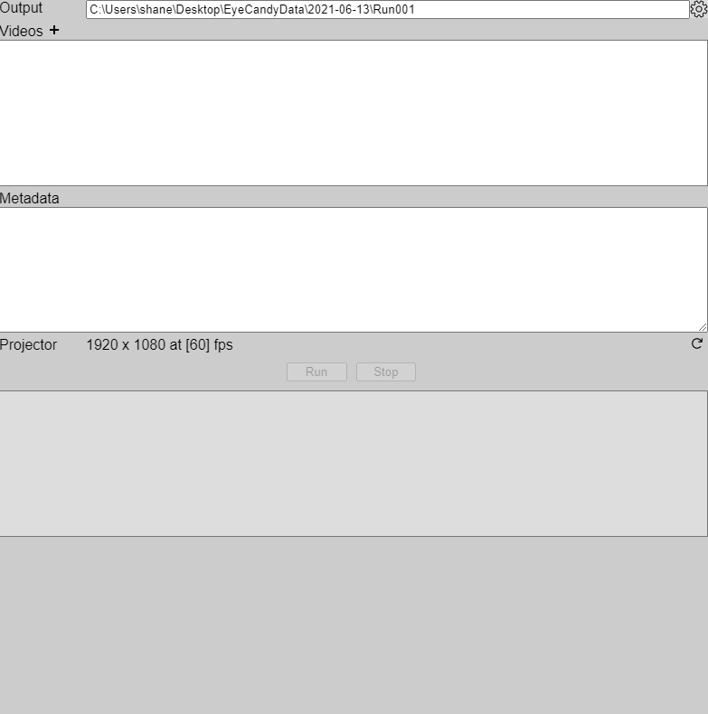
Control Window
EyeProjector Main Process
Create

Slide 6
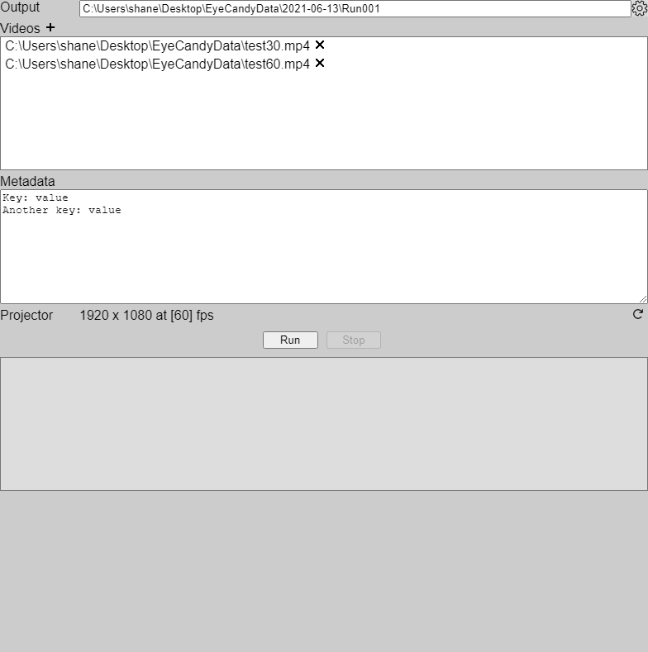
Control Window
EyeProjector Main Process
Experiment
Spawn
Create
Stimulus Window
(projector)
ffmpeg Process

Slide 7
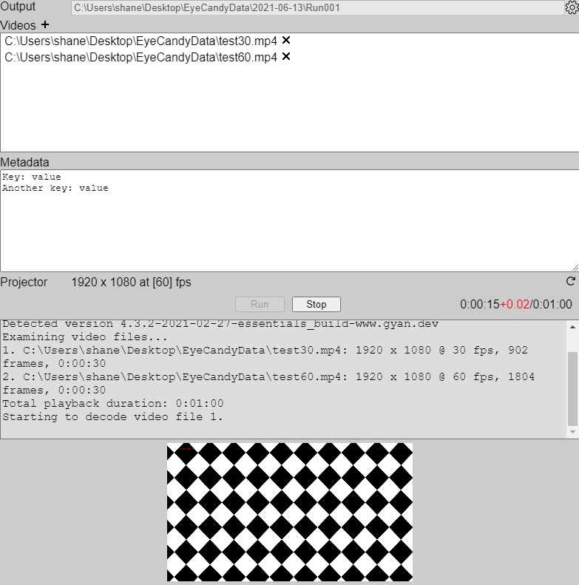
Control Window
EyeProjector Main Process
Stimulus Window
(projector)
ffmpeg Process
Stimuli frames (bmp)
video.mp4

Slide 8

Main Process (js)
Native Layer (C++)
nativeImage
queueNextFrame()
pendingFrameQueue
RecordThread
ffmpeg
pendingFrame[]
previewFrameQueue
video.mp4
PreviewSendThread
[named pipe]
checkCompletedFrames()
completedFrameQueue

Slide 9
Main Process (js)
Native Layer (C++)
Start
beginVideoPlayback()
video.mp4
PlaybackThread
ffmpeg
pendingFrameQueue
ProjectorThread
Projector
previewFrameQueue
PreviewSendThread
[named pipe]

Slide 10
Main Process (js)
Native Layer (C++)
Start
openPreviewChannel()
PreviewReceiveThread
[named pipe]
pendingPreviewQueue
Display next frame
getNextFrame()

Slide 11

EyeCandy
Computer
Photodetector
Projector
Timing card

