Slide 1
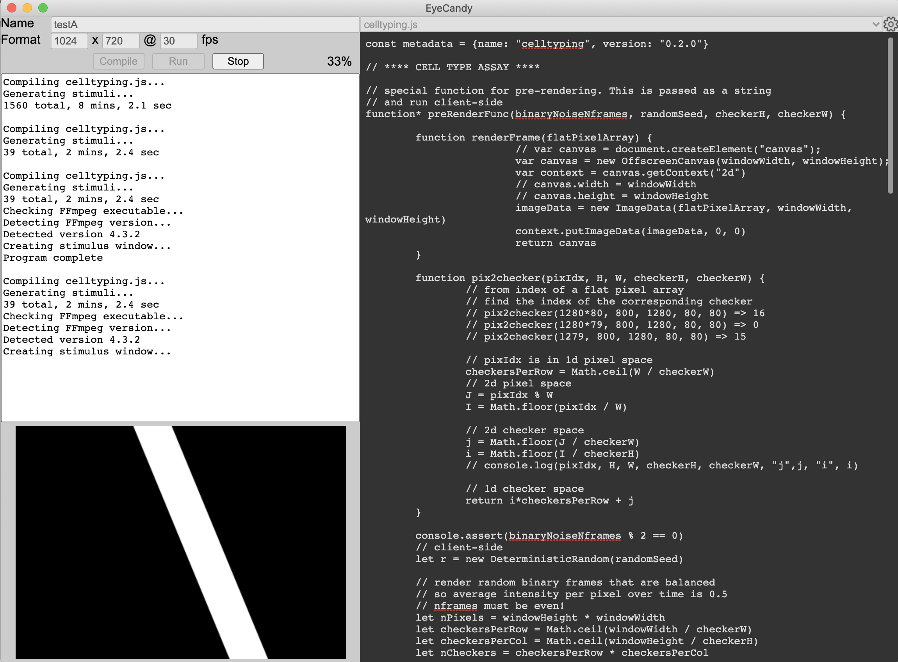
Control Window
EyeCandy Main Process
Create

Slide 2

Control Window
EyeCandy Main Process
Eye candy
program (js)
Eye candy
program (js)
Spawn
Create
Stimulus Window
(offscreen)
VM
ffmpeg Process

Slide 3
Control Window
EyeCandy Main Process
Stimuli objects (js)
Stimulus Window
(offscreen)
VM
ffmpeg Process

Slide 4
Control Window
EyeCandy Main Process
Stimuli frames (bmp)
Stimulus Window
(offscreen)
VM
ffmpeg Process
video.mp4

Slide 5
Control Window
EyeProjector Main Process
Create

Slide 6
Control Window
EyeProjector Main Process
Experiment
Spawn
Create
Stimulus Window
(projector)
ffmpeg Process

Slide 7
Control Window
EyeProjector Main Process
Stimulus Window
(projector)
ffmpeg Process
Stimuli frames (bmp)
video.mp4

