Slide 1
Make your Asciidoctor Groovy
Stephan Classen

Slide 2

About the speaker
Stephan Classen
TDD enthusiast
Loves Open Source
Hates repetitive jobs

Slide 3
About the speaker
Stephan Classen
TDD enthusiast
Loves Open Source
Hates repetitive jobs
A little paranoid

Slide 4
About the speaker
stephan.classen@canoo.com
 github.com/sclassen/greach2016

Slide 5
Terminology
AsciiDoc
  A mature, plain-text writing format for authoring documentation, books and more.
Asciidoctor
  A fast text processor and publishing toolchain for converting AsciiDoc files.

Slide 6

Notes:
I am no salesman
Advertisment for Asciidoctor
- Things I think make Asciidoctor groovy
- Other similar formats may have support for the same functionality

Slide 7
Little Formatting mostly Content
== Parameters
=== screenshot
The _screenshot_ block macro has the syntax `screenshot::<url>[<parameters>]` and supports the following parameters
(note: the URL is not needed when the browser was navigated to the page using a _geb_ block or other means)
name:: an optional unique file name (will be generated otherwise), the screenshot will be called `<name>.png`. This is the first positional parameter.
frame:: Try awesomeness with `iphone5`, `nexus5` or `browser`. This is the second positional parameter.
dimension:: size of the screenshot in the format `<width>x<height>` for instance 800x600. Also the values of 'frame' are supported.
selector:: the CSS-like dom selector to screenshot. Only this will be part of the image. For instance `div #login_window`.
Note: it is not allowed to set both 'frame' and 'dimension' or 'frame' and 'selector' for a screenshot.
Note: `screenshot::http://google.com[google]` and `screenshot::http://google.com[name=google]` are equivalent.
=== geb
The _geb_ block supports the following parameters:
dimension:: size of the screenshot in the format `<width>x<height>` for instance 800x600. Also the values of 'frame' are supported. This is the first positional parameter.
Notes:
Not important to be able to read this

Slide 8
Little Formatting mostly Content
== Parameters
=== screenshot
The _screenshot_ block macro has the syntax `screenshot::<url>[<parameters>]` and supports the following parameters
(note: the URL is not needed when the browser was navigated to the page using a _geb_ block or other means)
name:: an optional unique file name (will be generated otherwise), the screenshot will be called `<name>.png`. This is the first positional parameter.
frame:: Try awesomeness with `iphone5`, `nexus5` or `browser`. This is the second positional parameter.
dimension:: size of the screenshot in the format `<width>x<height>` for instance 800x600. Also the values of 'frame' are supported.
selector:: the CSS-like dom selector to screenshot. Only this will be part of the image. For instance `div #login_window`.
Note: it is not allowed to set both 'frame' and 'dimension' or 'frame' and 'selector' for a screenshot.
Note: `screenshot::http://google.com[google]` and `screenshot::http://google.com[name=google]` are equivalent.
=== geb
The _geb_ block supports the following parameters:
dimension:: size of the screenshot in the format `<width>x<height>` for instance 800x600. Also the values of 'frame' are supported. This is the first positional parameter.
Notes:
AsciiDoc formatting is highlighted to show relation of content to formatting

Slide 9
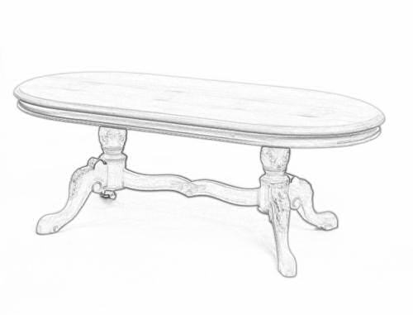
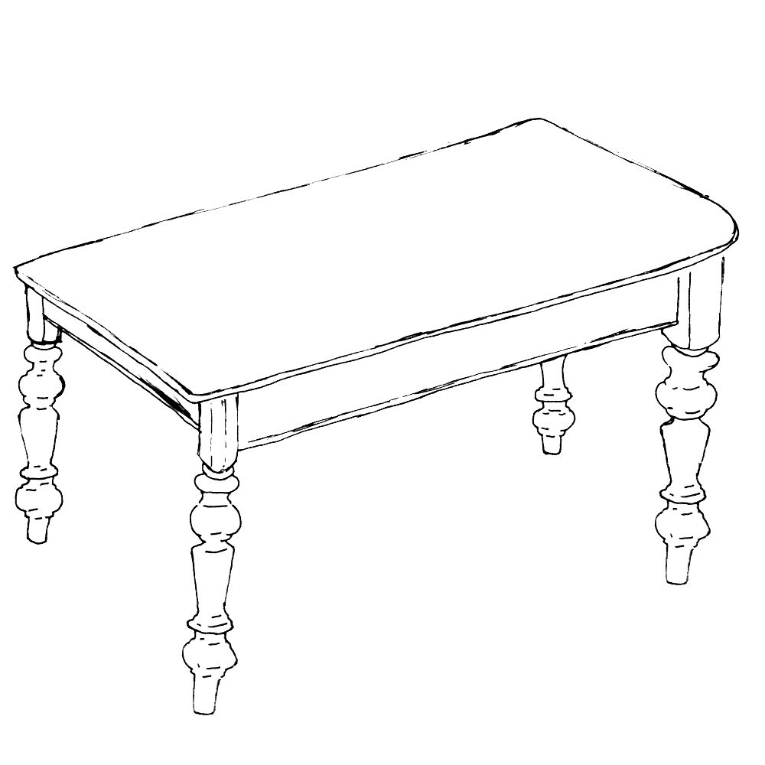
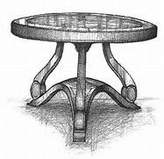
Tables
Notes:
Very practical and a ascii format without tables is just incomplete

Slide 10
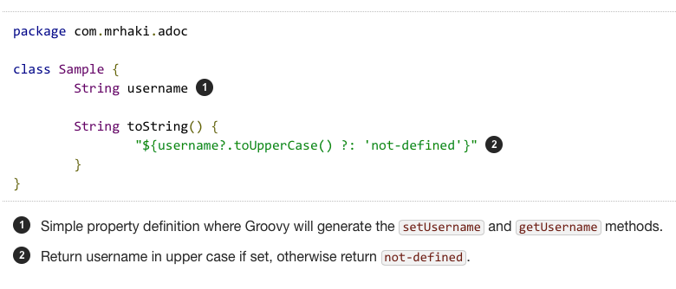
Syntax Highlighting and Callouts
Notes:
- Syntax highlighting is included out of the box
- custom highlighter can be supplied
- support for Callouts to add explanations for lines in the code

Slide 11

Includes
Notes:
- allows to separate documents
- a document part per chapter in a book
- a document part per module in a project
- reuse document parts in multiple document
- include (parts) of a source file
- see talk from last years greach conference by Markus Schichting

Slide 12
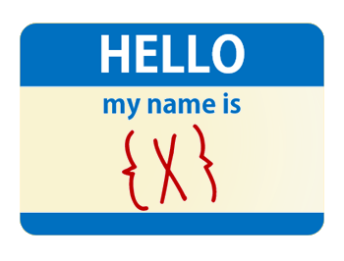
Attributes (Variables)
Notes:
Attributes can be defined in the document or passed from the outside
- do not repeat stuff
- pass environment information
- path to files
- version number of document
- customize included document parts

Slide 13
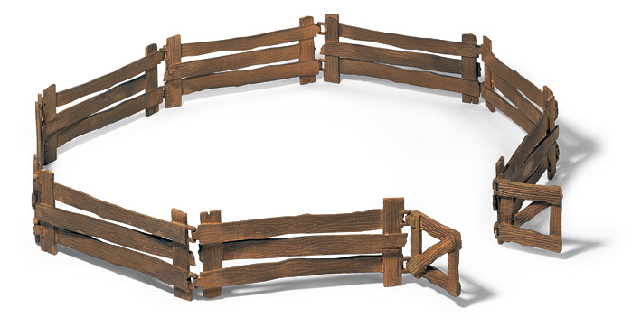
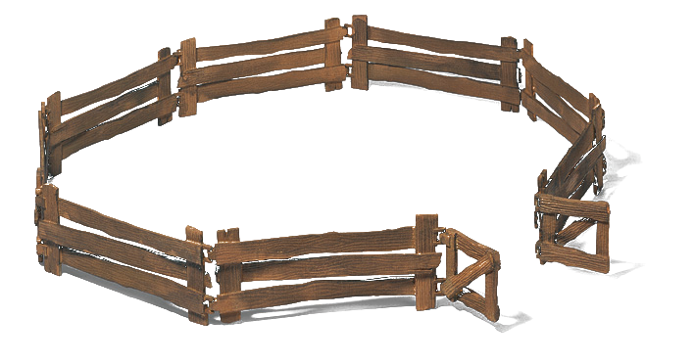
Fenced Content
Text
Notes:
Allows to mark multiple lines (with empty lines) to be part of a single block
Examples
- source code
- quotes

Slide 14
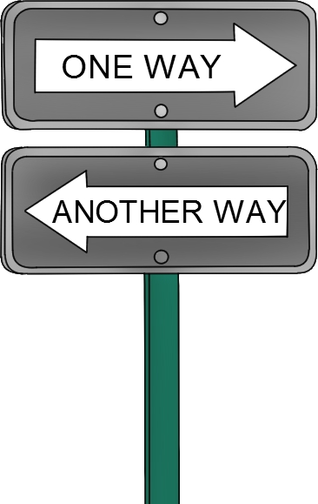
Conditionals
Notes:
- two sided sword
- good parts
- allows to adapt to environment
- allows to make included parts configurable
- bad parts
- increases complexity

Slide 15
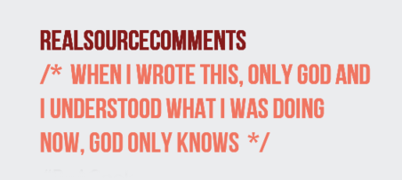
Comments
Notes:
Never thought this could be useful until had to switch to another format which does not support comments

Slide 16





Output Formats (Backends)

Slide 17




Runtimes
Notes:
Asciidoctor s written in Ruby
- Opal to transpile Asciidoctor from Ruby to JavaScript
- Jruby to run inside JVM
Original AsciiDoc toolchain was written in Python

Slide 18





Build Tools

Slide 19

Extensions
Notes:
Give Asciidoctor the feature you are missing

Slide 20
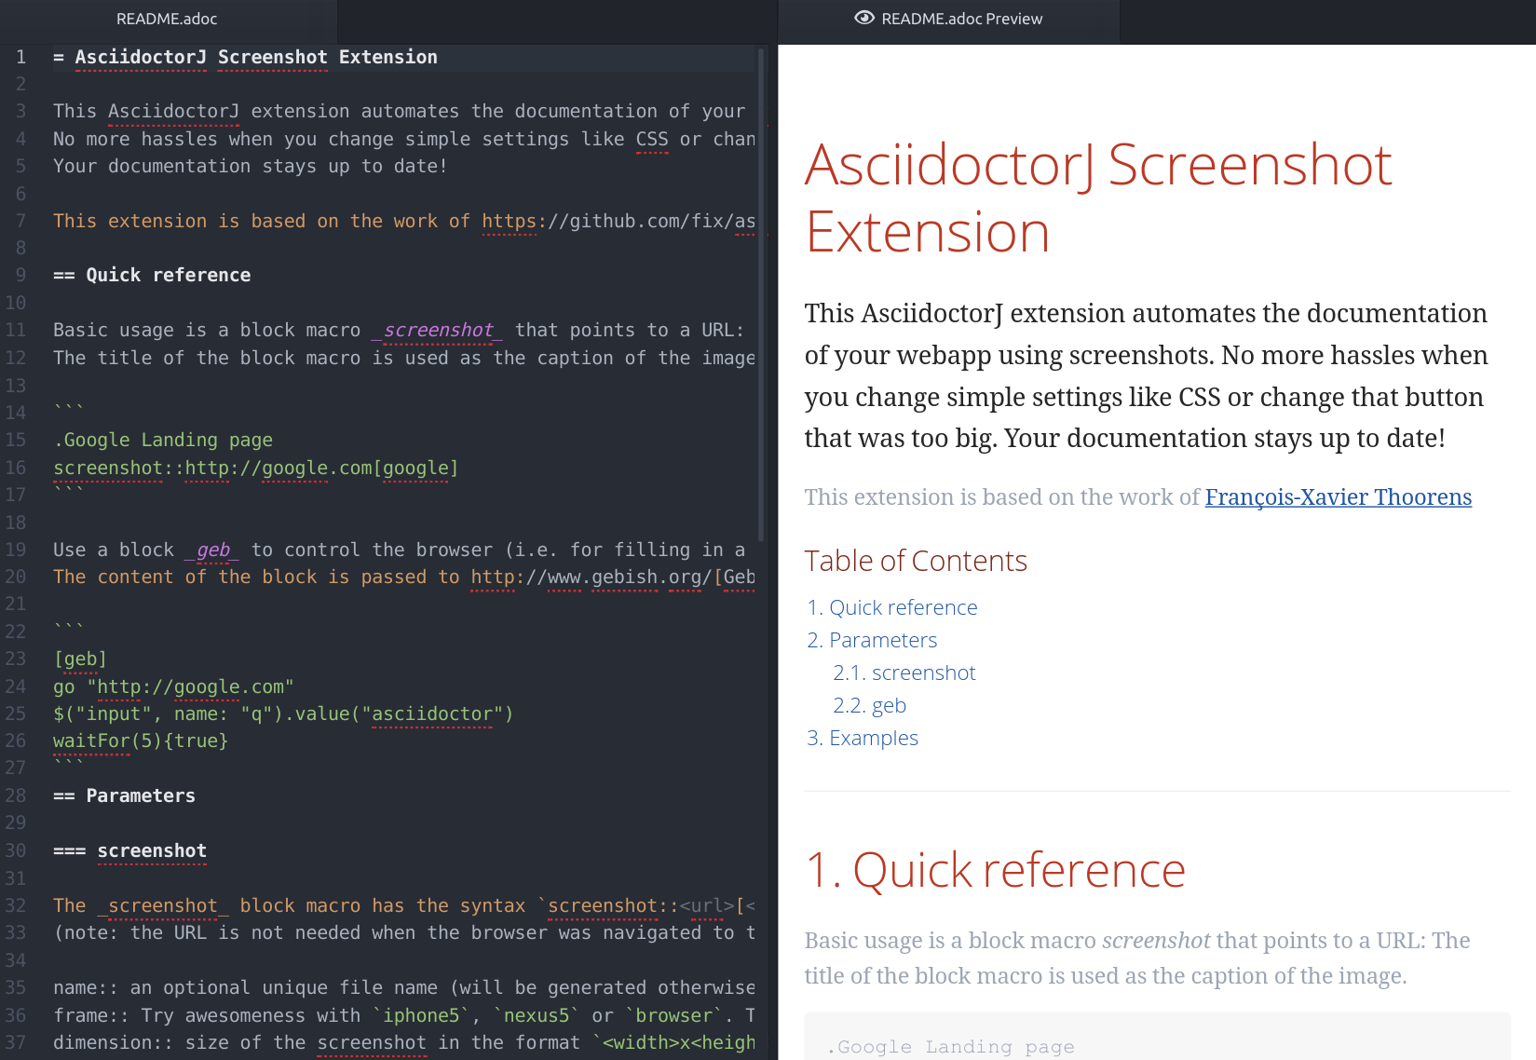




Instant Preview

Slide 21
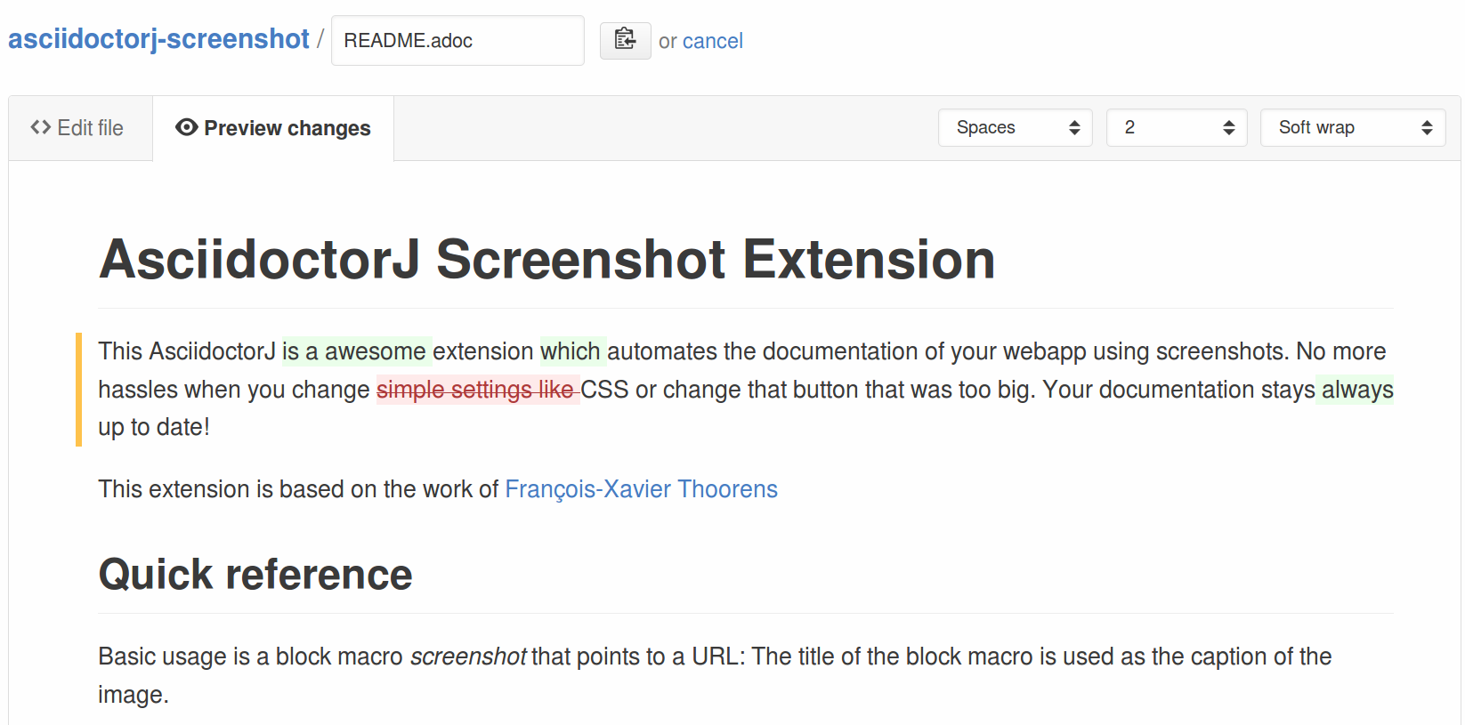
Github Diff Preview

Slide 22



Who uses Asciidoctor

Slide 23
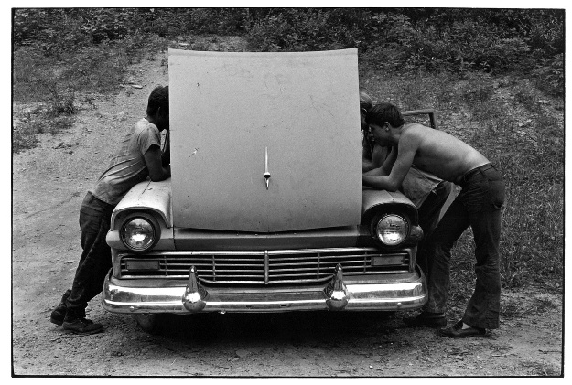

Slide 24



Asciidoctor conversion process
Could also be
PDF, docbook, etc.
AsciiDoc
File

Slide 25
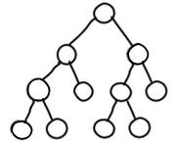
Asciidoctor conversion process
parse
output

Slide 26
Extending the conversion process
Notes:
Each step can be extended

Slide 27
Extending the conversion process
Pre

Slide 28
Extending the conversion process
Pre
Block
Inline

Slide 29
Extending the conversion process
Pre
Tree
Block
Inline

Slide 30
Extending the conversion process
Backend
Pre
Tree
Block
Inline

Slide 31
Extending the conversion process
Backend
Pre
Tree
Post
Block
Inline

Slide 32
PreProcessor
Process raw AsciiDoc file
Can change everything
Result will be passed to parser

Slide 33
TreeProcessor
Processes the entire tree
Can change every node in the tree
Result will be sent to the backend

Slide 34
PostProcessor
Processes the output of Asciidoctor
Can change everything
Result is the final outcome

Slide 35
BlockProcessor
Processes a single block
Receives the content of the block
Creates a node to add to the AST

Slide 36
BlockMacroProcessor
Processes an empty block
Creates a node to add to the AST

Slide 37
InlineMacroProcessor
Processes a substring of a block
Creates a replacement for the substring

Slide 38
Backend
Convert the tree into the output format

Slide 39


Slide 40
The goal
BlockMacro which takes screenshot
Block to control the browser

Slide 41
Simplified Screenshot Extension
== Capture Test
[geb]
....
go "file://example.html"
$("input").value("Greach 2016")
....
screenshot::"file://example.html"[]

Slide 42
3 Steps
Macro which includes a static image
Macro taking screenshot
Geb block to control browser

Slide 43
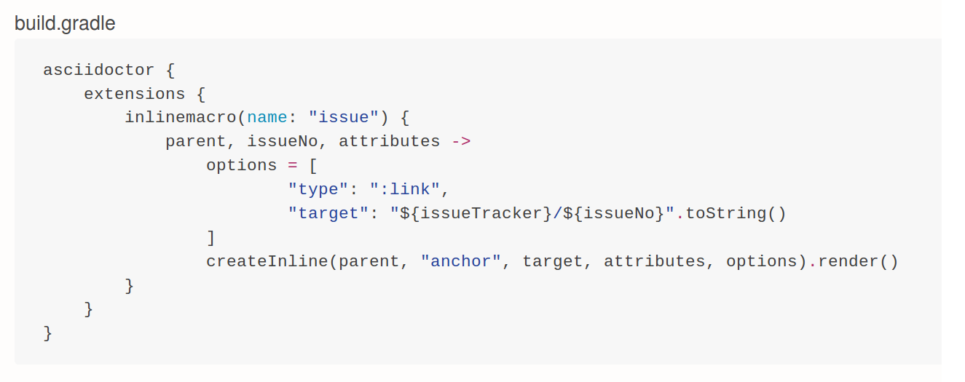
Extensions in Gradle

Slide 44
AsciidoctorJ 1.6.x
Annotations for extensions
Enums for attributes and configurations
Convenience methods

Slide 45
Go and write your documentation with Asciidoctor
http://asciidoctor.org/
http://discuss.asciidoctor.org/
http://mrhaki.blogspot.ch/

