Slide 1
Asciidoctor mal Groovy
Stephan Classen

Slide 2

Über mich
Stephan Classen
TDD enthusiast
Liebt Open Source
Hasst repetitive Aufgaben

Slide 3
Über mich
Stephan Classen
TDD enthusiast
Liebt Open Source
Hasst repetitive Aufgaben
Ein bisschen paranoid

Slide 4
Über mich
stephan.classen@canoo.com
 github.com/sclassen/sessions
Aktuelle Folien

Slide 5
Die Screenshot Extension
Idee und Proof of concept von
François-Xavier Thoorens
Verwende GEB um einen Browser zu kontrollieren und Screenshots zu erstellen

Slide 6
Definitionen
AsciiDoc
  A mature, plain-text writing format for authoring documentation, books and more.
Asciidoctor
  A fast text processor and publishing toolchain for converting AsciiDoc files.

Slide 7

Notes:
I am no salesman
Advertisment for Asciidoctor
- Things I think make Asciidoctor groovy
- Other similar formats may have support for the same functionality

Slide 8
Wenig Formatierung viel Inhalt
== Parameters
=== screenshot
The _screenshot_ block macro has the syntax `screenshot::<url>[<parameters>]` and supports the following parameters
(note: the URL is not needed when the browser was navigated to the page using a _geb_ block or other means)
name:: an optional unique file name (will be generated otherwise), the screenshot will be called `<name>.png`. This is the first positional parameter.
frame:: Try awesomeness with `iphone5`, `nexus5` or `browser`. This is the second positional parameter.
dimension:: size of the screenshot in the format `<width>x<height>` for instance 800x600. Also the values of 'frame' are supported.
selector:: the CSS-like dom selector to screenshot. Only this will be part of the image. For instance `div #login_window`.
Note: it is not allowed to set both 'frame' and 'dimension' or 'frame' and 'selector' for a screenshot.
Note: `screenshot::http://google.com[google]` and `screenshot::http://google.com[name=google]` are equivalent.
=== geb
The _geb_ block supports the following parameters:
dimension:: size of the screenshot in the format `<width>x<height>` for instance 800x600. Also the values of 'frame' are supported. This is the first positional parameter.
Notes:
Not important to be able to read this

Slide 9
Wenig Formatierung viel Inhalt
== Parameters
=== screenshot
The _screenshot_ block macro has the syntax `screenshot::<url>[<parameters>]` and supports the following parameters
(note: the URL is not needed when the browser was navigated to the page using a _geb_ block or other means)
name:: an optional unique file name (will be generated otherwise), the screenshot will be called `<name>.png`. This is the first positional parameter.
frame:: Try awesomeness with `iphone5`, `nexus5` or `browser`. This is the second positional parameter.
dimension:: size of the screenshot in the format `<width>x<height>` for instance 800x600. Also the values of 'frame' are supported.
selector:: the CSS-like dom selector to screenshot. Only this will be part of the image. For instance `div #login_window`.
Note: it is not allowed to set both 'frame' and 'dimension' or 'frame' and 'selector' for a screenshot.
Note: `screenshot::http://google.com[google]` and `screenshot::http://google.com[name=google]` are equivalent.
=== geb
The _geb_ block supports the following parameters:
dimension:: size of the screenshot in the format `<width>x<height>` for instance 800x600. Also the values of 'frame' are supported. This is the first positional parameter.
Notes:
AsciiDoc formatting is highlighted to show relation of content to formatting

Slide 10
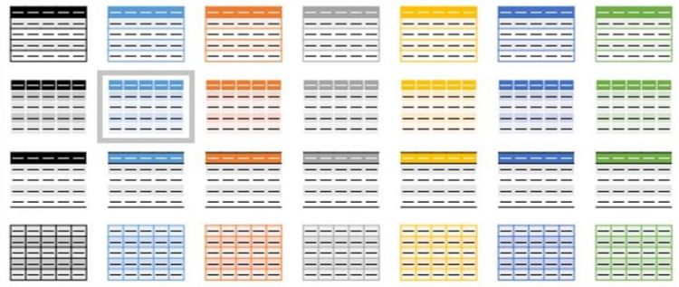
Tabellen
Notes:
Very practical and a ascii format without tables is just incomplete

Slide 11
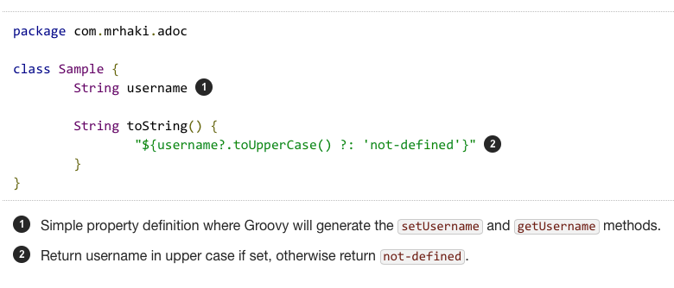
Syntax Highlighting und Callouts
Notes:
- Syntax highlighting is included out of the box
- custom highlighter can be supplied
- support for Callouts to add explanations for lines in the code

Slide 12

Includes
Notes:
- allows to separate documents
- a document part per chapter in a book
- a document part per module in a project
- reuse document parts in multiple document
- include (parts) of a source file
- see talk from last years greach conference by Markus Schichting

Slide 13
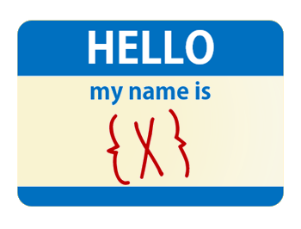
Attribute (Variablen)
Notes:
Attributes can be defined in the document or passed from the outside
- do not repeat stuff
- pass environment information
- path to files
- version number of document
- customize included document parts

Slide 14

Fenced Content
Notes:
Allows to mark multiple lines (with empty lines) to be part of a single block
Examples
- source code
- quotes

Slide 15
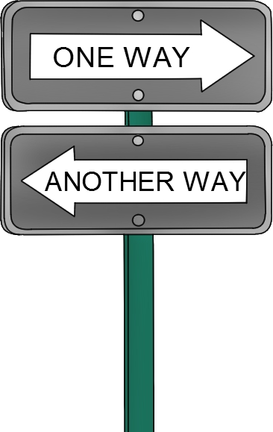
Conditionals
Notes:
- two sided sword
- good parts
- allows to adapt to environment
- allows to make included parts configurable
- bad parts
- increases complexity

Slide 16
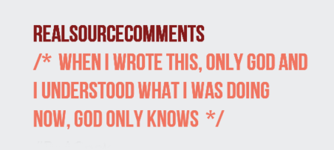
Kommentare
Notes:
Never thought this could be useful until had to switch to another format which does not support comments

Slide 17





Ausgabe Formate (Backends)

Slide 18



Runtimes
Notes:
Asciidoctor s written in Ruby
- Opal to transpile Asciidoctor from Ruby to JavaScript
- Jruby to run inside JVM
Original AsciiDoc toolchain was written in Python

Slide 19






Build Tools

Slide 20

Erweiterungen
Notes:
Give Asciidoctor the feature you are missing

Slide 21
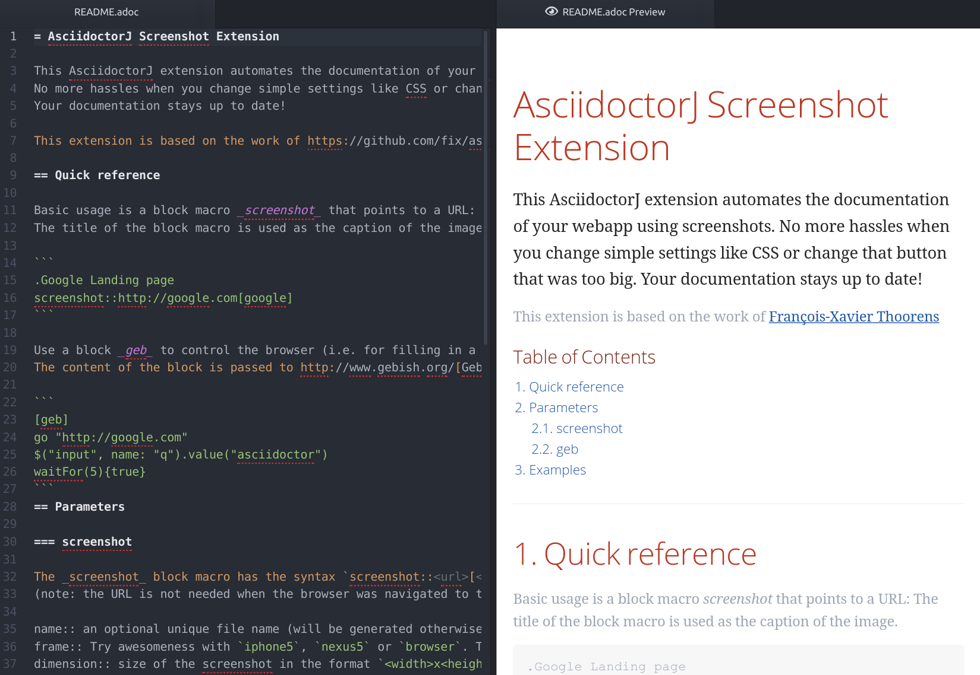




Instant Preview

Slide 22
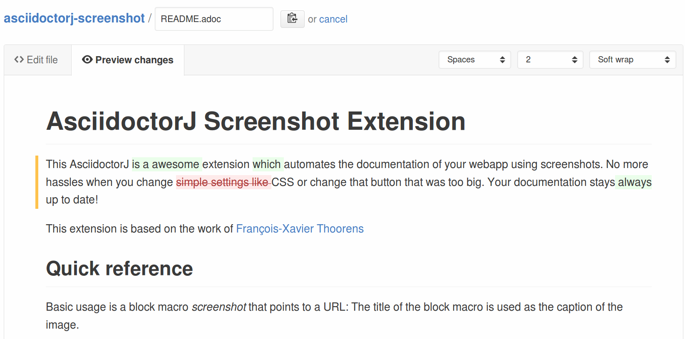
Github Diff Preview

Slide 23



Wer benutzt Asciidoctor

Slide 24
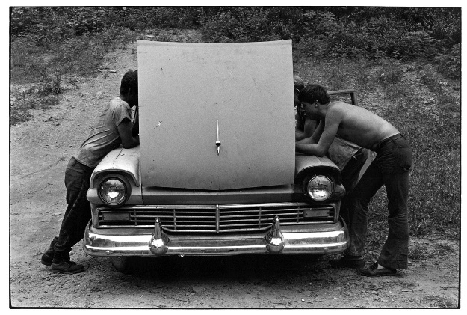

Slide 25



Asciidoctor Konvertierungsprozess
Könnte auch
PDF, docbook, etc.
sein
AsciiDoc
Datei

Slide 26
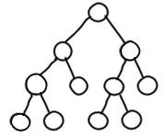
Asciidoctor Konvertierungsprozess
einlesen
ausgeben

Slide 27
Details des Konvertierungsprozess
Notes:
Each step can be extended

Slide 28
Details des Konvertierungsprozess
Pre

Slide 29
Details des Konvertierungsprozess
Pre
Block
Inline

Slide 30
Details des Konvertierungsprozess
Pre
Tree
Block
Inline

Slide 31
Details des Konvertierungsprozess
Backend
Pre
Tree
Block
Inline

Slide 32
Details des Konvertierungsprozess
Backend
Pre
Tree
Post
Block
Inline

Slide 33
PreProcessor
Bearbeitet AsciiDoc Dateien
Kann alles verändern/manipulieren
Resultat geht zum Parsen

Slide 34
TreeProcessor
Bearbeitet den ganzen AST
Kann jeden Knoten im AST verändern
Resultat geht zum Backend

Slide 35
PostProcessor
Bearbeitet das Resultat des Backend
Kann alles verändern
Resultat ist der Finale Output

Slide 36
BlockProcessor
Bearbeitet einen einzelnen Block
Erhält den Kopf und Inhalt des Blocks
Erzeugt einen Knoten im AST

Slide 37
BlockMacroProcessor
Bearbeitet einen leeren Block
Erhält den Kopf des Blocks
Erzeugt einen Knoten im AST

Slide 38
InlineMacroProcessor
Bearbeitet einen Teil eines Blockinhaltes
Erzeugt einen Ersatz für den Teil

Slide 39
Backend
Konvertiert den AST in das Output Format

Slide 40


Slide 41
Das Ziel
BlockMacroProcessor welcher Screenshots erstellt
BlockProcessor um den Browser zu kontrollieren

Slide 42
Vereinfachte Screenshot Extension
== Capture Test
[geb]
....
go "file://example.html"
$("input").value("JavaLand 2017")
....
screenshot::"file://example.html"[]

Slide 43
3 Schritte zum Ziel
Macro welches ein statische Bild einfügt
Macro welches Screenshots erstellt
Block um den Browser zu kontrollieren

Slide 44
AsciidoctorJ 1.6.x
Annotationen für Extensions
Enums für Attribute und Konfigurationen
Helfermethoden

Slide 45
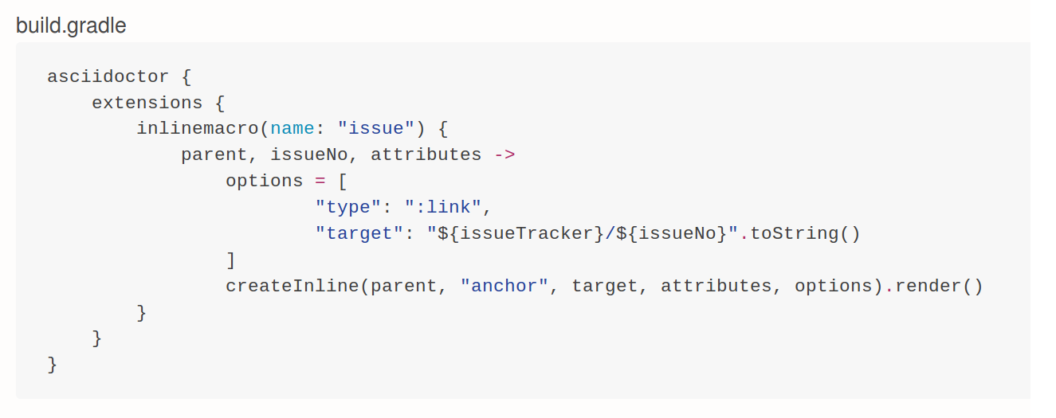
Extensions in Gradle

Slide 46
Schreibt eure Dokumentation mit Asciidoctor
http://asciidoctor.org/
http://discuss.asciidoctor.org/
http://mrhaki.blogspot.ch/

