Slide 1

Stephan Classen

Slide 2
Auf du und du mit
git
Stephan Classen

Slide 3
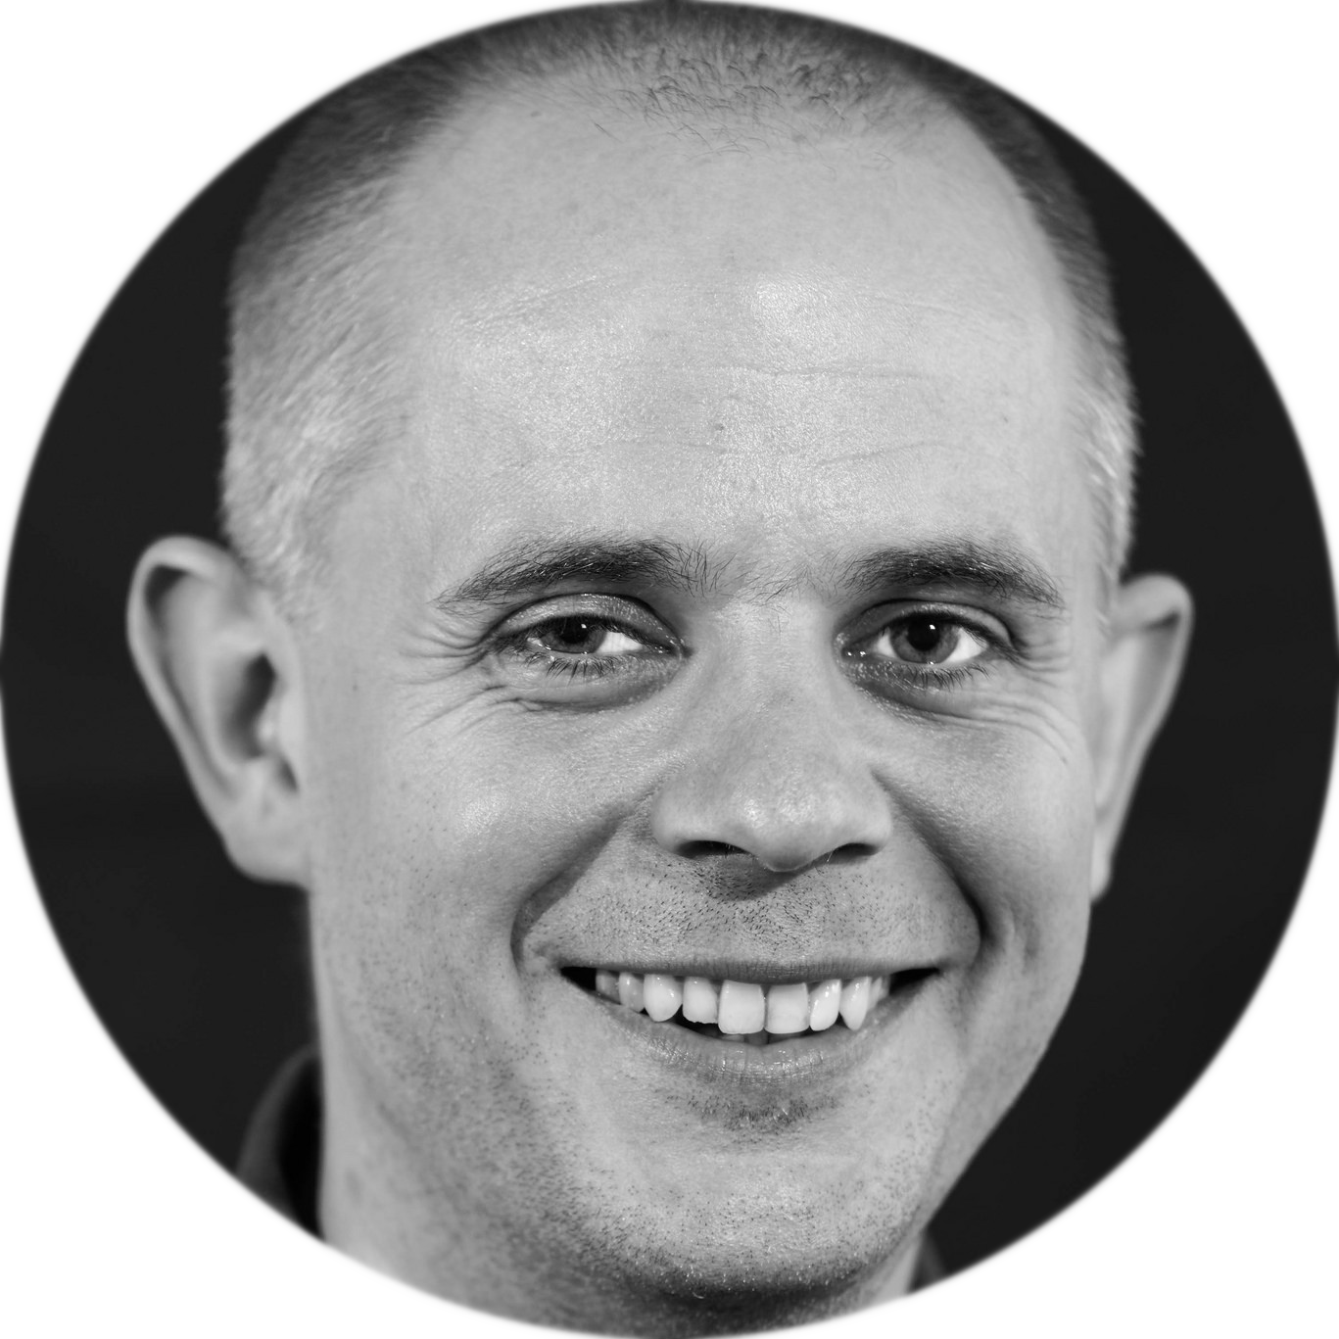

Über Mich
Seit 10 Jahren Java Entwickler
stephan.classen@karakun.com
github.com/sclassen/sessions
Folien
Stephan Classen

Slide 4
Agenda
Grundlagen
Kommandos
Stephan Classen

Slide 5
Grundlagen
Workspace
Stage
Repository
Ver. 3
Ver. 2
Ver. 1
Stephan Classen

Slide 6
Grundlagen
Workspace
Stage
Repository
Repository
Ver. 3
Ver. 3
Ver. 2
Ver. 2
Ver. 1
Ver. 1
Lokal
Remote
Stephan Classen

Slide 7
Grundlagen
Stephan Classen

Slide 8
Grundlagen
add
commit
push
Workspace
Stage
Repository
Repository
checkout
reset
fetch
Stephan Classen

Slide 9
Grundlagen
merge
rebase
cherry-pick
add
commit
push
Workspace
Stage
Repository
Repository
checkout
reset
fetch
Stephan Classen

Slide 10
Grundlagen
pull
Workspace
Stage
Repository
Repository
checkout <branch>/<tag>/<commit>
reset --hard <branch>/<tag>/<commit>
Stephan Classen

Slide 11
Grundlagen
Aktuelle Position
im Repo
Branch
Commit
HEAD
master
a47b3
56c7a
a4b2c3
3408c
afab5
Commit kennt
seinen Parent
Stage
Workspace
Stephan Classen

Slide 12
git checkout -b blubb 56c7a
HEAD
HEAD
blubb
master
a47b3
56c7a
a4b2c3
3408c
afab5
Stage
Workspace
Stephan Classen

Slide 13
git add someFile.txt
HEAD
blubb
master
a47b3
56c7a
a4b2c3
3408c
afab5
Stage
Workspace
Stephan Classen

Slide 14
git commit -m 'message'
HEAD
blubb
HEAD
blubb
0bc74
master
a47b3
56c7a
a4b2c3
3408c
afab5
Stage
Workspace
Stephan Classen

Slide 15
git checkout master
HEAD
blubb
HEAD
0bc74
master
a47b3
56c7a
a4b2c3
3408c
afab5
Stage
Workspace
Stephan Classen

Slide 16
git merge blubb
blubb
HEAD
0bc74
$REMOTE
master
a47b3
56c7a
a4b2c3
3408c
afab5
$BASE
$LOCAL
Stage
3-Way Merge
Workspace
Stephan Classen

Slide 17
git merge blubb
blubb
HEAD
0bc74
master
a47b3
56c7a
a4b2c3
3408c
afab5
Stage
3-Way Merge
Workspace
$MERGED
Stephan Classen

Slide 18
git add someFile.txt
blubb
HEAD
0bc74
master
a47b3
56c7a
a4b2c3
3408c
afab5
Stage
3-Way Merge
Workspace
Stephan Classen

Slide 19
git commit
blubb
HEAD
HEAD
0bc74
master
master
a47b3
56c7a
a4b2c3
3408c
afab5
76cc8
Stage
3-Way Merge
Workspace
Stephan Classen

Slide 20
HEAD
blubb
0bc74
f409f
master
a47b3
56c7a
a4b2c3
3408c
afab5
Stage
Workspace
Stephan Classen

Slide 21
git rebase master
HEAD
blubb
0bc74
f409f
master
a3ab4
a47b3
56c7a
a4b2c3
3408c
afab5
Stage
Workspace
Stephan Classen

Slide 22
git rebase master
HEAD
blubb
0bc74
f409f
master
a3ab4
6743c
a47b3
56c7a
a4b2c3
3408c
afab5
Stage
Workspace
Stephan Classen

Slide 23
git rebase master
HEAD
blubb
0bc74
f409f
master
a3ab4
6743c
$REMOTE
$LOCAL
a47b3
56c7a
a4b2c3
3408c
afab5
$BASE
Stage
Workspace
Stephan Classen

Slide 24
git rebase master
HEAD
HEAD
blubb
blubb
0bc74
f409f
master
a3ab4
6743c
a47b3
56c7a
a4b2c3
3408c
afab5
Stage
Workspace
Stephan Classen

Slide 25
blubb
HEAD
0bc74
f409f
master
a47b3
56c7a
a4b2c3
3408c
afab5
Stage
Workspace
Stephan Classen

Slide 26
git cherry-pick 0bc74
blubb
HEAD
HEAD
0bc74
f409f
master
master
a47b3
56c7a
a4b2c3
3408c
afab5
a3ab4
Stage
Workspace
Stephan Classen

Slide 27
git cherry-pick 0bc74
blubb
HEAD
HEAD
0bc74
f409f
master
master
$REMOTE
a47b3
56c7a
a4b2c3
3408c
afab5
a3ab4
$BASE
$LOCAL
Stage
Workspace
Stephan Classen

Slide 28
git commit --amend
HEAD
master
0bc74
HEAD
master
a47b3
56c7a
a4b2c3
3408c
afab5
Stage
Dieser Commit ist nicht
mehr Teil von "master"
Workspace
Stephan Classen

Slide 29
git reset 56c7a
HEAD
HEAD
master
master
a47b3
56c7a
a4b2c3
3408c
afab5
Stage
Workspace
Stephan Classen

Slide 30
git reset --hard 56c7a
HEAD
HEAD
master
master
a47b3
56c7a
a4b2c3
3408c
afab5
Stage
Workspace
Stephan Classen

Slide 31
Weiter Kommandos
git reflog - Liste der letzten HEAD Positionen
git add -i - Interaktives add
git add -p - Patch für Patch hinzufügen
git rebas -i - Interaktives rebase
Damit kann man die Geschichte im Repository Verändern
Stephan Classen

Slide 32
Stephan Classen

