Slide 1


The Google File System
Sanjay Ghemawat †, Howard Gobioff †, Shun-Tak Leung
† Google
SOSP’03
Yoona Kim, Geonhee Cho

Slide 2
Contents
Introduction
Design Overview
Systems Interactions
Master Operation
Fault Tolerance and Diagnosis
Measurements
Experiences
Conclusions

Slide 3



Introduction
They designed and implemented the Google File System(GFS) to meet
the rapidly growing demands of Google’s data processing needs.
  GFS shares many of the same goals as previous distributed file system.
  But its design had been driven by key observations of their application
workloads and technological environment.
Performance
Scalability
Reliability
Availability
Considering google-specific Workload & Environment ?

Slide 4




Key Observations
Component failures are the norm rather than the exception.
Files are huge by traditional standards. Multi-GB files are common.
Most files are mutated by appending at the end.
  Random writes (and overwrites) are practically non-existent.
Co-designing the applications and the file system API
  It benefits the overall system by increasing our flexibility.
File f
0101000100
Application
File System
Component Failures
Huge Files
Appending
Interface Co-design

Slide 5
Contents
Introduction
Design Overview
Systems Interactions
Master Operation
Fault Tolerance and Diagnosis
Measurements
Conclusions

Slide 6


Assumptions
Operation environment of Google File System
① Inexpensive commodity components that often fail
② Few million ﬁles, typically 100MB or larger
Typical Workloads
③ Large streaming reads, small random reads
④ Sequential writes, append data
⑤ Multiple concurrent clients that append to the same ﬁle
⑥ High sustained bandwidth more important than low latency
⑥
High Bandwidth > Low Latency
Client
Client
Client
Client
Client
③ ④ ⑤
① Often Fail
②100 MB ~
Sequential
I/O Characteristics

Slide 7
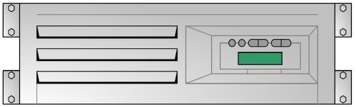


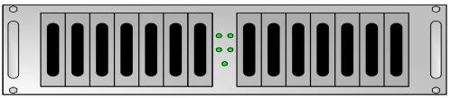

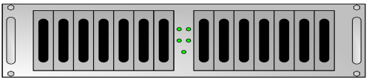
Overall GFS Architecture
A GFS cluster consists of ...
  Single GFS master (design simplification)
  Multiple GFS chunkservers
  Multiple GFS clients
GFS Master
 | A | pp | lication
 | GFS Client
Application
Application
GFS Clie
Application
nt
GFS Chunkserver 𝜶
GFS Client
GFS Client
GFS Chunkserver 𝜷
GFS Chunkserver 𝜸

Slide 8




GFS File
GFS Files are divided into ﬁxed-size chunks (64MB)
Each chunk is identiﬁed by a globally unique “chunk handle” (64 bits)
GFS Master
File f
Application
Application
GFS Clie
Application
A
pplication
GFS Chunkserver 𝜶
GFS Client
nt
GFS Client
GFS Client
GFS Chunkserver 𝜷
GFS Chunkserver 𝜸

Slide 9


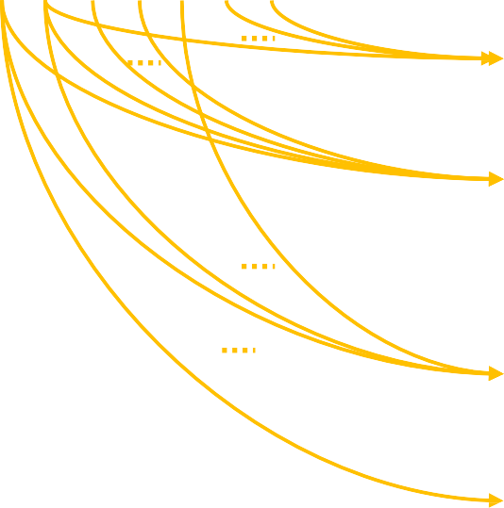




GFS File (Cont.)
Chunkservers store chunks on local disks as Linux ﬁle
For reliability, each chunk is replicated on multiple chunkservers
  default is 3
GFS Master
File f
Application
Application
GFS Clie
Application
A
pplication
GFS Chunkserver 𝜶
GFS Client
nt
GFS Client
GFS Client
Chunk File
Chunk File
Chunk File
Chunk File
GFS Chunkserver 𝜷
Chunk File Chunk File
Replication Factor = 3
GFS Chunkserver 𝜸
Chunk File Chunk File Chunk File

Slide 10
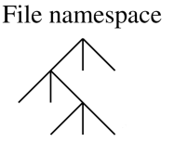


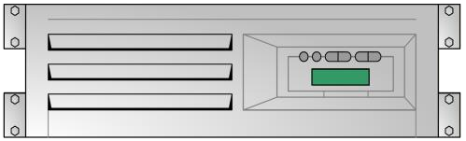



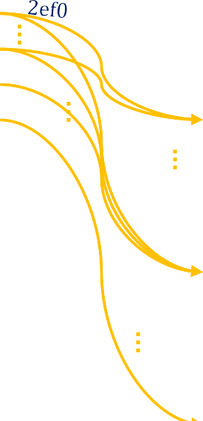






Architecture: GFS Master
Maintains all ﬁle system metadata
Send periodically heartbeat messages with chunkservers
The system is designed to minimize the master’s involvement
  So it’s not a bottleneck
GFS Master
Application
Application
GFS Clie
File /foo/bar
Application
A
pplication
GFS Client
nt
/foo/bar
GFS Client
GFS Client
GFS Chunkserver 𝜶
Chunk File
Chunk File
Chunk File
Chunk File
GFS Chunkserver 𝜷
Chunk File Chunk File
2020 Fall D.S.
GFS Chunkserver 𝜸

Slide 11
Metadata on GFS Master
3 types of metadata
  File and chunk namespaces (In-memory & Operation log)
  Mapping from ﬁles to chunks (In-memory & Operation log)
  Locations of each chunk’s replicas (In-memory)
All metadata is kept in GFS master’s memory (in-memory)
  Easy and efficient to do periodic scanning
    chunk garbage collection, re-replication (when chunkserver failure)
    chunk migration to balance load and disk space usage across chunkservers
Operation Log
  Only persistent record of metadata
  The logical timeline that deﬁnes the order of concurrent operations
  Master recovers its state by replaying the operation log
2020 Fall D.S.

Slide 12



Architecture: GFS Client
Library code linked into each applications
Data flow is decoupled from control flow
  Data flow: Communicates with chunkservers for read/write operations
  Control flow: Communicates with GFS master for metadata operations
GFS Master
Application
Application
GFS Clie
Application
A
pplication
GFS Client
nt
GFS Client
GFS Client
GFS Chunkserver 𝜶
Chunk File
Chunk File
Chunk File
Chunk File
GFS Chunkserver 𝜷
Chunk File Chunk File
2020 Fall D.S.
GFS Chunkserver 𝜸

Slide 13








Read Interaction Example
read (file name, byte offset)
GFS Master
Application
Application
GFS Clie
Application
A
pplication
❶ (file name, chunk index)
GFS Client
nt
GFS Client
❷ (chunk handle, chunk location)
GFS Client
Closest Chunkserver
❸ (chunk handle, byte range)
GFS Chunkserver 𝜶
❹ (Chunk data)
Chunk File
Chunk File
Chunk File
Chunk File
Cache info.
GFS Chunkserver 𝜷
Chunk File Chunk File
File Name | Chunk Id | Handle | Location
/foo/bar | a | b | c
... | ... | ... | ...
... | ... | ... | ...
GFS Chunkserver 𝜸
Chunk File Chunk File Chunk File

Slide 14
Contents
Introduction
Design Overview
Systems Interactions
Master Operation
Fault Tolerance and Diagnosis
Measurements
Conclusions

Slide 15
Leases and Mutation Order
Each mutation (write or append) is performed at all the chunk’s replicas
Leases used to maintain a consistent mutation order across replicas
  Master grants a chunk lease to one of the replicas
    called primary replica
  The primary replica picks a serial order for all mutations to the chunk
  All replicas follow this order when applying mutations

Slide 16
Atomic Record Appends
Client specify only the data
  GFS chooses the oﬀset
  concurrent atomic record appends are serializable
Mutation order is determined by the primary
  All secondaries use the same mutation order
GFS appends data to the file at least once as an atomically unit

Slide 17
Snapshot Operation
Make a copy of a ﬁle or a directory tree almost instantaneously by using standard copy-on-write techniques
  Revoke any outstanding leases on the chunk to snapshot
  Logs the snapshot operation to disk and duplicates the metadata
  If the client wants to write, it creates a new chunk and tell secondary to do same

Slide 18
Write Control and Data Flow
GFS Master
Application
❶ Client asks master for all chunkservers (including all secondaries)
GFS Client
❷ Master grants a new lease on chunk, increases the chunk version number, tells all replicas to do the same.
Replies to client.
Client no longer has to talk to master
Secondary Replica A
er 𝜶
GFS Chunkserv
Primary Replica
er 𝜷
GFS Chunkserv
Secondary Replica B
er 𝜸
GFS Chunkserv

Slide 19



Write Control and Data Flow
GFS Master
Application
❸ Client pushes data to all servers, not necessarily to primary first
GFS Client
Secondary Replica A
er 𝜶
GFS Chunkserv
Primary Replica
er 𝜷
Decoupled Data Flow
GFS Chunkserv
Fully utilize each machine’s network bandwidth
Avoid network bottleneck and high-latency links
Minimize the latency by pipelining the data
Secondary Replica B
er 𝜸
GFS Chunkserv

Slide 20
Write Control and Data Flow
GFS Master
Application
GFS Client
Secondary Replica A
er 𝜶
GFS Chunkserv
❹ Once data is acked, client sends
write request to primary.
Primary decides serialization order for all incoming modifications and applies them to the chunk
Primary Replica
er 𝜷
GFS Chunkserv
Secondary Replica B
er 𝜸
GFS Chunkserv

Slide 21
Write Control and Data Flow
GFS Master
Application
GFS Client
Secondary Replica A
er 𝜶
GFS Chunkserv
❺ After finishing the modification, primary forwards write request and serialization order to secondaries, so they can apply modifications in ame order. (If primary fails, this step is never reached.)
Primary Replica
er 𝜷
GFS Chunkserv
Secondary Replica B
er 𝜸
GFS Chunkserv

Slide 22
Write Control and Data Flow
GFS Master
Application
GFS Client
Secondary Replica A
er 𝜶
GFS Chunkserv
❻ All secondaries reply back to the primary once they
finish the modifications
Primary Replica
er 𝜷
GFS Chunkserv
Secondary Replica B
er 𝜸
GFS Chunkserv

Slide 23
Write Control and Data Flow
GFS Master
Application
GFS Client
Secondary Replica A
er 𝜶
GFS Chunkserv
❼ Primary replies back to the client, either with success or error
Primary Replica
er 𝜷
GFS Chunkserv
Secondary Replica B
er 𝜸
GFS Chunkserv

Slide 24
Contents
Introduction
Design Overview
Systems Interactions
Master Operation
Fault Tolerance and Diagnosis
Measurements
Conclusions

Slide 25
Namespace Management and Locking
Allows multiple operations to be active
  And uses locks to ensure serialization
Namespace is represented as a lookup table
  mapping full pathnames to metadata
Each node has an associated read write lock and each master operation
acquires locks before it runs
Locks are acquired in a total order to prevent deadlock

Slide 26
Namespace Locking Mechanism
Example Scenario
  prevent /home/user/foo from being created while /home/user is being snapshotted to /save/user
snapshot
𝐿𝑜𝑐𝑘_{𝑟𝑒𝑎𝑑}: /home & /save
Snapshotting
𝐿𝑜𝑐𝑘_{𝑤𝑟𝑖𝑡𝑒}: /home/user & /save/user
/home/user
/save/user
File A
Conflicting Lock !
∴Can be serializable
File B
Creation
𝐿𝑜𝑐𝑘_{𝑟𝑒𝑎𝑑}: /home & /home/user
File C
𝐿𝑜𝑐𝑘_{𝑤𝑟𝑖𝑡𝑒}: /home/user/foo
foo
Should not be created !

Slide 27
Replicas Placement Policy
GFS spreads chunk replicas across racks
  Maximize Data Reliability and Availability
    Ensures that some replicas will survive even if an entire rack is damaged
Maximize Network Bandwidth Utilization
  Exploit the aggregate bandwidth of multiple racks
GFS Master
Application
GFS Client
Secondary Replica A
er 𝜶
GFS Chunkserv
Primary Replica
er 𝜷
GFS Chunkserv
Secondary Replica B
er 𝜸
GFS Chunkserv

Slide 28






Chunk Creation
Places new replicas on chunkservers with below average disk space utilization
GFS Master
Application
GFS Client
Secondary Replica A
er 𝜶
GFS Chunkserv
Primary Replica
er 𝜷
GFS Chunkserv
Secondary Replica B
er 𝜸
GFS Chunkserv
Secondary Replica C
er 𝜸
GFS Chunkserv

Slide 29



Re-replication
Re-replicates a chunk when the number of available replicas falls below a user specified goal (default is 3)
GFS Master
Want Three Replicas
Application
GFS Client
Secondary Replica A
er 𝜶
GFS Chunkserv
Chunk
3 Replicas
Primary Replica
GFS Chunkserv
er 𝜷
2 Replicas
Chunk
Secondary Replica B
er 𝜸
GFS Chunkserv
3 Replicas
Chunk
Secondary Replica C
er 𝜸
GFS Chunkserv

Slide 30





Rebalancing
Rebalances replicas periodically for better disk space and load balancing
GFS Master
Application
GFS Client
Secondary Replica A
er 𝜶
GFS Chunkserv
Primary Replica
er 𝜷
GFS Chunkserv
Secondary Replica B
er 𝜸
GFS Chunkserv
Secondary Replica C
er 𝜸
GFS Chunkserv

Slide 31
Garbage Collection
GFS reclaims the storage for deleted files lazily via garbage collection at the file and chunk levels
  File Level
    Master logs the deletion and renames the file to a hidden name that includes the
deletion timestamp
    Hidden files are removed if they have existed for more than 3 days
  Chunk Level
    Each chunkserver reports a subset of chunks it has, and master identifies and replies with orphaned chunks
    Each chunkserver deletes orphaned chunks

Slide 32
Contents
Introduction
Design Overview
Systems Interactions
Master Operation
Fault Tolerance and Diagnosis
Measurements
Conclusions

Slide 33
High availability
Fast Recovery
  Both the master and the chunkserver are designed to
restore their state and start in seconds
Chunk Replication
  Each chunk is replicated on multiple chunkservers on different racks
  Users can specify different replication levels
    default is 3
Master Replication
  The master state(operation log, checkpoint) is replicated on multiple machines
  One master process is in charge of all mutations and background activities
  Shadow masters provide read-only access to the file system when the primary master is down

Slide 34
Data integrity
Each chunkserver uses checksumming to detect data corruption
  Each block has a corresponding 32bit checksum
Chunkserver verifies the checksum of data blocks for reads
During idle period, chunkservers scan and verify the inactive chunks
  when corruption is detected, the master create a new uncorrupted replica
and delete the corrupted replica

Slide 35
Contents
Introduction
Design Overview
Systems Interactions
Master Operation
Fault Tolerance and Diagnosis
Measurements
Conclusions

Slide 36
Micro-benchmarks
Experiment Environment
  Dual 1.4 GHz PIII processors, 2GB RAM, 2x80GB 5400 rpm disks, 100Mbps full- duplex Ethernet
1 Master & 2 Master Replicas
16 Chunkservers
16 Clients
1 Mater (+2 Replicas)
GFS Master
GFS Master
GFS Master
16 Clients
Application GFS Client
Application
Application
GFS Clie
16 Chunkservers GFS Chunkserver 𝜶 GFS Chunkserver 𝜷
 | GFS Chunkserver 𝜸
Application
GFS Client
nt
GFS Client

Slide 37
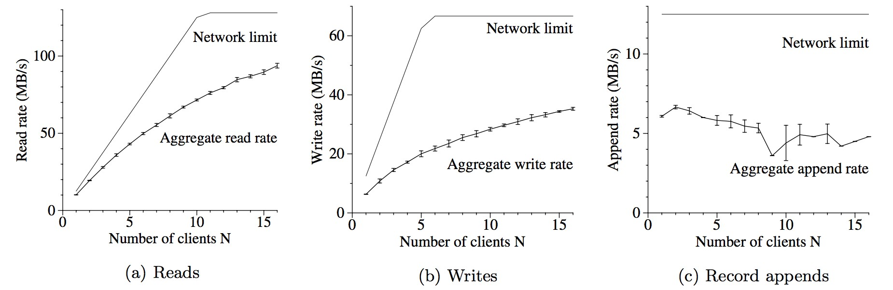
Micro-benchmarks Results
READS
  Each client read a randomly selected 4MB region 256 times (Total 1 GB) from
a 320MB ﬁle
Writes
  Each client writes 1GB data to a new file in a series of 1MB writes
  Each write involves 3 different replicas
Record appends
  All clients append simultaneously to a single file
75-80% eﬃciency
50% eﬃciency
≈38% eﬃciency

Slide 38
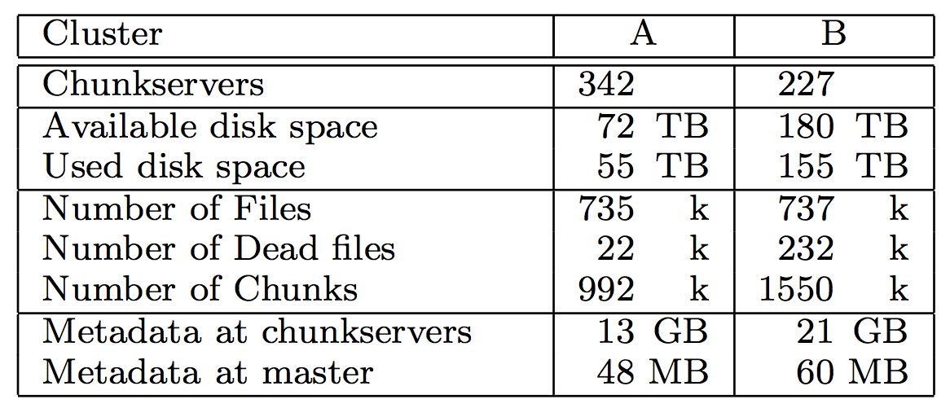
Real World Clusters
Experiment Environment
  Cluster A
    Used for research and development
    Reads MBs ~ TBs data and writes the results back
  Cluster B
    Used for research and development
    Reads MBs ~ TBs data and writes the results back

Slide 39
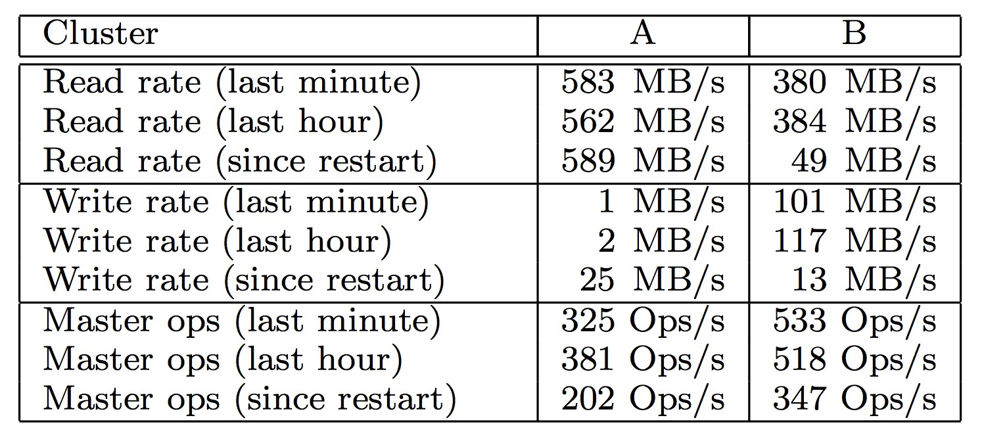
Real World Clusters Results
Performance metrics for two GFS clusters
  Cluster B was in the middle of a burst write activity
  The read rates were much higher than the write rates
Recovery time
  Killed a single chunckserver of cluster B
    Which had 15K chunks containing 600GB data
  All chunks were restored in 23.3 minutes

Slide 40
Contents
Introduction
Design Overview
Systems Interactions
Master Operation
Fault Tolerance and Diagnosis
Measurements
Conclusions

Slide 41
Conclusions
GFS has successfully met their storage needs and is widely used within Google as the storage platform for research and development as well as production data processing.
While some design decisions are specific to their unique setting, many may apply to data processing tasks of a similar magnitude and cost consciousness.

