Slide 1
TensorFlow: A System for Large-Scale
Machine Learning
Abadi et al.
OSDI `16
Yunho Jin, Sam Son
December 3rd, 2020
*Some of the figures are borrowed from Jeff Dean’s

Slide 2
Contents
Introduction
Background & Motivation
Tensorflow Execution Model
Extensibility Case Studies
Implementation
Evaluation

Slide 3
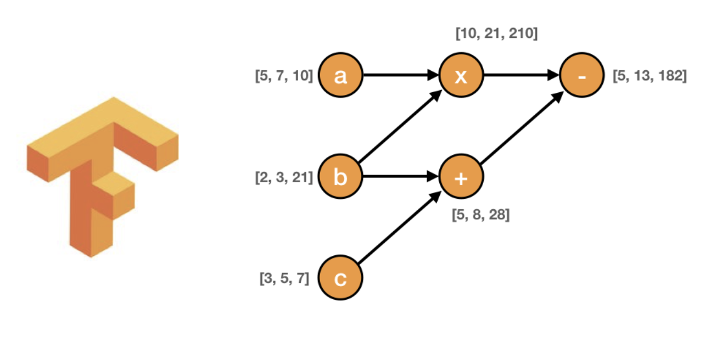
Introduction
Tensorflow for experimenting with new models
Unified dataflow graph
Applicable to diverse ML
  Paper focuses on training of NN

Slide 4
Contents
Introduction
Background & Motivation
Tensorflow Execution Model
Extensibility Case Studies
Implementation
Evaluation

Slide 5
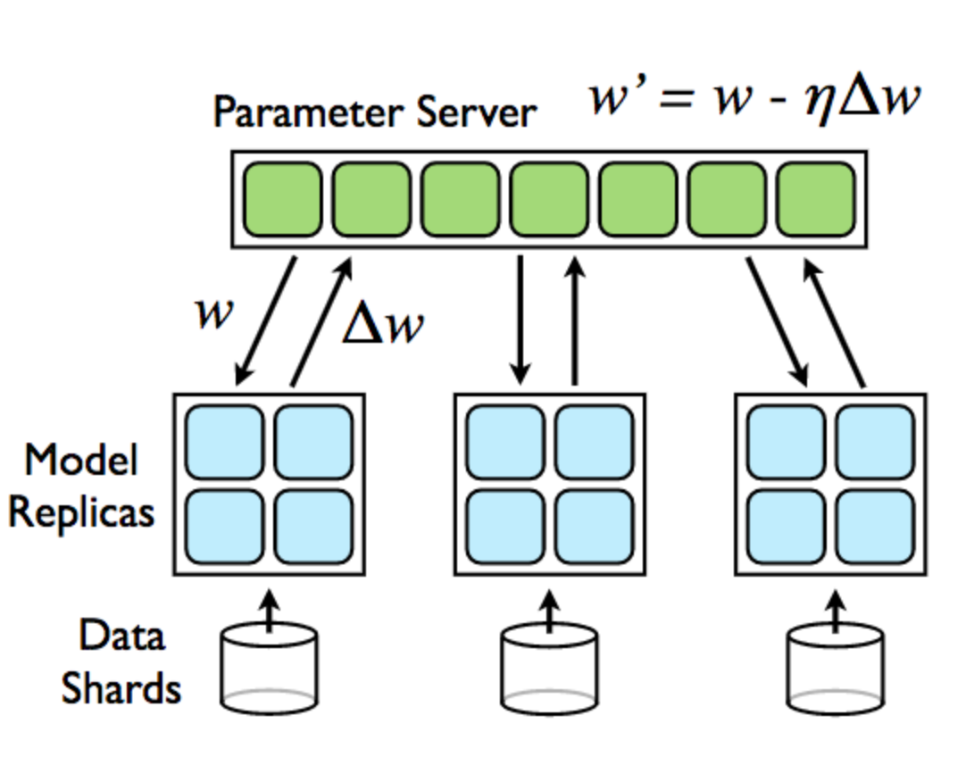
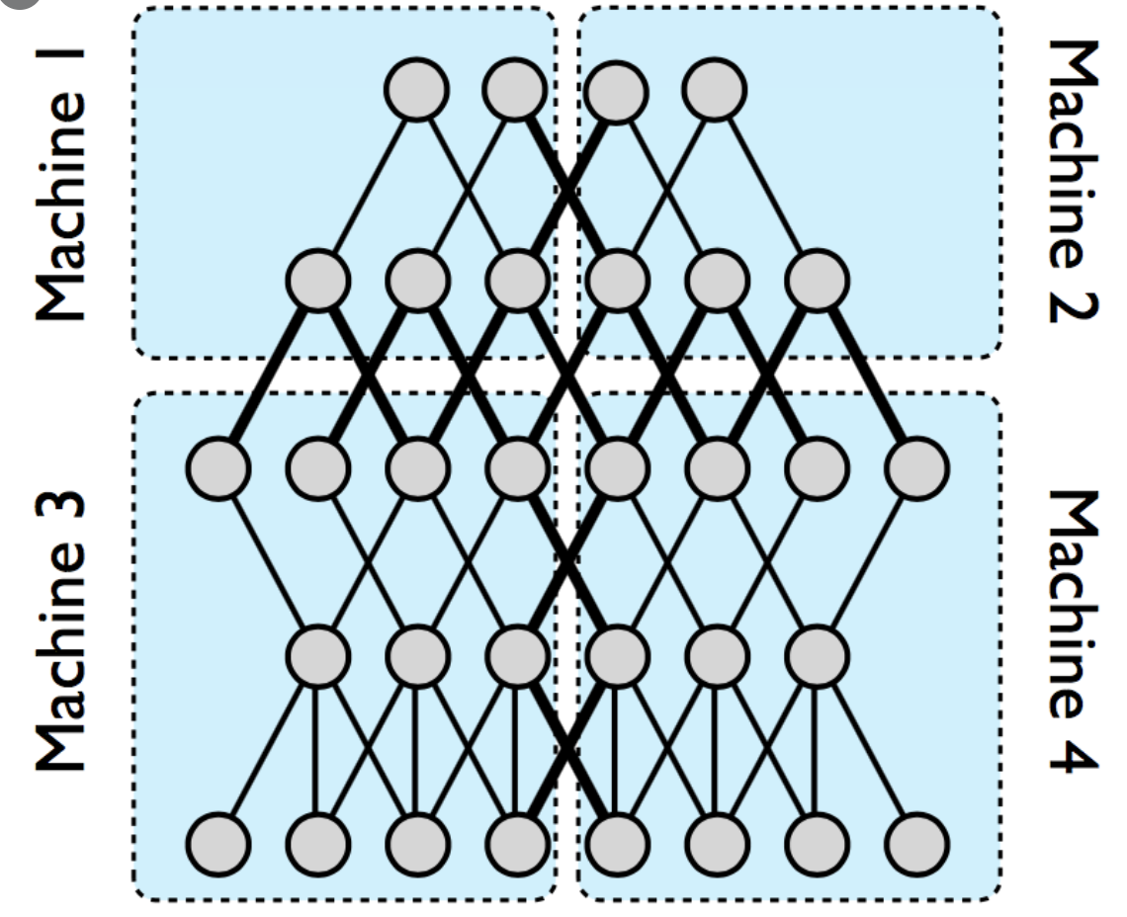
Background & Motivation
Previous system: DistBelief Comprises of stateless worker and parameter server
  Each worker process sends updates to parameter server

Slide 6
Background & Motivation
Limitations
  Layer definitions
  Refining training algorithms
  Defining training algorithms

Slide 7
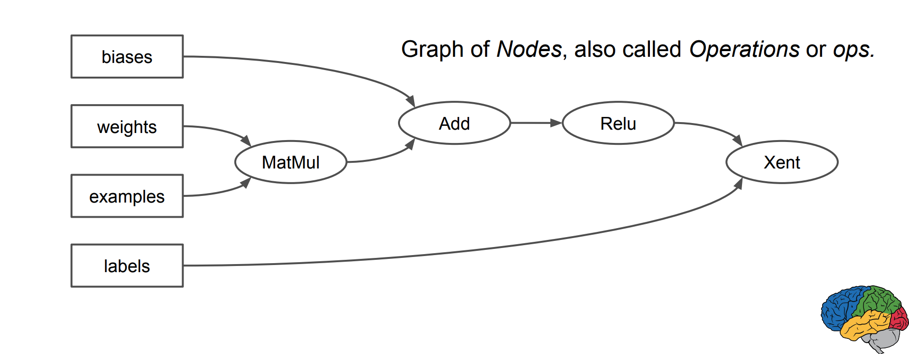
Background & Motivation
Design principles
  Flexibility
Dataflow graphs of primitive operators
Edges are N-dimensional arrays: tensors

Slide 8
Background & Motivation
Deferred execution
  Symbolic dataflow graph
  Optimization opportunity
  Distribute to devices
Abstraction for heterogeneous device
  Operators have multiple implementations for devices
PS tasks and worker tasks

Slide 9
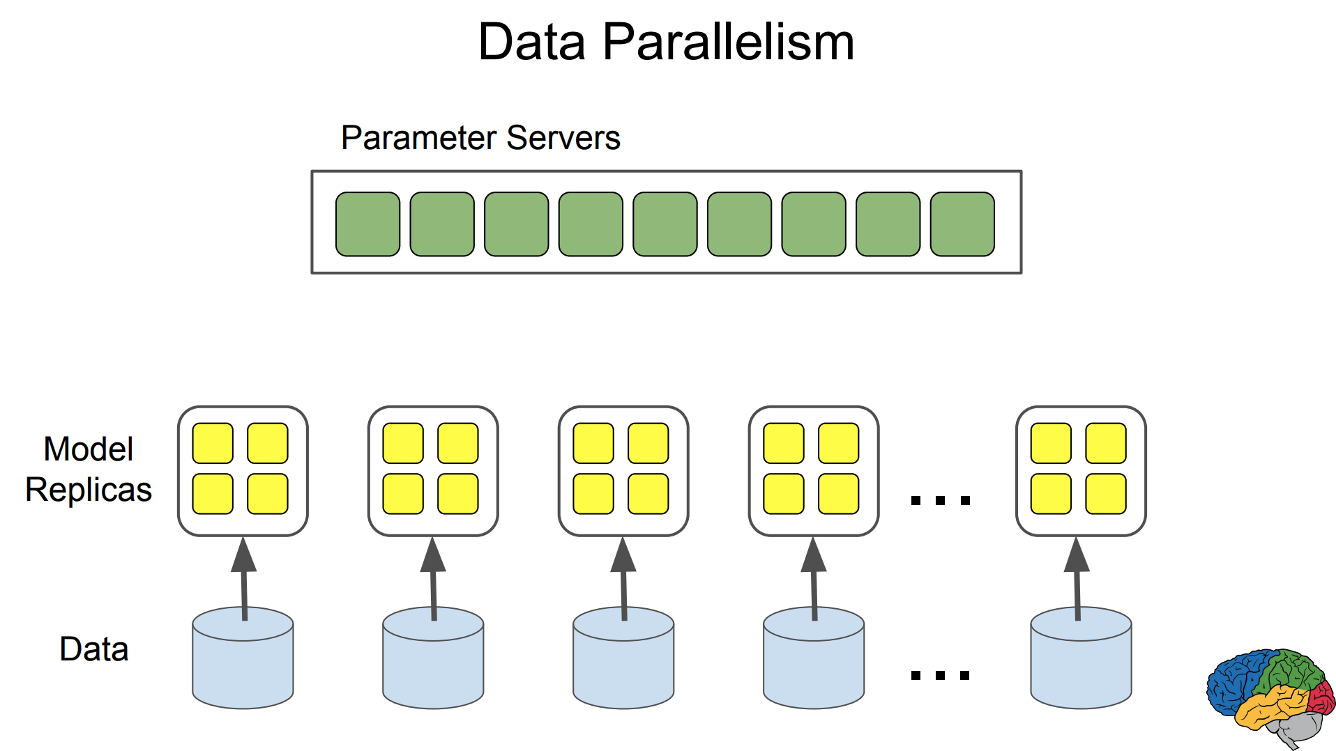
Background & Motivation

Slide 10
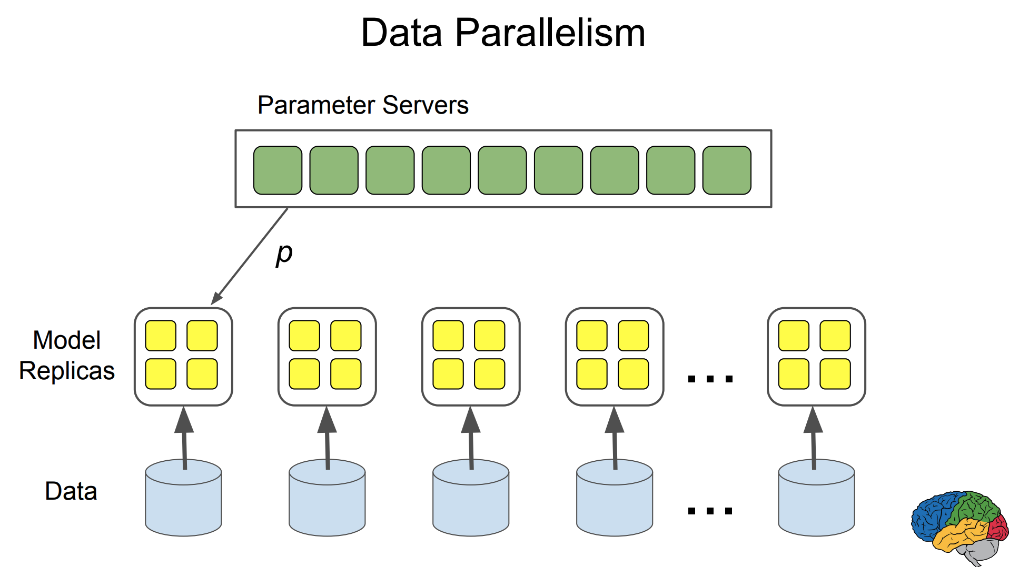
Background & Motivation

Slide 11
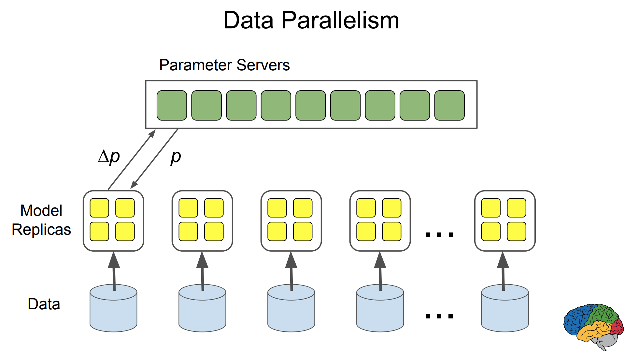
Background & Motivation

Slide 12
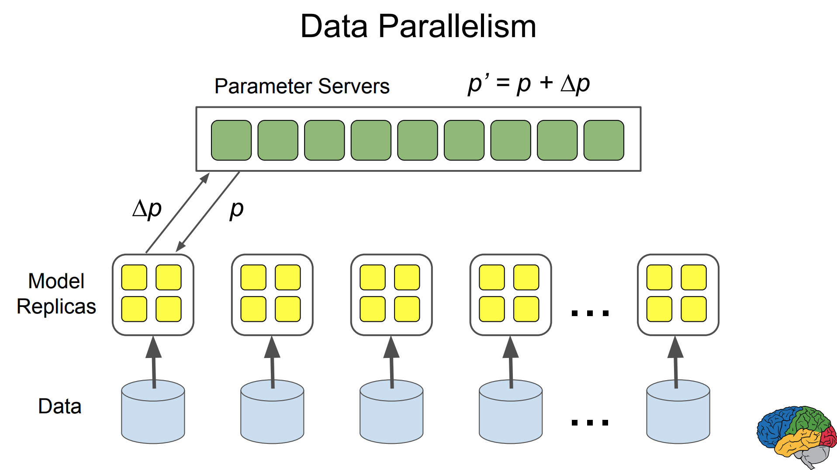
Background & Motivation

Slide 13
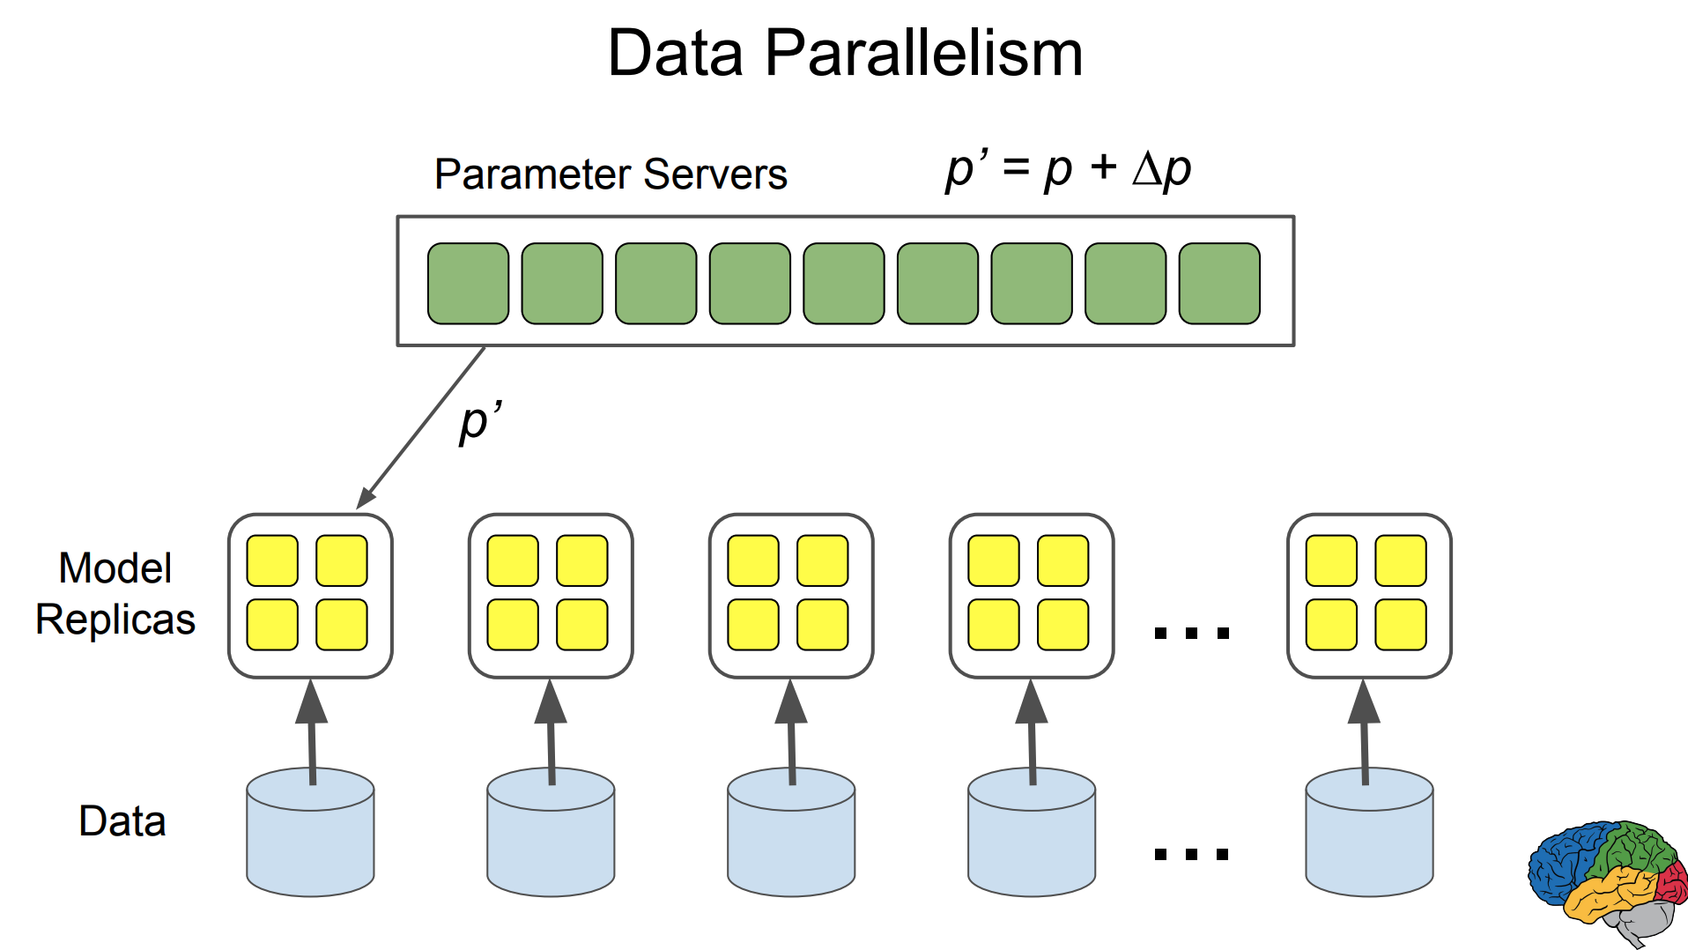
Background & Motivation

Slide 14
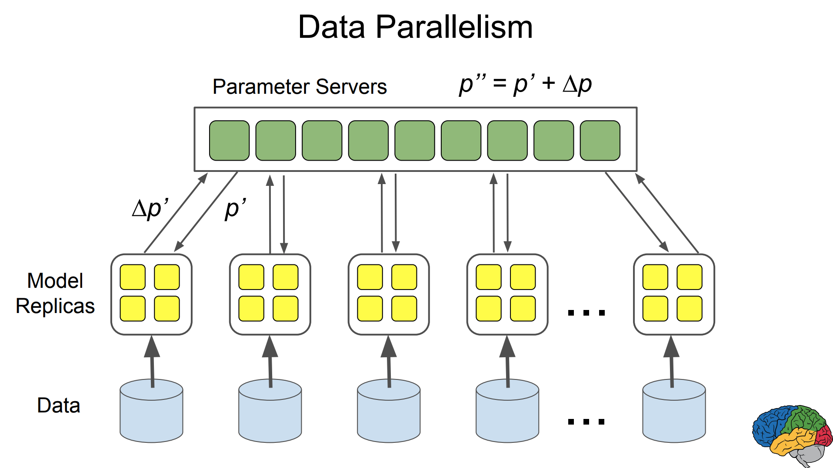
Background & Motivation

Slide 15
Contents
Introduction
Background & Motivation
Tensorflow Execution Model
Extensibility Case Studies
Implementation
Evaluation

Slide 16
Tensorflow Execution Model
Focusing on ”extensibility” and “flexibility”
  Let users can code what they want to do
Dataflow graph elements
Partial and Concurrent Execution
Distributed Execution
Dynamic Control Flow

Slide 17
(1) Dataflow graph elements
Tensors
  Variable shaped tensors
Operations
Stateful operations
  Variables: mutable state parameters
  Queues: stores states in queues

Slide 18
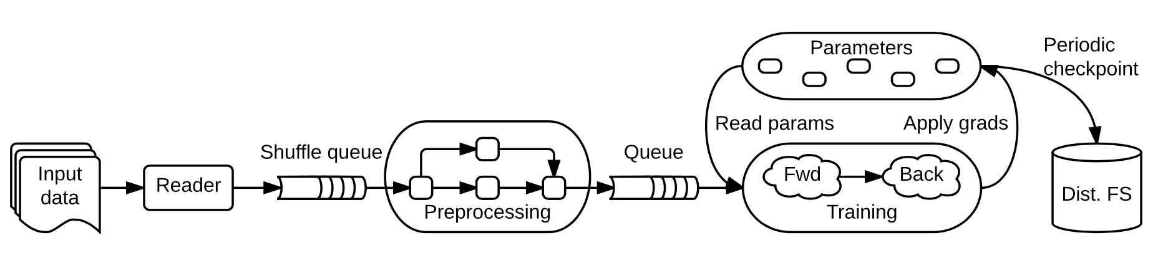
(2) Partial and concurrent execution
Utilizes subgraphs
Step: invocation of API for executing a graph
Share data between steps with stateful operations
Concurrent execution subgraphs

Slide 19
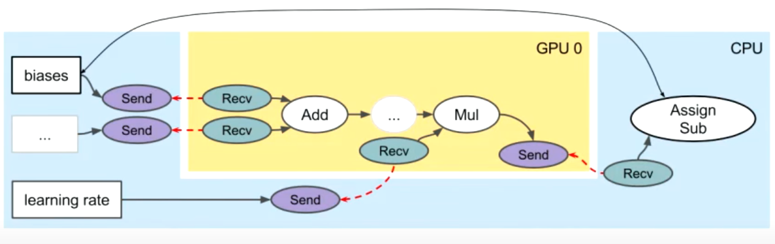
(3) Distributed Execution
For DNN execution in heterogeneous computing system(CPU, GPU, TPU, …)
Per-device subgraph execution with additional Send, Recv
Send, Recv are implemented for each pair of devices

Slide 20
(4) Dynamic Control Flow
TF supports dynamic control flow(DCF) for dataflow graph execution
DNNs such as RNN, LSTM benefit from DCF
  RNN cell should be unrolled to the length of the longest sequence without DCF
NO DCF → Fixed Unrolling
DCF → No Unrolling, Exit at the End of Sequence

Slide 21
Contents
Introduction
Background & Motivation
Tensorflow Execution Model
Extensibility Case Studies
Implementation
Evaluation

Slide 22
Extensibility Case Studies
The authors presented 4 example features to demonstrate the extensibility of TF.
The following features can be implemented on the top of TF API open to users without modifying TF core.
Differentiation / Optimization(Auto-gradient calculation)
Training Very Large Models(Embedding in LM)
Fault Tolerance(Checkpointing)
Synchronous Replica Coordination(Asynchronous SGD)

Slide 23
(1) Differentiation / Optimization
Backpropagation is a process computing gradients of a loss function w.r.t all parameters in the network
TF user-level library automatically produces backprop. code for a given neural network by identifying the structure of dataflow graph using BFS

Slide 24
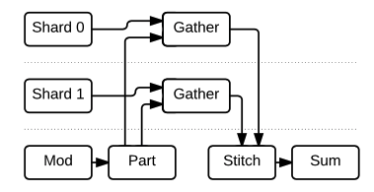
(2) Training Very Large Model
Training a language model(LM) for NLP is popular workload
It uses an embedding matrix which contains all encodings of words in the vocabulary list ~ up to tens of GB → distributed on multiple parameter servers
Each training iteration accesses few rows of an embedding
→ sparse embedding layers
Gather extracts only requested rows and updates those in backprop.

Slide 25
(3) Fault Tolerance
Training process is long and done by hundreds of nodes
  Fault tolerance mechanism is required
User can choose to checkpoint parameter tensors periodically using Save, Restore interface

Slide 26
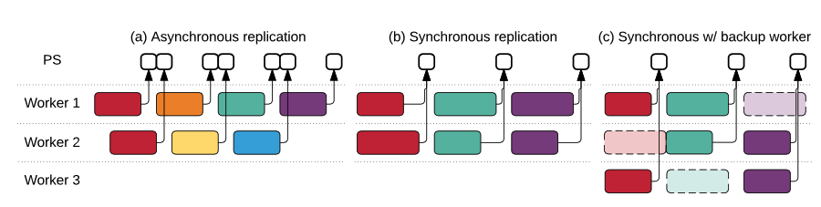
(4) Synchronous Replica Coordination
SGD in distributed system: synchronous vs. asynchronous
Asynchronous SGD is good for performance but sometimes take longer time to converge
Synchronous SGD performance suffers from straggler
Only takes first m of n updates produced – backup workers

Slide 27
Contents
Introduction
Background & Motivation
Tensorflow Execution Model
Extensibility Case Studies
Implementation
Evaluation

Slide 28
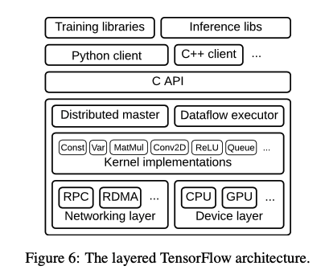
Implementation
User-level Code
API in C - portability
Core in C++
DM – Partition to subgraphs
DE – Subgraph execution
Device-specific implementation
Kernels
Send, Recv

Slide 29
Contents
Introduction
Background & Motivation
Tensorflow Execution Model
Extensibility Case Studies
Implementation
Evaluation

Slide 30
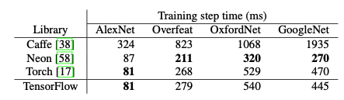
Evaluation (1) Single Machine Benchmark
“Scalability does not mask poor performance at small scales”
Benchmark on convolutional model performance
  Six-core Intel Core i7- 5930K CPU at 3.5 GHz and an NVIDIA Titan X GPU
Comparable with single machine frameworks
  Low framework overhead
  Due to cuDNN, same performance w/ Torch

Slide 31
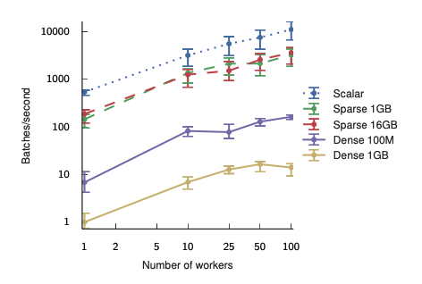
Evaluation (2) Multi-Machine: Embedding
Measuring a coordination cost in multi-machine training
  Scalar is an ideal performance
Sparse vs. Dense embedding
  Sparse shows consistent performance regardless of embedding table size

Slide 32
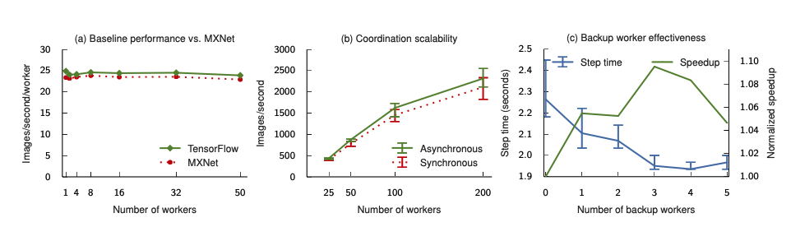
Evaluation (3) Multi-Machine: Image Classification
Performance is scalable with multiple workers
Synchronous vs. Asynchronous SGD
  Async. 10% better
Adequate number of backup workers cover performance drop

Slide 33
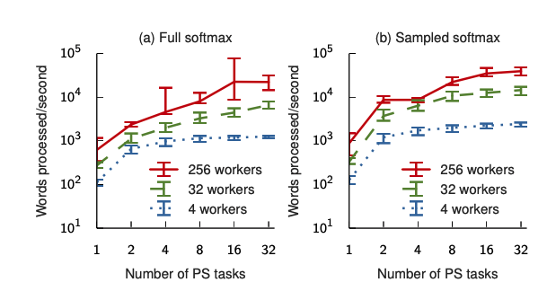
Evaluation (4) Multi-Machine: Language Model
Uses technique in ”Training Very Large Model”
Sampled softmax uses 512 out of 40000 classes in computing loss function
More PS tasks increase the performance due to parallelization

