Slide 1


Decentralized Training of Foundation Models in Heterogeneous Environments
Yuan et al. Decentralized Training of Foundation Models in Heterogeneous Environments. NeurIPS 2022.
2026. 10. 07
2026 Fall, Distributed Systems
장수호, 이지은

Slide 2
Contents
Introduction
- Background
Problem Formulation
Overview
Scheduling Algorithm
- Cost Model
- HGA
System optimization
Experiments and Results
Conclusion

Slide 3
Background 1 – Decentralized Training
High Cost of Foundation Model Training
  Large parameter counts require multiple forms of parallelism
  State of the art(SOTA) systems(e.g., Megatron, DeepSpeed) are tailored to fast, homogeneous data center networks
Decentralization: Underutilized GPU Resources
  Volunteer GPUs could offer a lower-cost alternative for FM training
Research Challenge
Support strategies for training foundation models over slow, heterogeneous data networks

Slide 4
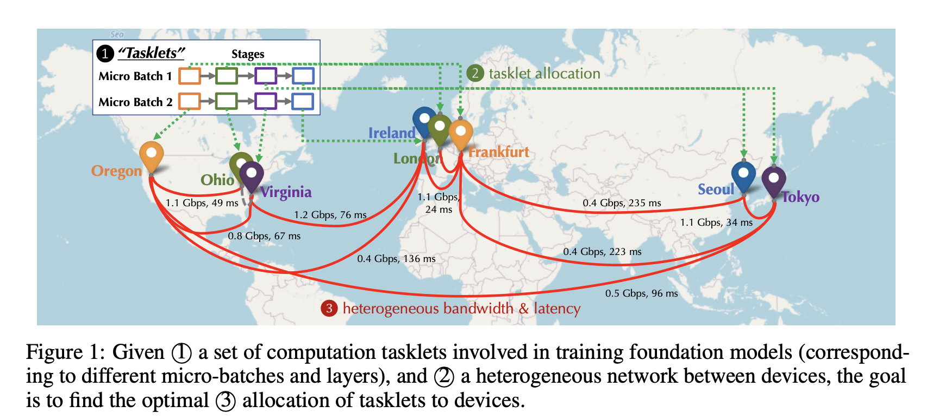
Background 2 – Why Heterogeneous Training is Hard?
Challenges of Training Foundation Models(FMs) over Heterogeneous Networks
  Prior decentralized learning efforts focus on data parallelism or alternative architectures
  Key considerations
    Foundation Models
      Models exceeding single-device capacity require parallelism beyond DP
    Heterogeneous Networks
      Limited bandwidth and significant latency
      Communication costs vary significantly depending on tasklet placement

Slide 5
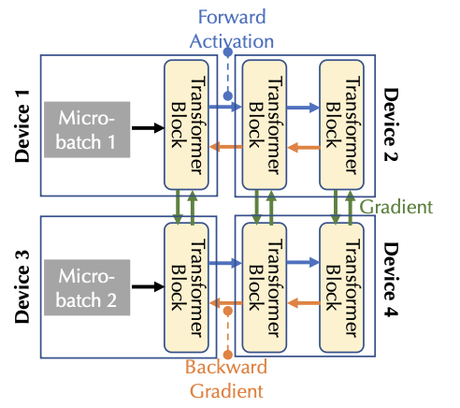
Problem Formulation – Tasklet Allocation
Definition
  Stage: A group of consecutive model layers
  Micro-batch: A small subset of a training batch
  Tasklets
    Collection of computational tasks in FM training
  Tasklet
    Forward and backward computation
    $t_{i,j}$ : Stage j with a micro-batch i

Slide 6
Problem Formulation – Tasklet Allocation (Cont’d)
Parallelism
  Data Parallelism + Pipeline Parallelism
  Data Parallelism(DP)
    Devices process different micro-batches independently and synchronize gradients
  Pipeline Parallelism(PP)
    Devices process different stages concurrently across micro-batches
  $D_{DP}×D_{PP}$=N (i.e., number of devices)
Goal
Maximize training throughput in decentralized training

Slide 7
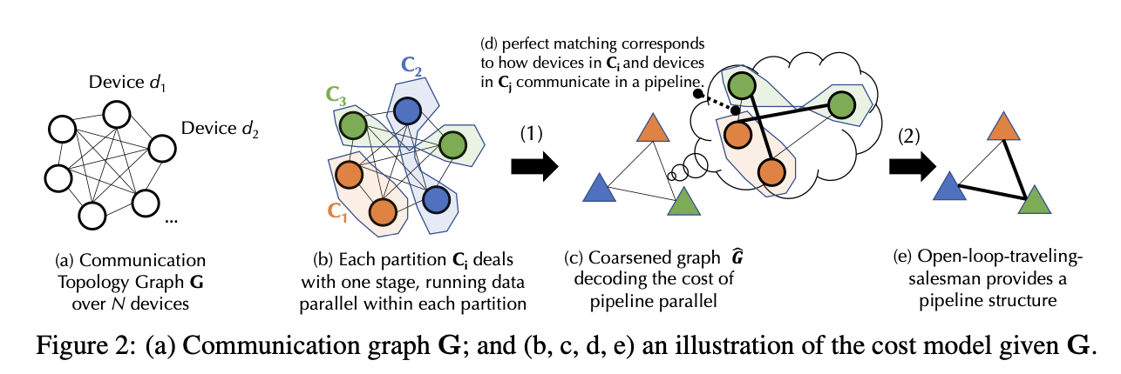
Contributions & Design Overview
Main Contribution
  1) Bi-level cost modeling
    Level 1: Balanced graph partitioning (b)
    Level 2: Matching (c)(d) + Open-loop TSP (e)
  2) Hybrid Genetic Algorithm(HGA) + Local search strategy
  3) System Optimization
    Communication/computation overlap
Scheduling Algorithm

Slide 8
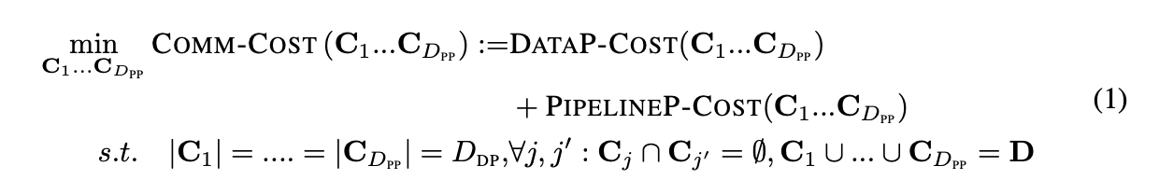
Cost Modeling Overview
Bi-level Optimization
  Level 1 : Data Parallel-Cost
    Devices within each group handle the same stage and synchronize gradients
  Level 2 : Pipeline Parallel-Cost
    Given the DP groups, determine device matching and stage ordering for PP
Objective
  Minimize total DP and PP communication costs
(Eq 1)

Slide 9
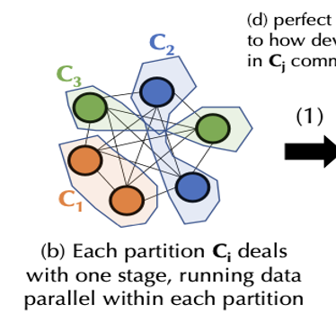
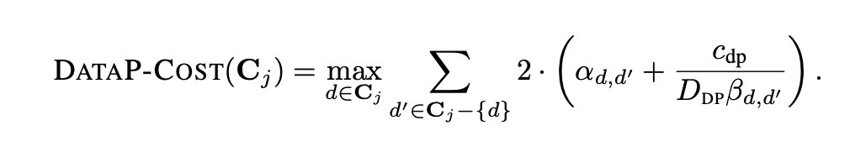
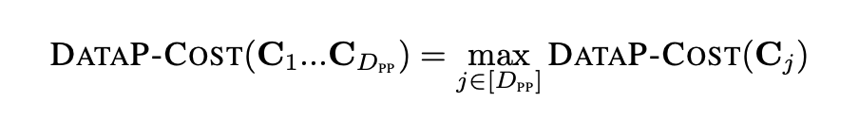
Cost Model 1 – Data Parallel Communication
Modeling Data Parallel Communication Cost
  Devices exchange gradient shards, aggregate them, and redistribute the results
  Group cost
    Determined by the device with the highest total communication cost
  Overall DP cost
    Determined by the slowest DP group, as groups communicate in parallel
(Eq 2)
(Eq 3)
$α$: latency $β$: bandwidth
$$c_{DP}:Parameter, gradient data size per stage$$
$c_{PP}:Activation data size per micro batch$

Slide 10
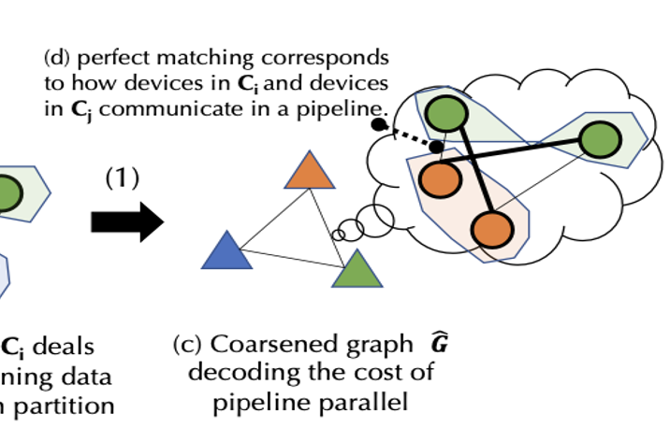
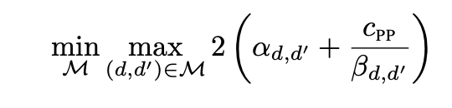
Cost Model 2 – Bottleneck Matching
Modeling Pipeline Parallel communication cost
  Connect GPUs one-to-one between two DP groups
  Find a perfect matching that minimizes the maximum link communication cost, rather than the sum
  Solvable in polynomial time
  Matching cost becomes an edge weight in the coarsened graph
(Eq 4)

Slide 11
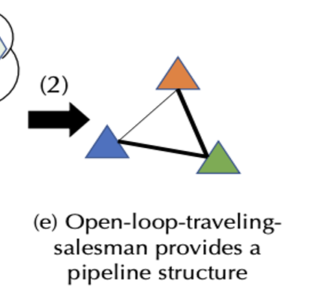
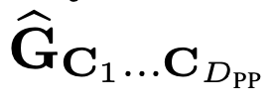
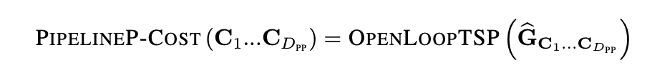
Cost Model 3 – Open-loop TSP
Modeling Pipeline Parallel communication cost (Cont’d)
  Construct a coarsened communication graph
    Vertices: DP groups
    Edge weights: Bottleneck matching costs
  Find a minimum-cost route using an open-loop TSP formulation to minimize total PP communication cost
  The path determines the pipeline stage order
(Eq 5)

Slide 12
Search Algorithm – Hybrid Genetic Algorithm
Why a Genetic Algorithm?
  Eq 1 → balanced graph partitioning with a complex objective
  NP-hard → exhaustive search is impractical
  Use a heuristic search: Hybrid Genetic Algorithm (HGA)
HGA Procedure
  Population: candidate balanced DP groupings
  Crossover: combine two parent groupings → offspring
  Local search: refine the offspring
  Replacement: replace the worst candidate if the offspring is better
Hybrid = Global exploration (GA) + Local refinement (local search)

Slide 13
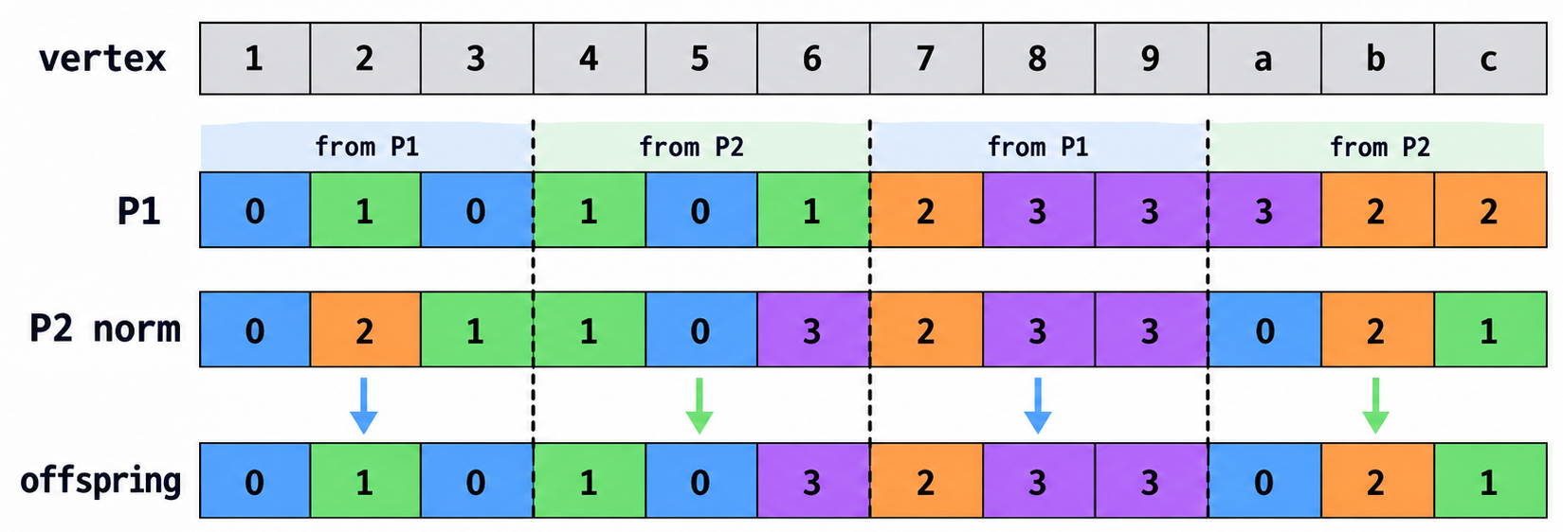
Search Algorithm – Hybrid Genetic Algorithm (Cont’d)
Crossover between Two Parents
  Select two candidate partitions as parents
  Inherit grouping structures from both parents
  Restore the balanced partition constraint
  Resulting offspring → Local Search
Parent 1
Parent 2
1. Align corresponding groups
match group labels between the parents
2. Combine grouping information
mix GPU assignments of the two parents
3. Rebalance partition sizes
restore equal-sized DP groups
Offspring o
* Crossover details follow the HGA method cited in [28] (Kang & Moon, GECCO 2000)

Slide 14
Local Search
Limitation of Kernighan–Lin (KL)
  Gain is based on the sum of edge weights between partitions
  Greedily following GAIN_{KL} does not reduce FM training cost
Key Observations
  Removing d₁ from a fast link within C_{j} is unlikely to increase the DP cost
  Once d₁ moves to C_{j'}, PP matching likely uses the fast link d₁↔d₂
Proposed Local Search
  Only the fastest link in each group is considered → 4 swap candidates
  New gain: expected PP cost before vs. after the swap

Slide 15
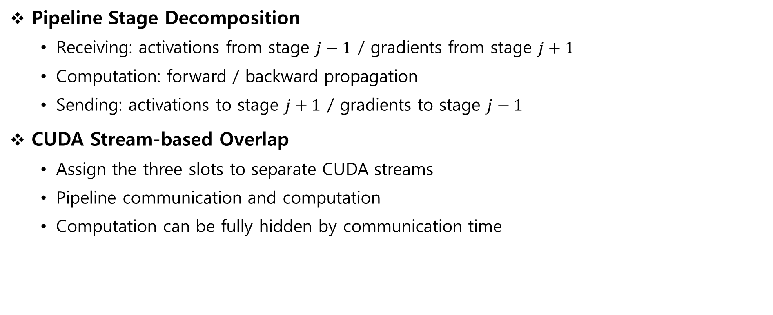
System Optimization – Comm./Comp. Overlap
Pipeline Stage Decomposition
  Receiving: activations from stage $j−1$ / gradients from stage $j+1$
  Computation: forward / backward propagation
  Sending: activations to stage $j+1$ / gradients to stage $j−1$
CUDA Stream-based Overlap
  Assign the three slots to separate CUDA streams
  Pipeline communication and computation
  Computation can be fully hidden by communication time

Slide 16
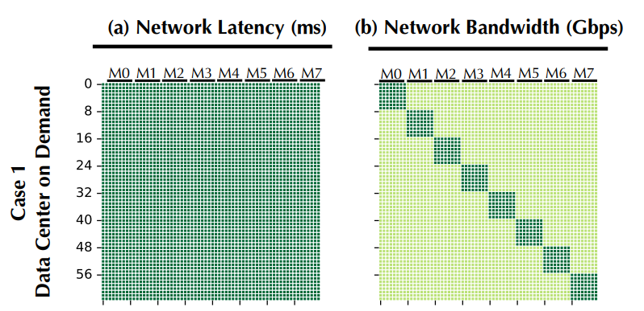
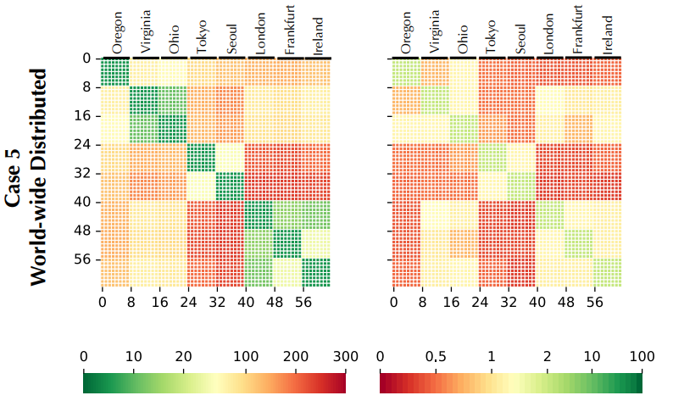
Evaluation Setup
Model & Hardware
  64 × Tesla V100, GPT-3 1.3B
  Layers 24 / 32 / 40, Batch 1024 / 2048 / 4096
Network Scenarios
  Network emulation from 8 AWS-region measurements
  Data Center On-Demand
  Data Center Spot Instances
  Multiple Data Centers
  Regional Geo-distributed
  World-wide Geo-distributed
Baselines
  Megatron, DeepSpeed (parallelism tuned per scenario)

Slide 17
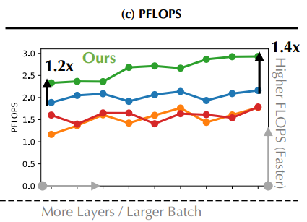
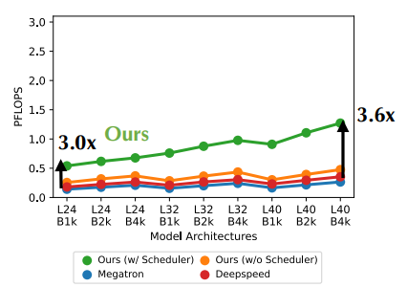
End-to-End Performance
DT-FM vs Megatron / DeepSpeed
  World-wide (Case ⑤): 4.8× vs. Megatron, 3.6× vs. DeepSpeed
  Cases ①–④: 1.2–2.5× speedup
Decentralized vs. Datacenter
  DT-FM in Case ⑤ is only 1.7–3.5× slower
  than Megatron / DeepSpeed in Case ①
  Despite networks being up to 100× slower
Scaling Trend
  Larger batch size → DP communication cost remains unchanged
  More layers per device → PP communication cost remains unchanged
  → Performance gap narrows for larger workloads

Slide 18
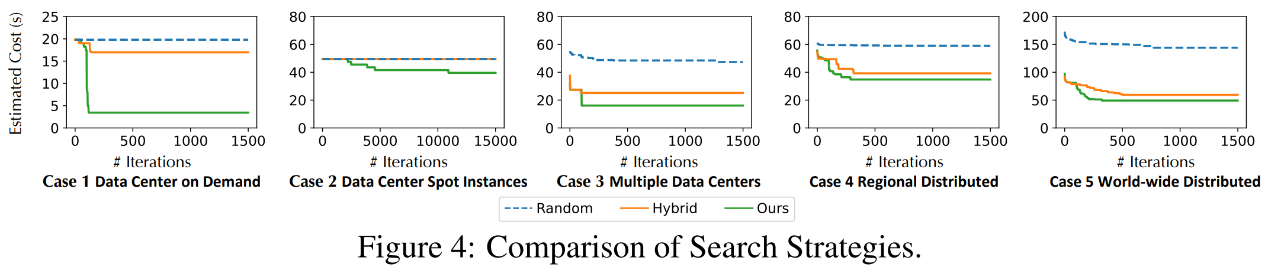
Effectiveness of Scheduler
Scheduler vs. Random Assignment
  Disable the scheduler → use random assignment
  Scheduler achieves up to 2.7× speedup in the world-wide setting (case ⑤)
Local Search Comparison
  HGA + Kernighan-Lin vs. HGA + proposed local search
  Both outperform random search
  Proposed local search achieves lower estimated cost than KL

Slide 19
Conclusion & Limitations
Conclusion
  Formulate FM training over heterogeneous networks as a tasklet allocation problem
  Bi-level cost model + Hybrid GA for topology-aware DP / PP scheduling
  Runtime optimization via communication / computation overlap
  Up to 4.8× speedup over prior SOTA in the world-wide setting
Limitations & Future work
  Assumes stable communication and always-online devices
  Future work: dynamic re-scheduling & checkpointing-based fault tolerance
Later systems (e.g., SWARM, DiLoCo): failure handling & dynamic availability under different training paradigms

Slide 20
Thank You!
({scloin9763, ijieun}@snu.ac.kr)

