Slide 1
Tbl_rajshahi Plan for physical & Logical pm

Slide 2
Overview of TBL_Rajshahi
Total No. of SCL Sites: 25
Total No. of HO Site: 01
Total No. of Access Sites: 23
Total No. of Monitoring Site: 01

Slide 3
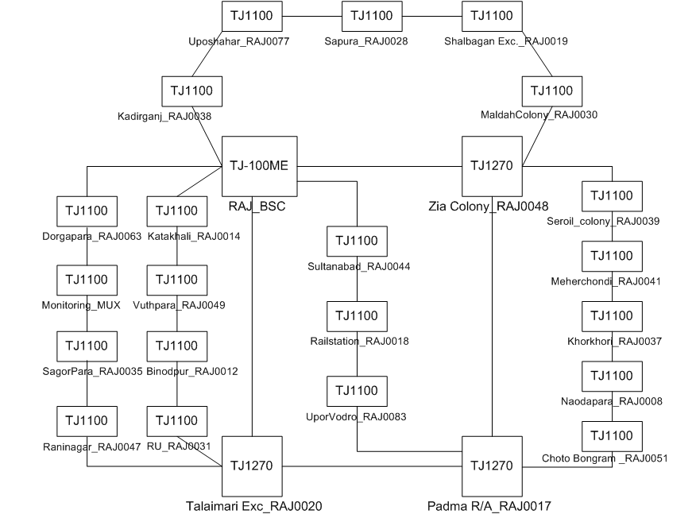
Visio of Rajshahi TBL Network

Slide 4
PM Responsible Concern
Logical PM
Physical PM
Responsible Person
Md. Sabbir Ferdous
Responsible Person
Md. Mahbubul Haque
Md. Jahidul Islam

Slide 5
PM Schedule
Logical & Physical PM
28/01/2018
29/01/2018
30/01/2018
31/01/2018
01/02/2018
Dorgapara_RAJ0063
Sagorpara_RAJ0035
Raninagar_RAJ0047
TalaimariEXC_RAJ0020
RU_RAJ0031
Binodpur_RAJ0012
Vuthpara_RAJ0049
Katakhali_RAJ0014
PadmaR/A_RAJ0017
Upor vodro_RAJ0083
Railstation_RAJ0018
Sultanabad_RAJ0044
Zia Colony_RAJ0048
Kadirganj_RAJ0038
Uposhahar_RAJ0077
Sapura_RAJ0028
ShalbaganExc_RAJ0019
Maldahcolony_RAJ0030
Naodapara_RAJ0008
Khorkhori_RAJ0037
Meherchondi_RAJ0041
Seroil Colony_RAJ0039
Choto Bongran_RAJ0051

Slide 6
Required Support
During Logical PM
During Physical PM
Service Down Permission for Minimum time if we found any abnormalities.
K,L,M of existing 2G Services.
Access Permission & Key Support.
Ensuring General Cleanliness inside BTS if possible.

Slide 7
Thank You

