Slide 1
信息技术 第七讲
if-else condition

Slide 2
if语句
boolean expression
if(boolean expression):
statements
true
statements

Slide 3
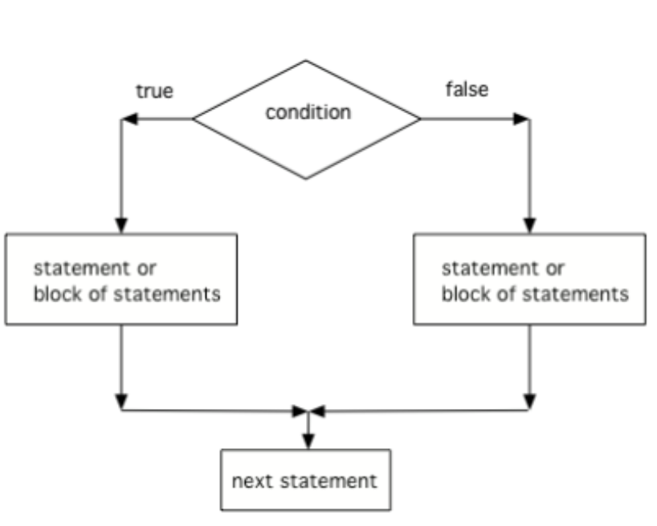
Two-way Selection: if-else statements(双分支语句)
if (boolean expression):
statement1
statement2
else:
statement3
statement4

Slide 4
Example
if (degrees > 95):
print("School will be closed due to extreme heat")
else:
print("School is open")

Slide 5
Example
if (degrees > 95):
print("School will be closed due to extreme heat")
else:
print("School is open")
else后面没有括号
if-else只有一个分支会被执行

Slide 6
if可以嵌套在另一个if中
if(num>0):
if(num%2==0):
print("A")
else:
print("B")

Slide 7
if可以嵌套在另一个if中
if(num>0):
if(num%2==0):
print("A")
else:
print("B")
if-else结构嵌套在if结构中
else与相同层次中离它最近的if组成if-else结构

Slide 8
if可以嵌套在另一个if中
def test(str):
if(len(str)%2 == 0): str = str[0:len(str)-1]
print(str)
else:
if(str[0] == ‘a’):
print(“A”)
else:
str = str[1:]
print(str)
test(“abcd”)
test(“abcde”)
test(“bbcde”)

Slide 9
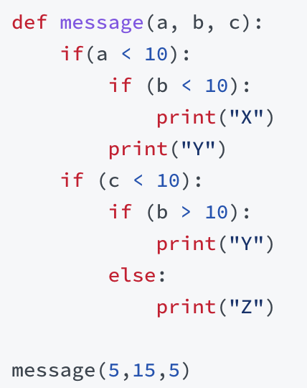
if嵌套

Slide 10
import math
def solve():
a = float(input("Enter coefficient a: "))
b = float(input("Enter coefficient b: "))
c = float(input("Enter coefficient c: "))
delta = b*b-4*a*c
if(delta >= 0):
x1 = (-b+math.sqrt(delta))/(2*a)
x2 = (-b-math.sqrt(delta))/(2*a)
print(x1, x2) print("No real roots")
solve()

Slide 11
import math
def solve():
a = float(input("Enter coefficient a: "))
b = float(input("Enter coefficient b: "))
c = float(input("Enter coefficient c: "))
delta = b*b-4*a*c
if(a!=0):
if(delta >= 0):
x1 = (-b+math.sqrt(delta))/(2*a)
x2 = (-b-math.sqrt(delta))/(2*a)
print(x1, x2)
else:
print("No real roots")
else:
print(-c/b)
solve()

Slide 12
Rock, Paper, Scissors
Create a function which takes two strings (p1 and p2 ⁠— which represent player 1 and 2) as arguments and returns a string stating the winner in a game of Rock, Paper, Scissors.
Each argument will contain a single string: "Rock", "Paper", or "Scissors". Return the winner according to the following rules:
Rock beats Scissors
Scissors beats Paper
Paper beats Rock
rps(“Rock”, “Paper”) -> “The winner is P2”
rps(“Scissors”, “Paper”) -> “The winner is P1”
rps(“Paper”, “Paper”) -> “It’s a draw”

Slide 13
Rock, Paper, Scissors
P1和P2有多少种不同的组合
每种组合的输出结果分别是什么

Slide 14
Rock, Paper, Scissors
def rock(s1, s2):
if(s1==s2):
print("It is a draw")
else:
if(s1 == "Rock"):
if(s2 == "Scissors"):
print("First player wins")
else:
print("Second player wins")
rock("Rock", "Scissors")

Slide 15
THAT’S ALL FOR TODAY

