Slide 1
数据库操作（C.R.U.D）
Create: 创建/新增（CREATE, INSERT INTO)
Retrieve: 查询（SELECT )
Update: 修改
Delete: 删除
“增删查改”
Notes:
Excel表格有哪些不好的地方？（不能储存过多数据，查询过慢）

Slide 2
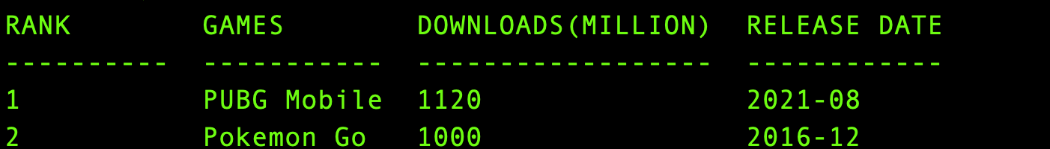
/*获取表中所有数据*/
SELECT * FROM MOBILE_GAMES;

Slide 3
“增删查改”
/*获取表中所有数据*/
SELECT * FROM MOBILE_GAMES;

Slide 4
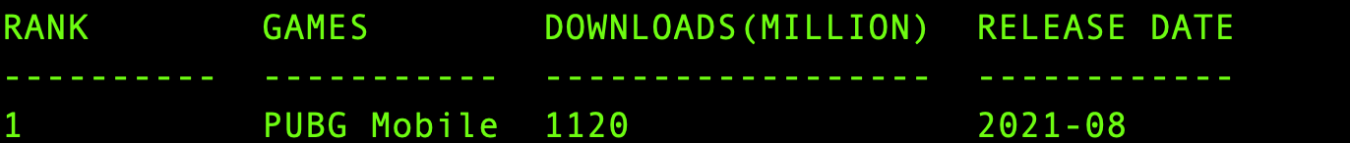
/*指定数据筛选条件*/
SELECT * FROM MOBILE_GAMES WHERE RANK = 1;

Slide 5

/*指定数据筛选条件*/
SELECT GAMES FROM MOBILE_GAMES WHERE RANK = 1;

Slide 6
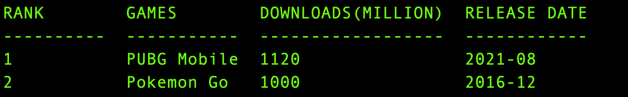
/*获取排名小于3的所有数据*/
SELECT * FROM MOBILE_GAMES WHERE RANK < 3;

Slide 7
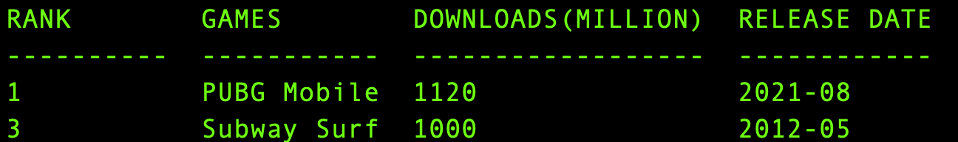
/*获取排名为奇数的所有数据*/
SELECT * FROM MOBILE_GAMES WHERE RANK % 2 = 1;

Slide 8
/*获取排名为奇数的所有数据*/
SELECT * FROM MOBILE_GAMES WHERE RANK % 2 = 1;

Slide 9
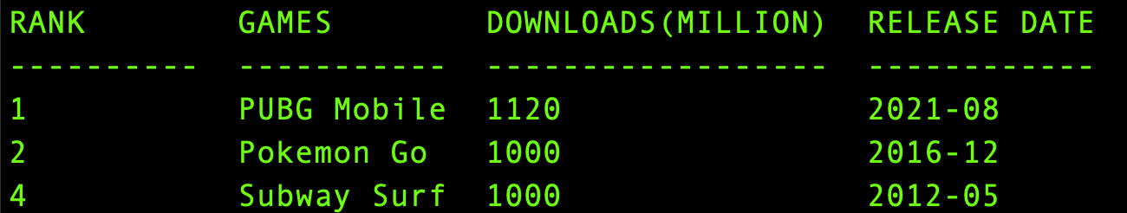
/*更新Subway Surfers的排名*/
UPDATE MOBILE_GAMES SET RANK = 4 WHERE GAMES LIKE “Subway Surfers”;
/*更新记录的语法*/
UPDATE table_name SET filds1=new-values1, fields2=new-values2
[WHERE Clause]

Slide 10
“增删查改”
/*更新Subway Surfers的排名*/
UPDATE MOBILE_GAMES SET RANK = 4 WHERE GAMES LIKE “Subway Surfers”;
/*更新记录的语法*/
UPDATE table_name SET filds1=new-values1, fields2=new-values2
[WHERE Clause]

Slide 11
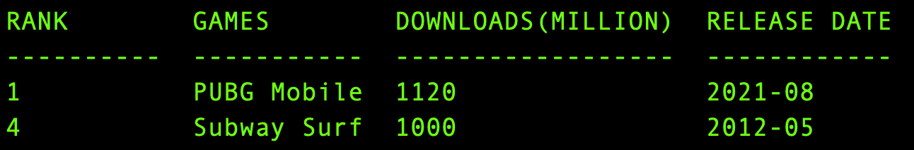
/*删除排名第二的游戏记录*/
DELETE FROM MOBILE_GAMES WHERE RANK = 2;
/*删除记录的语法*/
DELETE from table_name
[WHERE Clause]

Slide 12
“增删查改”
/*删除排名第二的游戏记录*/
DELETE FROM MOBILE_GAMES WHERE RANK = 2;
/*删除记录的语法*/
DELETE from table_name
[WHERE Clause]

Slide 13

HTML

Slide 14
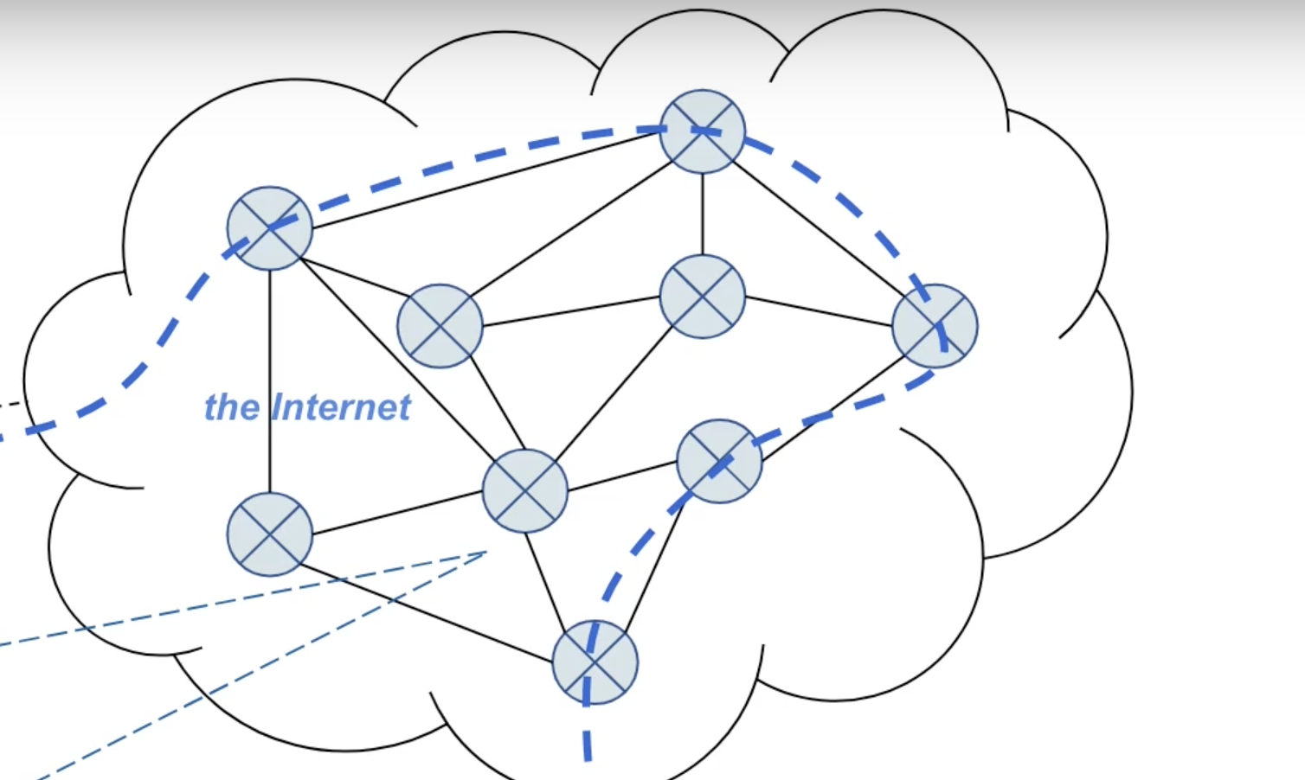
You
http://manga.bilibili.com/conan
192.168.0.101
139.159.241.37
DNS
manga.bilibili.com
139.159.241.37

Slide 15
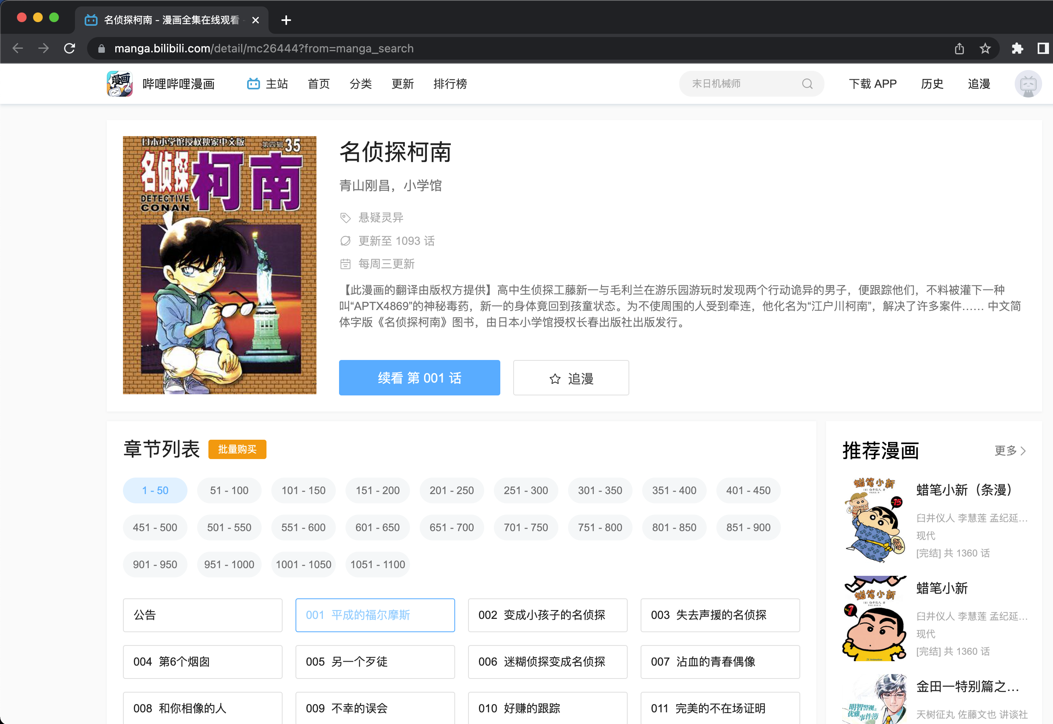
Notes:
网页设计：排版、布局、样式、图片、颜色、按钮大小

Slide 16
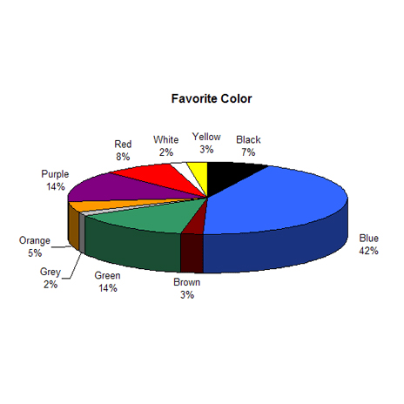
Notes:
网页设计：排版、布局、样式、图片、颜色、按钮大小

Slide 17
HTML
HyperText Markup Language

Slide 18
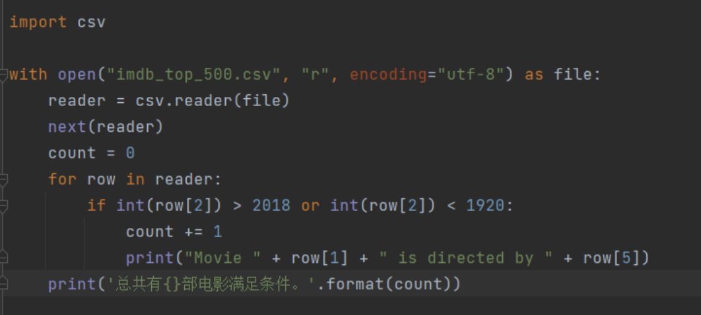
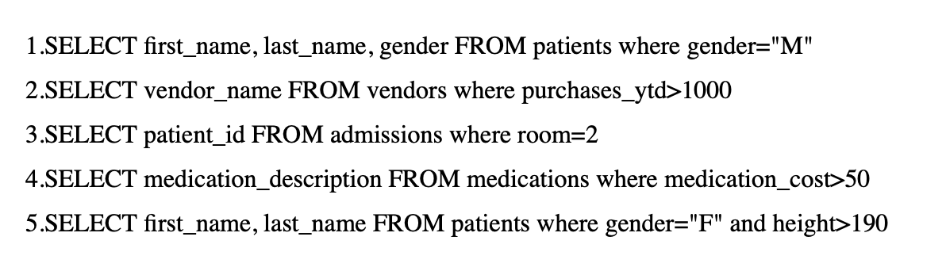
Python和SQL都是程序设计语言
Python
SQL

Slide 19
<!DOCTYPE html>
<html lang="en">
<head>
<title>This is Title</title>
</head>
<body>
This is Body!
</body>
</html>

Slide 20
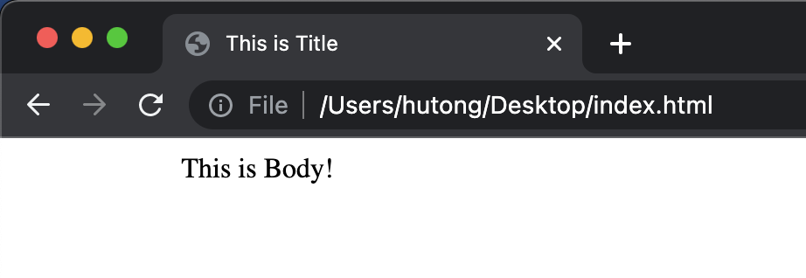
<!DOCTYPE html>
<html lang="en">
<head>
<title>This is Title</title>
</head>
<body>
This is Body!
</body>
</html>

Slide 21
<!DOCTYPE> 声明必须是 HTML 文档的第一行，告知浏览器使用的HTML版本
<!DOCTYPE html>
<html lang="en">
<head>
<title>This is Title</title>
</head>
<body>
This is Body!
</body>
</html>

Slide 22
HTML标签(tag)：尖括号包围的关键词，通常成对出现
<!DOCTYPE html>
<html lang="en">
<head>
<title>This is Title</title>
</head>
<body>
This is Body!
</body>
</html>

Slide 23
<html>和</html>是html文档最外层的标签，用来告知浏览器这是一个html文档
<!DOCTYPE html>
<html lang="en">
<head>
<title>This is Title</title>
</head>
<body>
This is Body!
</body>
</html>

Slide 24
<head>标签定义页面信息，其中一定要包含<title>标签。
<!DOCTYPE html>
<html lang="en">
<head>
<title>This is Title</title>
</head>
<body>
This is Body!
</body>
</html>

Slide 25
<title>标签定义页面标题
<!DOCTYPE html>
<html lang="en">
<head>
<title>This is Title</title>
</head>
<body>
This is Body!
</body>
</html>

Slide 26
<body>标签里面是页面的内容。
<!DOCTYPE html>
<html lang="en">
<head>
<title>This is Title</title>
</head>
<body>
This is Body!
</body>
</html>

Slide 27
标签可以具有属性(attributes)，通常以“名称=值”对的形式出现。
比如lang =“en”表示该页面的语言是英语。
<!DOCTYPE html>
<html lang="en">
<head>
<title>This is Title</title>
</head>
<body>
This is Body!
</body>
</html>

Slide 28
https://www.w3school.com.cn/html/index.asp

Slide 29
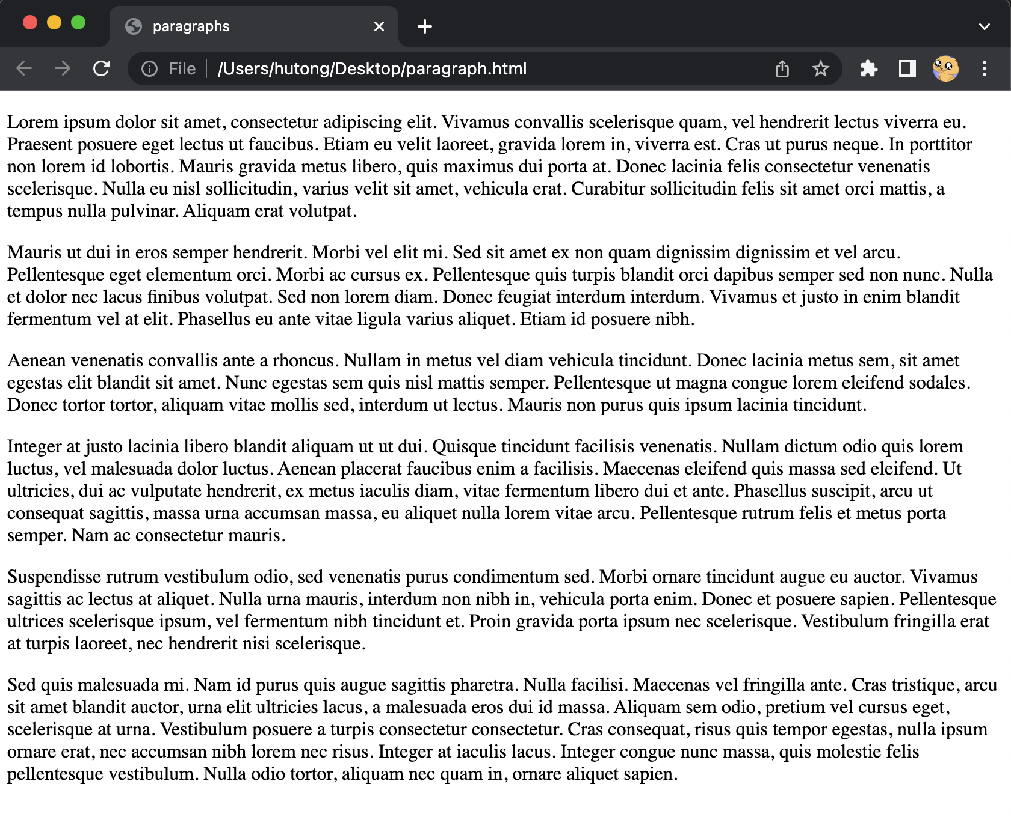
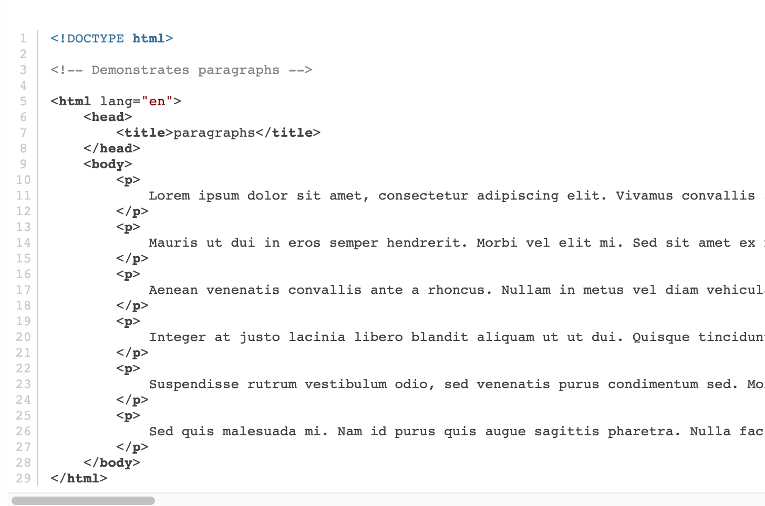
<p>：定义一个段落

Slide 30
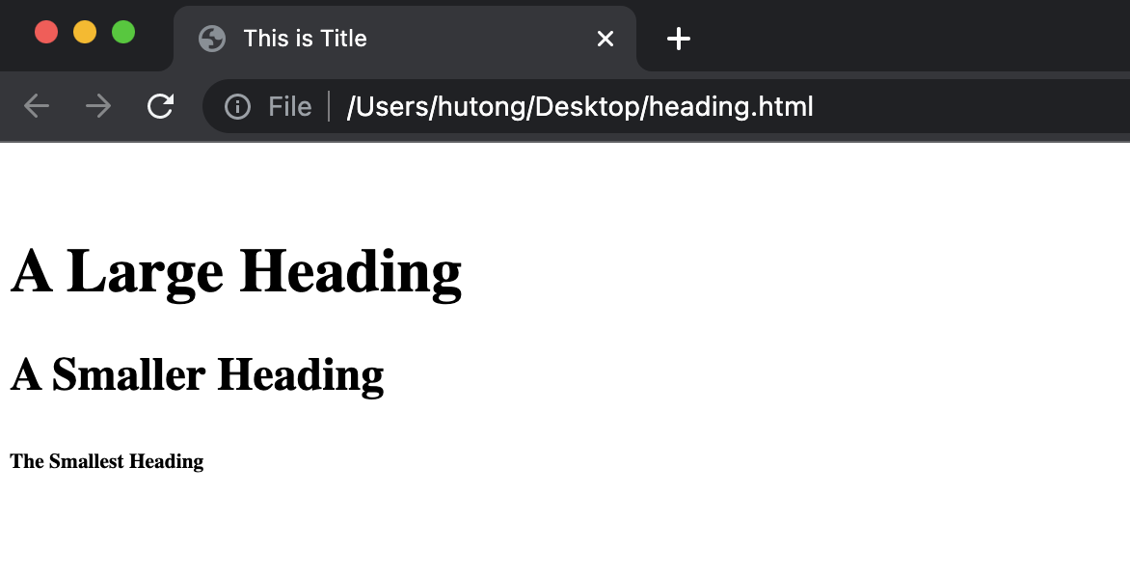
<h1> ~ <h6>: 定义标题
<!DOCTYPE html>
<html lang="en">
<head>
<title>This is Title</title>
</head>
<body>
<h1>A Large Heading</h1>
<h2>A Smaller Heading</h2>
<h6>The Smallest Heading</h6>
</body>
</html>

Slide 31
table: 定义表格
<body>
<table>
<thead>
<th>Ocean</th>
<th>Average Depth</th>
<th>Maximum Depth</th>
</thead>
<tbody>
<tr>
<td>Pacific</td>
<td>4280 m</td>
<td>10911 m</td>
</tr>
<tr>
<td>Atlantic</td>
<td>3646 m</td>
<td>8486 m</td>
</tr>
</tbody>
</table>
</body>

Slide 32
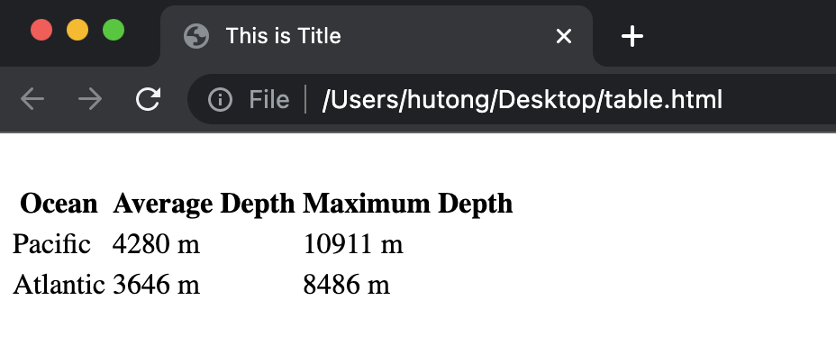
table: 定义表格
<body>
<table>
<thead>
<th>Ocean</th>
<th>Average Depth</th>
<th>Maximum Depth</th>
</thead>
<tbody>
<tr>
<td>Pacific</td>
<td>4280 m</td>
<td>10911 m</td>
</tr>
<tr>
<td>Atlantic</td>
<td>3646 m</td>
<td>8486 m</td>
</tr>
</tbody>
</table>
</body>

Slide 33
table: 定义表格
<body>
<table>
<thead>
<th>Ocean</th>
<th>Average Depth</th>
<th>Maximum Depth</th>
</thead>
<tbody>
<tr>
<td>Pacific</td>
<td>4280 m</td>
<td>10911 m</td>
</tr>
<tr>
<td>Atlantic</td>
<td>3646 m</td>
<td>8486 m</td>
</tr>
</tbody>
</table>
</body>

Slide 34
thead: 表头
<body>
<table>
<thead>
<th>Ocean</th>
<th>Average Depth</th>
<th>Maximum Depth</th>
</thead>
<tbody>
<tr>
<td>Pacific</td>
<td>4280 m</td>
<td>10911 m</td>
</tr>
<tr>
<td>Atlantic</td>
<td>3646 m</td>
<td>8486 m</td>
</tr>
</tbody>
</table>
</body>

Slide 35
th: 表格属性
<body>
<table>
<thead>
<th>Ocean</th>
<th>Average Depth</th>
<th>Maximum Depth</th>
</thead>
<tbody>
<tr>
<td>Pacific</td>
<td>4280 m</td>
<td>10911 m</td>
</tr>
<tr>
<td>Atlantic</td>
<td>3646 m</td>
<td>8486 m</td>
</tr>
</tbody>
</table>
</body>

Slide 36
tbody: 表格主体
<body>
<table>
<thead>
<th>Ocean</th>
<th>Average Depth</th>
<th>Maximum Depth</th>
</thead>
<tbody>
<tr>
<td>Pacific</td>
<td>4280 m</td>
<td>10911 m</td>
</tr>
<tr>
<td>Atlantic</td>
<td>3646 m</td>
<td>8486 m</td>
</tr>
</tbody>
</table>
</body>

Slide 37
tr: 表格行 td:单元格信息
<body>
<table>
<thead>
<th>Ocean</th>
<th>Average Depth</th>
<th>Maximum Depth</th>
</thead>
<tbody>
<tr>
<td>Pacific</td>
<td>4280 m</td>
<td>10911 m</td>
</tr>
<tr>
<td>Atlantic</td>
<td>3646 m</td>
<td>8486 m</td>
</tr>
</tbody>
</table>
</body>

