Slide 1
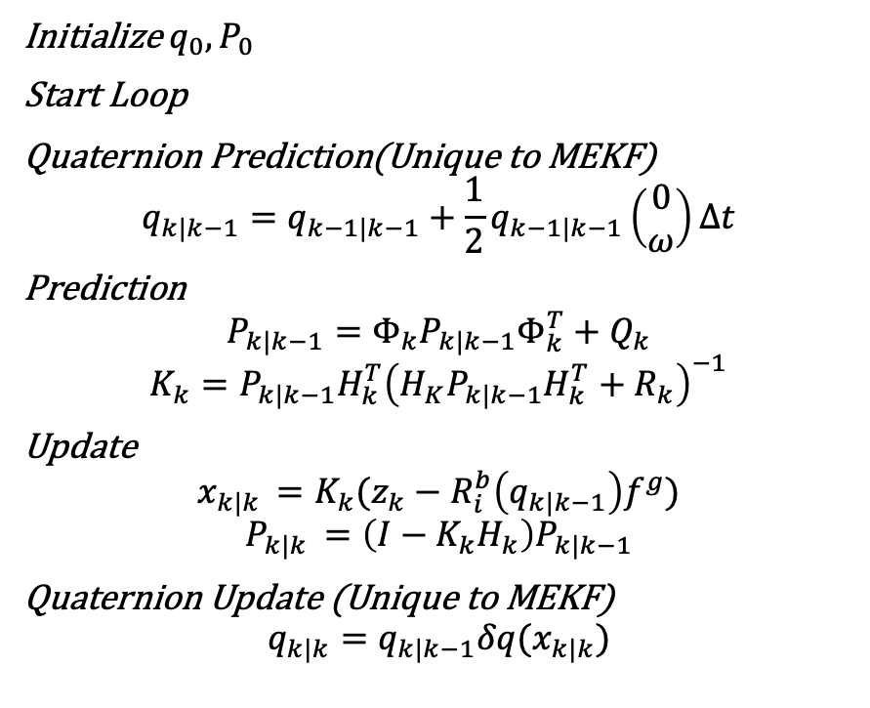
Multiplicative Extended Kalman Filter
Agenda: Estimate the attitude of CubeSat.
Allows to work with quaternions and is very similar to EKF.
Been used in conjunction with Quest/TRIAD in some recent works.
Initialize $q_{0}, P_{0}$
Start Loop
Quaternion Prediction(Unique to MEKF)
$$q_{k|k−1}=q_{k−1|k−1}+\frac{1}{2}q_{k−1|k−1}\left(\begin{matrix}0 \\ ω\end{matrix}\right)Δt$$
Prediction
$$P_{k|k−1}=Φ_{k}P_{k|k−1}Φ_{k}^{T}+Q_{k}$$
$$K_{k}=P_{k|k−1}H_{k}^{T}{\left(H_{K}P_{k|k−1}H_{k}^{T}+R_{k}\right)}^{−1}$$
Update
$$x_{k|k }=K_{k}(z_{k}−R_{i}^{b}\left(q_{k|k−1}\right)f^{g})$$
$$P_{k|k }=\left(I−K_{k}H_{k}\right)P_{k|k−1}$$
Quaternion Update (Unique to MEKF)
$$q_{k|k}=q_{k|k−1}δq(x_{k|k})$$

