Slide 1
Trajectory Optimization
Reference Trajectory
Dynamics
Cost Function
Jacobian
MATLAB
NLMPC
(model)
optimal
move
(zero-order hold)
Ode45
(plant)

Slide 2
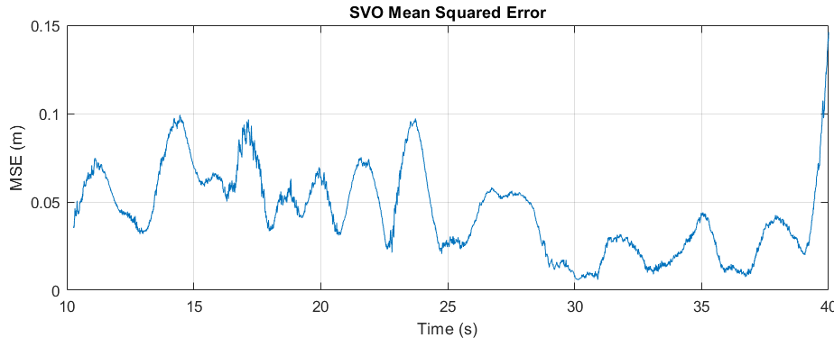
Beaglebone Blue
Altitude
Rasberry Pi
LCM
Timestamp

Slide 3
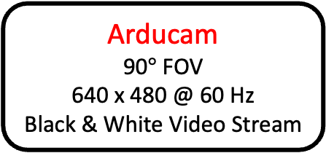
Video Stream OpenCV
reads video input and publishes the video stream to a ROS topic /camera/image_raw
Arducam
90$°$ FOV
640 x 480 @ 60 Hz
Black & White Video Stream
altitude.txt
keeps note of current altitude
Altitude
SVO (Fast)
subscribes to topic /camera/image_raw
Reads altitude data for initialization from .txt
Publishes to pose data to topic /svo_ros/pose
Timestamp
Rasberry Pi

