Slide 1


Slide 2
In some ways, programming is like a painting. You start with a blank canvas and certain basic raw materials. You use a combination of science, art, and craft to determine what to do with them.” – Andrew Hunt

Slide 3
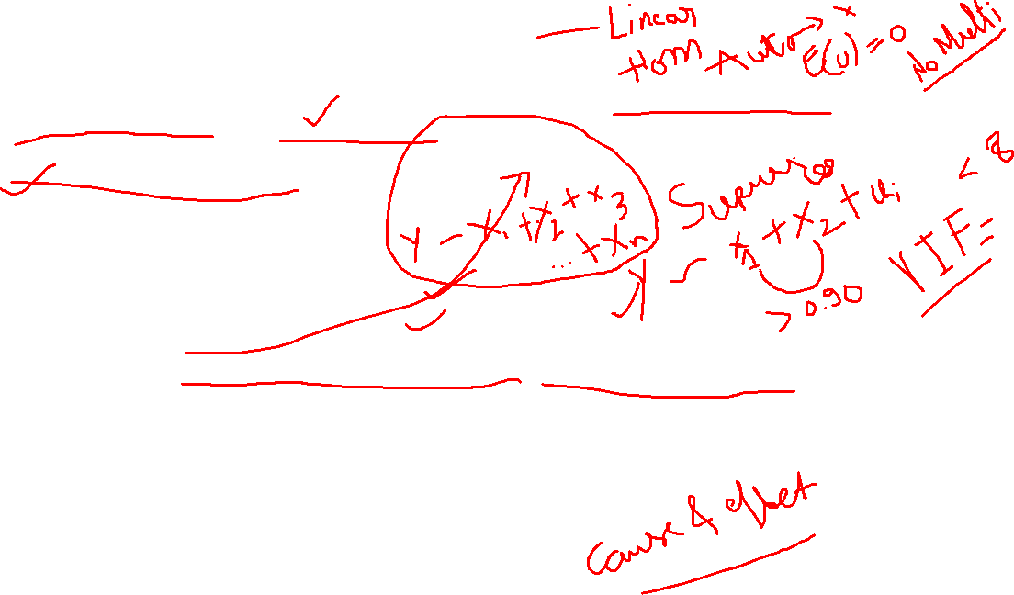
Perform Multiple regression analysis, carry out the regression diagnostics, and explain your findings. Correct them and revisit your results and explain the significant differences you observe. [data “NSSO68.csv”]
Problem statement:
Breakdown the question:
Multiple regression analysis-
What is required to do MLR?
Data
Dependent and Independent variable that have a theoretical relationship
What is Regression diagnostics?
Verify assumptions such as linearity, independence, homoscedasticity, and normality of residuals are satisfied
Address any violations of assumptions, such as by transforming variables or using alternative models.

Slide 4
NSSO68.csv dataset
Has household consumption data on 384 variables
We need to select one dependent variable and one or more independent variables that have a theoretical relationship.
foodtotal_q ~ MPCE_MRP,MPCE_URP,Age,Meals_At_Home,Possess_ration_card,Education, No_of_Meals_per_day

Slide 5
b)Using IPL data, establish the relationship between the player's performance and payment he receives and discuss your findings. Analyze the Relationship Between Salary and Performance Over the Last Three Years (Regression Analysis)
Ipl ball by ball data till 2024.csv
Player performance – runs scored (in wining causes), wickets taken, fielding (catches , run outs, stumping)
Ipl salary 2024
Player performance in past performance will decide his salary 2024
Subset the data for last three years Season > 2020
Merge data “Subset for last three years” and “ipl salary 2024”, fuzzy matching

Slide 6
Select Independent and Dependent variables
Salary is dependent variables
Performace is independent
Salary ~ performance( runs_scored / wicket taken )
Runs scored will be of magnitude 0-175
Wickets 0-10
Performance index = runs (1 run = 1 point)+ wickets taken (1 wicket = 25 points)

Slide 7
Results
Salary ~ performance_index , data is IPL DATA
R square = 0.13
R square = 0.22
Its not a good model to predict the salary
Reasons:
We have less variables (runs/wickets)
Brand value
Trust in the player
Franchise revenue
Will only IPL tell whether the player is good or bad? International matches, other leagues (Big Bash, CPL), domestic matches (Ranaji, Vijay Hazare trophy)
Less no of years data
Player might not have played

Slide 8
Feature engineering
New variables using existing data.

Slide 9
Steps to create markdown file in R
Go to File >> Compile Report >> fromat==html>> it will re run the code and give you a html file(that is called r markdown)

