Slide 1
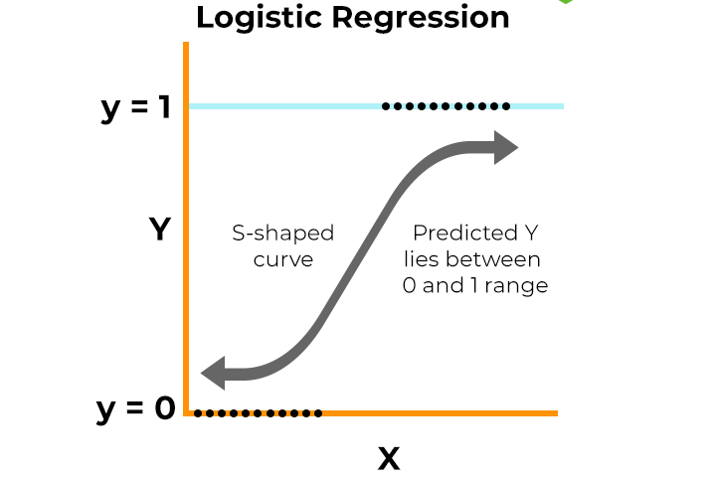
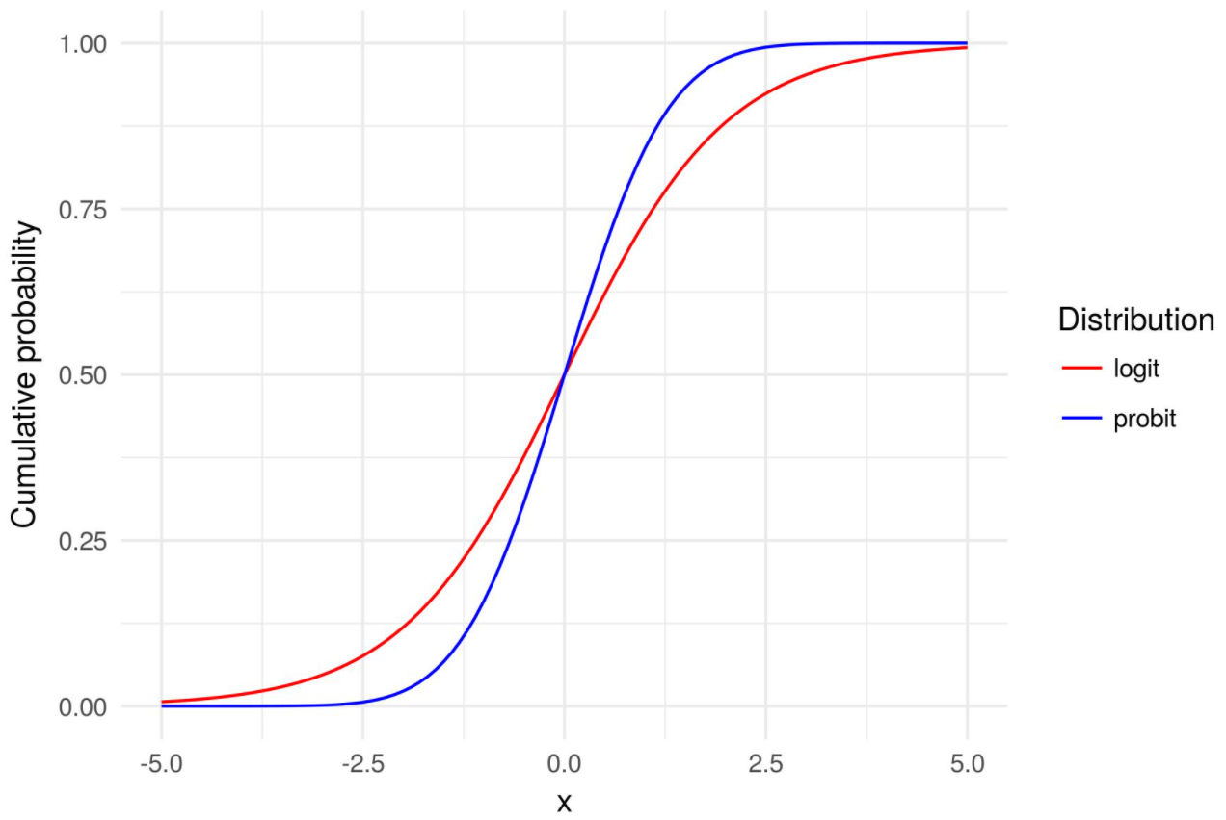
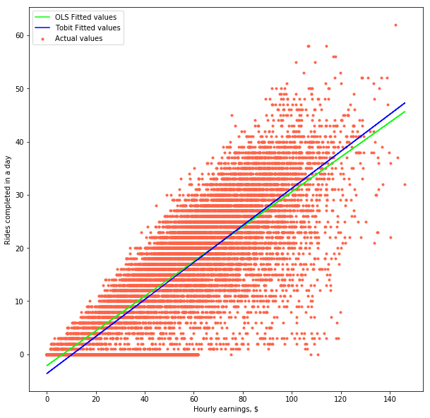
A3
Limited dependent variable Models

Slide 2
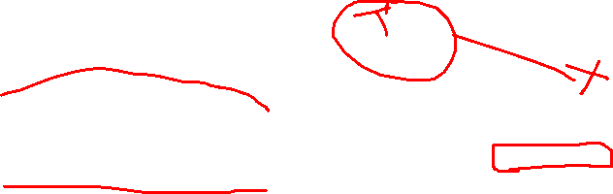
The difference
Feature | Logistic Regression | Probit Regression | Tobit Regression
Type of Dependent Variable | Binary (0 or 1) | Binary (0 or 1) | Continuous but censored (e.g., lots of zeros)
Mathematical Function Used | Logistic function | Cumulative distribution function of the normal distribution | Combination of linear regression and normal distribution
Typical Use Case | Classifying outcomes (e.g., pass/fail, yes/no) | Classifying outcomes with a preference for normal distribution | Modeling censored data (e.g., spending where many spend zero)
Interpretation | Odds ratios and probabilities | Z-scores from the normal distribution | Probability of being censored and expected value if not censored

Slide 3
Ifelse
If a logic : any of the variable (chicken_q, praws_q, eggs_q, etc) > 0
They are non vegetarians
Else
vegetarians

Slide 4
Objectives
Part A - Conduct a logistic regression analysis on your assigned dataset. Validate assumptions, evaluate with a confusion matrix and ROC curve, and interpret the results. Then, perform a decision tree analysis and compare it to the logistic regression.
Part B - Perform a probit regression on "NSSO68.csv" to identify non-vegetarians. Discuss the results and explain the characteristics and advantages of the probit model
Part C - Perform a Tobit regression analysis on "NSSO68.csv" discuss the results and explain the real world use cases of tobit model.

Slide 5
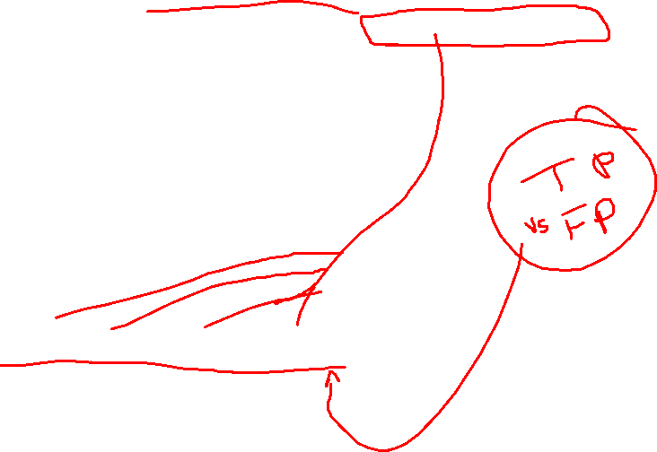
Problem statement:
Part A - Conduct a logistic regression analysis on your assigned dataset. Validate assumptions, evaluate with a confusion matrix and ROC curve, and interpret the results. Then, perform a decision tree analysis and compare it to the logistic regression.
Breakdown the question:
Logistic Regression
What is required to do Log-Reg?
Data
Binary dependent variable
Evaluation of model
Accuracy, Precision, Recall, F1 score , calculate using confusion matrix
ROC Curve (Receiver Operating Curve)

Slide 6
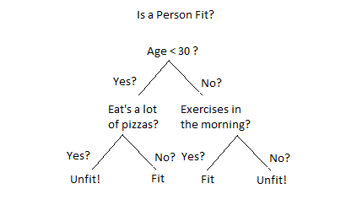
Contd…
Decision tree classification
It’s a machine learning algorithm used for classification problem

Slide 7
# Example assuming 'data' is your dataframe with appropriate variables
# and 'target_variable' is your binary dependent variable
Data_new = data[,c[‘var1’,var2]
X = [10 x variables]
Y = taget
# Example syntax
tree_model <- rpart(target_variable ~ ., data = Data_new , method = "class")
 | Logistic Regression | Decision Tree Classifier
Accuracy | 0.76 | 0.97
Precison
Recall
F1 Score

Slide 8


Slide 9
Part B - Perform a probit regression on "NSSO68.csv" to identify non-vegetarians. Discuss the results and explain the characteristics and advantages of the probit model
Problem statement:

Slide 10
PORT (Telecom)
Vi – they have lost customers
Telecom churn one company to another
Customer unhappy recharge plans, network speed, call drop
Previous recahrges he has done , annual plans(3k) to monthly (300)
His usage
9959461 likely to port, we need contact give offers , solve their problems

Slide 11
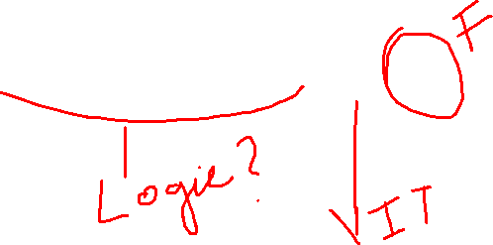
Feature engineering
We don’t have a variable that tells whether a person is vegetarian or non vegetarian
=IF(SUM(D3:F3)>0,1,0)
# Create the Target variable
data$nv <- ifelse(rowSums(data[, c('eggsno_q', 'fishprawn_q’, 'goatmeat_q', 'beef_q', 'pork_q','chicken_q', 'othrbirds_q')]) > 0, 1, 0)

Slide 12
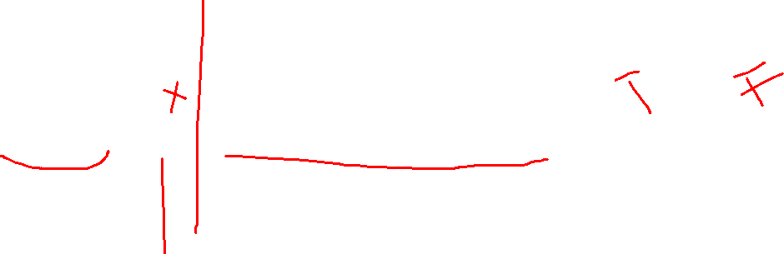
=IF(A2 < 40000, "Low", IF(AND(A2 >= 40000, A2 < 70000), "Medium", "High"))

Slide 13
The data: Selection of Dependent and Independent variables

Slide 14
Data encoding and feature engineering

Slide 15
Why Use Tobit Regression?
Censored Data: In your data, spending is "censored" at zero because it can't be negative. If you only used simple linear regression, it wouldn't handle the zeros properly.
Predictive Power: Tobit regression helps predict both the likelihood that someone spends money and how much they spend if they do spend.

Slide 16
Results

