Slide 1
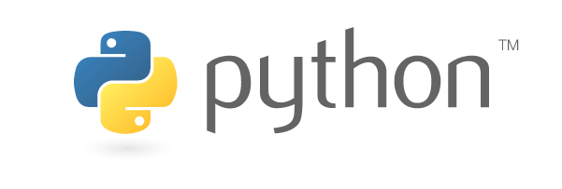

Python Virtual Environments
VS Code
Notes:
1

Slide 2
1
What is a virtual environment?
2
Creating a virtual environment in VS Code
3
Activating & deactivating your virtual environment
4
Using pip to install python packages
2

Slide 3
Global Env
pip install pandas==1.0
pip install pandas version 1.4.1
Import pandas as pd
Virtual Environment1 TS FORECAST
pip install pmdarima
pip install sci-kit learn
Virtual Environment2
Classification
pip install statsmodel
Logistic regreesion
Virtual Environment3
pip install pandas=1.0
Virtual Environment4
pip install pandas=1.0

Slide 4



What is a Virtual Environment?
An environment for your user account
Install python packages without adversely affecting other users
Use different sets of packages for different projects
Project 1 requires Pandas 1.0
Project 2 requires Pandas 0.25
Solution ... create 2 separate virtual environments
4

Slide 5
1
What is a virtual environment?
2
Creating a virtual environment in VS Code
3
Activating & deactivating your virtual environment
4
Using pip to install python packages
5

Slide 6


Creating a Virtual Environment
Open Visual Studio Code
Press Ctrl + Shift + ` it will the terminal in the vs code where you can write codes. ` is called “back tick”
Then in the terminal type python –m venv venv command tells python to create a virtual environment in the current folder you are in.
6

Slide 7
1
What is a virtual environment?
2
Creating a virtual environment in VS Code
3
Activating & deactivating your virtual environment
4
Using pip to install python packages
7

Slide 8


Activate & Deactivate Virtual Environment
To activate the virtual environment type this command in terminal venv/Scripts/Activate
When the environment is successfully activated you will see its name at the command prompt, as seen above.
To exit the virtual environment, simply enter the deactivate command. You should no longer see the environment name at the prompt.
8

Slide 9
1
What is a virtual environment?
2
Creating a virtual environment in VS Code
3
Activating & deactivating your virtual environment
4
Using pip to install python packages
9

Slide 10
1
What is a virtual environment?
2
Creating a virtual environment in VS Code
3
Activating & deactivating your virtual environment
4
Using pip to install python packages
10

Slide 11
Using pip to Install Python Packages
The pip command can be used within an activated virtual environment to install a packages.
For a searchable python package index, visit https://pypi.org/
11

Slide 12
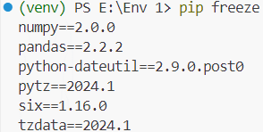
Using pip to list all the Python Packages
The command pip freeze will display a list of all the packages that are currently installed in the environment.
12

Slide 13
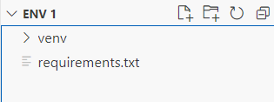
Creating a requirements.txt file
The command pip freeze > requirements.txt will create a list of all the packages that are currently installed in the environment and store it in the requirements.txt file.
You will see a new file called requirements.txt will be created in the folder.
13

Slide 14
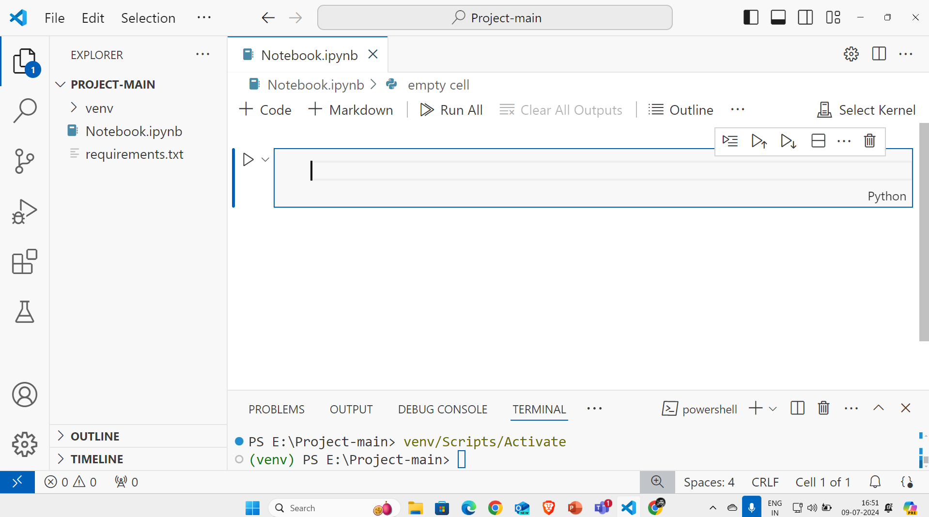

Slide 15

Thank You!
Notes:
15

