Slide 1
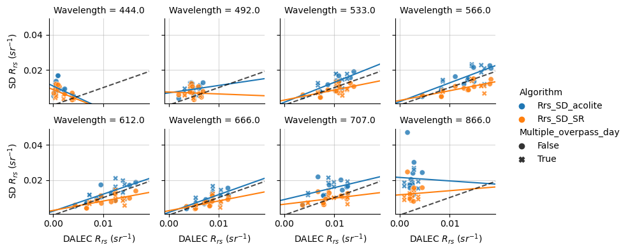

Slide 2
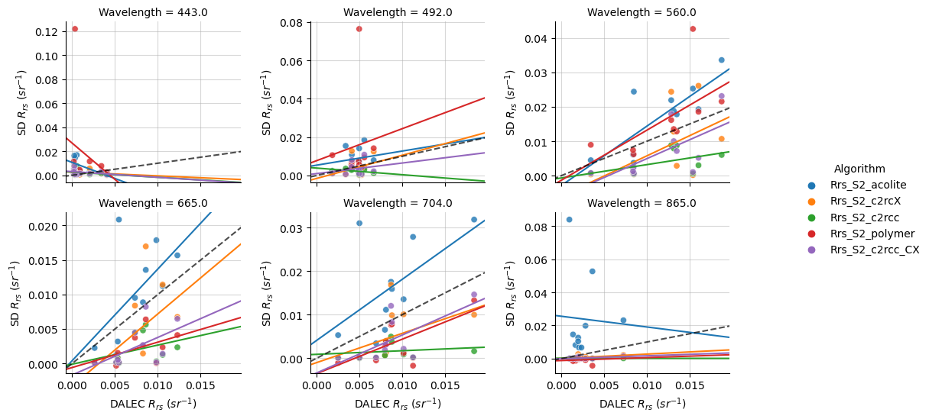

Slide 3
Use R^2, Slope, MAPD, MAvD, RMSE to decide which correction works best
Rank performance based on each metric and then choose the procedure with the lowest mean rank
Acolite for SD (although not much difference!)
C2RCC_CX for S2

Slide 4
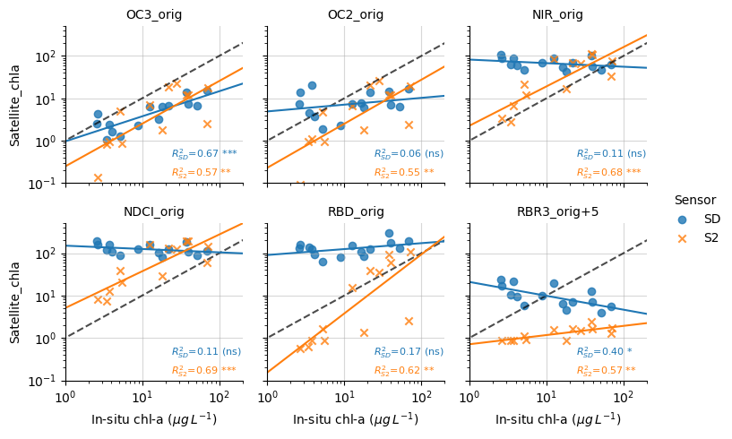

Slide 5
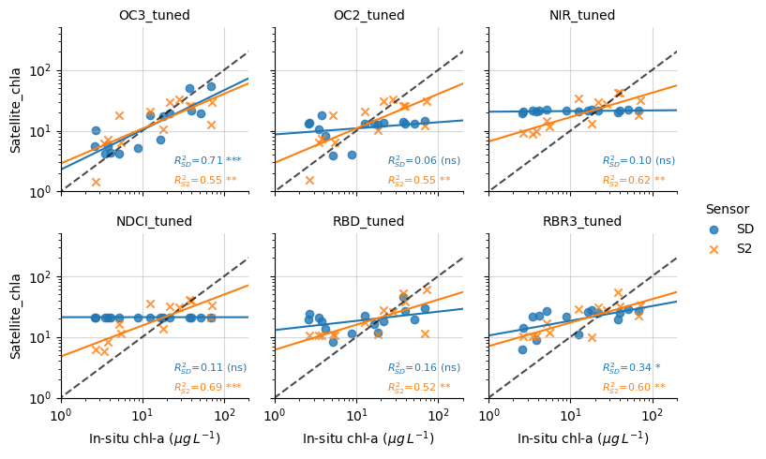

Slide 6
All chl-a algorithms work (to some extent) with Sentinel 2
Only OC3 works for Planet
OC3 best for Sentinel 2
Same metrics (in logspace) used for evaluation

Slide 7
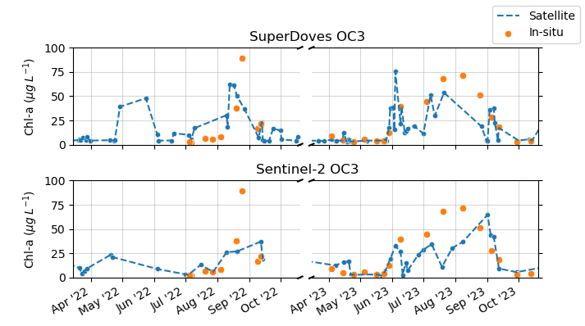

Slide 8
Blooms below / above threshold?
Threshold hard to define from literature
  SEPA use 100000 cells/ml, but hard to convert chla to cells/ml
Percentile approach?
  66.666% percentile of the insitu chla data is 21.7 ug/L
  If I use this then I get:
  Planet: F1_score = 0.93
  Sentinel_2 F1_score = 0.85
Possibly a bit arbitrary, and as I’m testing on the same data that the models were fitted to, I’m not sure how useful this is.

Slide 9
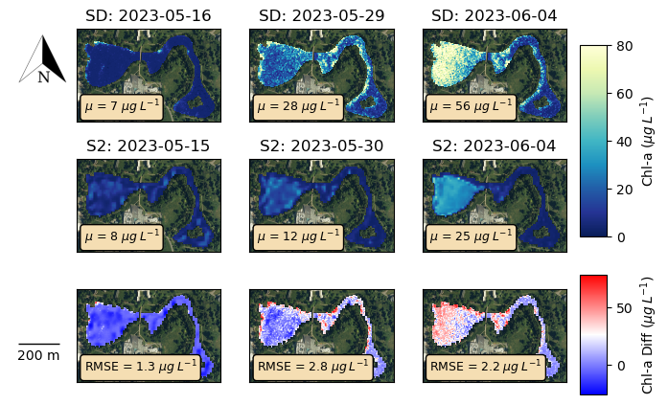

Slide 10
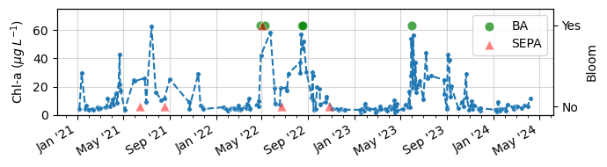
BA – ‘verified bloom’ according to Bloomin Algae App
SEPA – bloom definition is >100,000 cells/ml

