Slide 1
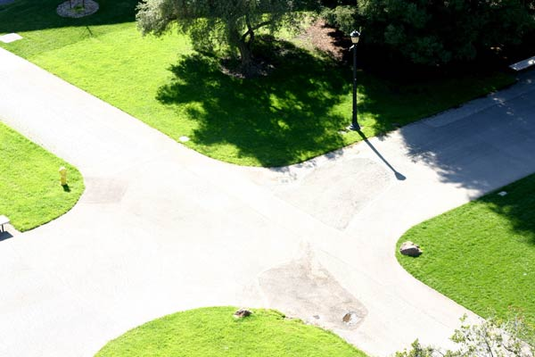




Shanghai, October 22 2024,
Fudan University seminar
感谢您的邀请 ! !
c
The Salesman and the Postman : Frontiers and Crossroads of and in within Combinatorial Optimization
András Sebő
CNRS, G-SCOP, Univ. Grenoble

Slide 2
Shanghai, 2024 October 22
Frontiers of Mathematics
感谢您的邀请 ! !
c
The Salesman and the Postman : Frontiers and Crossroads of and in within Combinatorial Optimization
András Sebő
CNRS, G-SCOP, Univ. Grenoble

Slide 3
Your future: Various Frontiers
Efficiently Solvable Intractable
Real Life Abstract
3. Discrete Continuous
4. Exact Approximation
5. Deterministic Random
6. Combinatorial Geometric
7
7. Linear Nonlinear
8. Graphic Number Theoretic
9. Elementary Algebraic
10. Uni-Focus: Atomic Multifocus: Synthetic
c

Slide 4

The (Chinese) Postman (Meigu Guan 1960)
1. The Complexity Frontier
Minimize the roads :
中国邮递员
(管梅谷)
c
Edges = streets
Do all the streets
and come back !
In P, that is, tractable (Edmonds 1965)
Efficiently Solvable
Intractable
The (Travelling) Salesman
Nodes = Cities
Do all the cities
and come back !
NP-hard, that is intractable
(Karp, 1972)

Slide 5
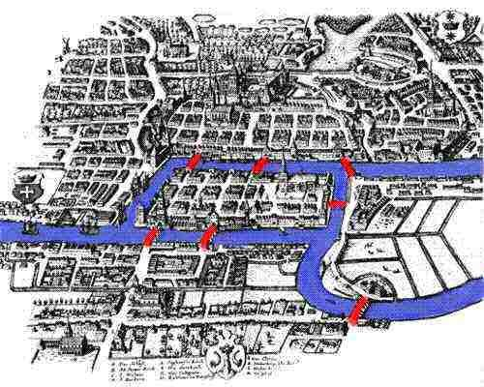
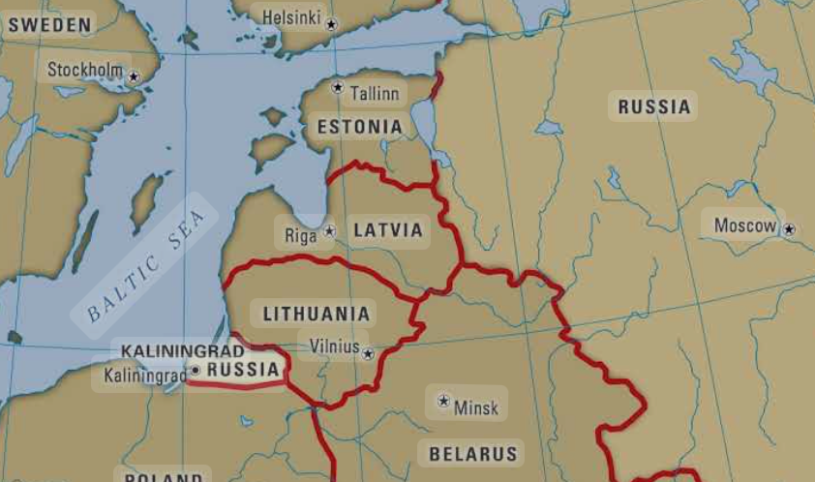
Bridges: “Real Life’’ graphs: “abstract”
2.Modellisation: Bridges over River Frontiers
Königsberg
Real Life
Abstract
c
s
t
deletion was explored in a clever way by Mömke & Svensson (2011)
Euler’s theorem : Given a graph
there exists a tour using every edge exactly once ⬄
The graph is connected, and
there are an even number of edges incident to nodes.
If s≠ t for stating and endpoints s and t then an odd number of edges incident to s and t - ’’ .

Slide 6
Efficient Algorithm for the Postman
F ⊆ E(G) is a T-join, if
T = vertices of odd degree of F.
G=(V,E)
T_{G}-joins, where
T_{G} :={v: d(v) is odd}
Euler: one can go through all the streets exactly once ⇔ G conn., ∀degree even
Easy facts about T-joins : G connected, |T| even ⇒ ∃ T-join ;
min weight «Eulerian replication» = duplication of a min weight T_{G}-join
G=(V,E), w: E → IR minimum weight T-joins ↔
minimum distance-weighted perfect matchings of T
Edmonds (1965) Edmonds, Johnson (1973)

Slide 7
The Chinese Postman’s help for the Salesman
来自中国邮递员的帮助
G=(V,E)
tour : connected (on V = spanning) sub-multigraph of G, even degrees
T_{G}-joins, where
T_{G} :={v: d(v) is odd}
Non-negative, triangle inequality, otherwise non-approximable
Min Hamiltonian cycle for metrics
in complete graphs
↔
Min tour for arbitrary positive
weights in arbitrary graphs
2
3

Slide 8
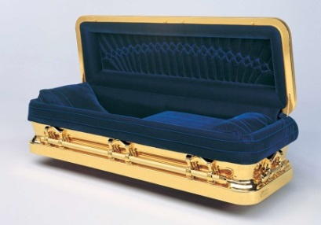
metrics
TSP: Min weight tours for nonneg weights
- Graph TSP: all 1 weights, i.e. cardinality
- Use of polyhedra
- Sparsity

Slide 9
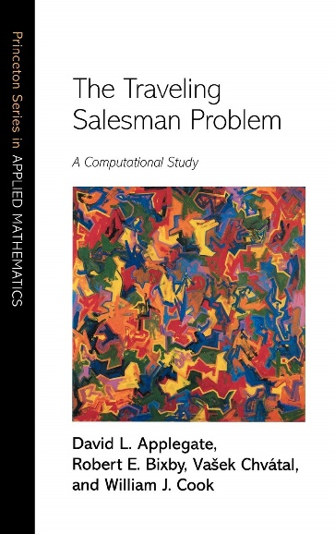
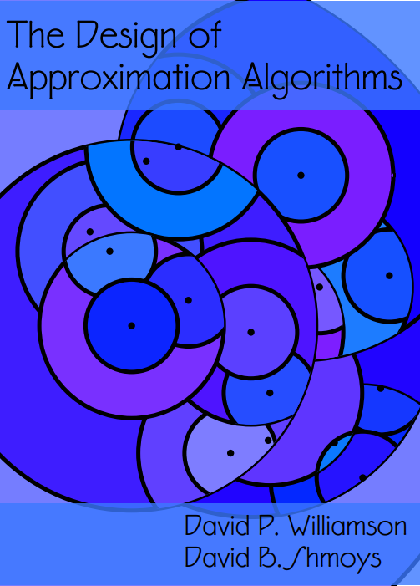
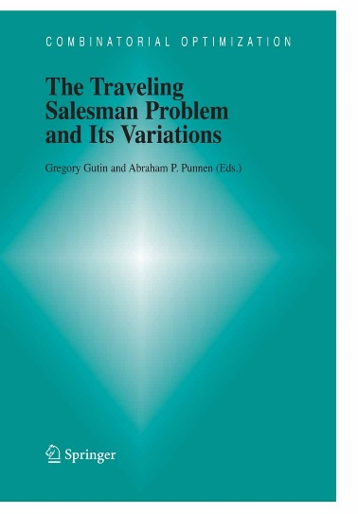
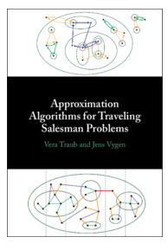
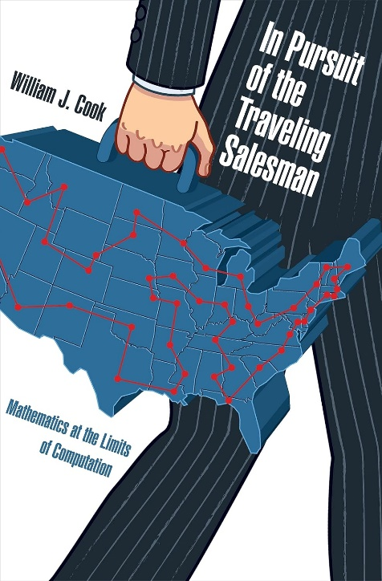
3. Exact Approximation
D.Applegate, R. Bixby, V. Chvátal, W.J. Cook
(2006)
Williamson, Shmoys
(2010)
G. Gutin and A. P. Punnen
(2002)
Traub, Vygen
(2024)
W. Cook
(2012)

Slide 10
Approximate Solution for the Postman Kruskal’s connectivity + the Postman’;s parity correction
= 1 + ½ = 3/2 OPT
Christofides, Serdyukov (1976)
3/2 approximation
G=(V,E)
Minimum weight spanning tree : Greedy algorithm (Kruskal 1956) Minimum T-join : Minimum weight matching on T
Connectivity
Weight of edge ab=
distance
Parity correction

Slide 11
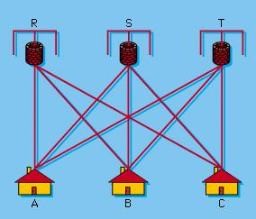





4. Discrete Continuous
Edmonds(1965) Perfect Matching Polytope PM(G):=
x∈IR^{E}, conv hull of perf. matchings:
x≥0 , x(δ(v)) = 1,
x(δ(U)) ≥ 1 U⊆V, |U|odd
matching : a set of
vertex-disjoint edges.
$$1/2$$
$$1/2$$
$$1/2$$
$$1/2$$
$$1/2$$
Every vertex has 3 incident edges. König (1931) ⇒
δ(U) is the set of edges with 1 end in U⊆V
Theorem: G cubic, bipartite
G is 3-edge-colorable i.e
E(G) partitioned to 3 matchings.
Corollary : G cubic, bipartite ⇒
p.m. matching of weight at most
1/3 of the sum of the weights.
Is this true for non-bipartite graphs ?
Thm: G cubic
No bridge ⇒ 1/3 ∈ PM(G)

Slide 12
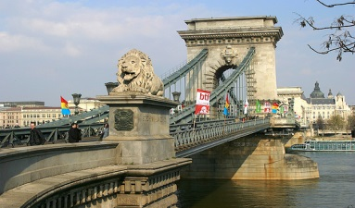
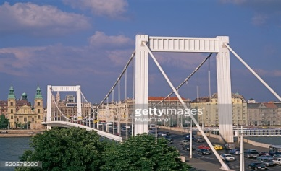
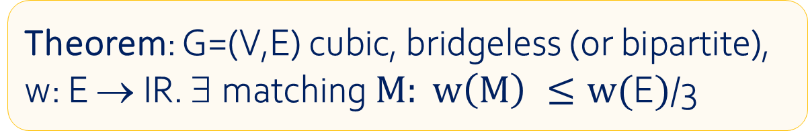
桥
Theorem: Petersen (1891) G is a cubic graph
G has no bridge ⇒ G has a perfect matching.
Bridges
布达佩斯
匈牙利
Bridgeless, cubic, but not partitionable into three matchings
G cubic, no bridge ⇒ 1/3 ∈ PM(G)
Theorem: $\text{G}\text{=(}\text{V}\text{,}\text{E}\text{) }\text{cubic}\text{,} \text{bridgeless}\text{ (}\text{o}\text{r} \text{bipartite}\text{),}$
$\text{w}\text{: }\text{E} → \text{IR}\text{.} ∃ \text{matching} M: w\left(M\right) ≤w(\text{E})$/3

Slide 13
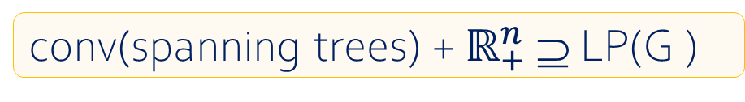
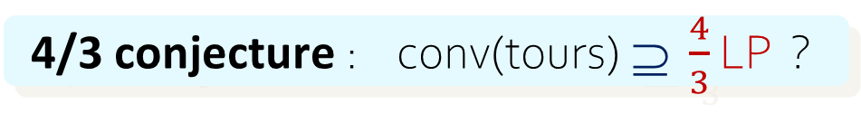
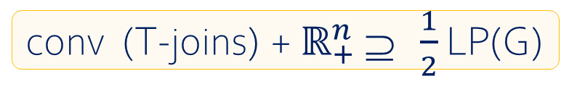
LP for the TSP But the convex hull of tours is hopeless
subtour elimination constraints
OPT := min tour
tour OPT_{LP}:=min { c^{T}x : x ∈ LP(G)}
LP(G) := {x∈IR₊^{E}: x(δ(W)) ≥ 2, for all ∅ ≠ W ⊂ V}
t
connectivity
Matroid intersection
Parity correction
Edmonds, Johnson (1973)
conv(spanning trees) + $ℝ_{+}^{n}$ ⊇ LP(G )
conv (T-joins) + $ℝ_{+}^{n}$ ⊇ $\frac{1}{2}$ LP(G)
+
Wolsey (1980) , Cunningham (1986) : conv(tours) ⊇ $\frac{3}{2}$ LP
=
⇒ OPT ≤ $\frac{3}{2}$ OPT_{LP}(w); 4/3 conjecture: ≤ $\frac{4}{3}$ OPT_{LP}(w) ?
4/3 conjecture : conv(tours) ⊇ $\frac{4}{3}$ LP ?
Isn’t this too much to ask ?

Slide 14
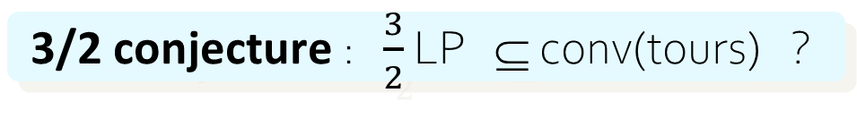
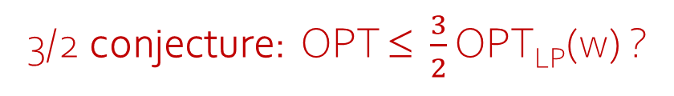
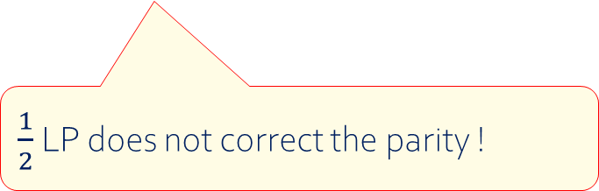
For the s,t -path TSP But the convex hull of tours is hopeless
LP(V,s,t)={x∈IR₊^{E}: x(δ(W)) ≥ 2, ∅ ≠ W⊂ V, s, t ∈ W or∉
1, if s,t separated by W
on vertices (1 for s, t, else 2 ).
s
s
s
t
t
$\frac{1}{2}$LP does not correct the parity !
3/2 conjecture: OPT ≤ $\frac{3}{2}$ OPT_{LP}(w) ?
3/2 conjecture : $\frac{3}{2}$ LP ⊆ conv(tours) ?
Isn’t this too much to ask ?

Slide 15



The gateway
Discrete Continuous
No, equivalent ! Goemans (1995), Carr, Vempala (2004)
Integrality ratio
Thm:For ρ (≥1)∈IR:OPT(w) ≤ ρOPT_{LP}(w) ∀w≥0 ⇔ conv (tours) ${+ ℝ}_{+}^{n}$ ⊇ ρLP
ρ LP
Proof: Farkas’ lemma
Q
LP
${+ ℝ}_{+}^{n}$
Lower bound coefficients
Lower bound
$\frac{4}{3}$
s
$\frac{3}{2}$
t
Lower bound for approximability: 1+ ε (Karpinsky, Lampis, Schmied, … ,2015)

Slide 16
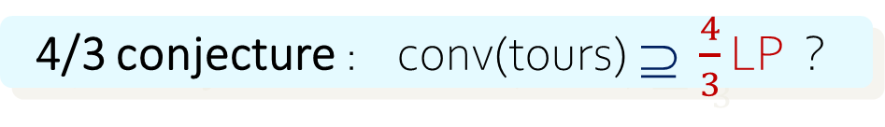


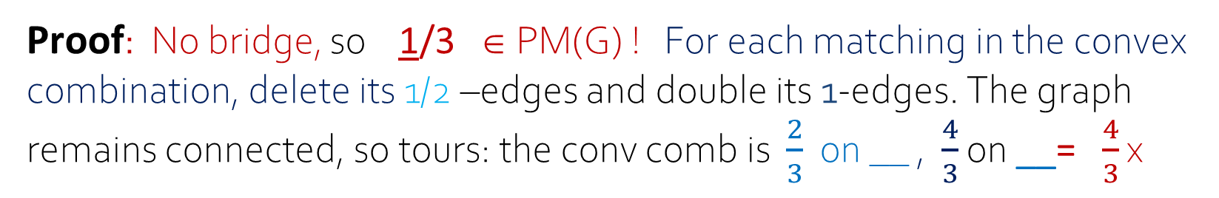
Example :
½ -edges
x:=
1-edges
G
Assume x ∈ LP
i.e. no bridge
$\frac{2}{3}$ = $\frac{4}{3}×\frac{1}{2}$
$\frac{4}{3}$ $$ 1
4/3 conjecture : conv(tours) ⊇ $\frac{4}{3}$ LP ?
If the ½-edges form partitioning triangles: conv(tours) ⊇ $\frac{4}{3}$ LP ?
Proof: No bridge, so 1/3 ∈ PM(G) ! For each matching in the convex combination, delete its 1/2 –edges and double its 1-edges. The graph remains connected, so tours: the conv comb is $\frac{2}{3}$ on __ , $\frac{4}{3}$ on __= $\frac{4}{3}$ x

Slide 17



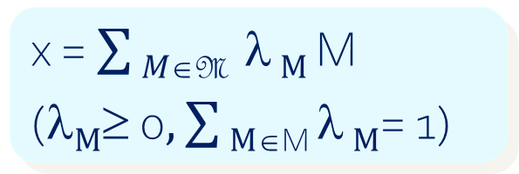
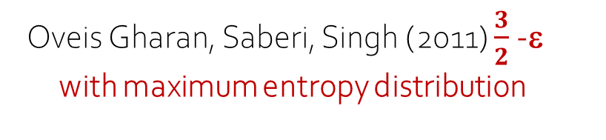


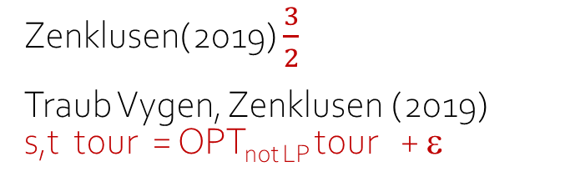

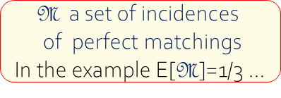

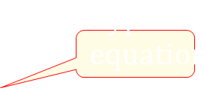
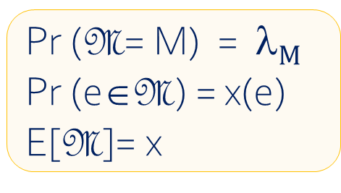


5. Deterministic Probabilistic
Pr ($\text{M}$= M) = λ$M$
Pr ($\text{e}\text{∈}\text{M}$) = x(e)
E[$\text{M}$]= x
x = $\sum{M∈\text{M}}$ λ $M \text{M}$
$\text{(}\text{λ}M≥\text{ 0}, \sum{M∈\text{M} \text{λ}}M\text{= 1}\text{) }$
$$\text{M} \text{a} \text{set} \text{of} \text{incidences}$$
$$\text{of} \text{perfect} \text{matchings}$$
In the example E[$\text{M}$]=1/3 …
$$\text{or} \text{T} \text{a} \text{set} \text{of} \text{tours}\text{,...}$$
Integrality ratios:
Max of $\text{−}\sum{F∈\text{F}}\text{λ} F\text{λ} F$log₂ $\text{} F$ on trees
Christofides, Serdyukov (1976) $\frac{3}{2}$
Oveis Gharan, Saberi, Singh (2011) $\frac{3}{2}$-ε with maximum entropy distribution
graph TSP
Sebő, Vygen (2014) $\frac{7}{5}$
Mömke Svensson (2012):Removable pairs
Hoogeveen (1991) $\frac{5}{3}$
Not LP
$$\text{path} \text{TSP}$$
$$graph TSP$$
An, Kleinberg, Shmoys (2011) $\frac{1+\sqrt{5}}{2}$
Sebő (2013) $\frac{8}{5}$ Sebő, van Zuylen (2019) OPT _{LP} $≤$ $\frac{3}{2}$+ε Traub (2020) + ε’
Zenklusen(2019) $\frac{3}{2}$
Traub Vygen, Zenklusen (2019) s,t tour = OPT_{not LP} tour + ε
Karlin, Klein, Oveis Gharan 2020-2023, $\frac{3}{2}$- ε with max entropy, in general
Deterministic (2023)
… with lower bound (2024) using Boyd, Sebő (2021)

Slide 18
Opening the frontier between
connectivity and parity connection
Simultaneous connectivity and parity correction made possible by matroid intersection in the best bounds:
- for the graph TSP
- for “fundamental vertices”
- for general path TSP/LP
Parity correction
Matroid intersection: Max weight of common elements of two particular hypergraphs, solved in polynomial time by Edmonds (1979)
connectivity

Slide 19
P₆
P₃
P₅
The longer the ears, the
smaller the quotient
G 2-edge-connected ⇒ G = P₀ +P₁ + P₂ + … + P_{k}
P₇
P₄
P₈
R
P₉
P₁
Probabilities through Mömke and Svensson’s ingenious Lemma (2016) combined with the ear-decomposition, + matroid intersection, Frank’s joins,
G₀:= G - R
P₂
P₀
Lemma : (Whitney, Cheriyan, Sebő, Szigeti, Vygen, 1932-2012) If G is 2-connected, then there exists a nice open ear-decomposition, i.e.
- 1-ears last, 2-ears, 3-ears « before the last »
- no edges between their inner vertices,
- min number of even ears
…
Best integrality and approx ratio for the graph TSP :
Thm: Sebő, Vygen (2014): Tour in polytime of cardinality ≤ 7/5 OPT_{LP}

Slide 20
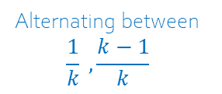
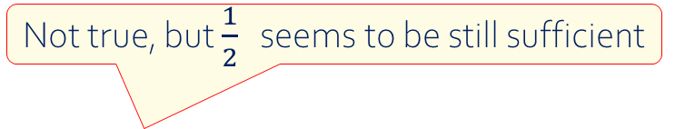
Recent trials multiple methods : Fundamental vertices, ½-vertices, uniform covers
Boyd, Sebő 2018-24
Alternating between $$\frac{1}{k} ,\frac{k−1}{k}$$
for k=2 : ½ -edges
1-edges
…
…
Carr-Vempala
fundamental vertex
Boyd-Carr square fundamental vertex
Generalized Prism
Conjectures open for n ≥ 9
The reduction
keeps ½ integrality
10/7 for ½ -integer vertices of subtour elimination (BS ‘21)
Not true, but $\frac{1}{2}$ seems to be still sufficient
Uses delta-matroids (Bouchet), polyhedra, matroid intersection, elementary probabilities; ½ not kept
Conjecture: (Schalekamp, Williamson, van Zuylen 2014) Largest ratio $: \frac{1}{2}$ - integer

Slide 21
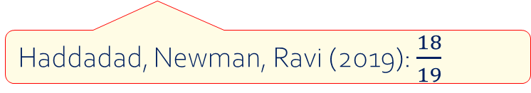
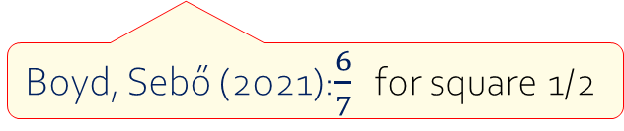
Uniform Covers by Tours
Remark (A. S. 2018) : G= (V,E) 3-edge conn. Then
1 ∈ conv ( x : x ∈ {0,1,2}E is the incidence vector of a tour}
G
1/2
+
=
1/2
Proof : 2/3 dominates a point of the spanning tree polytope
1/3 dominates a point the T –join polyhedron ∀ T.
E (tree F + parity correction for F, i.e. a T_{F}-join) ≤ 2/3 + 1/3
solved
unsolved
4/3 x 2/3 = 8/9
Conjecture (A. S. 2018) : G= (V,E) cubic,3-edge connected. Then 8/9
∈ conv ( x : x ∈ {0,1,2}^{E} is the incidence vector of a tour}
Haddadad, Newman, Ravi (2019): $\frac{18}{19}$
Boyd, Sebő (2021):$\frac{6}{7}$ for square 1/2

Slide 22
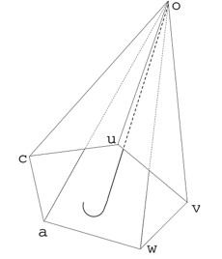
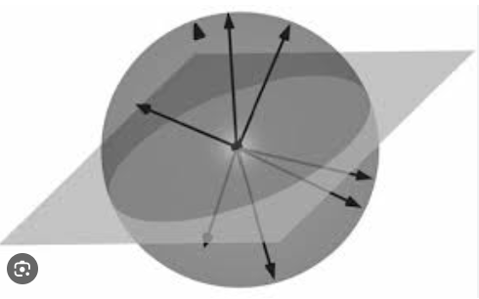
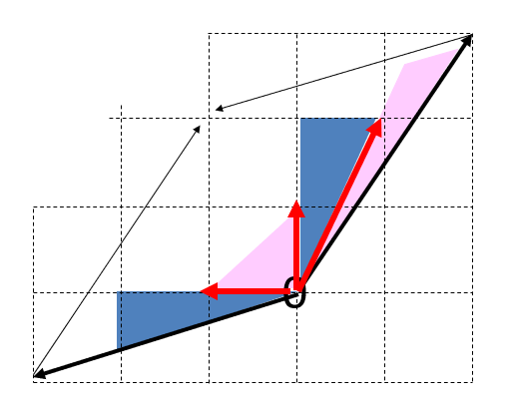
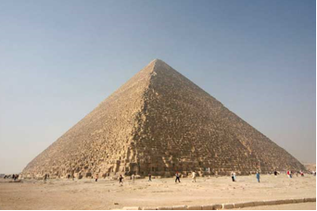
c
a
u
6. Combinatorial Geometric (Lovász 1979) Coloring Topology …
Geometric Combinatorial
7 Linear, Combinatorial Nonlinear: Semidef. programming (Goemans-Williamson,max cut,1995)
Entropy maximization
8. Combinatorial Number Theoretic: Hilbert bases, TDI, width 1990-2025
9. Elementary
w
v
Algebraic or Analytic: Polynomials, Gröbner bases, Nullstellensatz (colorings, graph factors), 1990-
10 . Unique focus Multifocus, Various tools simultaneously (eg above) eg Olver, Shepherd some forTSP, 2010-

Slide 23
We are
HAPPY ` END
but it is not yet the
Matroid intersection
Parity correction
connectivity
感谢您的关注
Thank you for your attention

