Slide 1


Slide 2
Making Security Decisions Like a Boss
Ron Parker
http://www.secretchipmunk.com
@scmunk
Notes:
Ron Parker
Work for a Fortune 250 Insurance Company
Security Solution Engineering
Changing the model or the approach is your prerogative.
This is a Roughly Right beginning.
V1.0 20220330 RLP First called version

Slide 3



A typical day in security
We had lunch with a thought-leading vendor, and they said we could replace everything with an AI-centric quantum blockchain-verified precognitive edge service. For less money than you are spending now!
Ethereum…
S.A.S.E…
SOAR
ZT
iSOC
Ransomware Prevention
UEBA…
XDR++
NFT…
Security Leadership
3
Notes:
I just love reading that. I actually hear this kind of stuff.
It always cheaper. Nevermind the army you have to hire.

Slide 4
Those questions and decisions pile up*
What technologies and implementations do we have for security?
Don’t we have something that will do that already?
We are covering the important stuff, right?
Is there anything we can DROP?
Which way should we grow or improve?
What happens when this services goes out of support?
How do I plan the work for next year?
I know we just moved to the cloud but I though we already implemented that security thing.
How does this fit with the long-term road map?
How does that new security product fit in?
How does all this relate to our security controls?
Is our organization organized correctly?
Where are we spending our money?
* This is a good example of a bad slide
Notes:
Then come the questions.
And who do you ask?
How did you answer last time?
Who is asking?

Slide 5

How do we make security decisions like a boss?
Notes:
Because no one WANTS to make bad decisions?
It would be nice if the answers led to better security.
The more you back up what you say the more people will listen to you.
YOU HAVE TO START SOMEWHERE

Slide 6
First, what makes a good decision?

Slide 7
Good decisions are:
Consistent – Your method can be depended upon
Traceable – You can show the factors the result is based upon
Valuable – Your answers are useful for your business and you
Transparent – The process is open
Deliberate – There is no guessing (ok, maybe some)
Notes:
Or good decisions sometimes are these things.
Or this really helps make a decision good.

Slide 8
Looking at typical security
Network Operations*
Application Security
Identity & Access Management
Security Compliance
Architecture & Engineering
Threat Intel & Research
Threat & Vulnerability
Security Program
Security Operations
Notes:
Let's look at SECURITY
Most of the time when we discuss security it is
is organized by people, HR-like, Mangers and such
Groups of people doing similar things
Look at a couple boxes

Slide 9
Each area does a lot
Threat & Vulnerability
Compliance
Vulnerability
Inventory
Patching
Configuration
Notes:
If you look inside one of those areas like T&V
There is a lot under T&V, more than listed here
Lots of activities

Slide 10
Behind each activity lies more
Threat & Vulnerability
Inventory
Tenable
CMDB
SCCM
That Cloud Thing
Notes:
And the more we dig the more there is.
Even taking something like INVENTORY
It is composed of multiple processes, techs etc.

Slide 11
How do we organize this a bit?
Notes:
Managers change
CISO change
The business regorgs all the time
How do WE talk about SECURITY and have it make sense?

Slide 12
A capability model for clarity
A Capability is the management of an ability
Capability
A Capability can be broken down into its parts
Service or Function
People, Process, Technology
Those parts are implemented
Notes:
Lets use a model, something to follow
Capability
Service
Implementations
Capabilities may vary between understandings
There can be different names for these items, levels,
Capability Levels, Services, Functions, Processes
We are just PICKING SOMETHING and sticking with it
Super important to not – WRAPPED AROUND the AXLE

Slide 13
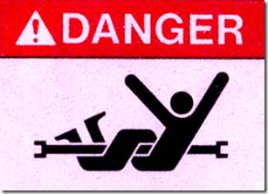
Notes:
You know what this means
Don’t get so close to the moving fiddly parts that you get all entangled
Lets don’t do that
Stay Simple
Stay SAFE

Slide 14
The model connects to reality
A Capability is the management of an ability
Capability
Threat & Vulnerability
T&V is an area that must be managed
A Capability can be broken down into its parts
Service or Function
Compliance Monitoring
Compliance is a service, and has many functions
People, Process, Technology
Tenable
A technology that implements compliance
Those parts are implemented
Notes:
So a CAPABILITY is something you can DO
A SERVICE or FUNCTION is more detail on that, SPECIFIC
Then you have to actually implement those great ideas
EXAMPLES
T&V IS-A CAPABILITY
T&V has to be managed
Compliance Monitoring is something that T&V does
Compliance could have many functions, lots of processes
Tenable is an actual thing that does Compliance Monitoring
So we have a T&V capability that covers Compliance Monitoring and Tenable is the implementation end of it

Slide 15
Another example
A Capability is the management of an ability
Capability
Identity& Access Management
IAM is an area that must be managed
A Capability can be broken down into its parts
Service or Function
Authentication
Authentication is a service, and has many functions
People, Process, Technology
Azure AD
A technology that implements Authentication
Those parts are implemented

Slide 16
More detail
A Capability is the management of an ability
Capability
Identity& Access Management
MFA
A Capability can be broken down into its parts
Service or Function
Authentication
Conditional
Device Reg
People, Process, Technology
Azure AD
Those parts are implemented
Notes:
We can be much more specific
Specific Functionality

Slide 17
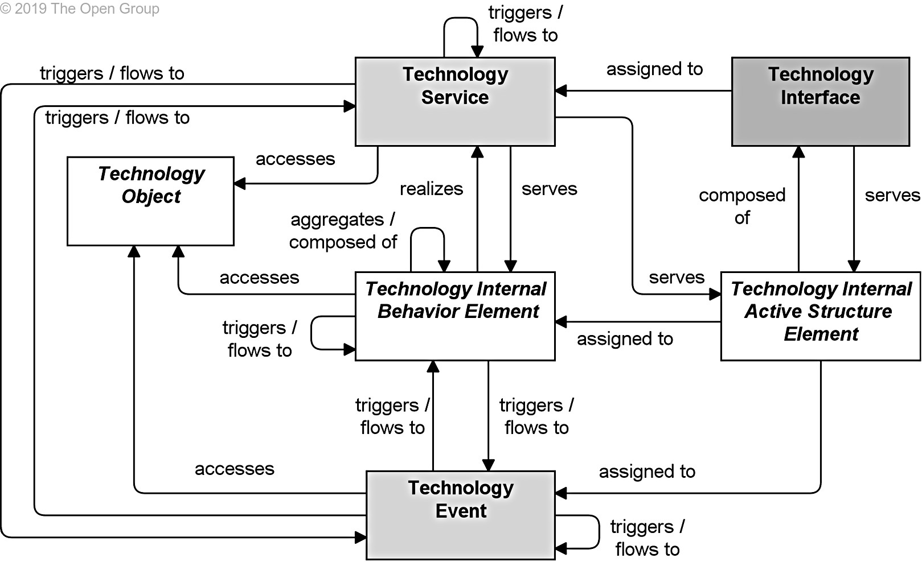
Geeky note
There is a logical SERVICE like “Compliance Monitoring”
There is also an implementation of that LOGICAL SERVICE that the industry also may call a SERVICE. We purchase services that are a service, and you can have cloud service providers.
Archimate is an example of a modeling language used to clear up these types of description
Notes:
You can use languages and tools to be really specific.
Archimate is a modeling language to help with this.
Archi is also a nice tool.
There are also complete architecture methods
SABSA
Zachman - very old and stodgy
TOGAF - is not what you think it is

Slide 18
Common InfoSec capabilities
Capability
Access Administration
Access Control
Boundary
Content Control
Cryptography
Detection
Governance
IAM Governance
Program
Threat and Vulnerability
Service or Function
People, Process, Technology
Notes:
What are some common InfoSec Capabilities?
Notice these are not technology specific
You may come up with your own names but whatever you do pick the labels and use them.
CAPABILITIES but right underneath them are

Slide 19
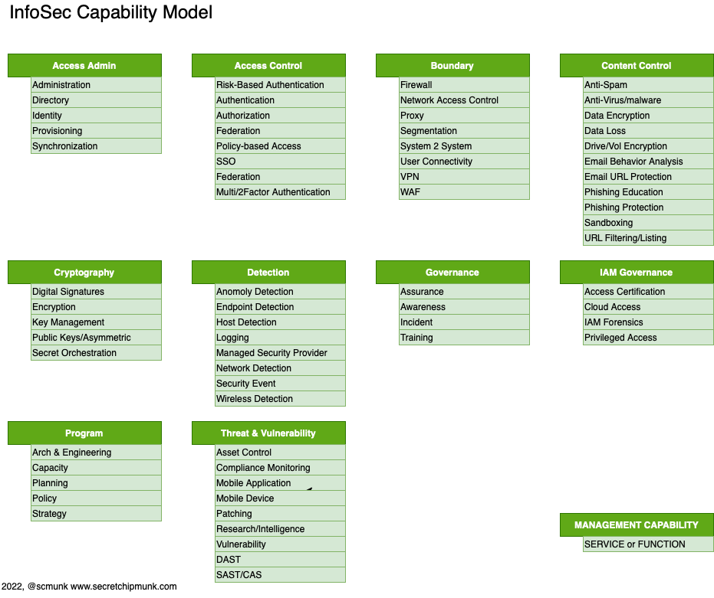
The Capability
The Service or Function
Capabilities and high-level services
Notes:
Some of these look like they overlap
They may.
You must make a call and put items into buckets.
As you get new ideas and functionality into the InfoSec world you will add more to this list.

Slide 20
Capability examples
This is a catalog of capabilities, not necessarily the capabilities you have.
Notes:
Remember this is really the catalog of capabilities, not yours
You may have all, some, or more than is shown.
You may break them down a lot more.
It depends on your audience and needs.
Your industry
The level of detail

Slide 21

Great to know but are we there yet?
Notes:
No

Slide 22
The approach
Inventory
Model
Matrix
Assess
Change
Notes:
I am almost sure you will not do these in order or all at one time
But notice the progression
Discovery - Model - Assess - Change
so

Slide 23
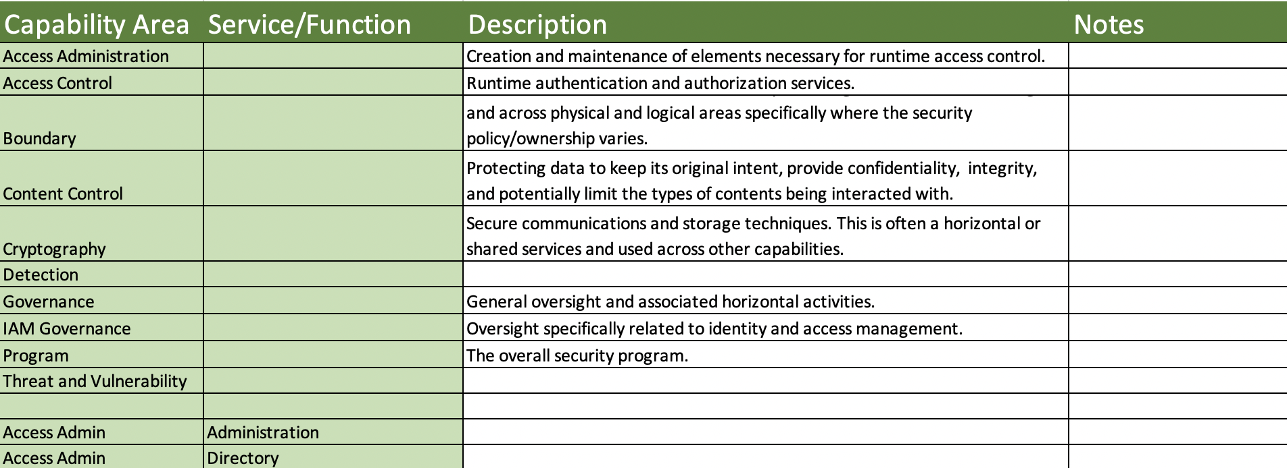
Making a list
Inventory
Make a list of your people/roles, processes, and technologies
Look for where you have implemented security
Group similar things together
Notes:
INVENTORY
Make a list
What are the managers managing?
What technology do you have?
What have your outsourced, or vendored out?
Group what looks to be similar
Look at the capabilities list in the matrix (modify it)
If the technology does several things or has several functions, note them - this will be common especially for new "tech" like SASE

Slide 24
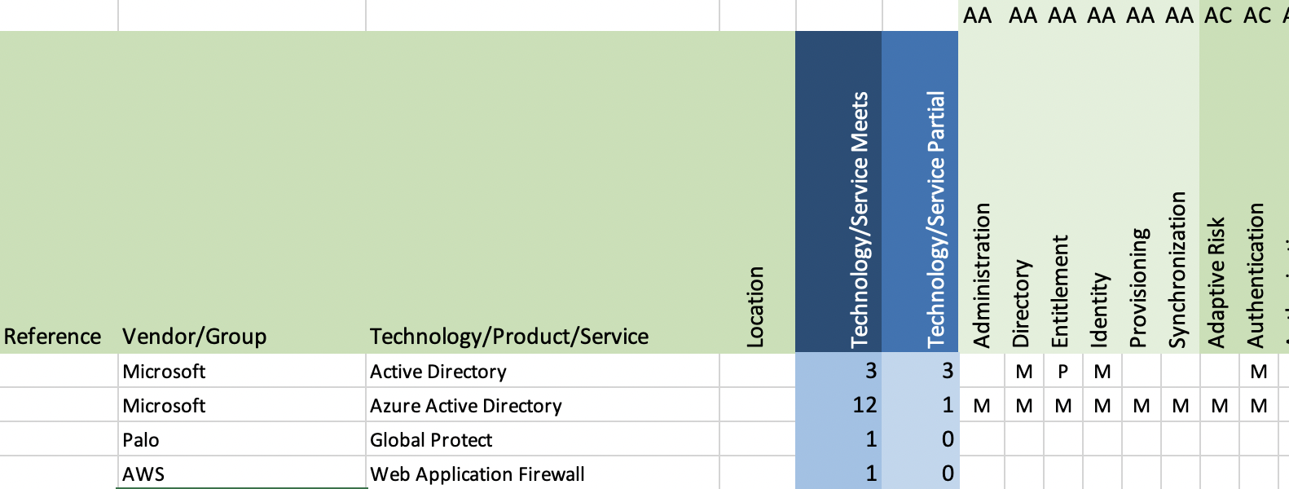
Model and Matrix
Model & Matrix
Compare you list to the capability model
Add your implementations to the Matrix
Technology to capability matrix
Notes:
Enter the items into the Matrix
You may also need other columns
Maybe division, country, identifier, yearly cost
If a technology has separate modules for different functionality enter those separately - multiple line items

Slide 25
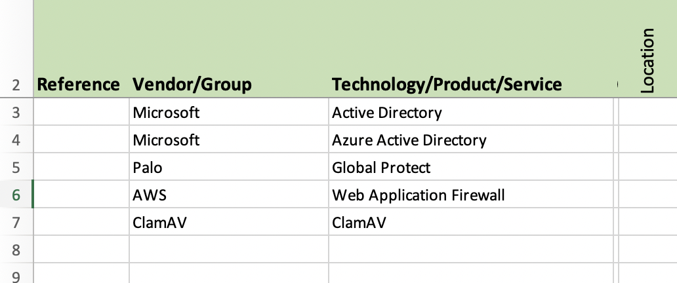
The implementation of security
Notes:
We are capturing how we do a capability, what does what ewe need to get done?
IMPLEMENTATION of security

Slide 26
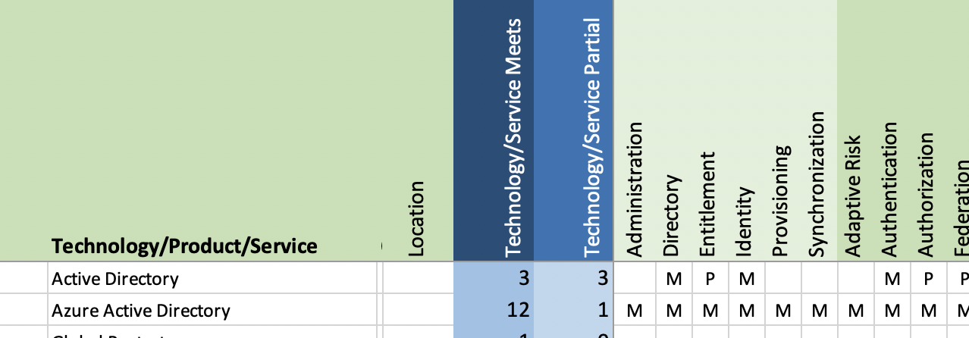
The number of Services/Functions that are implemented with this technology
The Service/Function being implemented
Notes:
The to the right we have all those Services/Functions listed
For each line item you want to indicate the FUNCTION that is performed by that IMPLEMETATION
Azure AD does a lot
Look across marking Meets or Partial
It is ok to guess because this is an estimation, big picture thing
Notice the number of FUNCTIONS per IMPLEMTATION

Slide 27
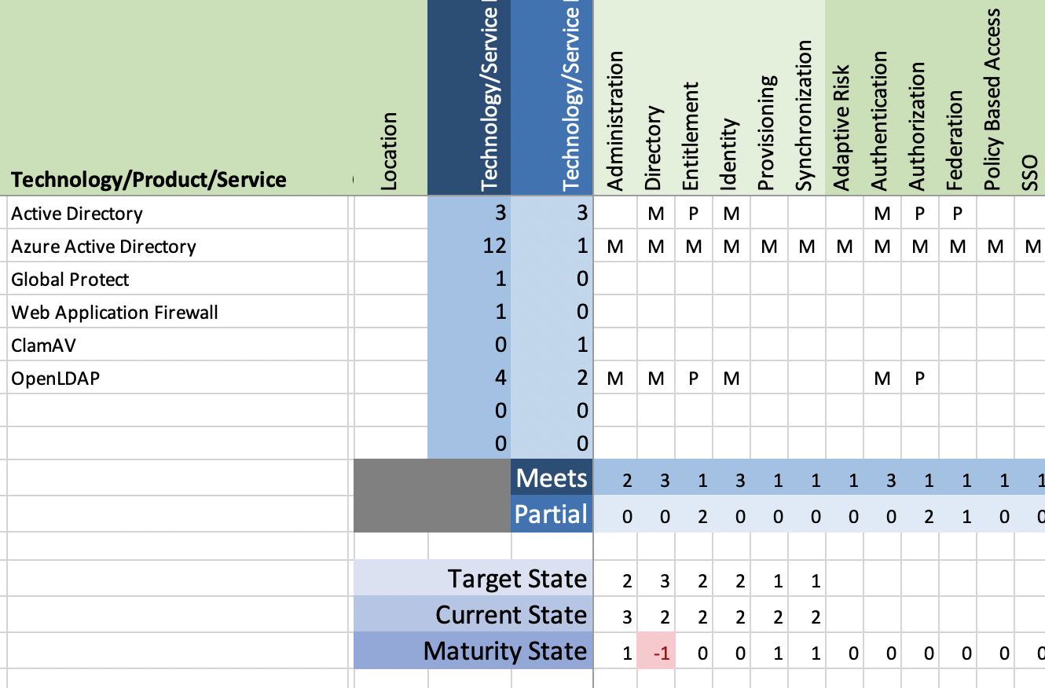

Notes:
Notice AD, OpenLDAP, and Azure AD can be a DIRECTORY
That is why there are 3 MEETS for the DIRECTORY function
This should raise a question - why? location, platofmr? COTS?

Slide 28
Maturity assessment using the matrix
Assess
By setting a target state and evaluating your current functionality you can get some idea of your general maturity.
You can’t necessarily judge the maturity of a capability by the number of technologies that meet a capability. There may be other circumstances that have to be considered.
Notes:
ASSESS
What about some maturity

Slide 29
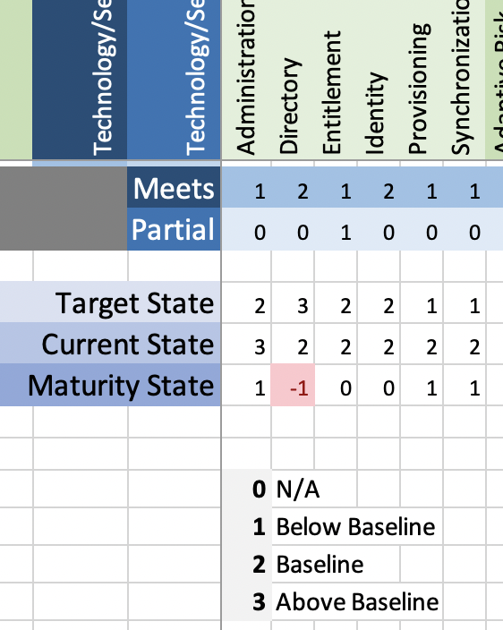
Assess
Notes:
This is a very simple scale
But it is the easiest to begin with
and it works

Slide 30
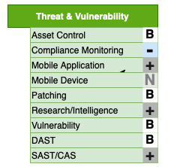
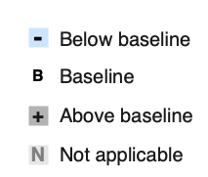
Visual assessment
Assess
Notes:
You dont just have to use a spreadsheet
Visually you can mark the capabilities you care about
You can mark the functionality that you have, don’t have and need
It would make for a good wall sized poster
But nothing stays the same

Slide 31
What about changes
Change
New Capability
New Services or Functions
Gap or Issue
New Service or Function
Implement or Purchase
Drop
Change in Service
Notes:
You want to Increase maturity
You have a new New threat and you are adding Zscaler
Change in your business whole new mobile platform to protect
Change in services, your outsourced provider just went belly up
No longer need fax machine protection
Comes down to a couple of choices
Once we have made our changes and updated all our artifacts we can...

Slide 32
Rinse and Repeat
Inventory
Model
Matrix
Assess
Change
Notes:
Yep
let it sit or work on it some more
Get more detailed
Add more FUNCTIONS

Slide 33
Visual Mapping
Notes:
A little more on visual mapping
To me this is actually the core or heart of the work
But it connects from front to back

Slide 34
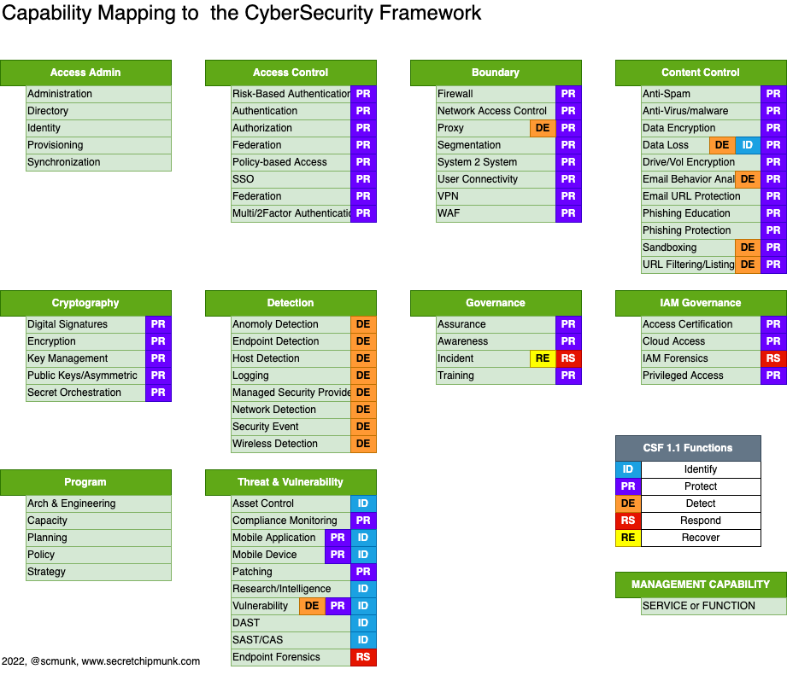
Notes:
You can map the FUNCTIONS to the CSF
You may not think much about the CSF
But we have a lot of large customers who understand it
It is a common understanding

Slide 35
Notes:
Once you do that you can even add the technologies to the labels and have a complete map of
The more specific the functions are the less overlap you will have
CAPABILITIES - FUNCTIONS - TECHNOLOGIES - CSF

Slide 36
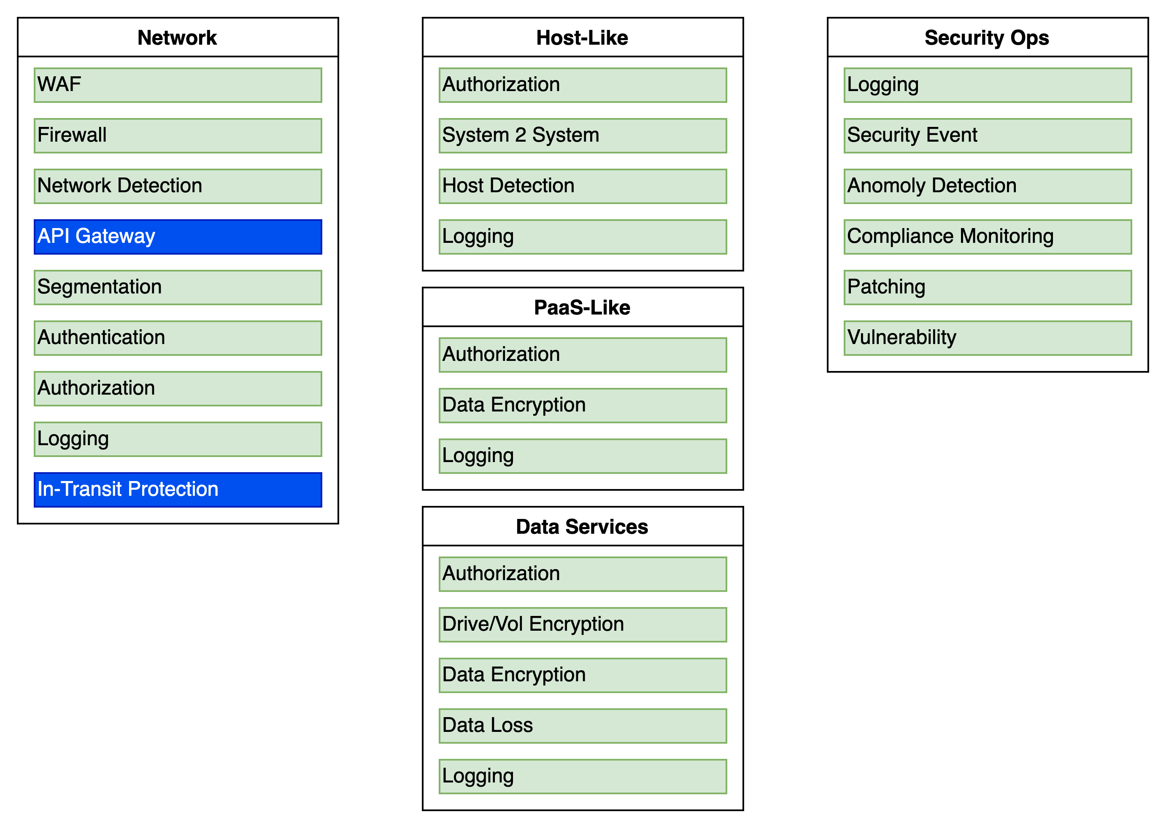
Cloud Capability Model
Notes:
You can also place the security FUNCTIONS
To show people where you expect security to be applied
You could even express these as controls
Typical cloud setup
Here is what you expect
Notice the two items in BLUE we don’t have FUNCTIONs for those in our model
Model needs updated to match what we need or know about

Slide 37
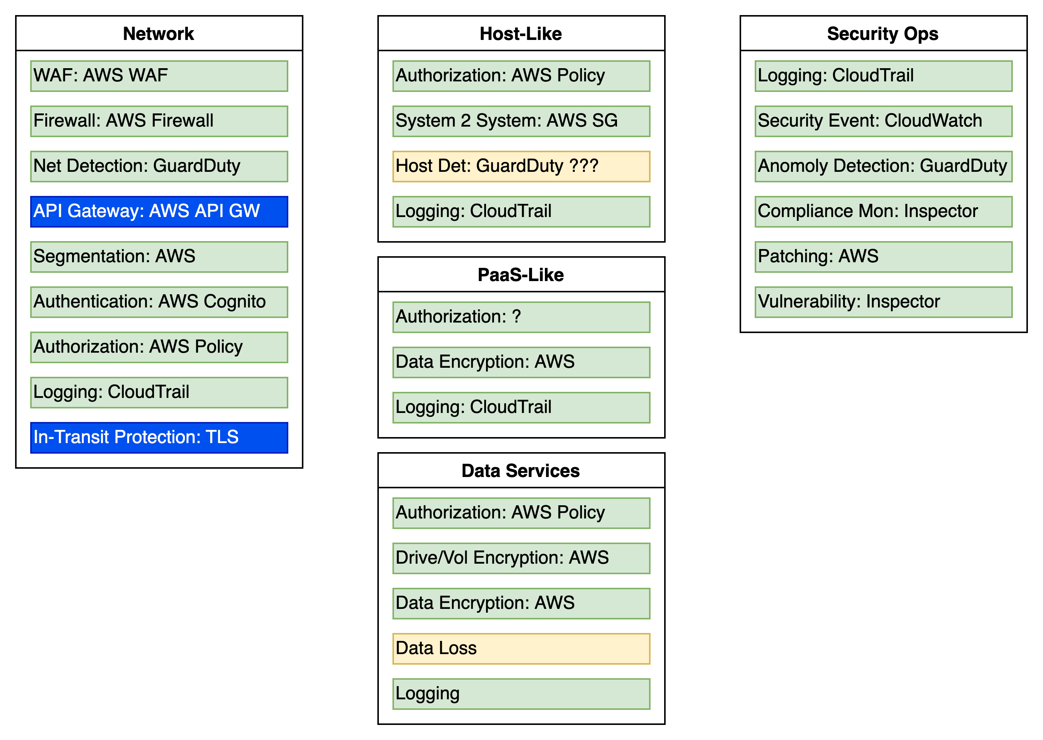
AWS Capability Model
Notes:
Place that is a simple AWS Context
We can see what technologies are being used where
Also are these on your MATRIX?
Also notice we don’t have a DLP solution yet although we should have one
And is Guard Duty good enough.?
The next level is to build out a Reference Architecture
When you add more lines and boxes
SO

Slide 38
Can we make decisions like a boss yet?
What technologies and implementations do we have for security?
You can now look at your Matrix for the specific area in question
Don’t we have something that will do that already?
You can see what you have that overlaps, you may also use addition data (columns) to see what makes them different such as platform or location
We are covering the important stuff, right?
You can ask them what they think is important. It should be in your model. Maybe you need a discussion on what is important.
Is there anything we can DROP, stop supporting, cancel the contract?
What happens when this services goes out of support?
See what specific areas of security will be affected and if you have multiple implementations for that coverage.

Slide 39
Making decisions - Continued
Which way should we grow or improve?
How does this fit with the long-term road map?
How do I plan the work for next year?
Look at your Matrix and diagrams you can see obvious gaps or places that you don’t have coverage that is needed. These discoveries should be turned into plans and projects.
I know we just moved to the cloud but I though we already implemented that security thing.
This may take more contextual diagrams or some extra columns in the Matrix to show what platforms apply but it can be answered.

Slide 40
Our security decisions should now be more:
Consistent – A reusable process
Traceable – You can follow you decision path
Valuable – Your answers are meaningful to you and not just guesses
Transparent – The process is open and documented
Deliberate – For the most part
Notes:
This is not an end all be all
This is just a foundation for you to use
Add more data points
Draw more diagrams
Change your diagrams to models

Slide 41
Making Security Decisions Like a Boss
Questions?
Ron Parker
https://github.com/scmunk/decisions
http://www.secretchipmunk.com
@scmunk
Notes:
Changing the model or the approach is your prerogative.
This is a Roughly Right beginning.
QUESTIONS?

Slide 42
REFERENCES
Making Decisions Like a Boss Artifacts
https://github.com/scmunk/decisions
Archimate
https://pubs.opengroup.org/architecture/archimate3-doc/chap01.html#_Toc10045266
Archi – a modeling tool
https://www.archimatetool.com
Draw.io – a diagramming tool, there is an offline version too
https://app.diagrams.net

