Slide 1


Slide 2
Making Security Decisions Like a Boss
Ron Parker
http://www.secretchipmunk.com
@scmunk
Notes:
Changing the model or the approach is your prerogative. This is a Roughly Right beginning.
V1.0 20220330 RLP First called version

Slide 3



A typical day in security
We had lunch with a thought-leading vendor, and they said we could replace everything with an AI-centric quantum blockchain-verified precognitive edge service. For less money than you are spending now!
Ethereum…
S.A.S.E…
SOAR
ZT
iSOC
Ransomware Prevention
UEBA…
XDR++
NFT…
Security Leadership
3

Slide 4
Those questions and decisions pile up*
What technologies and implementations do we have for security?
Don’t we have something that will do that already?
We are covering the important stuff, right?
Is there anything we can DROP?
Which way should we grow or improve?
What happens when this services goes out of support?
How do I plan the work for next year?
I know we just moved to the cloud but I though we already implemented that security thing.
How does this fit with the long-term road map?
How does that new security product fit in?
How does all this relate to our security controls?
Is our organization organized correctly?
Where are we spending our money?
* This is a good example of a bad slide

Slide 5

How do we make security decisions like a boss?

Slide 6
First, what makes a good decision?

Slide 7
Good decisions are:
Consistent – Your method can be depended upon
Traceable – You can show the factors the result is based upon
Valuable – Your answers are useful for your business and you
Transparent – The process is open
Deliberate – There is no guessing (ok, maybe some)

Slide 8
Looking at typical security
Network Operations*
Application Security
Identity & Access Management
Security Compliance
Architecture & Engineering
Threat Intel & Research
Threat & Vulnerability
Security Program
Security Operations
Notes:
Most of the time is is organized by people
Groups of people doing similar things

Slide 9
Each area does a lot
Threat & Vulnerability
Compliance
Vulnerability
Inventory
Patching
Configuration
Notes:
If you look inside one of those areas
Each area does a lot
Lots of activities

Slide 10
Behind each activity lies more
Threat & Vulnerability
Inventory
Tenable
CMDB
SCCM
That Cloud Thing

Slide 11
How do we organize this a bit?

Slide 12
A capability model for clarity
A Capability is the management of an ability
Capability
A Capability can be broken down into its parts
Service or Function
People, Process, Technology
Those parts are implemented
Notes:
This is just one approach, there are many model, pick one and follow it
Capabilities may vary between understandings

Slide 13
The model connects to reality
A Capability is the management of an ability
Capability
Threat & Vulnerability
T&V is an area that has to be managed
A Capability can be broken down into its parts
Service or Function
Compliance Monitoring
Compliance is a service, and has many functions
People, Process, Technology
Tenable
A technology that implements compliance
Those parts are implemented
Notes:
This is just one approach, there are many model, pick one and follow it
We reuse a lot of terms here – sorry –
There is a logical service and a service you go pay for

Slide 14
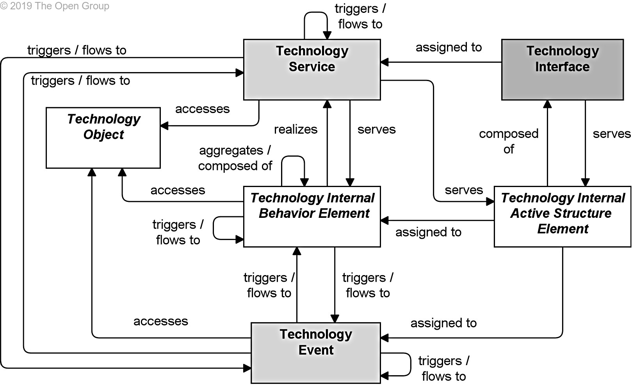
Geeky note
There is a logical SERVICE like “Compliance Monitoring”
There is also an implementation of that LOGICAL SERVICE that the industry also may call a SERVICE
Archimate is an example of a modeling language used to clear up these types of description

Slide 15
Common InfoSec capabilities
Access Administration
Access Control
Boundary
Content Control
Cryptography
Detection
Governance
IAM Governance
Program
Threat and Vulnerability
Notes:
Notice these are not technology specific
You may come up with your own names but whatever you do pick a layout and use it

Slide 16
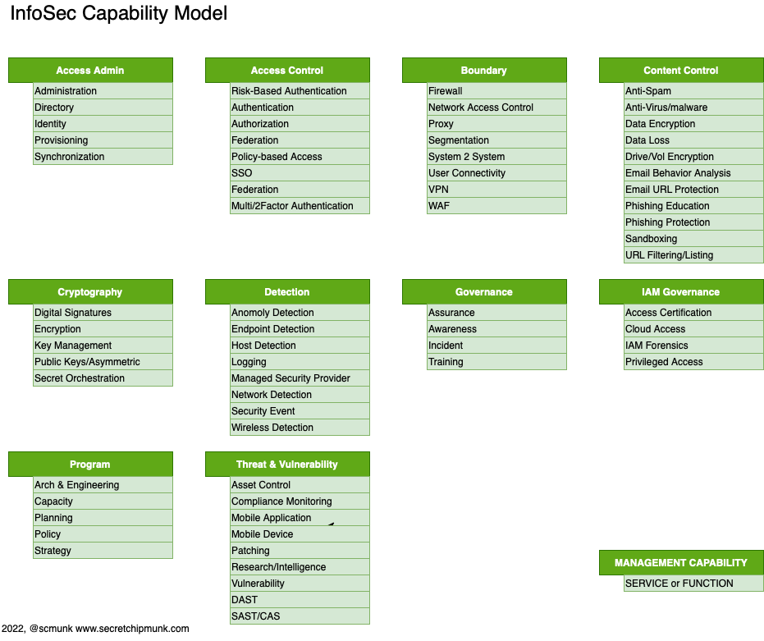
The Capability
The Service or Function
Capabilities and high-level services
Notes:
Some of these look like they overlap
They may

Slide 17
Capability examples
This is a catalog of capabilities, not necessarily the capabilities you have.
Notes:
Remember this is really the catalog of capabilities, not yours
You may have all, some, or more than is shown

Slide 18

Great to know but are we there yet?
Notes:
No

Slide 19
The approach
Inventory
Model
Matrix
Assess
Change

Slide 20
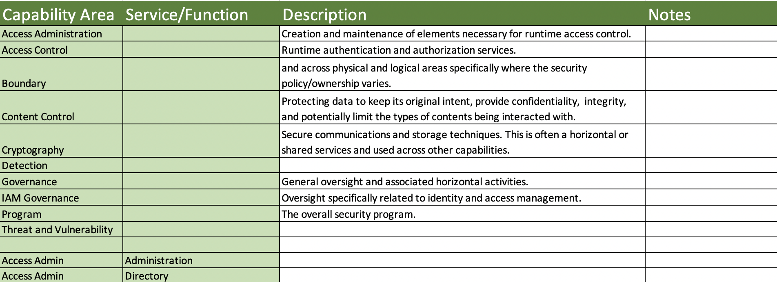
Making a list
Inventory
Make a list of your people/roles, processes, and technologies
Look for where you have implemented security
Group similar things together
Notes:
DEMO EXCEL
Make a list
If the technology does several things or has several functions, note them

Slide 21
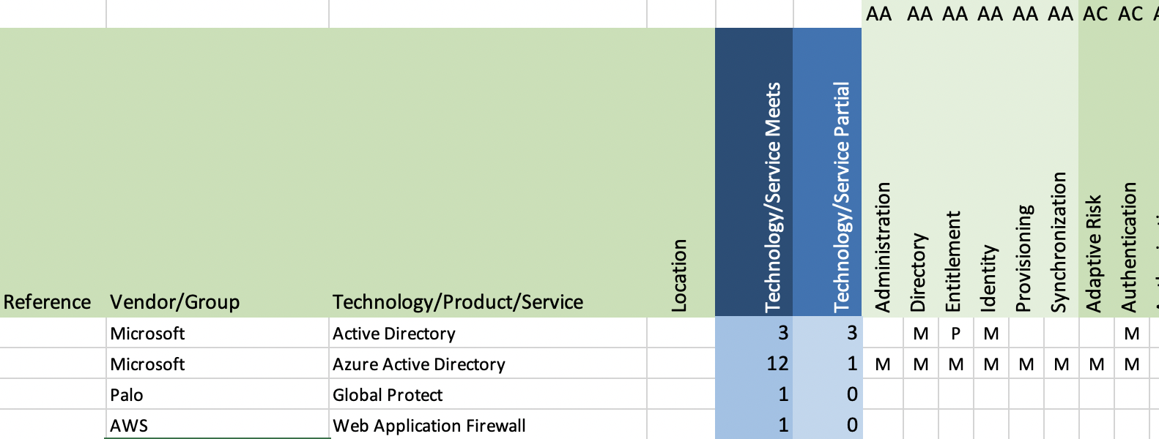
Model and Matrix
Model & Matrix
Compare you list to the capability model
Add your implementations to the Matrix
Technology to capability matrix
Notes:
DEMO EXCEL
Enter items
Items have multiples

Slide 22
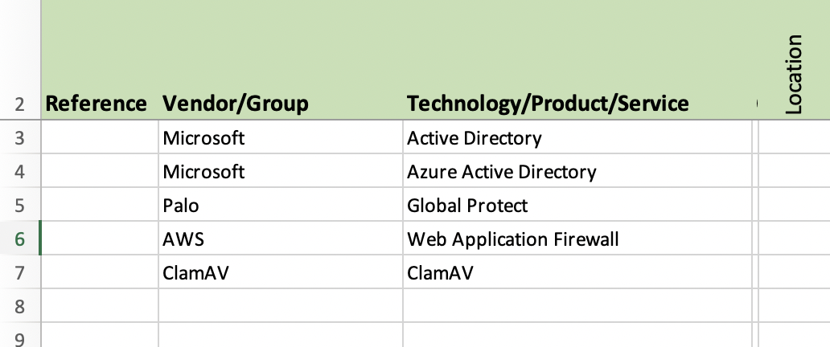
The implementation of security

Slide 23
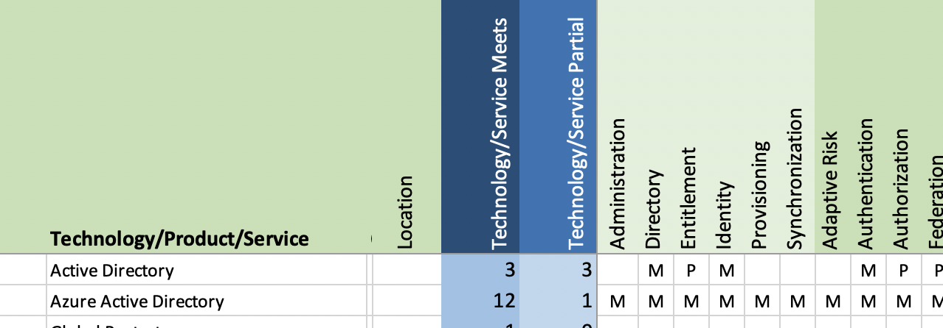
The number of Services/Functions that are implemented with this technology
The Service/Function being implemented

Slide 24
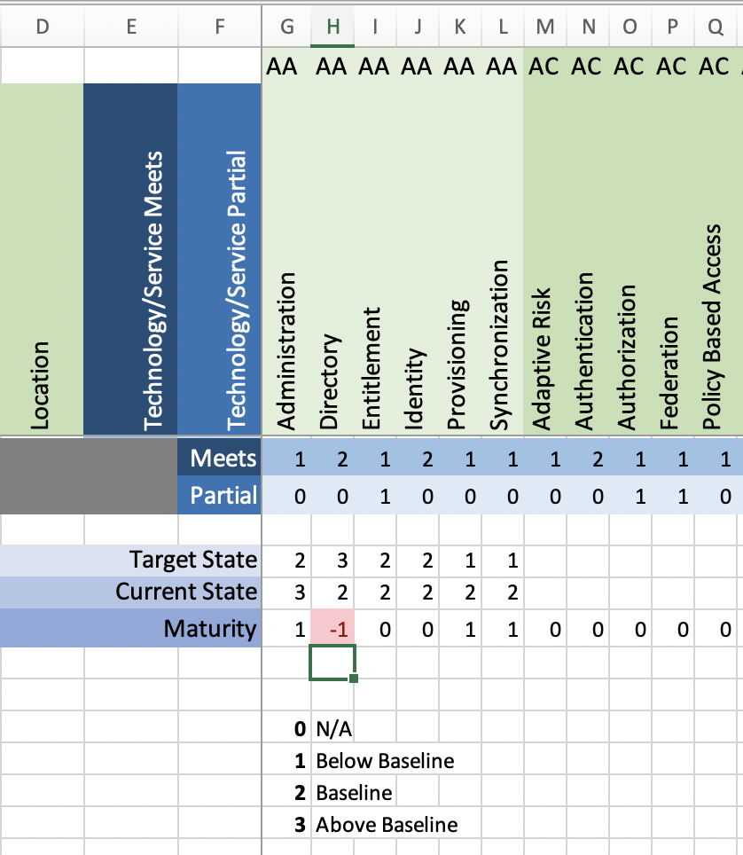
Maturity assessment using the matrix
Assess
By setting a target state and evaluating your current functionality you can get some idea of your general maturity.
You can’t necessarily judge the maturity of a capability by the number of technologies that meet a capability. There may be other circumstances that have to be considered.
Notes:
DEMO EXCEL

Slide 25
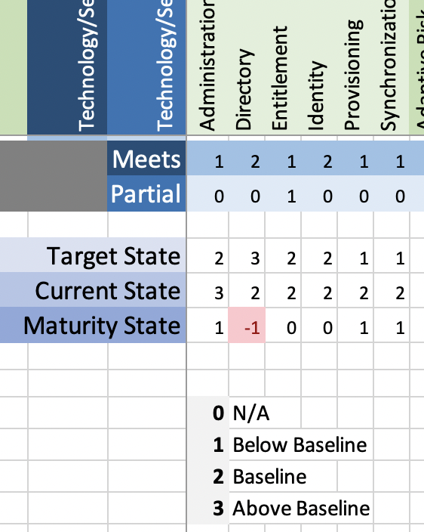
Assess

Slide 26
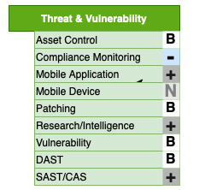
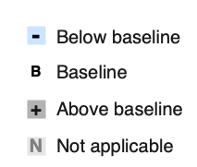
Visual assessment
Assess
Notes:
Visually you can mark the capabilities you care about
You can mark the functionality that you have, don’t have and need

Slide 27
What are changes
Change
New Capability
New Services or Functions
Gap or Issue
New Service or Function
Implement or Purchase
Drop
Change in Service
Notes:
Increase maturity
New threat
Change in your business
Change in services
No longer need fax machine protection

Slide 28
Rinse and Repeat
Inventory
Model
Matrix
Assess
Change

Slide 29
Visual Mapping

Slide 30
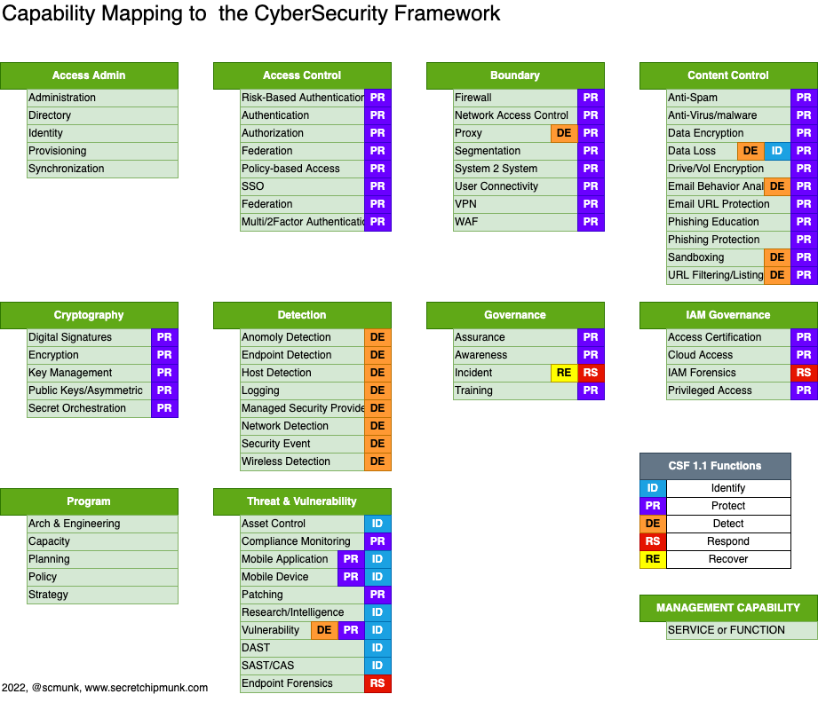

Slide 32
Can we make decisions like a boss yet?
What technologies and implementations do we have for security?
You can now look at your Matrix for the specific area in question
Don’t we have something that will do that already?
You can see what you have that overlaps, you may also use addition data (columns) to see what makes them different such as platform or location
We are covering the important stuff, right?
You can ask them what they think is important. It should be in your model. Maybe you need a discussion on what is important.
Is there anything we can DROP, stop supporting, cancel the contract?
What happens when this services goes out of support?
See what specific areas of security will be affected and if you have multiple implementations for that coverage.

Slide 33
Making decisions - Continued
Which way should we grow or improve?
How does this fit with the long-term road map?
How do I plan the work for next year?
Look at your Matrix and diagrams you can see obvious gaps or places that you don’t have coverage that is needed. These discoveries should be turned into plans and projects.
I know we just moved to the cloud but I though we already implemented that security thing.
This may take more contextual diagrams or some extra columns in the Matrix to show what platforms apply but it can be answered.

Slide 34
Our security decisions should now be more:
Consistent – A reusable process
Traceable – You can follow you decision path
Valuable – Your answers are meaningful to you and not just guesses
Transparent – The process is open and documented
Deliberate – For the most part
Notes:
This is not an end all be all
This is just a foundation for you to use
Add more data points
Draw more diagrams
Change your diagrams to models

Slide 35
Making Security Decisions Like a Boss
Questions?
Ron Parker
https://github.com/scmunk/decisions
http://www.secretchipmunk.com
@scmunk
Notes:
Changing the model or the approach is your prerogative. This is a Roughly Right beginning.

Slide 36
REFERENCES
Making Decisions Like a Boss Artifacts
https://github.com/scmunk/decisions
Archimate
https://pubs.opengroup.org/architecture/archimate3-doc/chap01.html#_Toc10045266
Archi – a modeling tool
https://www.archimatetool.com
Draw.io – a diagramming tool, there is an offline version too
https://app.diagrams.net

