Slide 1

Agile and Security.
Oil and Water?
Ron Parker | @scmunk
Notes:
My name is Ron Parker. I work for a Fortune 250ish Insurance Company. Been in Risk and Security for over 10 years with that being backed up by lots of development, IT Architecture and overall Security Architecture

Slide 2
Some things just don’t mix well.
Like Oil and Water.
Notes:
Skipped the long into on Salad Dressing issues
…
That is the problem with oil and water
they don’t mix naturally so you don’t get good results

Slide 3
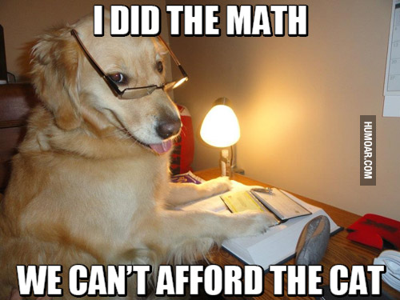
Notes:
All types of reasons they do not go together on their own

Slide 4
agile and security
Notes:
That is what most people think about agile and security too-They say they don’t mix
Truth be told most people don’t want to mix security and development
Or actually security with anything
Lets talk a minute about agile and security

Slide 5
Agile Overview
Agile Operating Model
Coordination Team
Attributes
Accountable
Self organizing
Move at their own pace
Use their own methods
Wait on as little as possible
Continuously improving
Quality as a goal
Delivery as a goal
Customer focused
Agile Teams
Support/Infrastructure
Other Experts
Security Expert
Polices
Training
Tools
Notes:
Agile is more than Scrum,Khanbhan,Lean,ScrumBan,SAFe, Less.works
Look at their similar attributes
No BDUF, not waterfall – know everything before you take the first step, “quick on their feet”

Slide 6
Security
High Level
CIA+AA
Privacy
Compliance
Brand
Task Areas
Identity management
Access management
Vulnerability management
Secure coding
Security testing
Configuration management
Disaster recovery
Third party integration
Mobile
Cloud
API security
Policy
Standard
Guideline
Notes:
There is a lot to security – much more than we see tweets about everyday
Do we have as many security people developer areas or business areas
Do we have coverage?
Can we move fast enough?
Do we have things to do outside of what the business sees (we are busy doing stuff, baseline security)

Slide 7
Security
High Level
CIA+AA
Privacy
Compliance
Brand
Task Areas
Identity management
Access management
Vulnerability management
Secure coding
Security testing
Configuration management
Disaster recovery
Third party integration
Mobile
Cloud
API security
Assurance
Believing and Knowing
Policy
Standard
Guideline
Notes:
Assurance is what we really want
The business is looking for Security Assurance-How does the business know they are secure?
We tend to be over technical when the business “just wants to know if it is ok”

Slide 8
Security needs to mix with the agile approach of the business.
Notes:
If the business is agile and performing using agile techniques
SECURITY NEEDS TO MIX WITH THIS AGILE APPROACH
So lets talk about mixing security and agile

Slide 9
Mixing security and agile
Security
Agile
Notes:
Big bubbles represent general work
Usually different people, different work

Slide 10
Apply effort
Notes:
The tasks we have can be broken down into little pieces on both sides
Security people can work to make this happen

Slide 11
More effort
Notes:
We tend to have an Incredible number of meetings
Security people have to be everywhere and understand everything, being ready at a moments notice
Takes a lot of work – continued effort

Slide 12
Stop and turn your back
Notes:
The minute you stop putting effort into it things just about go back to the way they were
Entropy takes over

Slide 13
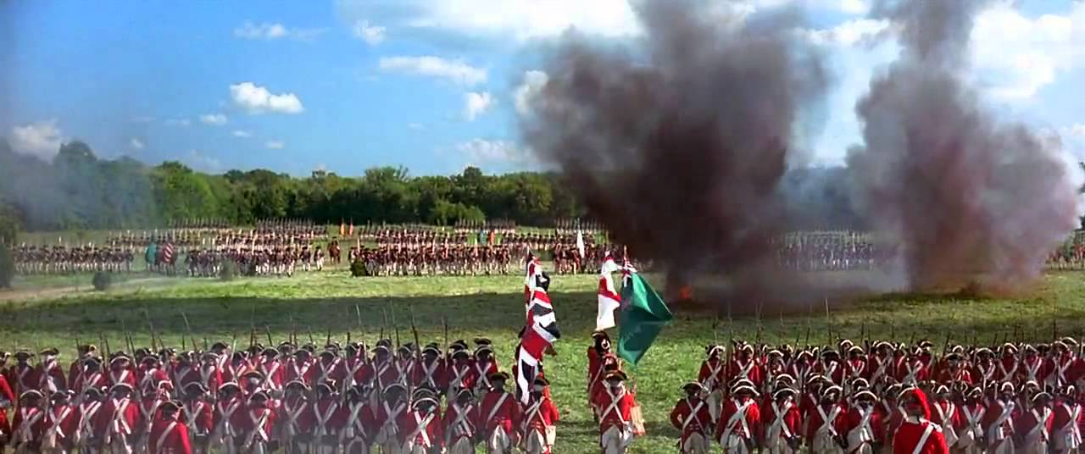

Slide 14
Security
Agile
Notes:
They just don’t mix well

Slide 15
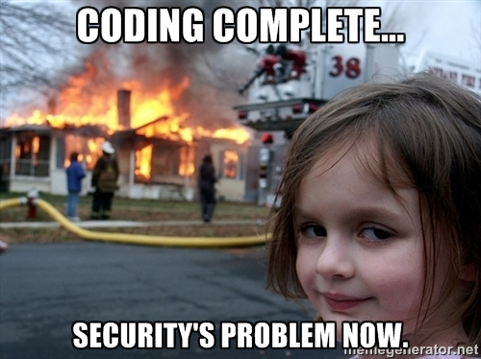
Notes:
No, really, all kidding aside
It takes effort to get anywhere and in the past we have put to much effort in to have it fail
They have not been mixing

Slide 16
Stuff that really happens
Too many meetings with security driving them
Development teams wait in frustration
Insecure code gets released into the wild
No positive or negative security testing
Data security issues
Data privacy issues
Simple things are missed like the OWASP Top 10
The same questions are repeatedly asked regarding security
Compliance issues – customers don’t like how you treat their data
The same questions are repeatedly asked regarding security
We the same bad things over and over
Security and agile – not a natural mix.

Slide 17
The problem
This knowledge
Knowledge Issues
That knowledge
Different knowledge
Not at hand (easy)
Slow Speed
Resource Speed
Fast Speed
Process speed
Timeliness
Governance
Mixed People
Me
You
Different goals
Different organizations
Numbers of people
Notes:
Different mindset (two things, separate) and different way of working​
People don't know what to do but we are looking for​

Slide 18
Why do we want the mix?
We have goals beyond
just doing development
and
just doing basic security.
We need secure development.
Notes:
BUT Enable people to do security no matter
Scale because there are never enough security people
ASSURANCE for security, for the business
WHAT WE NEED IS A.............

Slide 19

Notes:
Which is about like wanting a Rainbow Unicorn Butterfly Kitten

Slide 20
What would these goals be?
ENABLE with knowledge and process
SCALE security with enabled people
ASSURE with enablement and scale
Notes:
Necessary Knowledge and Necessary Process
You have to enable AND scale
Enable one developer when you have 1000 is not a Win-Win
You can’t get that assurance until you have people knowing and doing at scale
Scale is also a Lean Thinking poiint

Slide 21
√
emulsifier
Notes:
We Skipped a lot here in this condensed version
We need something to help mix the two together – just like oil and water in salad dressing
We need and Emulsifier
Definition: Emulsifier is something to link Oil and Water
Bring them together so they will mix and pretty much stay mixed
Emulsifiers work because they attract both oil and water
They do the work for you

Slide 22
Start again with an emulsifier
Emulsifier
Security
Agile
Notes:
With our new found knowledge lets add an emulsifier to the security mix

Slide 23
Mix
√
√
√
√
√
√
√
√
√
√
√
Notes:
I put some effort in to get things going and spread around

Slide 24
Science happens
√
√
√
√
√
√
√
√
√
√
√

Slide 25
Notes:
Security is distributed with a lot less effort

Slide 26
What can bring Security and Agile together?
Notes:
Business wants assurance
Teams want to move
Security wants to secure
BUT WHAT IS OUR EMULSIFIER?

Slide 27
Security Development Lifecycle
Security Emulsifier
Notes:
Not the old sdlc, not the ones your grandpa grew up with, Not gates, Not auditors up to eye balls
Not your government spawned mega document form system
It can be the Emulsifier for security

Slide 28
Wait, we have heard this before
re· hash
Verb
put (old ideas or material) into a new form without significant change or improvement.
"he contented himself with occasional articles in journals, rehashing his own work“ (not that any infosec analyst would do that)
Notes:
Lets talk about why this is not a rehash
This is a different method than the old way we used to do SDLCs

Slide 29
Solution
Security Development Lifecycle
Enable
Scale
Assure
Work themselves
Find it themselves
Know it themselves
At their pace
Knowledge driven
Process driven
Not Security People driven
Remember what is important
Check during and after
Framework for familiarity
Notes:
SDL will give us what we wanted, the mix, new goals
Enable and empowers those who need to do the work
Scale by using process, knowledge - not tribal knowledge, not 1:1 security
Scale with knowledge and process not meetings
Assurance – remembering is the number on issue

Slide 30
Normal Implementation
A
B
C
D
Work
Agile Teams
WAIT
Request
Tribal Security Knowledge
Security
Notes:
Traditional SDLCs are push models - OTHER PEOPLE with gates and security driven meetings
PUSH MODEL::Wrong people push, Ignorant of situation, Push wrong amount, Push at wrong time, Push wrong thing, Disrupt work
Different team, Waiting on security individual
Tribal knowledge over repeatable accessible
We will get back to you – push model
You as an end-user don’t control the flow

Slide 31
Agile Implementation
A
B
C
D
Work
Agile Teams
Pull
SDL Checklist
Security Item
Security Item
Security Item
Security Item
…
Security Info and Tool Repository
Security
Notes:
Microsoft SDL, There are others, Some are not agile, Some are heavy with governance, Some are just talk or paperwork
Pull models put users in control
SDLs can be good Checklists
Enable
Scale
Assure
Honestly, it is a CHECKLIST
When you are ready
Crafted for self service
Efficient
Continuous improvement
Crowdsourced
Queuing Theory actually proves this out, that using a pull model is more efficient
Difference today is that I am going to tell you how to make this real - and accessible (real implementation and a checklist to start this thing)

Slide 32
The SDL is our Security Emulsifier.
So how do we get one?
Notes:
That will help us mix what most people think cant be mixed
PAUSE

Slide 33

Timeout for Checklists
Not checklist management
Used in complex or high pressure situations
Doctors, astronauts, pilots - ScrumMasters
Acts as a reminder but also gives you sequence and may also give you alternate paths
Notes:
Known as the 4th crew member in the Apollo missions
It was said that the astronauts basically read their way to the moon with their checklists
Checklists lend to queues instead of straight assignments – push == assign, pull ==queue
So Checklists are good things when used by wise people for the right reason
Where do we GET OUR CHECKLIST?

Slide 34
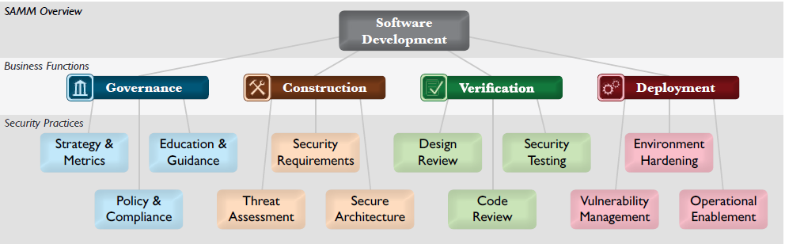
OpenSAMM
Open Software Assurance Maturity Model
Four major functions
Each function has three practices
Each practice has multiple activities
Assess the organization’s maturity
Build a security program
Define and measure security activities
Built in metrics and measures
Notes:
Where do we get this good checklist?
OWASP
Sections
Maturity Model
Levels
direction
Some organizational
Some directly SDL related
Security Assurance
Section Overview

Slide 35
SAMM Functions
Notes:
Type of work – not necessarily when you do it

Slide 36
SAMM Practice
Notes:
Practices are the high level things we think about like SR and SA

Slide 37
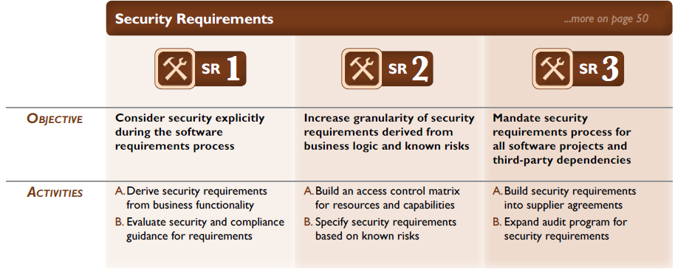
Each Practice has Maturity Levels
Notes:
The OpenSAMM helps you start at the bottom and work your way up
Also gives you a way to measure your maturity and set goals or a target where you want to be (if you have no clue)
Notice there are multiple activities

Slide 38
Activity – SR 1 A
Notes:
This is the checklist item – what you are supposed to do
The OpenSAMM gives you a starting place - more detailed than most others and built for the org not just the development

Slide 39
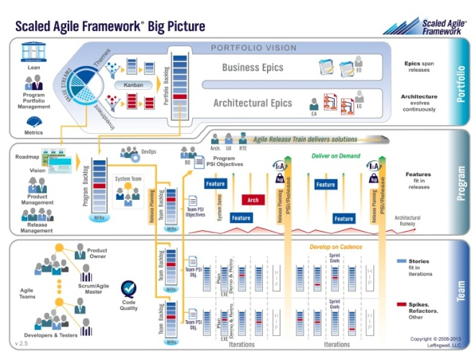
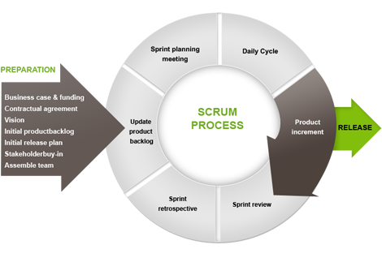
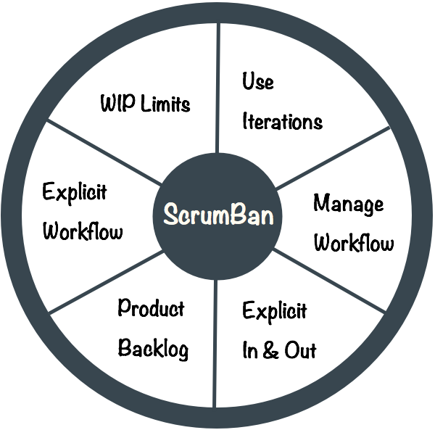
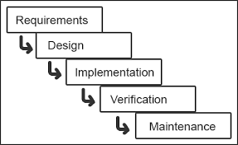
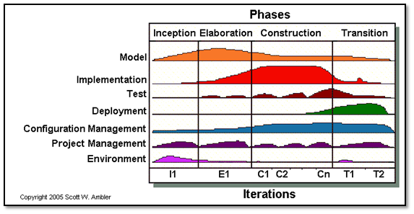
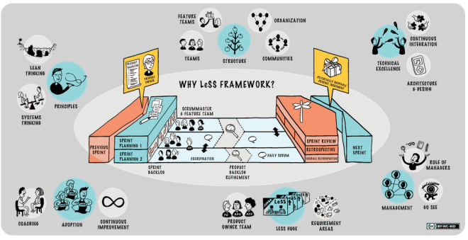
Methodologies may vary
Notes:
Problem with methodologies is that everyones got one
So we need to make sure what we (security) do fits anywhere
We dont want to change each time there is a new methodology
So that is why we need some generic phases
The OpenSAMM is not phased, it is set up for types of work - good for some
Not good for SDLC specific work

Slide 40
Phases
Inception
Iteration
Release
At the beginning before creation begins – usually once per project
One or more times
Something is produced, may be production or even pre-production
External
Outside iterations or releases – maybe in parallel
Notes:
We categorize those checklist items into these phases
In order to be generic across methodologies because it is generic enough
Each phase has multiple activities that may or may not apply

Slide 41
Activities
Inception
Iteration
Release
Training
Vuln management
Security contacts
Risk assessment
NFR for security
Attacker profile
Security stories
Static code analysis
Security architecture
Document deployment
Document DR
Penetration testing
External
Vendor assessment
3rd-party service creation
Notes:
Should be tailored to meet your company’s needs, take each requirement(activity) put it in a phase
Baseline security, regulatory, compliance
Not all activities apply to all projects
Need to include all areas of the security umbrella – huge issue with other SDLs
Access Control and IAM is just as important as secure coding
DR may be important for your company

Slide 42
Atypical SDL Activities
Many lifecycles are just concerned with the core security testing/coding. Real security is much larger than that.
Role engineering
Access Control requests
Access Control models
Integration of application level security
Privacy requirements
Customer requirements
Disaster Recovery design and documentation
Security Poker
Security Stories
Security Retrospective
Security Spikes
Notes:
Most SDL’s or SDLC’s fail miserably here – this is the differentiator for us for this SDL
They don’t have the atypical actions needed to fulfill security
Nor were they all designed to be agile
Security is a large umbrella – more than just secure coding

Slide 43

Notes:
How do we hold all of this together?
We need a guide or a ranger to help pull all the SDL items for the team
Probably not the Post-Apocalyptic Ranger Rick but we do need someone to herd these activities

Slide 44

Security Owner
Is a single person with a role
The contact for security concerns
The SDL subject matter expert for the team
Keeper of the List
Is accountable for security activities and artifacts
Notes:
This really helps scale security
So each team should have one of these people
Too many cooks spoil the soup, ITIL Says – One throat to choke; one hand to shake
Is accountable for activities but may not be responsible for completing them

Slide 45
Wiki – You Got What I Need
You Need
Wiki’s Got
Flexible but smart pages
Knowledgebase
Easy access and update
Searchable
Expandable repository
Crowdsourcing driven
As many pages as you need
Document as you go
Easy formatting
History/version for each page
Categories and tags
Easy relationship linking
Notes:
You need more than a Security Owner – they need resources
Many different wikis with different features
You are really looking for a Knowledgebase
Repository for guidelines, standards, policies

Slide 46
The Real Implementation List
Involve stakeholders (developers, product owners, compliance)
Read OpenSAMM materials
Determine your current assurance maturity level
Determine your target level
Determine actions needed to reach your target
Work with your audit/controls department on what they may need
Assign an owner for each action
Build your basic Wiki with your primary actions
Build a list of current tools
Build a list of current standards and guidelines
Begin a list of missing tools, standards and guidelines
Use the Wiki to house knowledgebase items
Educate your Security Owners (initial ones)
Educate your general population
Run a pilot project where a security member is embedded on the team
Use feedback from pilot to streamline actions
Metric, track number of projects using the SDL
Assess through feedback whether the actions are necessary and correct
Add new actions that move you towards your assurance target
Rinse and repeat
Notes:
We have blown through several steps but a more realistic view would be this
Notice all the buy-in and other group involvement

Slide 47
Goals for Agile and Security
ENABLE with knowledge and process
SCALE security with enabled people
ASSURE with enablement and scale
Security Development Lifecycle
Notes:
SDL is the Security Emulsifier - Salad dressing fix

Slide 48

Agile and Security.
Oil and Water?
Thanks!
Ron Parker
@scmunk
http://www.secretchipmunk.com

