Slide 1
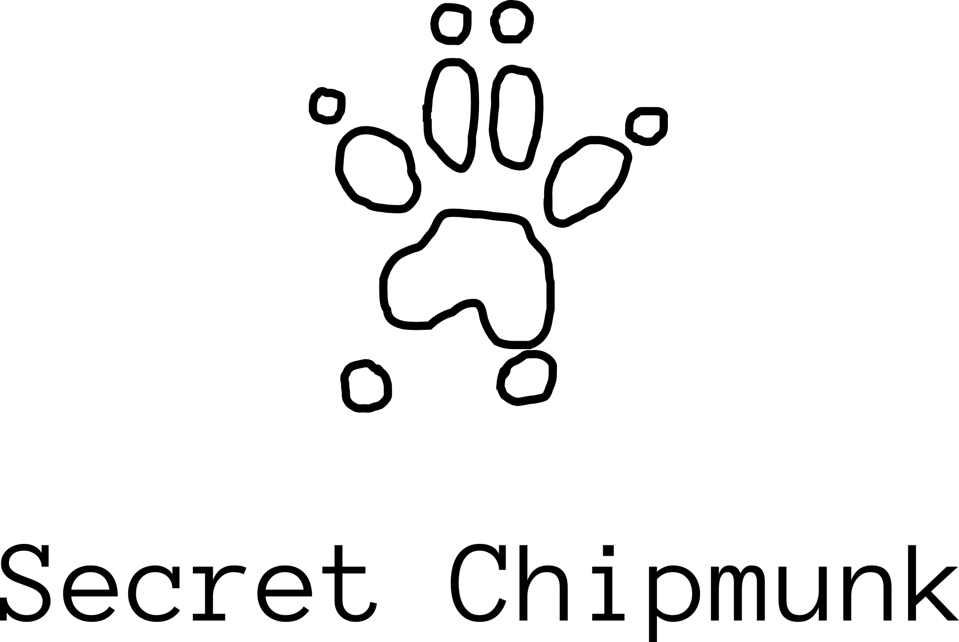
Entitlements
In a Multi-Tenancy World
Ron Parker | @scmunk

Slide 2
But what does that even mean?
We are in a super-shared, and super-scaled world where rights are no longer concentrated in one place.
Your rights and permissions are living everywhere in the neighborhood.
They have left home.

Slide 3
The World of Access
Administration
Runtime
Notes:
Administration and Runtime
Access Control is the end goal
A lot of these are cycles
Provisioning, deprovisioning
Entitlements start at the beginning

Slide 4
Entitlements
Do you have permission to do something
Can you be Authorized
Created, engineered
Granted and Provisioned
Set up on the resource
Maintained
Audited
Notes:
These can be all over because authorization happens all over
Entitlements Start with a business need
So they have to be created, engineered
There is a whole line of items

Slide 5
Entitlements are Everywhere
Authentication
IDs/Pwds, Policies, hard-coded entitlements, multi-factor
Authorization
Client
Client Types, Serverless Apps, Old Apps, FaaS
Service
Configurations, Unstructured Data, Structured, Queries
Database/Svc
ACLs, Local Groups, GPOs
Hosting
Identity Management, Virtualization, Containers, IaaS
Hardware
Networking
More ACLs, Network Security Groups (NSG)
Notes:
Entitelments have to be connected to the user of the entitlements
Entitlements have to be connected to the resources

Slide 6
Entitlements
This works well with simple groups of accounts and resources that are all related.
The problem comes in when you want to operate on groups of accounts or resources that are not really related nor have the same owner.
This takes us into Multi-Tenancy.
Notes:
Most companies in the old days just had accounts
The customer didn’t administer any of the system
The customer didn’t write queries, reports, or stand up more resources
How do you allow sub administrators

Slide 7
What is it really?
Haven’t we been doing this forever anyway?
Notes:
So lets go back to the beginning

Slide 8
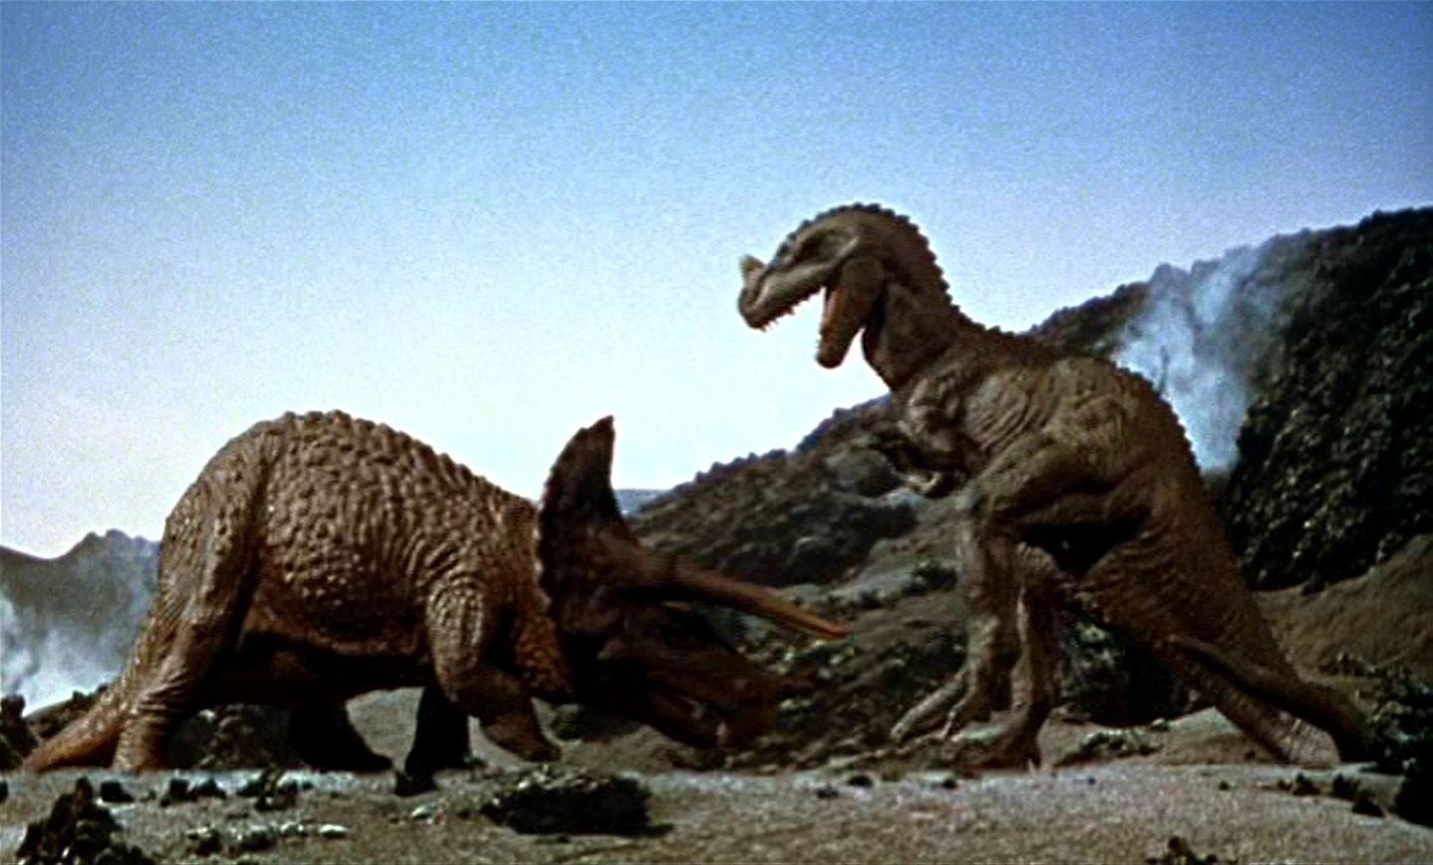
Notes:
Thanks to Ray Harryhausen

Slide 9
Multi-Tenancy
In the beginning we needed to serve multiple customers. We called these customer tenants. Each Tenant wanted to view or use the service as if it was their own.
Basic Multi-Instance
Notes:
Gave them hardware but quickly we realized this was expensive
Changes were hard because we had all those copies
Think about keeping the application and the database schema in synch

Slide 10
Multi-Tenancy
We figured out ways to make it cheaper. We began to share more of the underlying service resources.
Tenants were sharing resources.
True Multi-tenancy.
Scaling was still hard.
Basic Multi-Tenancy
Notes:
Share all that hardware, data, software
The database became a central part of the puzzle
Scaling was still hard

Slide 11
Multi-Tenancy
Eventually we even solved scaling.
Virtualized Multi-Tenancy
Notes:
We went through multiple iterations here
I am talking older virtualization, of at least two years ago

Slide 12
Multi-Tenancy
Then we moved to the cloud to let someone else take care of some of the issues.
Cloud Multi-Tenancy
Notes:
What are characteristics of a cloud

Slide 13
Multi-Tenancy
Because scaling was there and it was inexpensive we could even go back to using multiple instances.
Super Cloud Multi-Instance
Notes:
Scalability, Privacy, reduced Costs
Problem with this was maintenance, patching, schema and code updates, change management
Automation helps some

Slide 14
Multi-Tenancy and Entitlements
We still need authorizations. All those permissions and rights.
All that for all of our tenants.
What is different when you put these two things together?

Slide 15
Issues
Privacy
Data Leakage
Privilege Escalation
Varying customer or regulatory requirements
Privileged access management – groups of admins?
Maybe you can’t do Multi-tenancy for some parts of your data due to regulations

Slide 16
Examples

Slide 17
Active Directory/LDAP
First Big Surprise – Active Directory is not MT-ready
Admin entitlements and trusts are set up for a group of admins
You could make it work with separate account forests/domains and one-way trusts
OpenLDAP and others are about the same
So if you store all of you entitlements in LDAP you have to really think about the ramifications
Doing this yourself can be dangerous
This is a huge reason that we have MS Azure AD that is much more multi-tenant aware.
Notes:
AD is not Multi-tenant
That is why they invented Azure AD
What can you do?

Slide 18
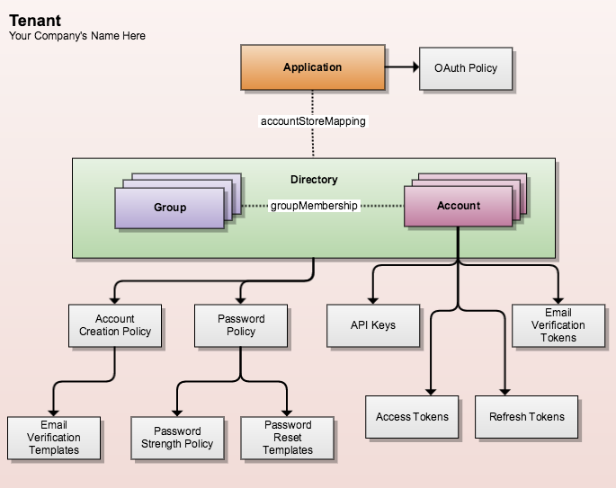
StormPath – Vendor Example
Cloud-ready service providing authentication, authorization, and account management
Application centric with Accounts, Attributes, Groups
REST Driven
http://www.stormpath.com
Security Model
User REST Response
{
"href": "https://api.stormpath.com/v1/accounts/3apenYvL0Z9v9spExAMpLe",
"username" : "jlpicard",
"email" : "capt@enterprise.com",
"givenName" : "Jean-Luc",
"surname" : "Picard",
"customData": {
"permissions": {
"crew_quarters": "&nbsp;9-3601",
"lock_override": "all",
"command_bridge": {
"type": "vessel:bridge",
"identifier": "NCC-1701-D",
"action": "lockout”
}}}}
Notes:
AD is not Multi-tenant
That is why they invented Azure AD
What can you do?

Slide 19
Databases
There multiple approaches
Database per tenant
Single database with multiple tables per tenant
A Tenant ID in a shared table
Sharding
Policy
Shared Table Query
SELECT acct.name, acct.sales
FROM acct.TID
WHERE acct.TID = &1
Problem is you have to remember to do this for every query, stored procedure, view, or any other database object.
Notes:
Problems with each solution
Maintenance issues are the worst, shared tables are the easiest to maintain and the hardest to secure
At one point I had to write queries like this
Now with MS SQL 2016

Slide 20
More Modern Databases - Sharding
Sharding – Separating data into logical, physical/geographical based on a key
Many databases will shard based on a key
You can implement tenancy if the key is based n the tenant.

Slide 21
Databases – Policy-based Tenancy
Some databases can use a policy to enforce tenancy
MS SQL 2016 and AWS Dynamo
You don’t have to remember to “fix” each object
Policy is system wide
PREDICATE Function for MS SQL
…WHERE
(DATABASE_PRINCIPAL_ID() = DATABASE_PRINCIPAL_ID('dbo') -- note, should not be dbo!
AND CAST(SESSION_CONTEXT(N'TenantId') AS int) = @TenantId)
OR (DATABASE_PRINCIPAL_ID() = DATABASE_PRINCIPAL_ID('superuser’))
Notes:
Problems with each solution
Maintenance issues are the worst, shared tables are the easiest to maintain and the hardest to secure
At one point I had to write queries like this
Now with MS SQL 2016

Slide 22
Reporting
Don’t forget any fixed reporting needs to take MT into account
It is much harder to control dynamic reporting
You want to look back at database level policies

Slide 23
Application Level
You have to authenticate then capture the tenant information in a secure manner
In a browser-based situation this mean you need a token or a session
A signed SAML token with a tenant assertion
Delegated authorization token with Oauth/JWT
Session cookies can be used but they are not ideal
Oauth can be helpful using a combination of the SCOPE and the actual caller ID
Authorization may be needed at the service boundary and later on inside the actual service
All these components have to be MT aware in order to keep your entitlements straight
Notes:
Make sure the tokens are signed

Slide 24
Backup and Recovery
What are the ramifications of backing up all the tenants data to one spot, one file, one virtual tape?
Do I have encryption or key issues?
Is my Disaster Recovery solution also multi-tenant ready?
Notes:
Make sure the tokens are signed

Slide 25
Summary
Using MT vs Providing – most don’t need to provide MT
Building a MT environment is
Dangerous
Expensive
Needs to be built from the beginning
MT is very hard out-of-the-box with older tools
Most cloud-based services are built with MT in mind
Maybe the customer doesn’t care but the service provider has to
If someone says there is no difference between cloud and non-cloud computing you can bring up Multi-Tenancy.
It is a lot more than a deployment model.

Slide 26

Entitlements
In a Multi-Tenancy World
Thanks!
Ron Parker
@scmunk
http://www.secretchipmunk.com

