Slide 1
Judge
By: Sean Nevin, Zackary Squires, Maalik Howard, Quinnten Fritz

Slide 2
Concept
Judge is an application that attempts to blend social media as well as a game. The basic idea is that users will create groups in which they are able to exchange pictures to have another user pick their favorite one. That user known as the “Judge” will tell users within a group a topic to take a photo of. The users should then upload or capture a picture that best applies to that topic. Once all users submit their photos, the judge picks their favorite one. The user that wins gets a point and the game randomly cycles the role of judge to another user. The process repeats as long as the users are interested.

Slide 3

Login Page
This is the First page
User can Create or Login
Error Messages:
If user tries to log in with wrong account it gives error
If user tries to login with existing account it does nothing
To create account…
Fill out Username
Fill out Password
Click the create account button
Username
Password
Create
Login

Slide 4

Group Page
Where the user can access their current games
User is able to reach the Pages that get to the contact list, ability to invite the players, and change the users password.
Group Name
Group Name
Group Name
Group Name
Group Name
Group Name
Group Name
Group Name

Slide 5
Contact List
This page allows the user to create a group of users that will also participate in the game
User must have clicked the contacts page button on previous “Groups Page”
The user is able to add other users that play the game by clicking the add user button and typing in the username.
Add Contact
Username
Username
Input
Username
Username
Okay
Cancel
Username
Username
Username
Username

Slide 6
Settings Page
Changing Password
User types in a new password in textbox
Clicks the change password button
Warning appears to inform the user that their password has been changed
Change Password
Input
Okay
Cancel

Slide 7
Contacts Invitation Page
Click this to make a new group
Displays contacts page where user can select the individuals they want included.
They then click the add button
After this they are able to create a group name and the game begins
Invite Friends
Username
Username
Username
Username
Username
Username
Username
Username

Slide 8
Game Page
This takes the user to the actual game functionality.
User can see all participants in the group and their scores.
They are able to submit a photo at this page.
Viewing page at bottom displays all the submissions of the users
Topic
Username
5
Username
7
Username
5
Username
3
Username
9
Viewing Page

Slide 9


Viewing Page
Here the user is able to view everyone's submission. Submissions are anonymous.
Judge’s view is much different
Not only can they view submissions they can click one they like and submit
Game gives person a point and randomly cycles the judge position to a new user
Topic
Topic
Submissions
Submissions
Submit

Slide 10
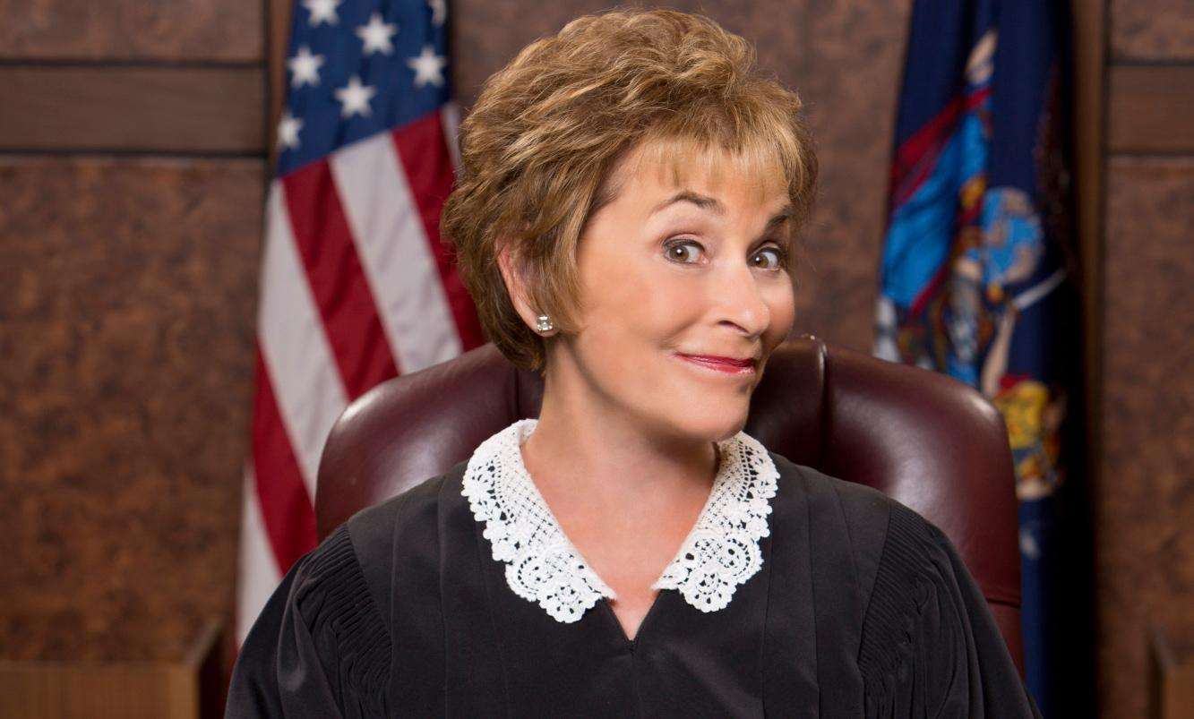
Judge
Any Questions?

