Slide 1
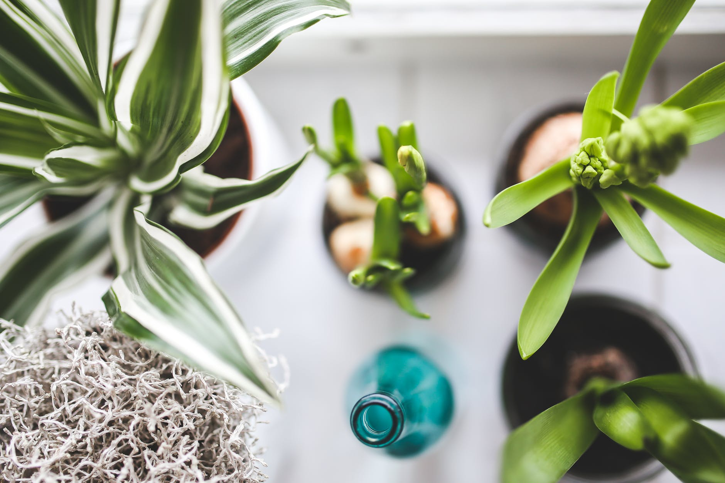
THE FUTURE OF
SMART GARDENING
STARTS HERE.

Slide 2
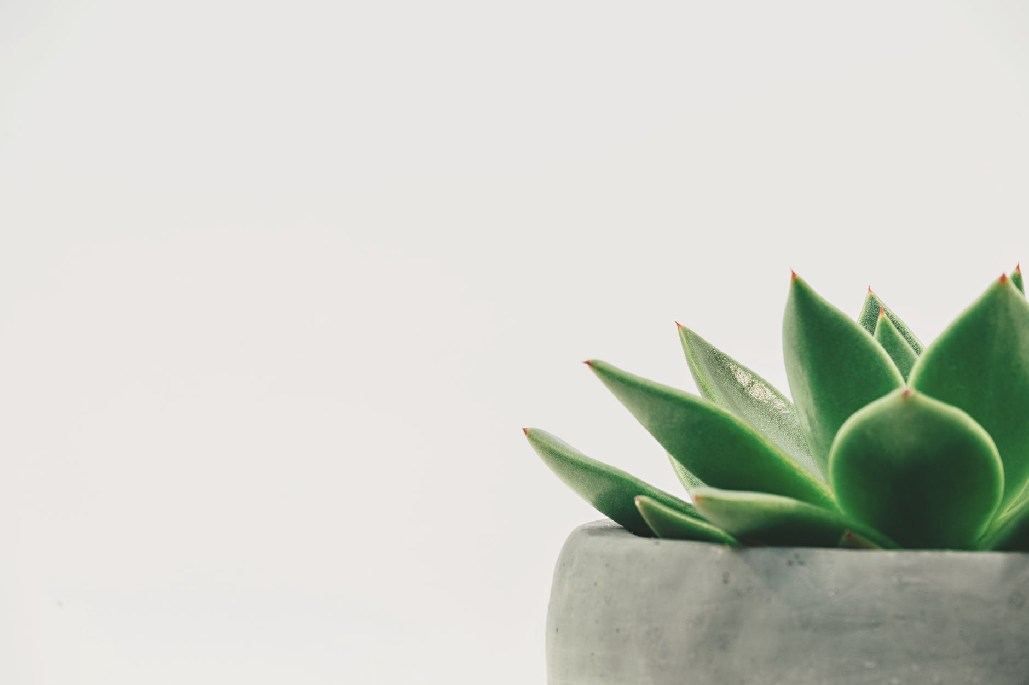
Smart eco system - client pitch
Prepared By TEAM DDNS
Dorota marczak, nader sobhi, Declan bell and scott allan
23.10.2018

Slide 3
PROJECT OVERVIEW

Slide 4
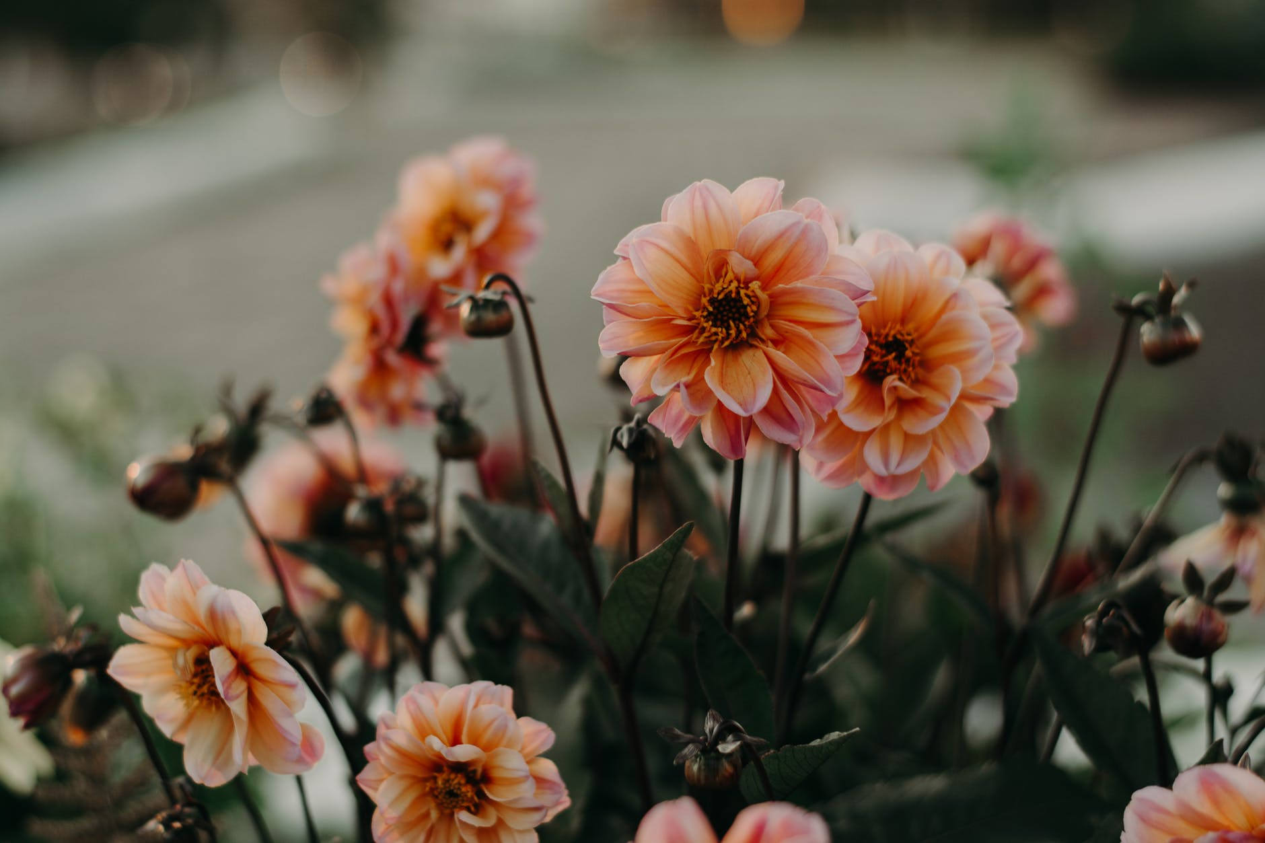
PRODUCT BRIEF
Develop an affordable smart plant Monitoring & Maintenance System
Improve gardening skills with the application providing
precise data regarding the plant growth.
Optimise plant growth using detailed statistics
collected through cutting-edge technology

Slide 5
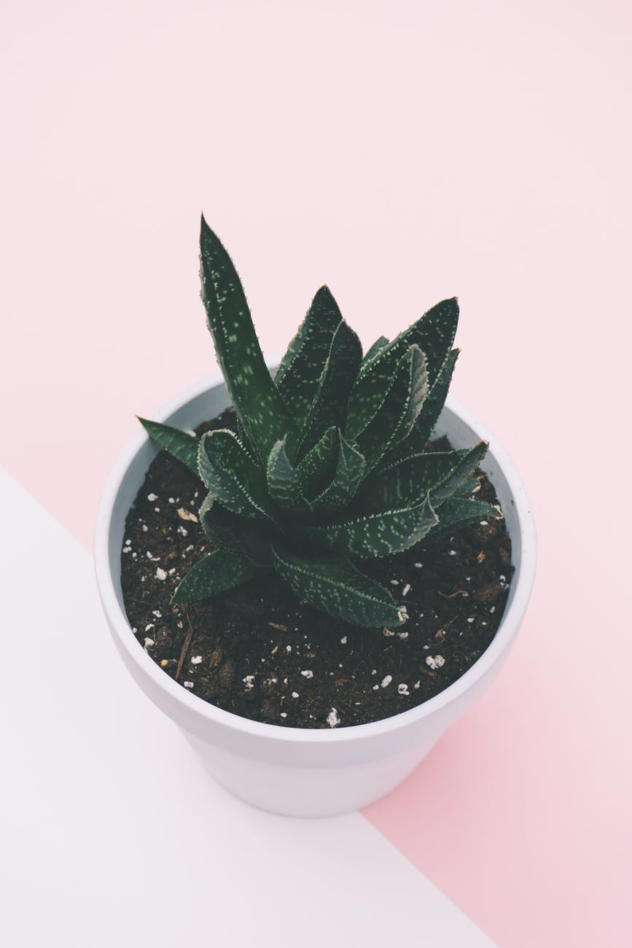
MAIN POINTS TO CONSIDER
Hardware needed
Software needed
Plant needed
Time needed
Power source
Data Storage regulations

Slide 6
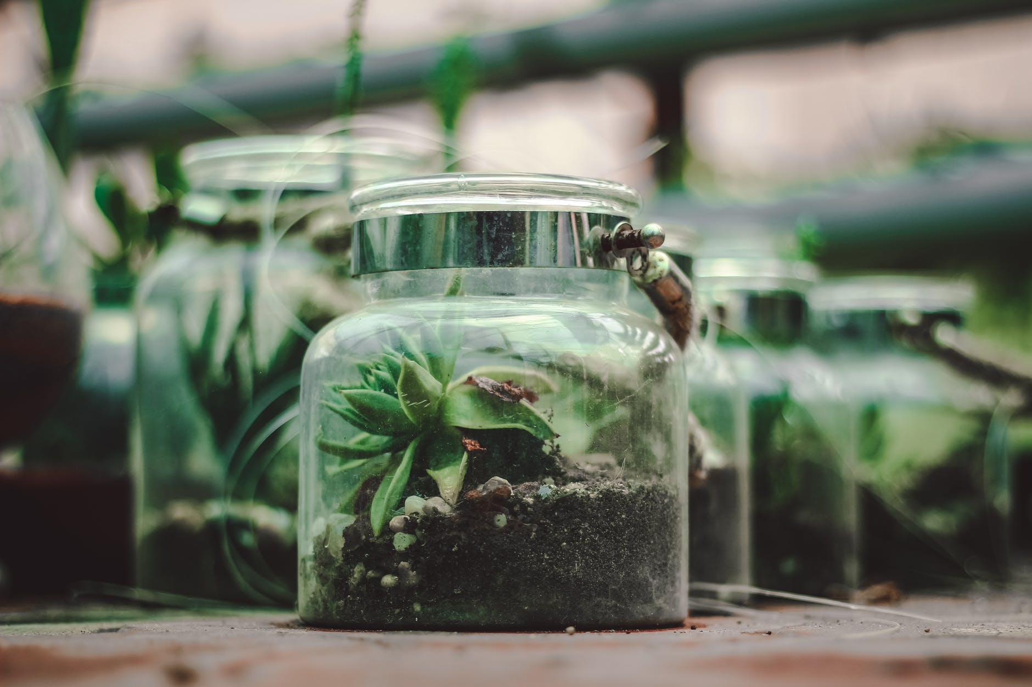

Slide 7
PROJECT PLAN

Slide 8
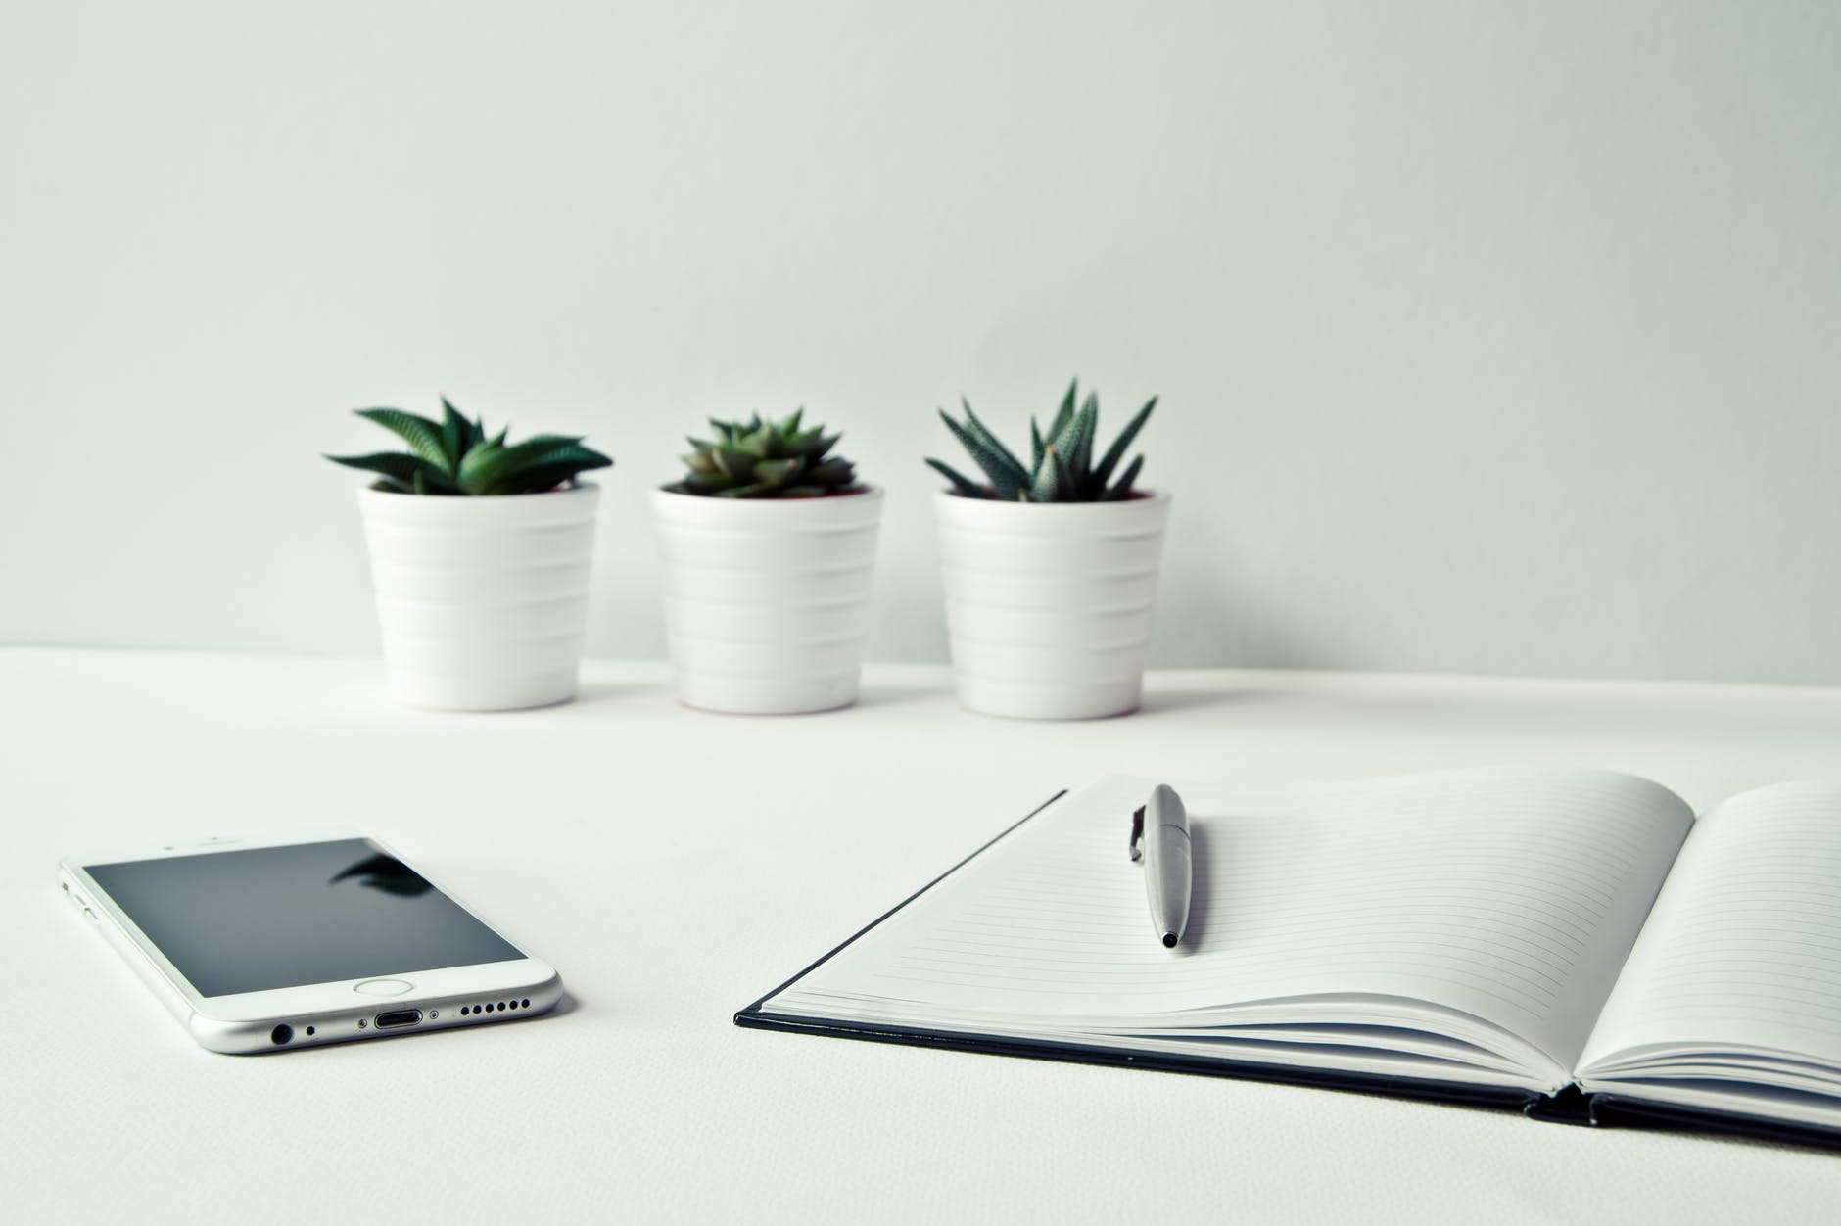
THE CLIENT IN QUESTION

Slide 9
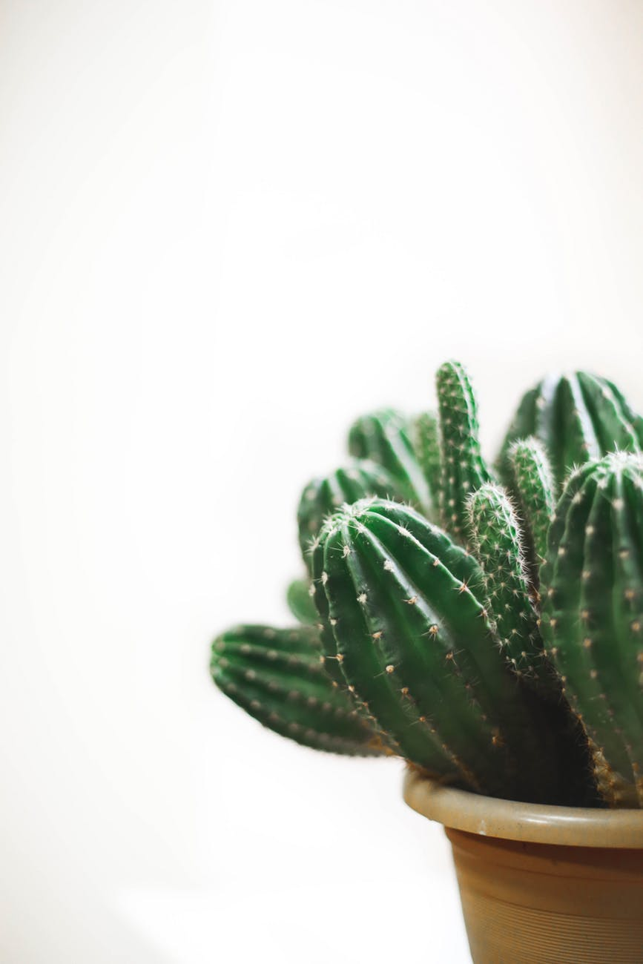
Title

Slide 10
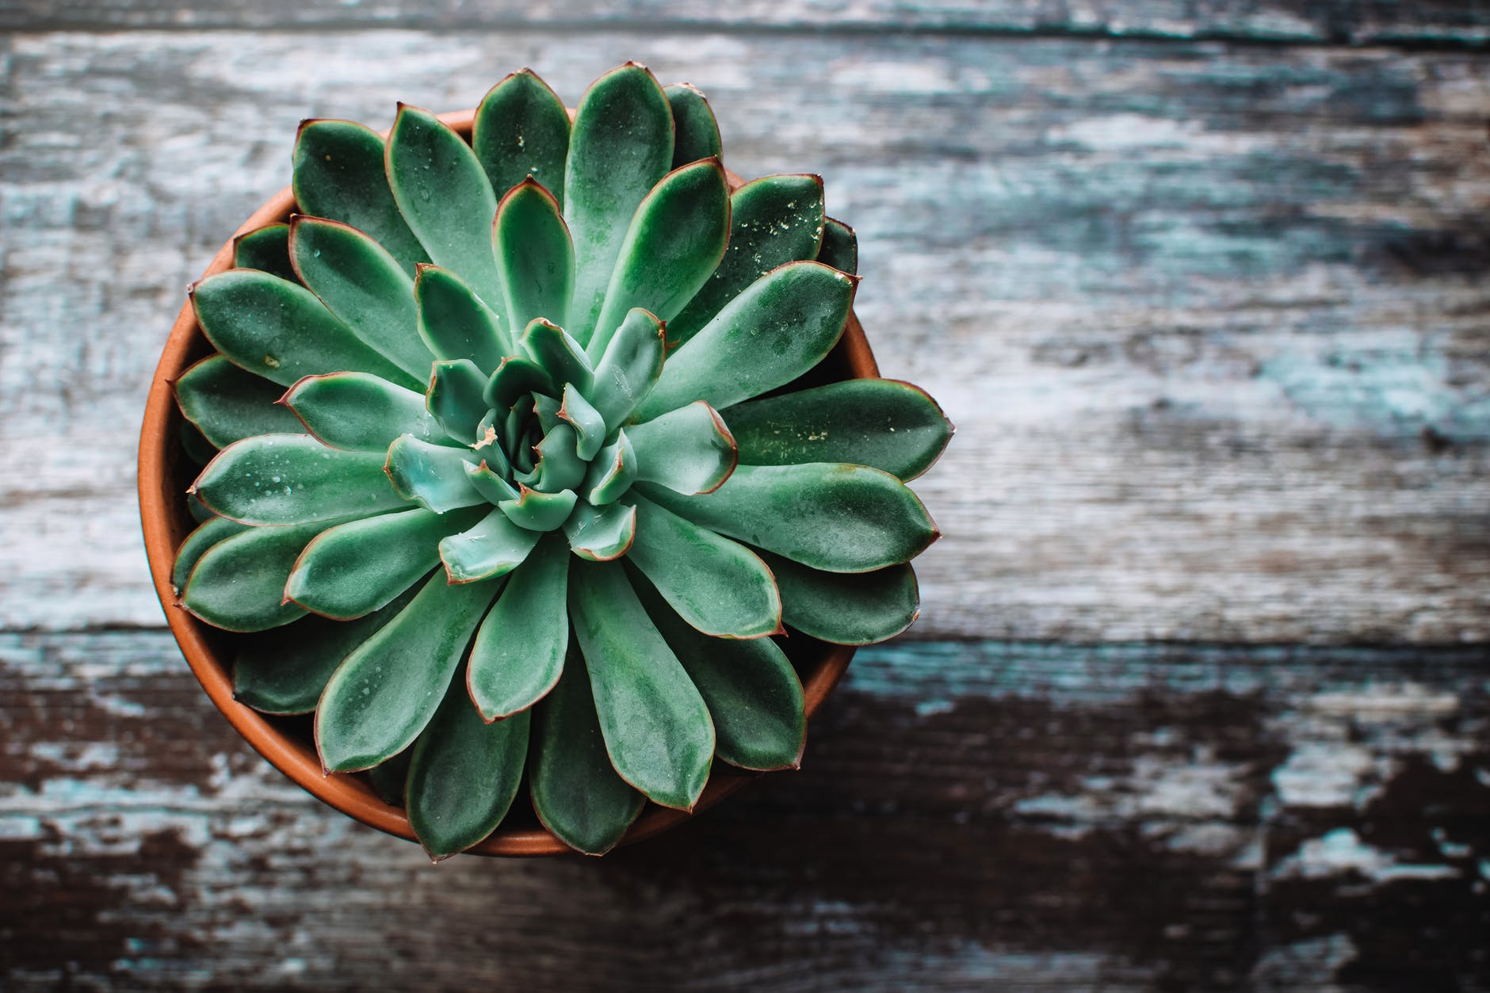

Slide 11
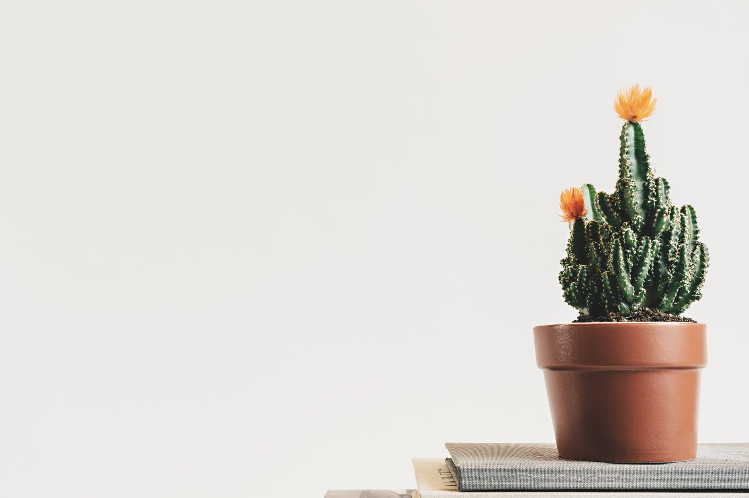

Slide 12
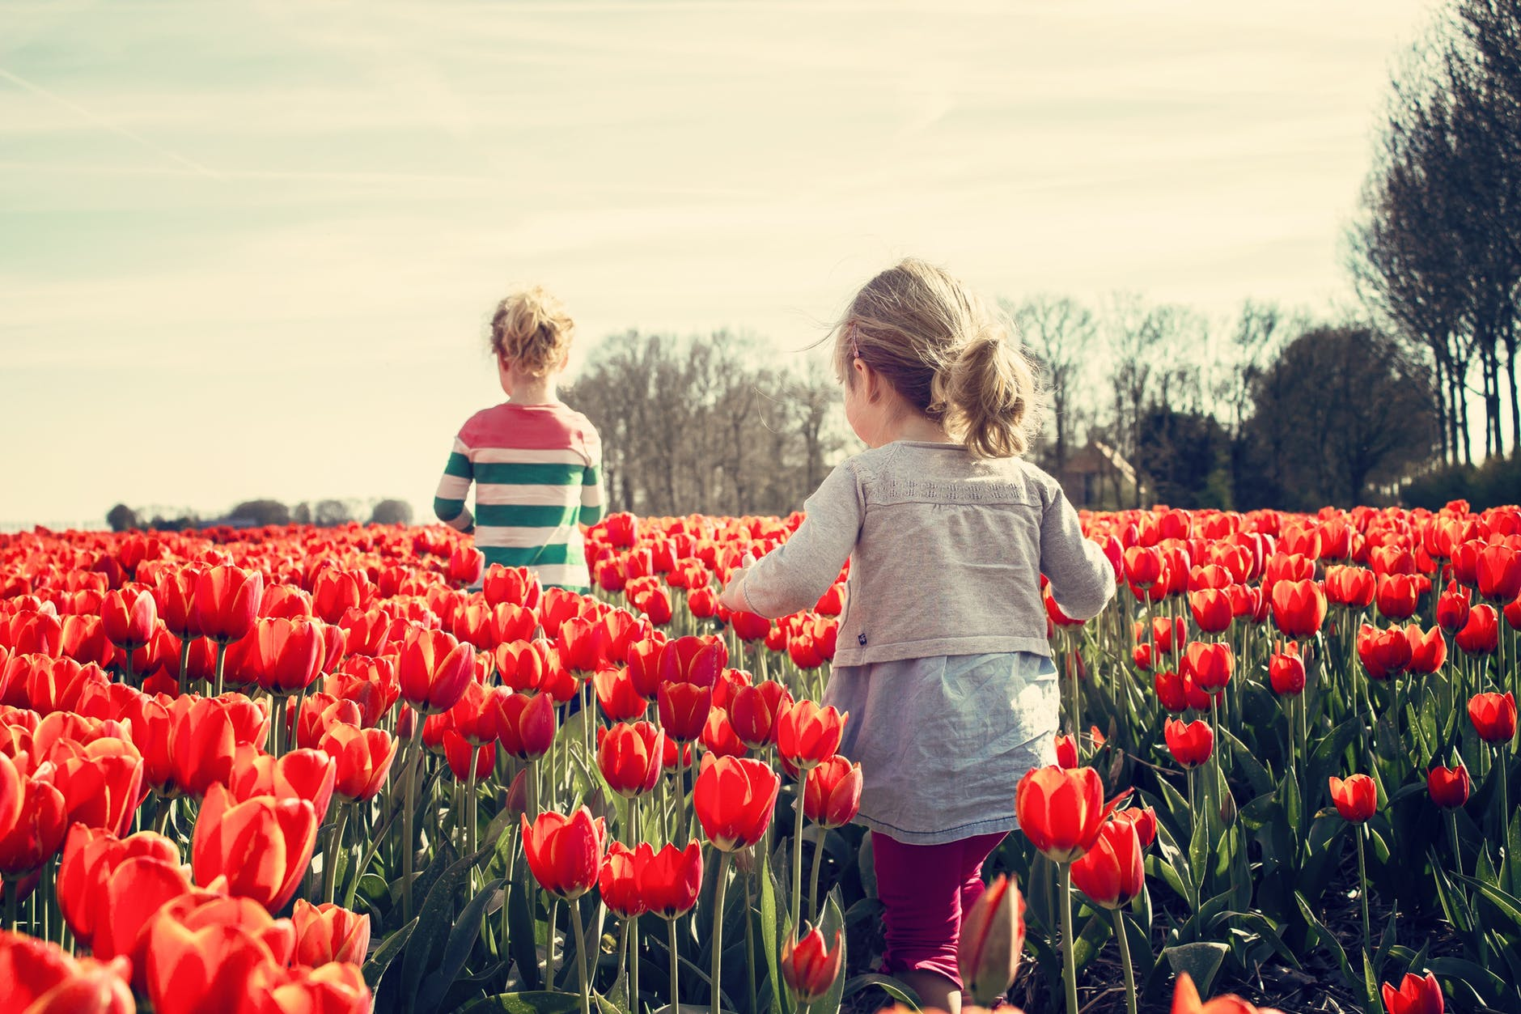
Thank you for attention

