Slide 1
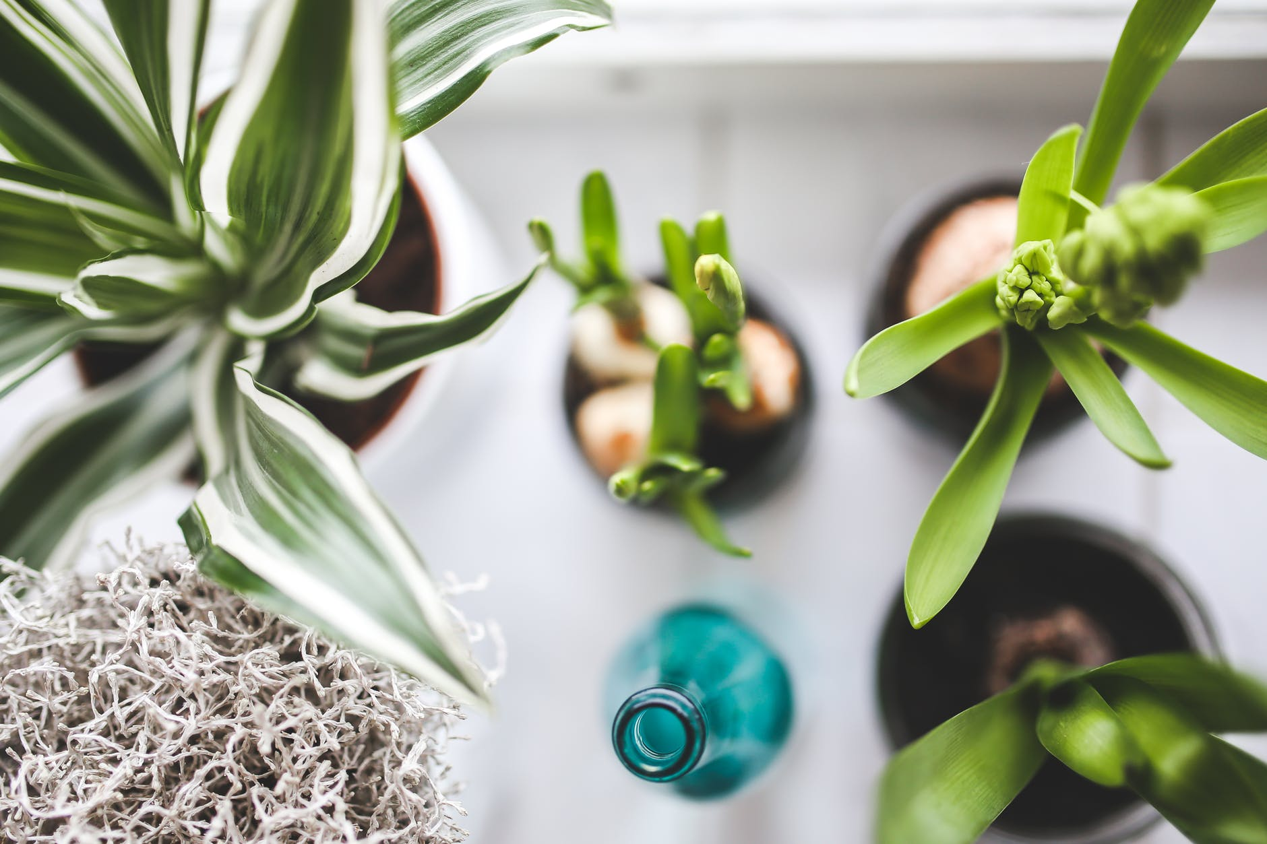
THE FUTURE OF
SMART GARDENING
STARTS HERE.

Slide 2

Smart eco system client pitch
Prepared By TEAM DDNS
Dorota marczak, nader sobhi, Declan bell and scott allan
23.10.2018

Slide 3
PRODUCT BRIEF
The Client
Lynsey Shepard of Abertay Plant System to build a IoT plant monitoring system
The Brief
Task with build an inexpensive alternative to current products
Collect data on the plants environment
Provide a graphical representation of the data collected.
What will be covered?
Our proposal on how we are going to build a smart plant Monitoring System for your company
Our ideas about what is needed to accomplish this project and how we will go about it
Notes:
ksjdfkldsjfl

Slide 4
TENTATIVE PLAN

Slide 5
Clients Requirements
As part of this project the client requested specific components that had to be Created.
Gather sensor data on a plant:
Temperature
Light
Moisture
Humidity
Collect data into Database
Present data in a graphical manner on website
Ability to produce device commercially
Easy set-up of device

Slide 6
Meeting Requirements
In order to satisfy the needs the client has laid out the following will be done:
Use an Arduino UNO paired with a WEMOS board to collect data through proprietary sensors
Push the data collected from the boards to a database
Create a web portal that dynamically graphs data
Devices will be very easy to manufacture en-masse
Device will be “plug and play”.

Slide 7
Project Approach
In order to complete this project the following shall be done:
Create a project plan
Test feasibility of desired outcome
Regular consultations with client – improvements or concerns
Produce necessary project documentation
Develop prototype – hardware and performance testing
Share notice board with the client

Slide 8
Deliverables
An executive summary will be delivered to the client to provide an overview of the project
The project proposal will also be developed
Cost breakdown
A prototype will be showcased to the client throughout development
Results from performance testing
Final product will contain a device, website, and database
User manual and other required documentation

Slide 9
Risks
Exceeding the predetermined budget
Inconsistent staff availability throughout development
The technology in use becoming obsolete
Data protection legislation changing (Thus not allowing us to collect said data)c
Competitor creating a alternative solution
Delay in delivering final product

Slide 10
Benefits/Costs
Benefits
A device that will be used as a template for the product that will be produced commercially
A reputation for fine IoT device production
A low cost of production of devices
Easy to produce
Easy to advertise due to the fact the product is suitable for multiple use cases
Low maintenance costs
Costs
The hardware needed
The maintenance of the production line
The database and web hosting will also need to be paid for by the client
Potential commercial licences licenses

Slide 11
Going forward
Better communication with the client
Better inter-team communication
More detailed description of working processes
Better software development methodologies

Slide 12
Questions?

Slide 13

MAIN POINTS TO CONSIDER
Hardware needed
Software needed
Plant needed
Time needed
Power source
Data Storage regulations

Slide 14
PROJECT PLAN

Slide 15

THE CLIENT IN QUESTION

Slide 16

Title

Slide 17


Slide 18


Slide 19

Thank you for attention

