Slide 1
Team DNS
Smart Plant Monitoring System
CMP311
Dorota Marczak, Nader Sobhi, Scott Allan
April 30th 2019

Slide 2
Brief & Client
Create a solution for monitoring a plant in homes
Hardware device for collecting data
Database to hold data
Website to display data via graphs
Dr. Lynsay Shepherd, Abertay Plant Systems
Required IoT device to expand business

Slide 3
Background
Looked at devices currently available
Found to be expensive / hard to set up
Gap in market for cheaper, 'plug and play' system
Had to appeal to experienced gardeners / digital natives
Plants as decoration, relaxation aid
'Green Tech' becoming more important

Slide 4
Methodology I
Agile
Promotes communication & collaboration
Fast development of functional prototypes
Adaptable, self-organising teams
Allows for concurrent development

Slide 5
Methodology II
Scrum
Sprints - breakdown of work into 'chunks'
Values real-world results
Leads to continuous improvement
Test Driven Development
Use test results to refine system
Part of workflow

Slide 6
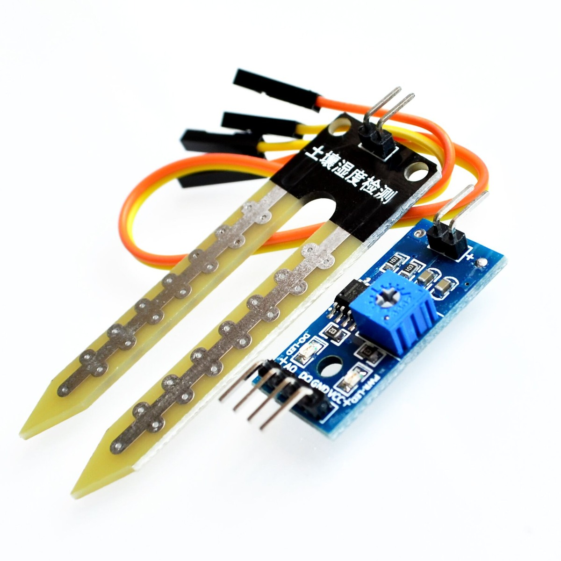
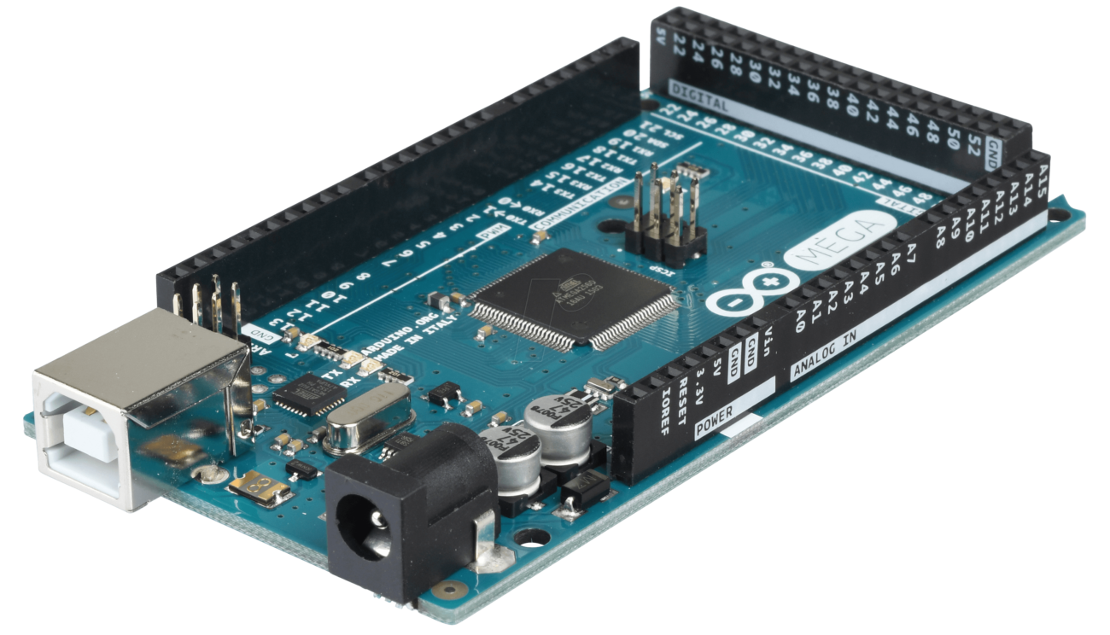
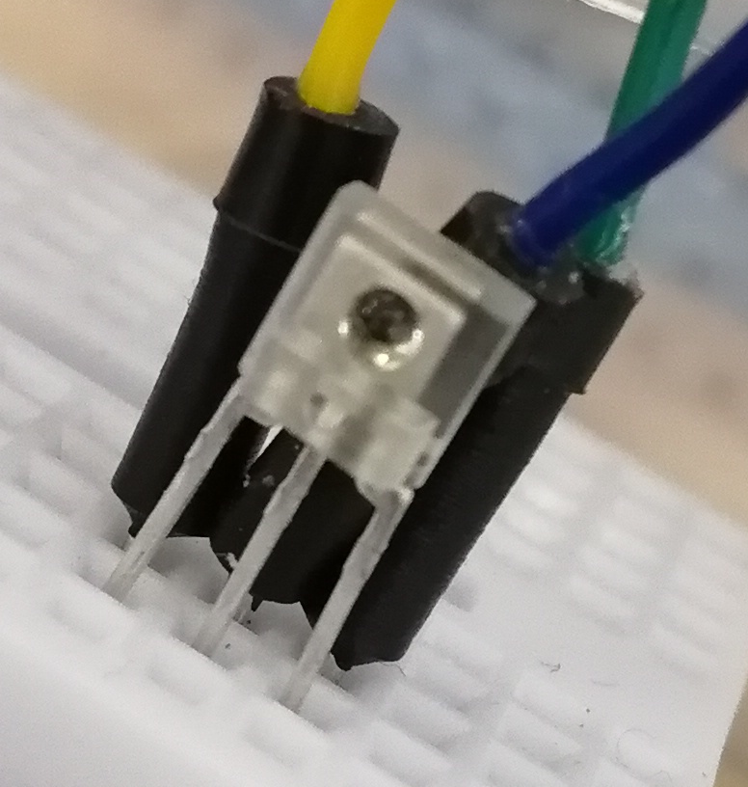
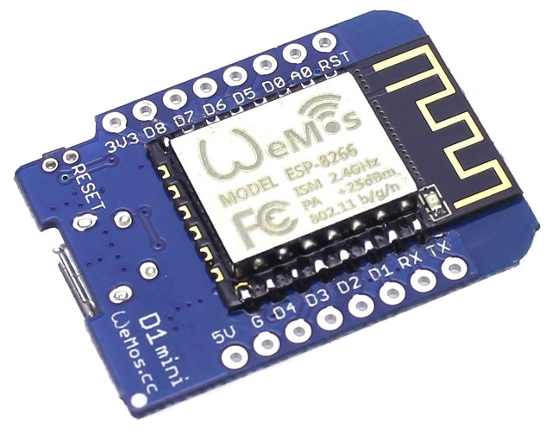
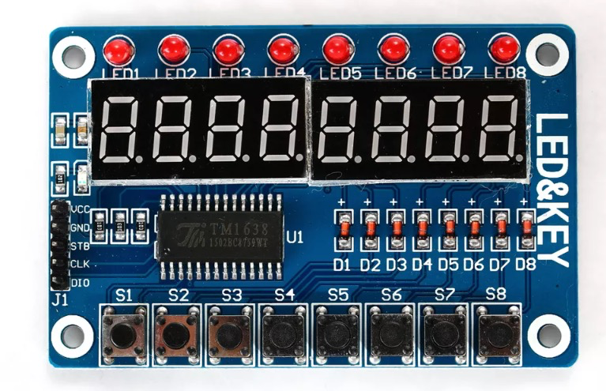
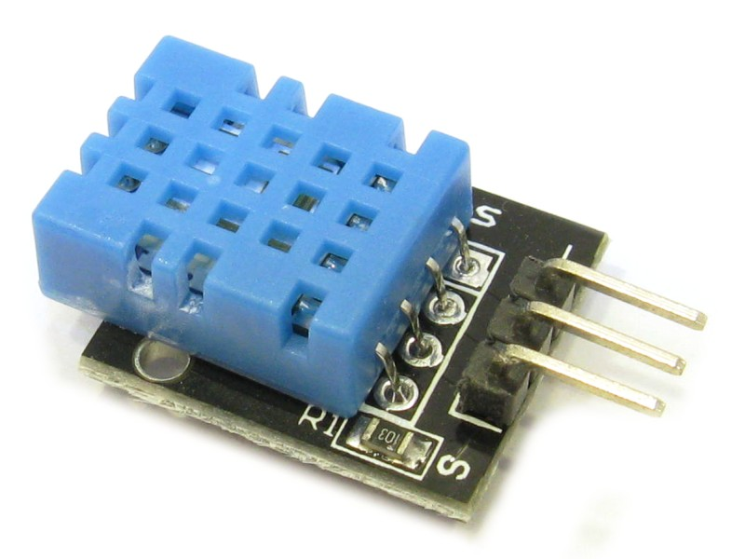
Technology Used - Hardware
Methodology III
YL-38 Moisture Sensor
Arduino Mega2560
TSL2561 Light Sensor
WEMOS D1 Mini
DHT11 Temperature / Humidity Sensor
TM1638 LED Display

Slide 7
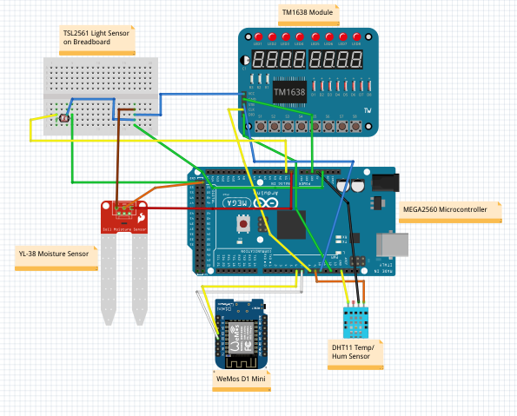

Device Circuit Diagram
Methodology III
fritzing.org

Slide 8



Technology Used - Database
Methodology III

Slide 9


Technology Used - Website
Methodology III

Slide 10
Results I
Hardware
Arduino MEGA2560 & WEMOS boards
Environmental sensors
Display peripheral
JSON String for data - highly efficient

Slide 11
Results II
Database
Amazon Web Services
MySQL
Four columns - ID, MAC, Timestamp, JSON String

Slide 12
Results III
Website
Developed using Bootstrap, Javascript
Split into two sections:
Digital Business Card
Users area – graphs

Slide 13
Conclusions
Hardware device has capability to be expanded
JSON String makes parsing data easier
Website serves two purposes
Solution is three seperate subsystems working together

Slide 14
Meeting Client Brief
Hardware device is 'plug and play'
Website allows user to view current plus historical data
Data collected allows user to make informed decisions
New gadget for digital natives
Intuitive for use by late adopters
'Green Tech' = new market opportunities

Slide 15
Benefits to Client
Simple device can be used by digital natives / late adopters
IoT buzz term - on cutting edge
Creates new market opportunites for APS
Generate sales in other aspects of business
Can be used 'in-house'
Device good basis for upgrading in future

Slide 16
Reflections & Limitations
Reflections
Device very efficient at collecting data
Website displays data in intuitive manner
Limitations
Relies on WiFi connection
Sensors 'hardwired'

Slide 17
Improvements
Device could be modular - swap sensors in/out
Screen could be improved
Remote watering/lighting solution
Develop standalone app
Incorporate social media to trade tips / advice

Slide 18
Team Dynamics
Worked well together
Unique views on problem solving
Opportunities to input into whole project
Discussions rather than arguements
Learning from peers

Slide 19
Thanks for Listening
Any Questions?

