Slide 1
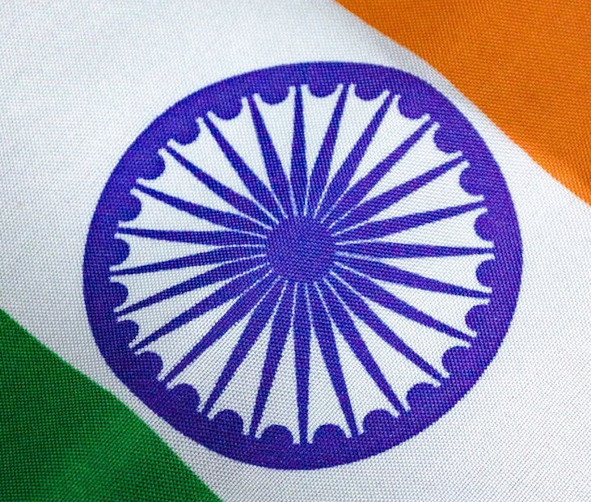
Challenges to Democracy

Slide 2
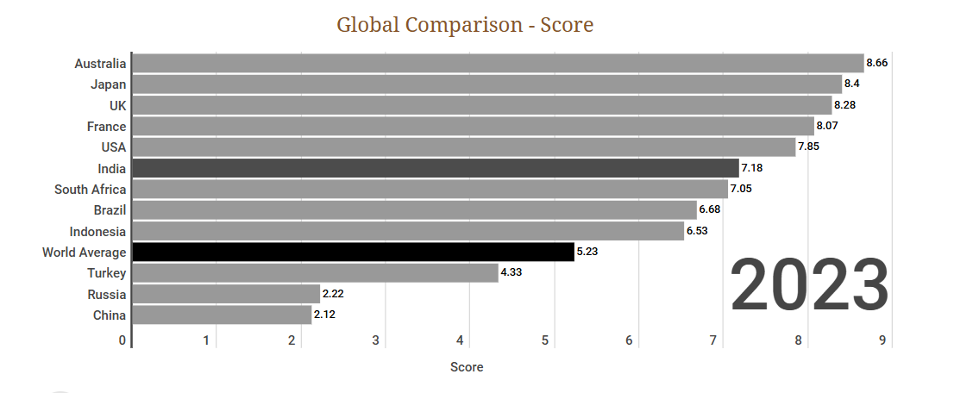
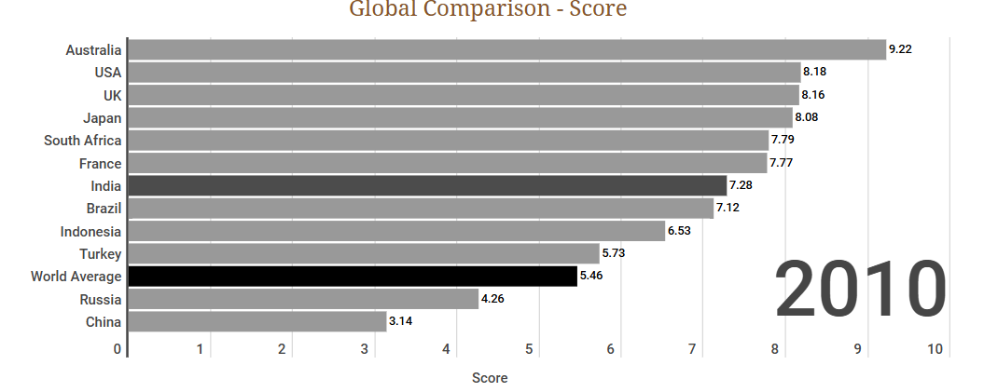
What is Democracy?
• Democracy means rule by the people.
• It ensures citizen participation in the decision-making process.
• Participation can be direct or indirect through elected representatives.

Slide 3
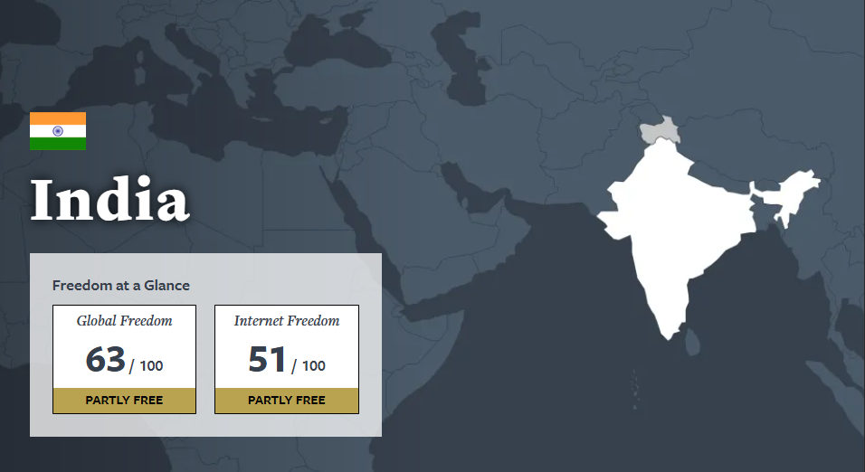
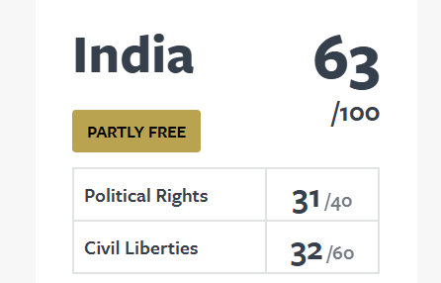
Meaning of "Challenges" to Democracy
•
Challenge = demanding situation(requiring action).
• In this context, it refers to problems faced while ensuring a democratic setup.
• Main Challenges:- Lack of Unity, Transparency. More of Misinformation & Inequality.

Slide 4
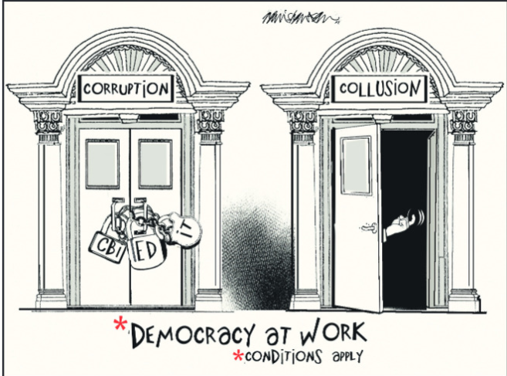
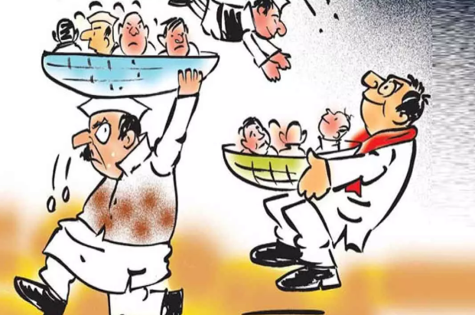
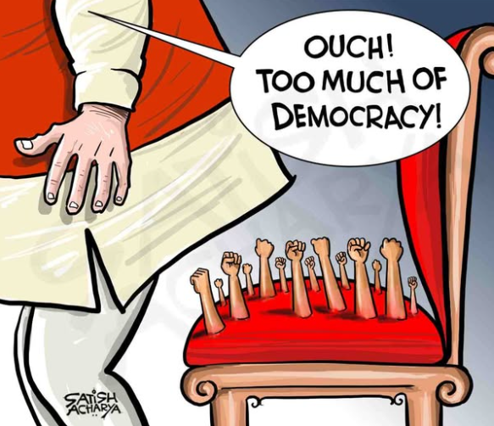
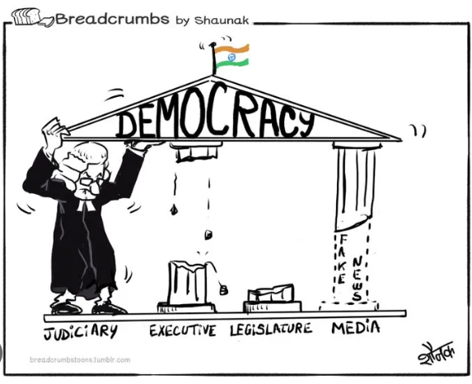
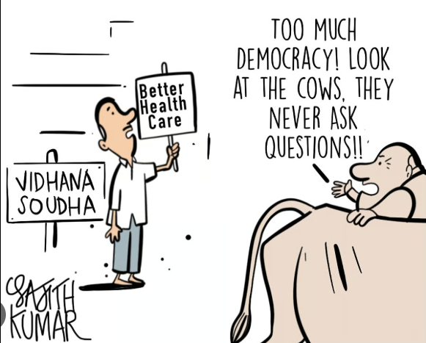
Three Broad Challenges - Foundational
• Democracy relies on citizen participation in decision-making.
• Foundational Challenge: Making the transition to a democratic style of government.
• One-fourth of the world is still not under a democratic government.
• These nations must lay the foundation of democratic laws and policies.
Ex: India(1947), Africa after Apartheid(1994)

Slide 5
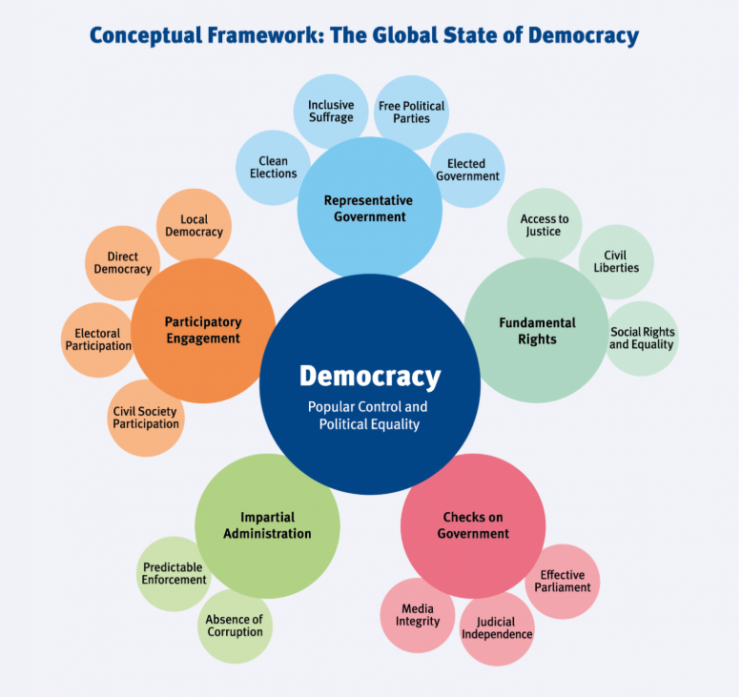
Challenge to Expansion & Deepening
• Challenge to Expansion: Expanding democracy to various social groups and regions.
• Ensures more institutions and regions follow democratic functioning.
• Involves distributing more power to lower levels of government. Ex: Voting Rights of African Americans(1960’s)
• Deepening of Democracy: Improving the quality of democracy, making institutions more accountable, transparent, and responsive.
• Ex: Information Act(2005).

Slide 6
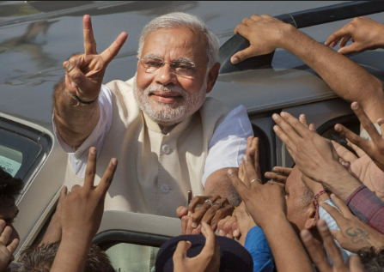
Particular Challenges to Indian Democracy
• India is the world's largest democracy, achieving success over six decades.
• The Constitution grants Fundamental Rights to meet India's diversity.
• However, it still faces significant hurdles:
- Social and Economic Inequalities & Poverty and Unemployment.
- Illiteracy and Ignorance.
- Casteism & Communalism.
- Population Explosion & Regionalism.
- Linguism & Separatism.
- Corruption & Terrorism.

Slide 7
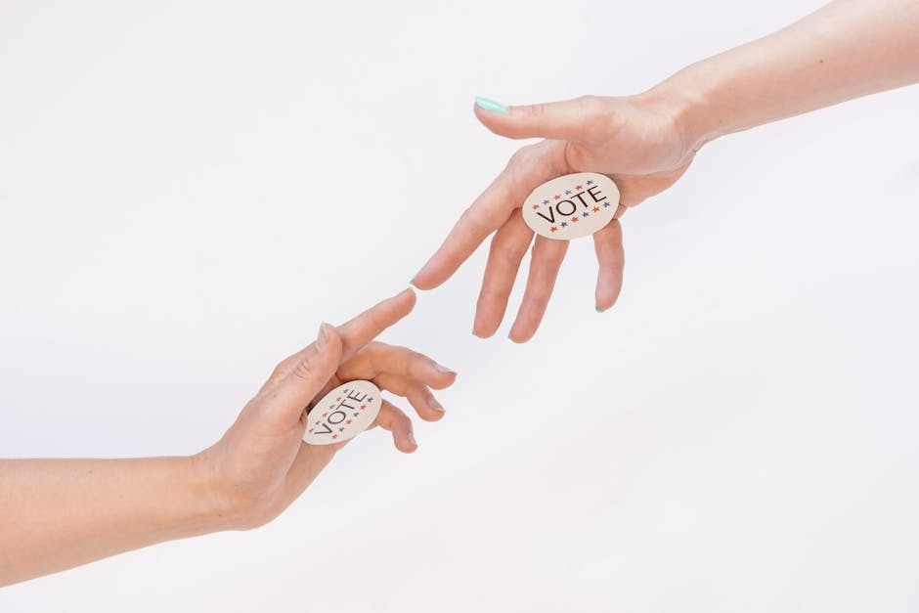
How Could We Reform Democracy?
• Challenges of democracy are linked to the possibility of reforms.
• Overcoming these constraints is called Democratic Reform or Political Reform.
• Since challenges vary, countries cannot follow the same recipe for reform.
• India needs reform proposals at the national, state, and local levels.

Slide 8
Reform Strategy 1 - Introduce New Laws
• Law plays a crucial role by discouraging wrong political practices and encouraging good ones.
• However, legal changes alone cannot overcome democratic challenges.
• Analogy: Changing cricket rules helps, but improving the game depends on players, coaches, and administrators.
• Reforms must be driven by political activists, parties, movements, and conscious citizens.

Slide 9
Reform Strategy 2 - Analyze Results of the Law
• Legal changes can sometimes be counterproductive.
• Example: Banning people with more than two children from panchayat elections denied democratic opportunities to the poor and women.
• Empowering laws are more successful than laws that simply ban actions.
• Example: The Right to Information Act empowers citizens to act as watchdogs, helping control corruption.

Slide 10
Reform Strategy 3 - From Theory to Practical
• Democratic reforms must be brought about through political practice.
• The main focus should be on strengthening democratic practice.
• Proposals must address what the solution is, who will implement it, and how.
• While legislatures pass laws, citizens, organizations, and the media must help implement them.

Slide 11
Measures to Deepen Democracy
• Education for All: A literate society is an important resource; education brings awareness of political rights.
• Fundamental Rights: Ensures citizen rights are protected, increasing faith in the constitution.
• Freedom of Press: Helps form public opinion and raises awareness about societal issues.

