Slide 1
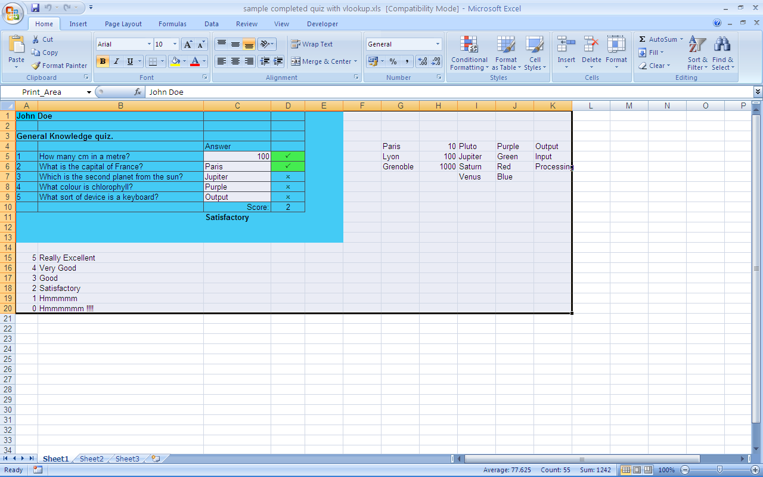
VLOOKUP
=VLOOKUP(D10,A15:B20,2,FALSE)
Based on the
total number
of correct answers
output a suitable
Text message
Indicating how well
they did

