Slide 1

About me
By Pat

Slide 2


My name is Pat Smith
I live at 45 West street in Newtown by the post office in a house with a blue door and three bedrooms
My mum works for the post office and goes to work very early every day and I have to get breakfast for Jane
My best friend likes football and chips and his dad’s car and going to his nan’s house on sundays except when Jamie is there because she’s always getting everyone into trouble

Slide 3

My family
My dad lives in Spain
My sister is younger than me and is a pain in the neck
We have got three cats called Tommy fred and tibbs
We got our dog from the rescue centre because he had been abadoned

Slide 4
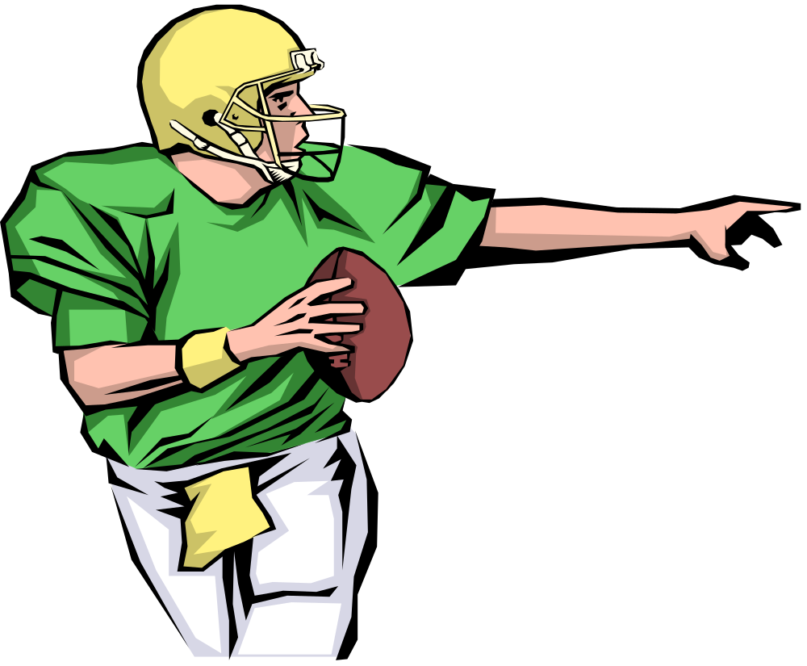
Hobbies
Football
Tele

Slide 5

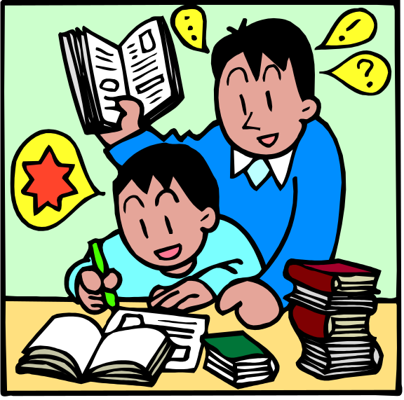

School
I liked my last school
Miss jones was great but mr best was horrid and he got cross when I talked
I liked maths but not history or geography
My school was near here, just round the corner

Slide 6
The end

