Slide 1
Using images

Slide 2


Which image would you use for a road sign to the beach?

Slide 3
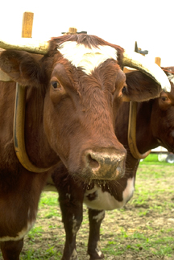

Which image would you use for an article about foot and mouth disease?

Slide 4


Which image would you use for a travel brochure?

Slide 5


Which image would you use for an advertisement for a bakery?

Slide 6

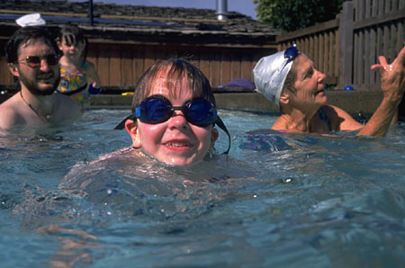
Which image would you use for an advertisement for a swimming pool?

Slide 7

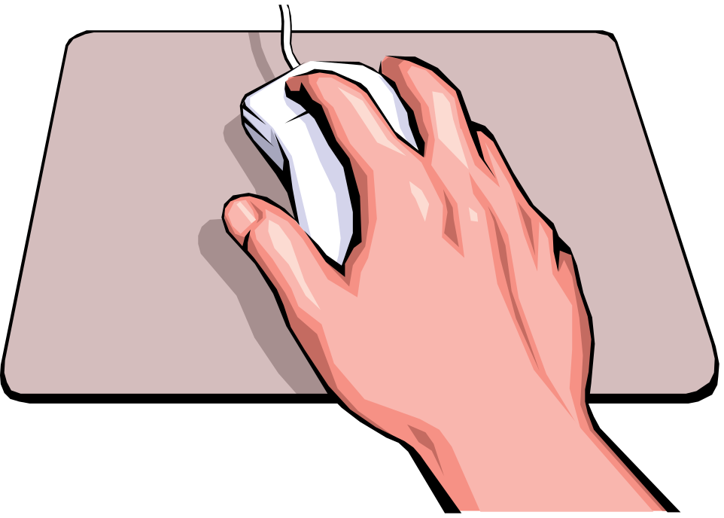

Which image would you use to demonstrate how to use a mouse?
A
C
B

