Slide 1
Objective and Outcome
Teaching Objective
Today we are going to use Excel to create a times table program and a Battleships war game.
Learning Outcome
All – of you will have an understanding of how to format a spreadsheet for colour and borders
Most – of you will be able to insert shapes and conditionally format
Some – of you have an understanding of sum(), countif() and if() formulas

Slide 2
Session 1 - Using Formulae to work out Maths problems
Spreadsheets can be very useful when trying to work out mathematical problems
In this exercise we will create a spreadsheet that can be used to work out times tables

Slide 3

Homepage
Open a spredsheet, create a home page so the user can put their name in

Slide 4
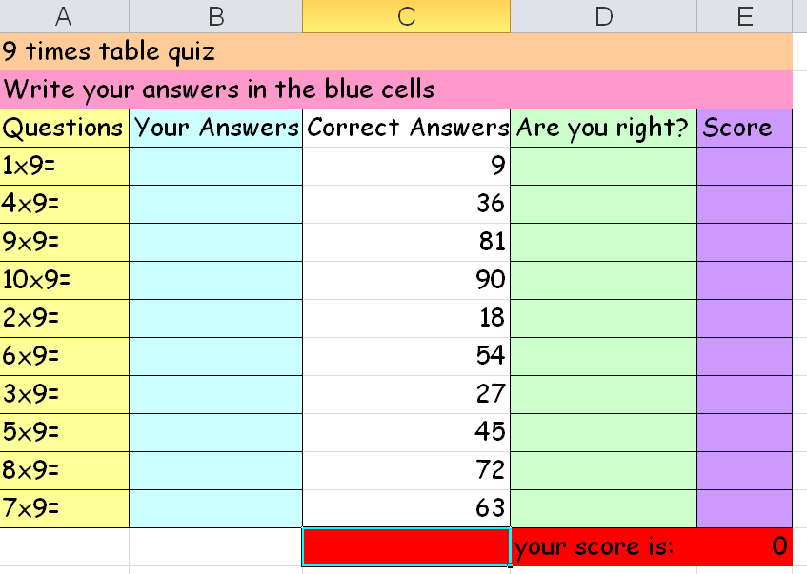
Create a times table page
On a new worksheet, type in the questions and answers, leave a few blank columns

Slide 5
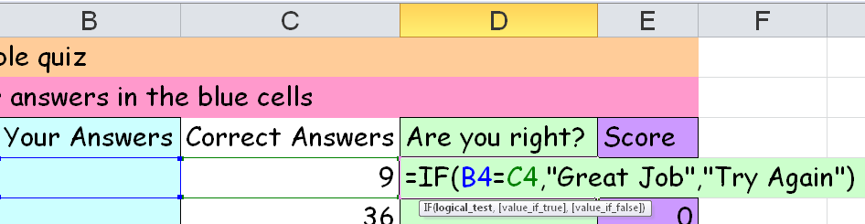
Add Formula to check answer
Once you’ve done it drag it down the column

Slide 6
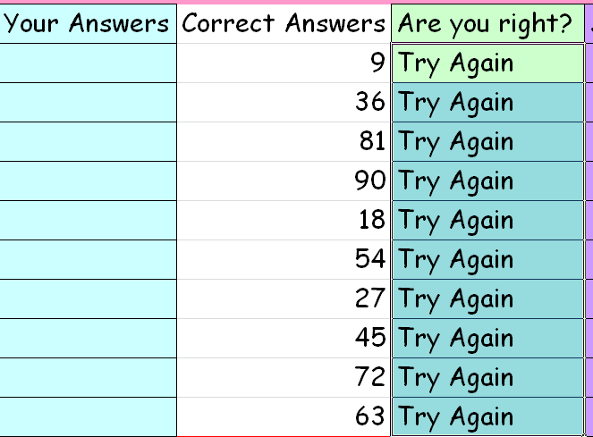
Like this
After dragging

Slide 7
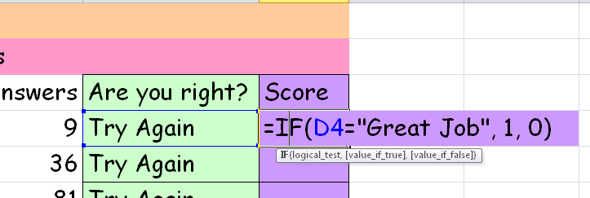
Formula to add up
Add the IF() formula, drag it down once you have finished

Slide 8
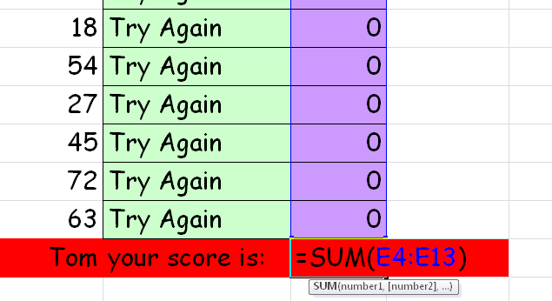
Add up the total
You can then add up the total for the user

Slide 9
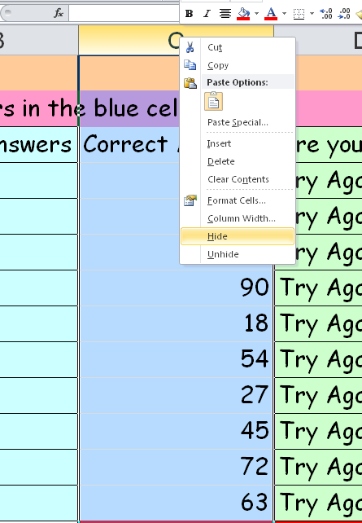
Hide answers
Hide the answers from the user

Slide 10
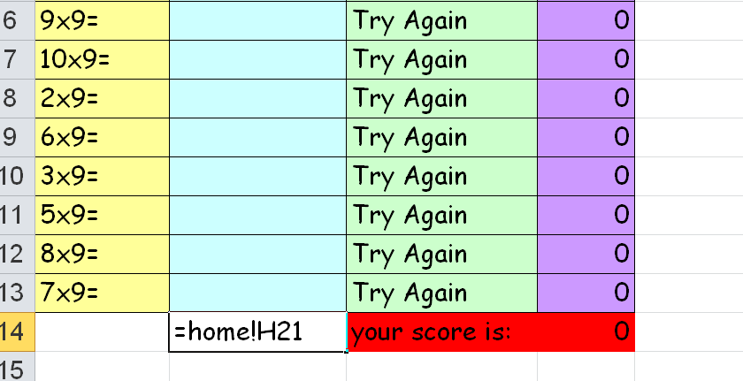
Get the name
Link the sheets together to get the name of the user

Slide 11
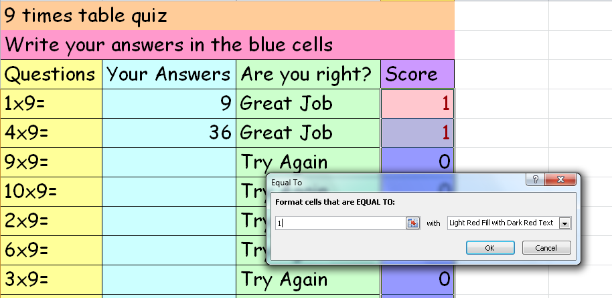
Conditional Format
Conditionally format the score column so it changes colour

Slide 12
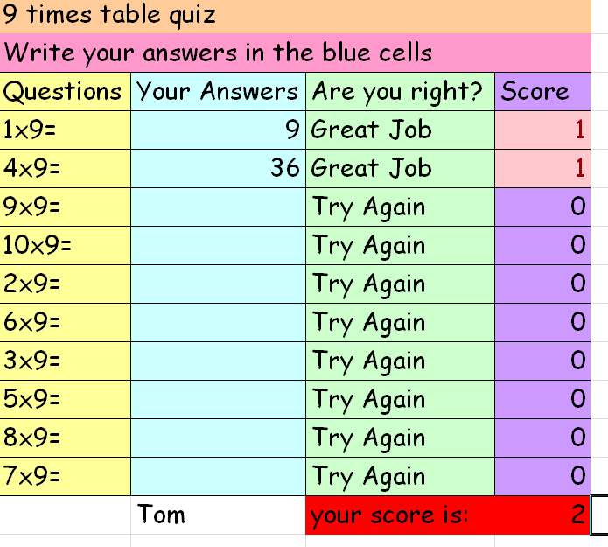
Finished!

Slide 13
Battleships – Session 2
  Demonstrate the game
  http://www.primarygames.com/puzzles/strategy/battleship/

Slide 14
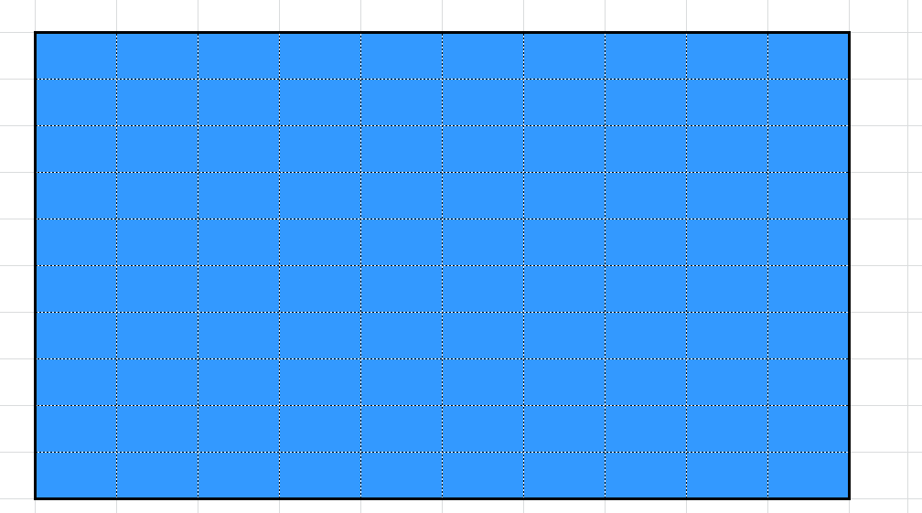
Create the Grid
Create a grid 10 * 10 grid. Fill the grid to make it look like see

Slide 15
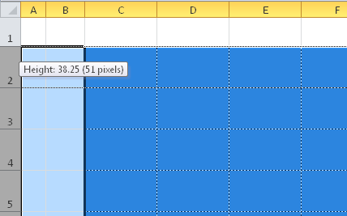
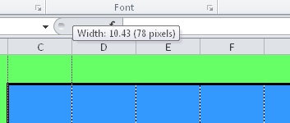
Height and Width
Set the height of the cells to
Set the width of the cells to

Slide 16
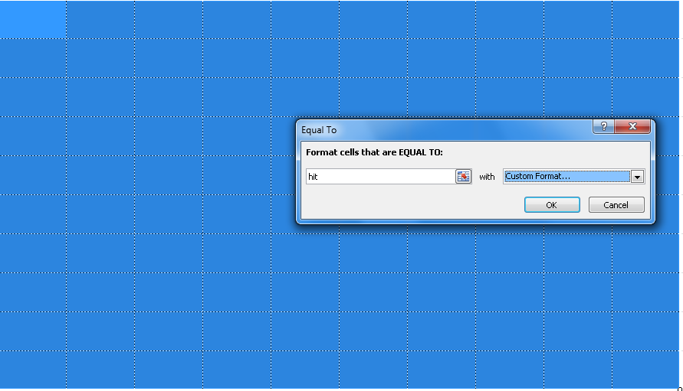
Conditional Formatting
Conditionally format the cells for hit and miss

Slide 17
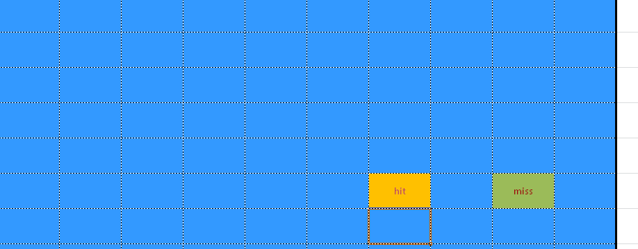
Test
If you type in hit or miss the colours should change

Slide 18
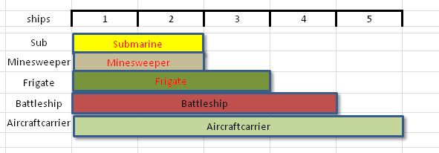
Create some ships
Using the shapes option place the following ships on the board
Make sure they are the correct length

Slide 19
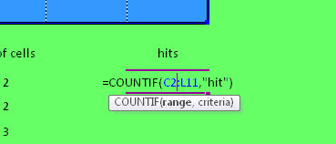
Counting the hits
We know that the ships in length add up to 16, therefore if we get hit 16 times we lose
We can add a formula to add up all the hits on the board
The countif() formula will do this

Slide 20
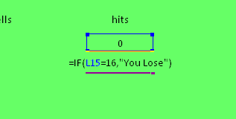
Showing a Lose Message
If we are hit sixteen times we lose
Our countif() formula will add up the amount of hits we have
We need an IF formula to display a message if we get hit sixteen times

Slide 21
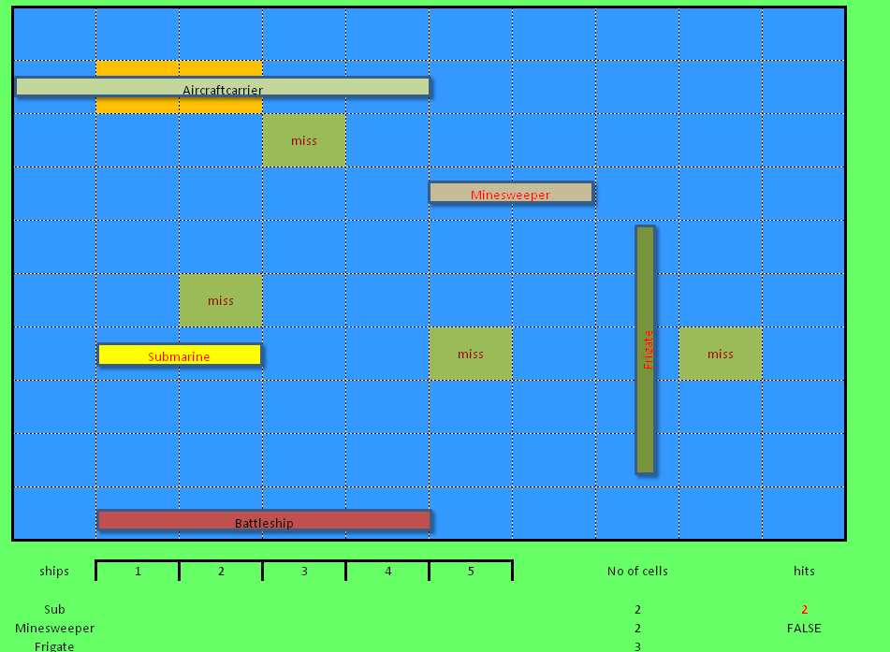
Test our game with two players

Slide 22
Plenary
We have looked at cell reference
We have looked at conditional formatting and formatting
We have looked at formula such as Countif() and IF()

