Slide 1
Kodu Games Programming

Slide 2
Objective and Outcome
Teaching Objective
The focus of today’s lesson is to use the program Kodu to create a simple game. We will add objects to the screen and then make choices about how the game progresses
Learning Outcome
All – of you will create a simple world with a Kodu character that will respond to keyboard events
Most – of you will be able to move the Kodu object around using the arrow keys
Some – of you will be able to react to events and use scoring

Slide 3
Getting Kodu
Kodu is a free download made by microsoft
The purpose of Kodu is to encourage young people to learn how to code
Kodu gives you the power to create your own worlds with your own rules
It is similar to Scratch in that you do not have to write the code but you do have to understand the logic
Download at
http://fuse.microsoft.com/kodu

Slide 4

Using Kodu

Slide 5
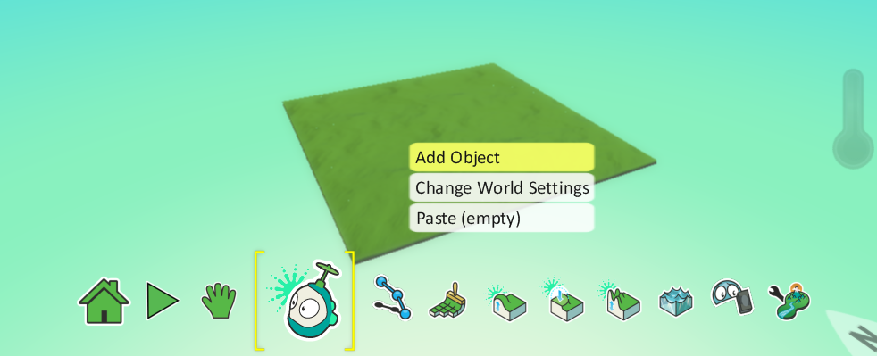
Menu
The menu below shows the options, add an object to the world by right clicking on the world

Slide 6
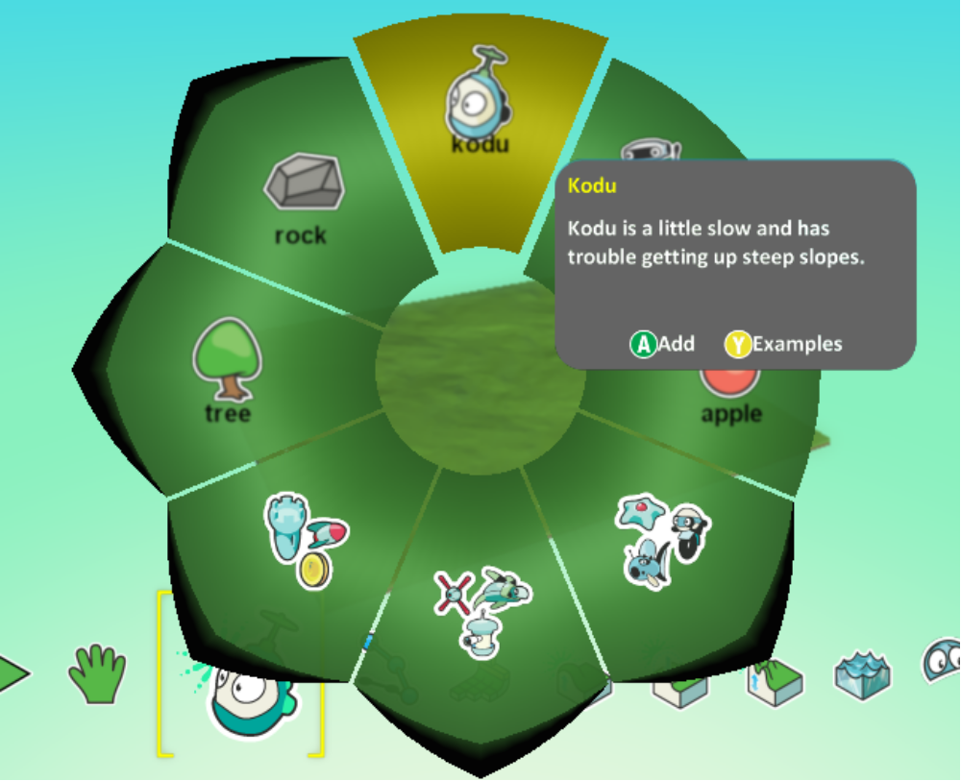
Adding an object

Slide 7
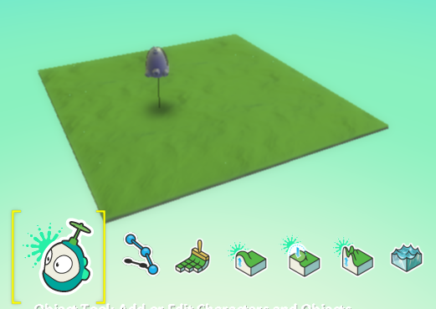
Adding Kodu
Kodu is now in your world, he hovers above the ground. You can adjust this height by doing the following

Slide 8
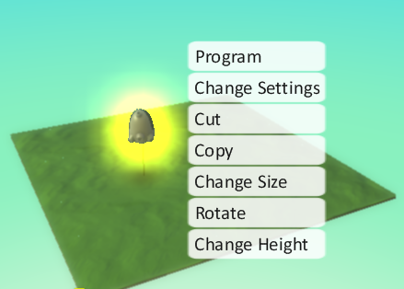
Adjust Height
Right click on Kodu and adjust the height he hovers at

Slide 9
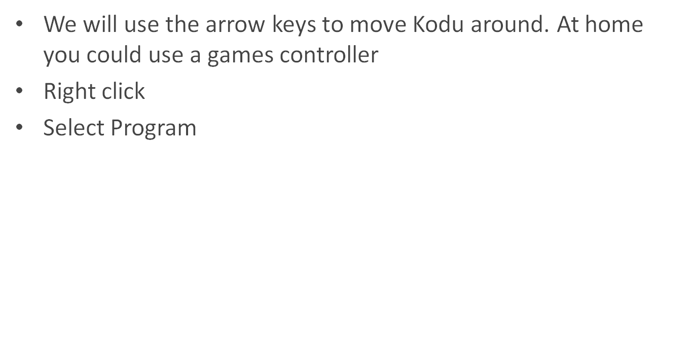
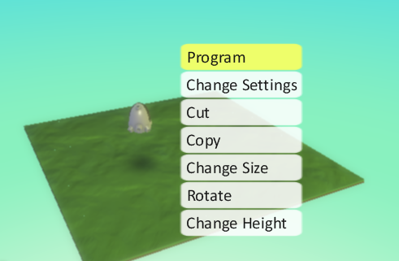
Moving Kodu around

Slide 10
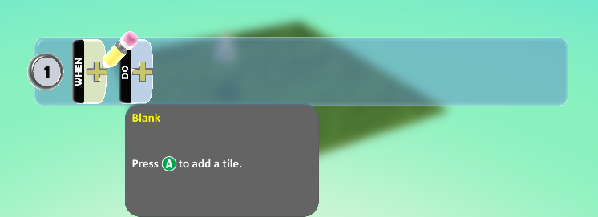
Moving
When you select Program you will see this screen
Here we can add events in the same way we did when we programmed in Scratch

Slide 11
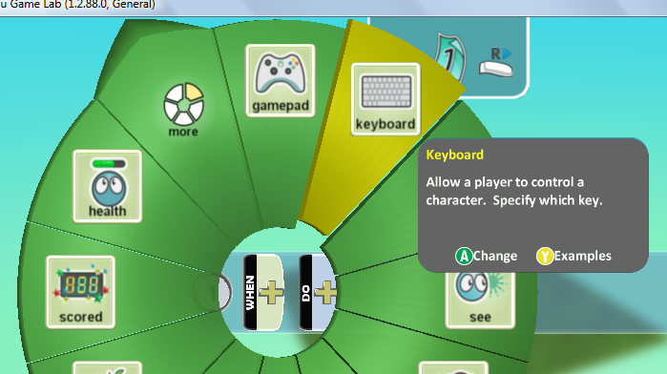
Moving
Click on the plus sign next to WHEN, select Keyboard

Slide 12
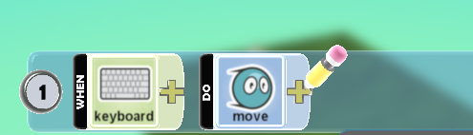
Moving
We have selected the trigger for the event, we also need to add the action
Click on the DO plus sign and add Move

Slide 13
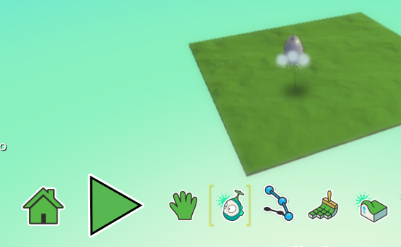
Testing are movement
Push the ESC key to return to the Main Menu
Click on the Run Arrow to test the Kodu in your world

Slide 14
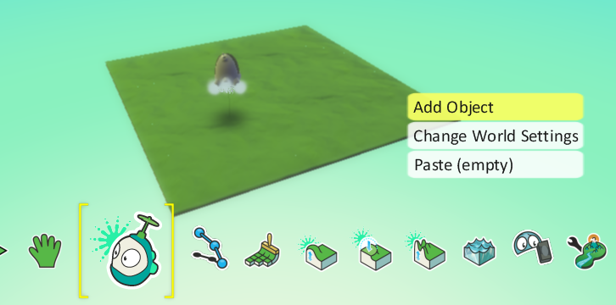
Adding over Objects
Now we will add some more objects so that our Kodu can eat them as he bumps into them. Select > Add Object

Slide 15
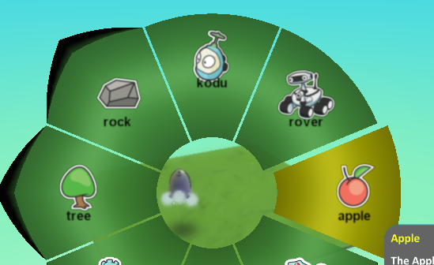
Over Objects
Add several apples for the Kodu to eat
Add some trees to your landscape
Add some rocks too

Slide 16
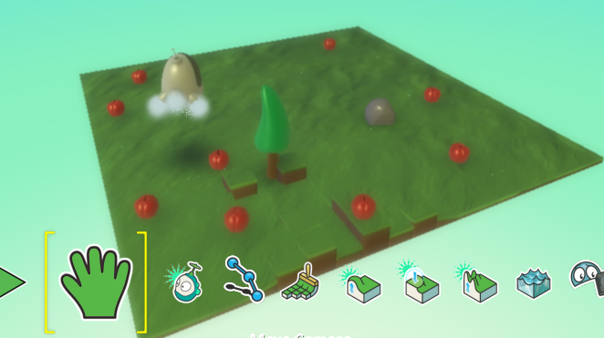
Over objects

Slide 17

Eating the Apples
Create a condition whereby if the Kodu moves over the apples they are eaten

Slide 18

Adding points for each apple
See if you can code the game so that 5 points are awarded for eating an apple

Slide 19
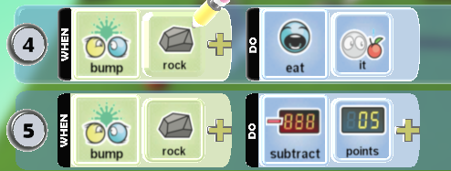
Deduct points for hitting a rock
If you hit a rock the following should happen:
The rock gets eaten
You lose 5 points

Slide 20
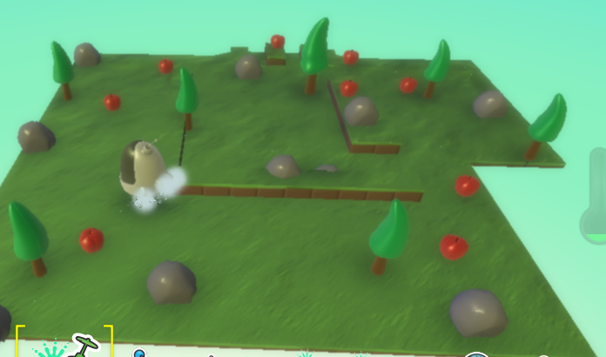
Test your game

Slide 21
Extend the game
Now extend the game so that when you bump into a tree you lose 10 points

Slide 22
Plenary
In this lesson we have looked at Kodu worlds
We have added a Kodu and programmed it to move using the keyboard
We have added other objects such as rocks, apples and trees
We have made the Kodu each apples that it bumps into
We have programmed for collisions and updated scores

