Slide 1
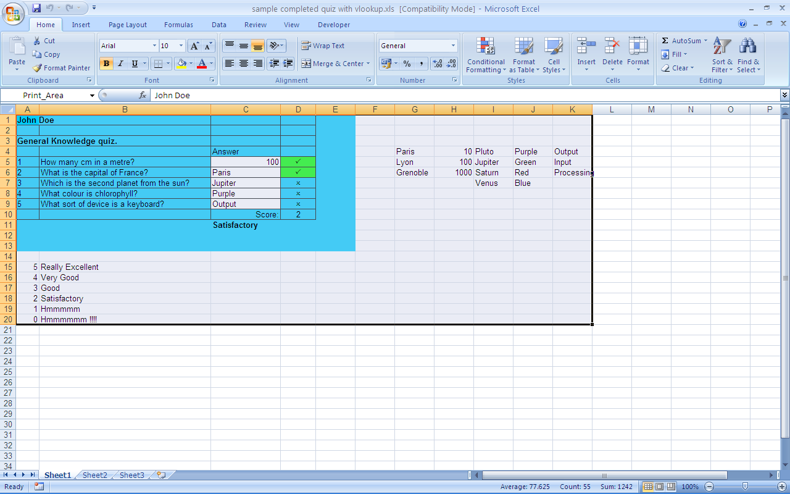

True or False
=IF(C6=Green,"P","O")
Left HAND up = Good IF function syntax
Right HAND up = Bad IF function syntax

Slide 2
True or False
=IF(C6="Green","P",O)
Left HAND up = Good IF function syntax
Right HAND up = Bad IF function syntax

Slide 3

True or False
=IF(C6="Green","P", "O")
Left HAND up = Good IF function syntax
Right HAND up = Bad IF function syntax

Slide 4
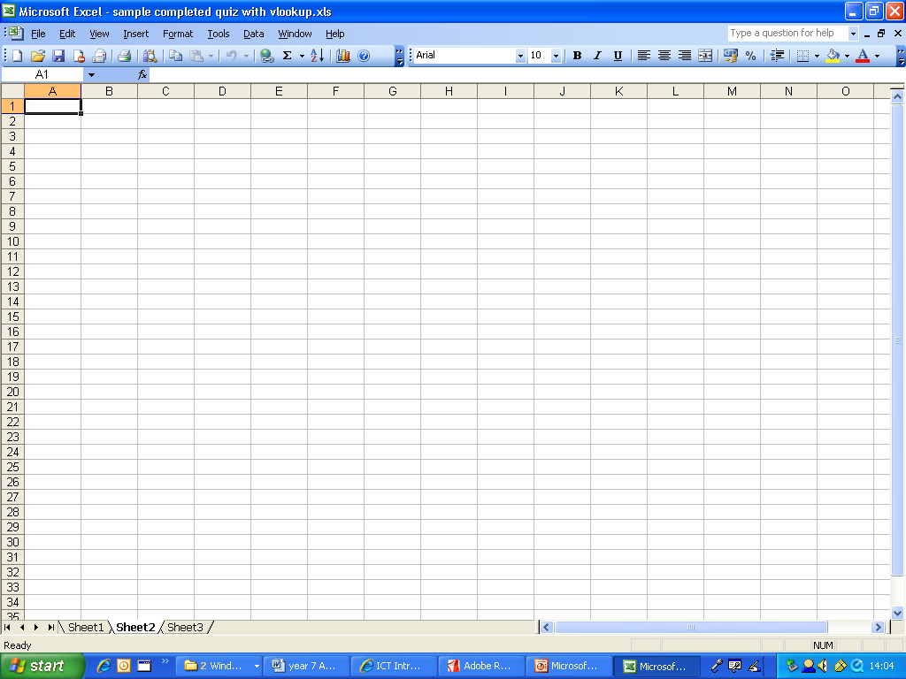

Which Menu
Which Excel Menu contains the DATA VALIDATION Box
that is where you enter a list of values for the drop down box
Left HAND up = TOOLS
Right HAND up = DATA

Slide 5
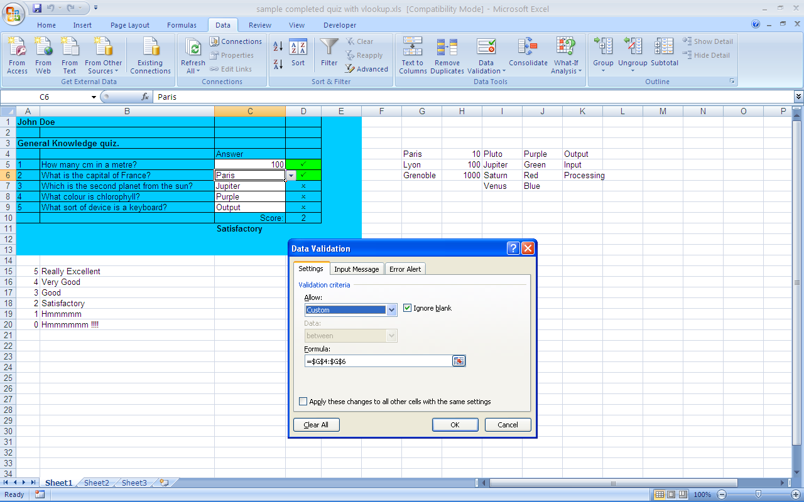

True or False
Is this the correct selection for Data validation to give you a drop down box of all the possible answers ?
Left HAND up = TRUE
Right HAND up = FALSE

Slide 6

True or False
Is this the correct selection for Data validation to give you a drop down box of all the possible answers ?
Left HAND up = TRUE
Right HAND up = FALSE

Slide 7
True or False
=IF(C5=100,P,O)
Left HAND up = Good IF function syntax
Right HAND up = Bad IF function syntax

Slide 8
True or False
=IF(C5= "100",P,O)
Left HAND up = Good IF function syntax
Right HAND up = Bad IF function syntax

Slide 9
True or False
=IF(C5= 100,"P","O")
Left HAND up = Good IF function syntax
Right HAND up = Bad IF function syntax

Slide 10
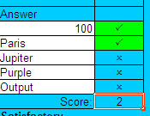
True or False
This excel COUNTIF function adds up all the letter P’s for you to give a total score
=COUNTIF(D5:D9,P)
Left HAND up = TRUE
Right HAND up = FALSE

Slide 11
True or False
This excel COUNTIF function adds up all the letter P’s for you to give a total score
=COUNTIF(D5:D9,"P")
Left HAND up = TRUE
Right HAND up = FALSE

