Slide 1
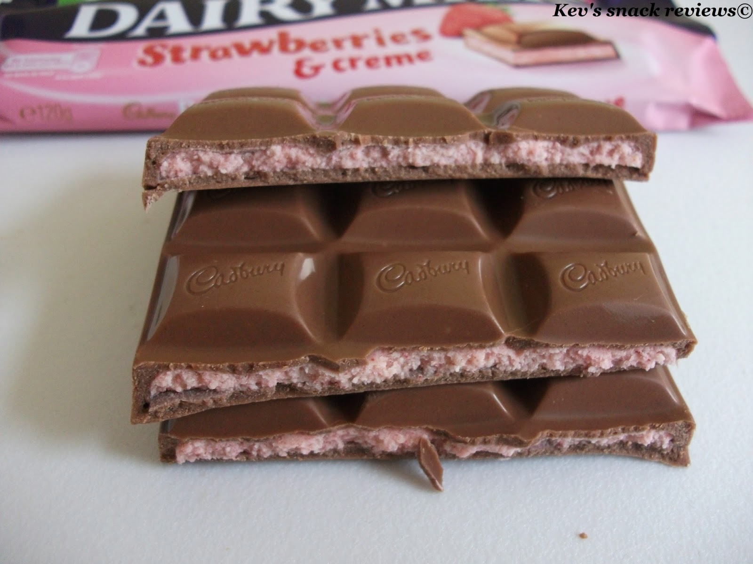

Slide 2
Necessary Truths
2+ 2 = 4

