Slide 1
Just Allocations & Structural Inequalities

Slide 2
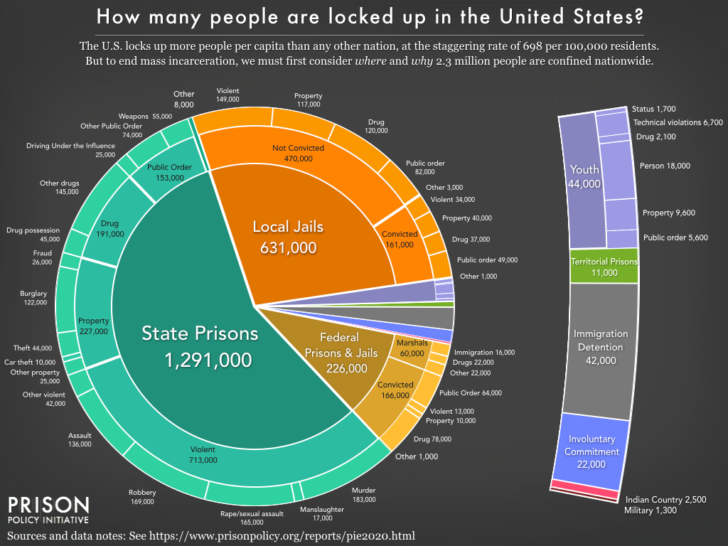

Slide 3
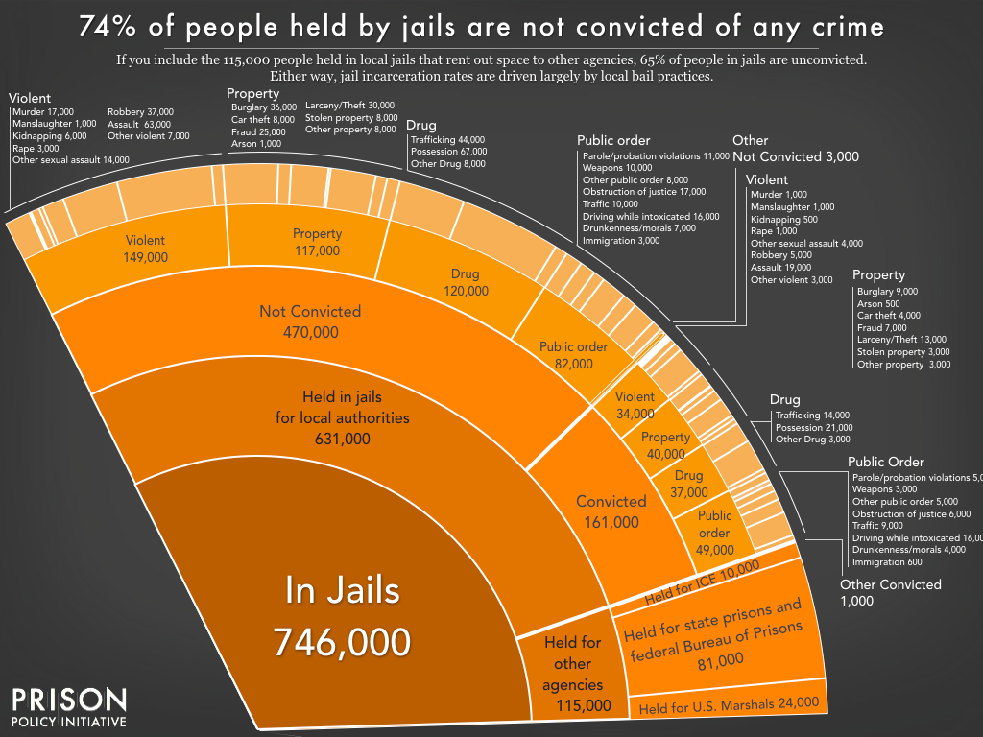

Slide 4
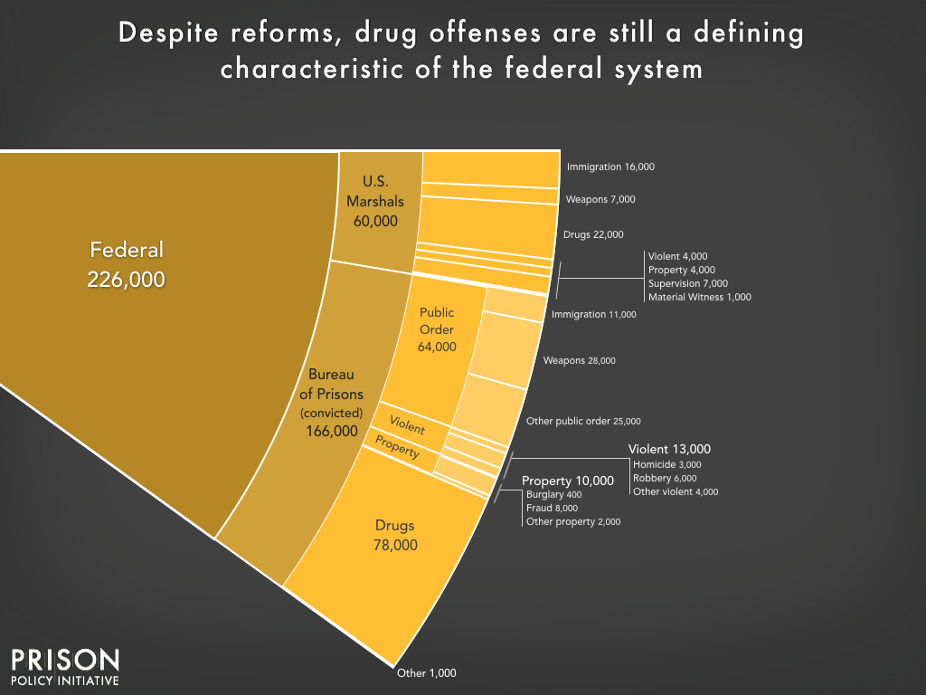

Slide 5
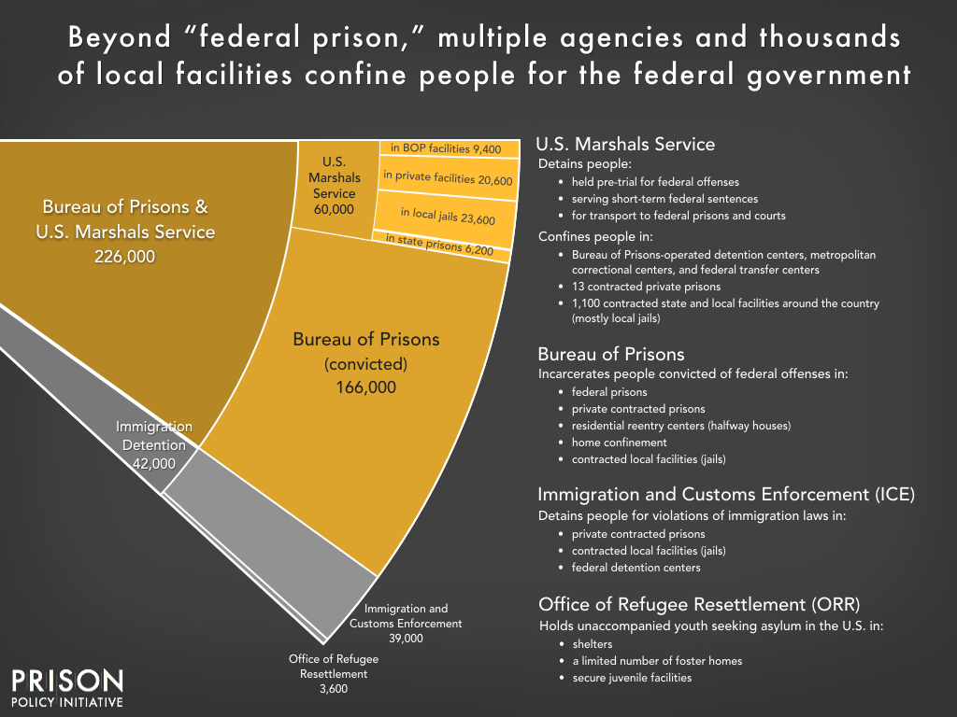

Slide 6
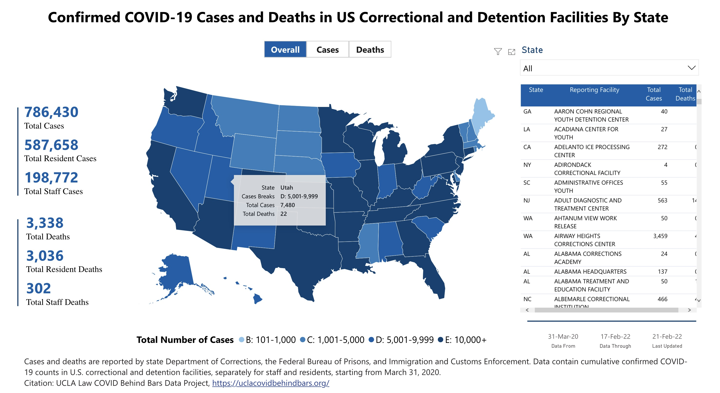

Slide 7
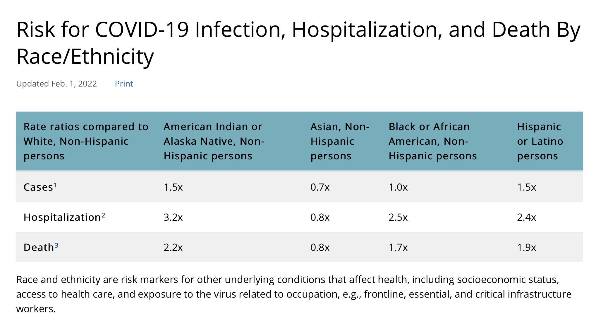

Slide 8
Just Allocations

Slide 9
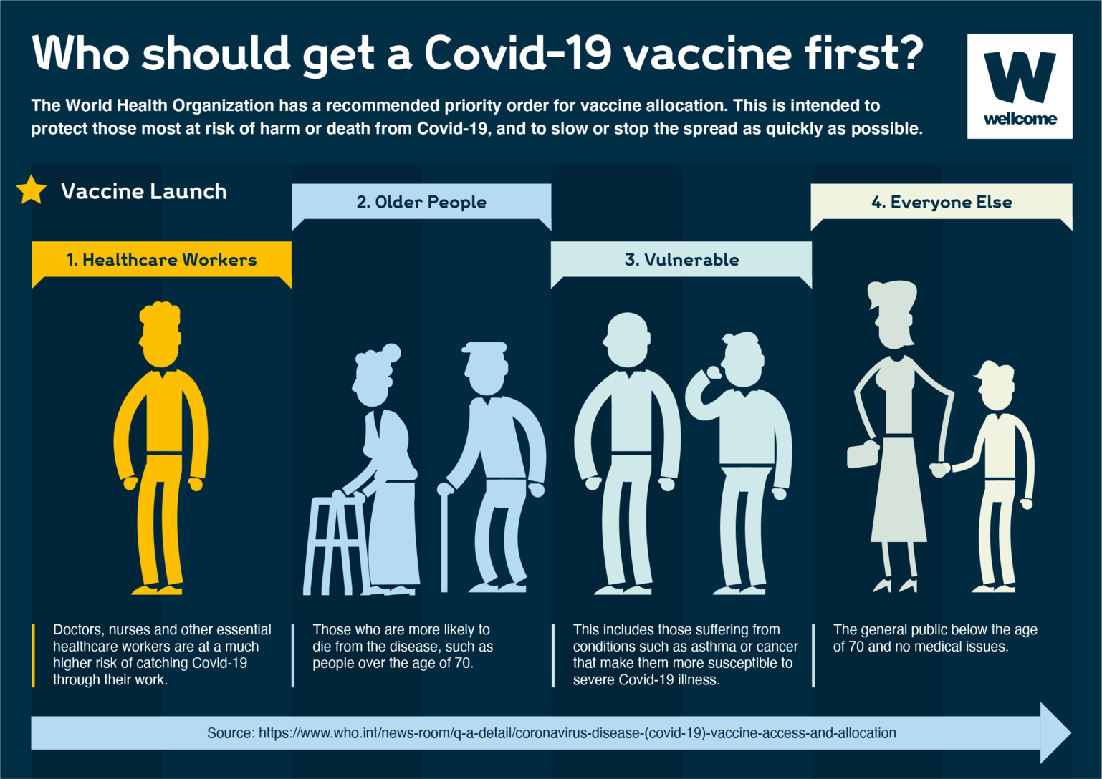

Slide 10


Slide 11
Just Social & Political Institutions

Slide 12
What is Justice?
Justice as equality
Justice as fairness
Justice as entitlement

Slide 13
Justice as Equality
Equal basic liberties and opportunities including the opportunities for meaningful work, for self-determination, and political participation.
Income and wealth shall be so divided that each person will have a right to an equal share and for the burdens of society also to be equally shared, subject to limitations by differing abilities and differing situations.

Slide 14
Justice as Fairness
John Rawls (1921-2002)

Slide 15
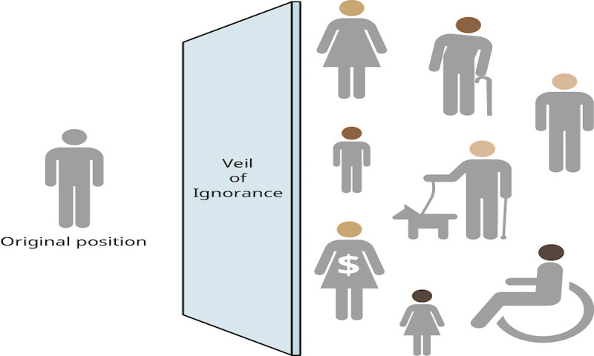

Slide 16
Original Position
Suppose we ask agents to agree upon principles of justice we can use to create a just society, a society the agents will subsequently live within. If the agents are to do this fairly, they cannot create principles that will favor one agent over another. If we can agree upon fair conditions and fair considerations in deciding such principles, then the agreed upon principles will be fair and Rawls claims just. These three conditions require the agents be:
Free
Mutually disinterested—they care only about their own interest and won’t aim to harm others.
Rational

Slide 17
The Veil of Ignorance
Agents don’t know |  | Agents do know
Age |  | Biological facts
Gender |  | Psychological facts
Ethnicity |  | Sociological facts
Handicaps
Intelligence
Race
Talents
Social standing
Values
Wealth

Slide 18
The Liberty Principle. Each person has an equal claim to a fully adequate scheme of equal basic rights and liberties, which scheme is compatible with the same scheme for all; and in this scheme the equal political liberties, and only those liberties, are to be guaranteed their fair value.
Social and economic inequalities are to satisfy two conditions:
Equality of Opportunity: (a) They are to be attached to positions and offices open to all under conditions of fair equality of opportunity;
The Difference Principle: (b), they are to be to the greatest benefit of the least advantaged members of society.

Slide 19
Difference Principle & Vaccines
Vaccines were initially scarce in the US. Not everyone who wanted one could get one.
Vaccines are still scarce in many countries. Fewer than 4% of people in Nigeria and Ethiopia, for instance, are fully vaccinated. When we don’t have vaccines for all, we must distribute them unequally.
The Difference Principle dictates that any inequalities in vaccine allocations must be to the maximum benefit of the least advantaged.

Slide 20
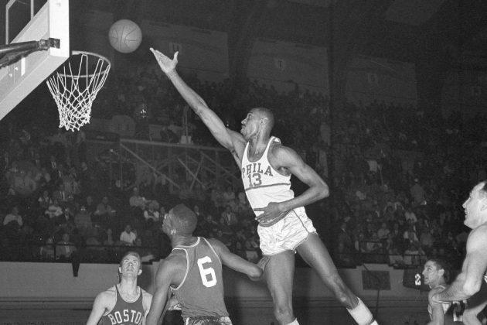
The Wilt Chamberlain Objection

Slide 21
Libertarianism (Robert Nozick)
First, anyone who justly acquires any holding is rightly entitled to keep and use it.
Second, anyone who acquires any holding by means of a just transfer of property is rightly entitled to keep and use it.
Third, justice can require the rectification of unjust past acquisitions.

