Slide 1
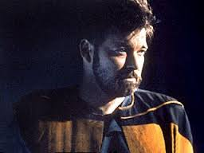
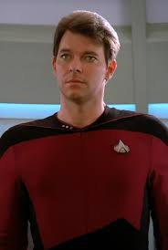
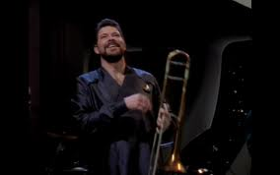
Which one of you has my soul?
Thomas
Riker
William

Slide 2
Which one of you has my body?
Thomas
Riker
William

Slide 3
