Slide 1
Just Allocations & Structural Inequalities

Slide 2
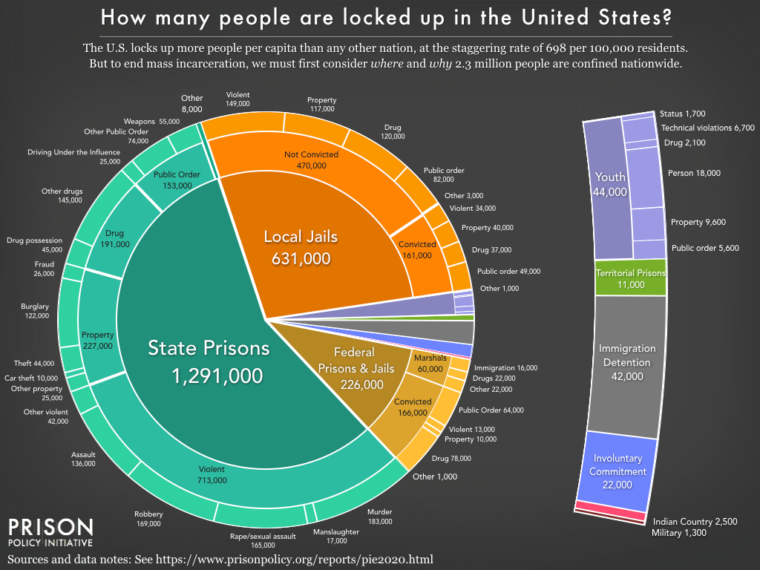

Slide 3
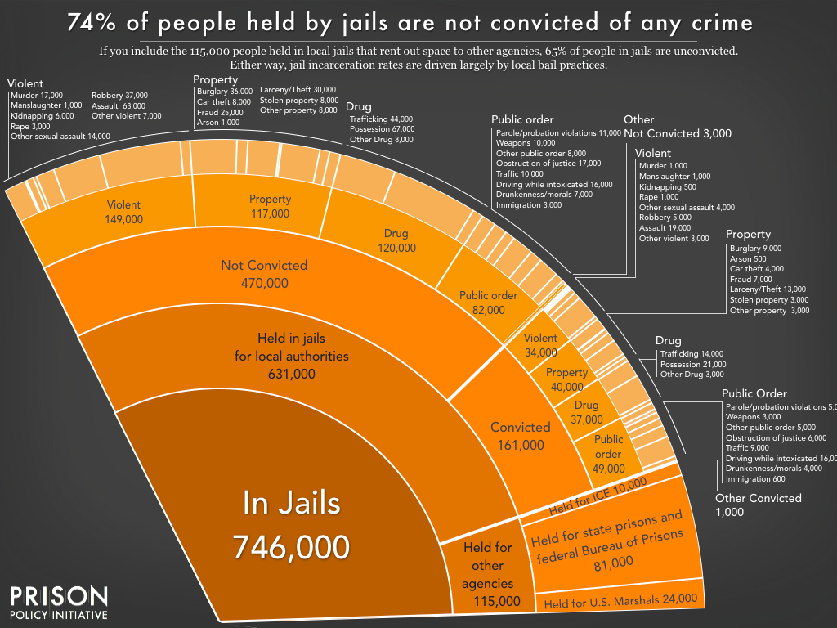

Slide 4
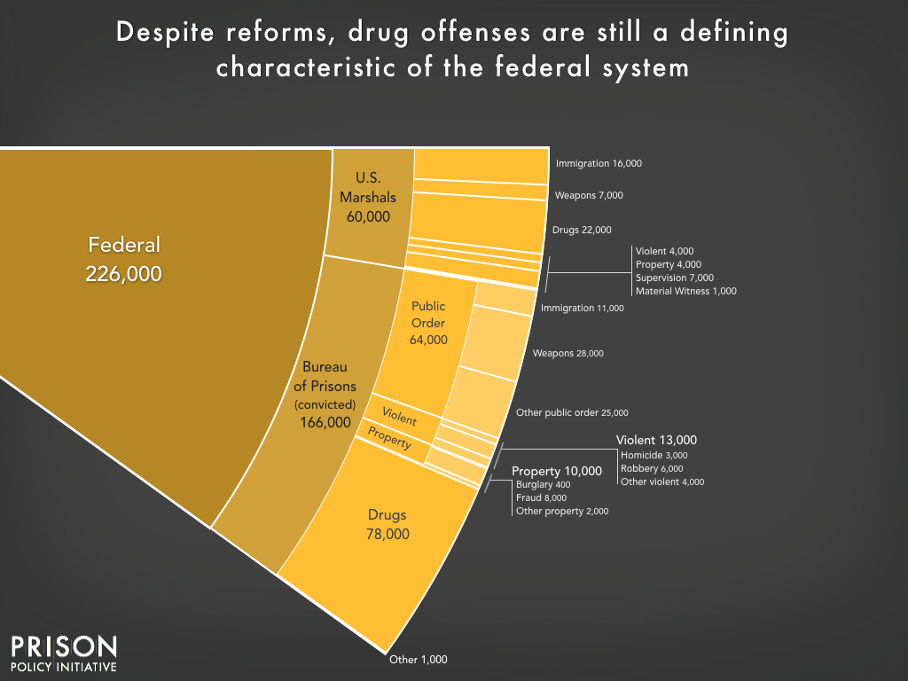

Slide 5
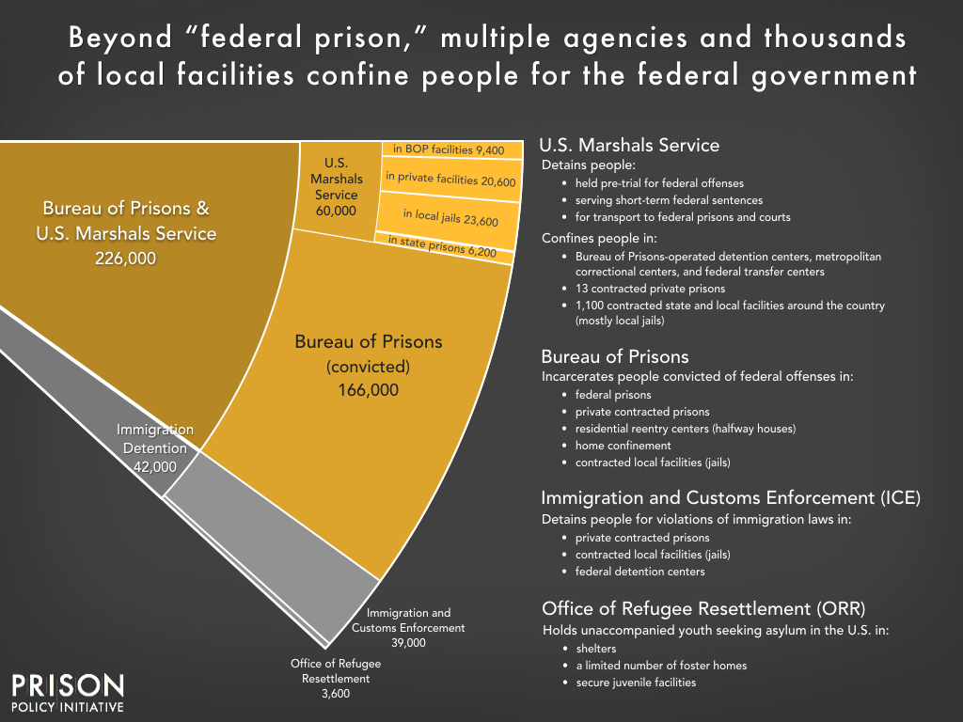

Slide 6
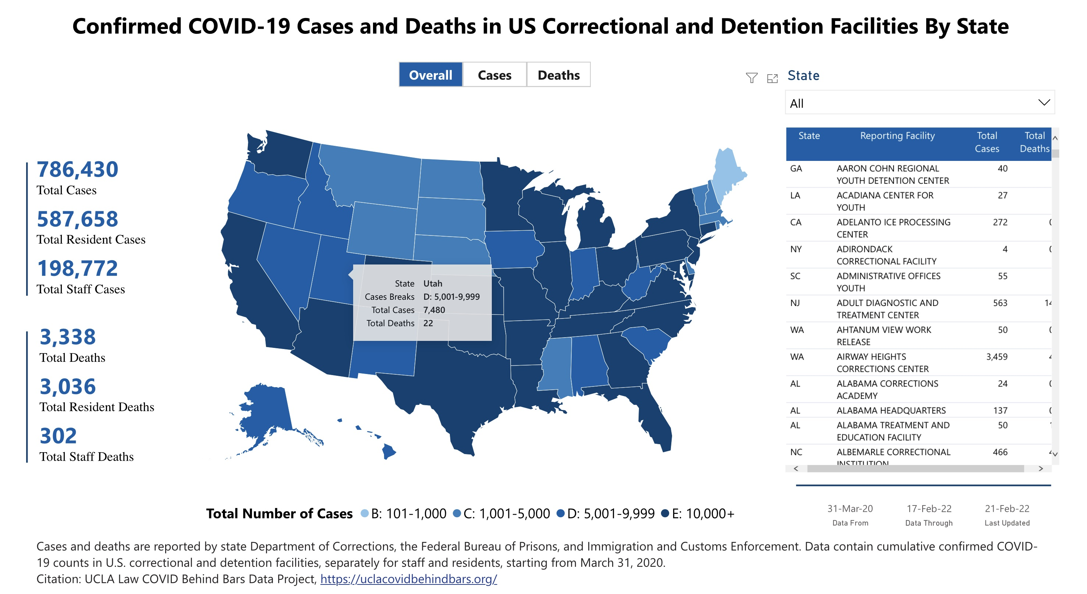

Slide 7
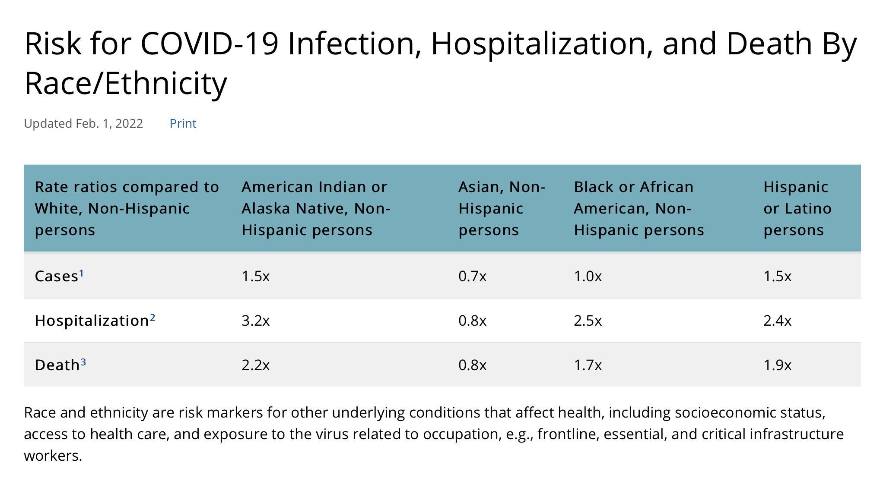

Slide 8
Just Allocations

Slide 9


Slide 10


Slide 11
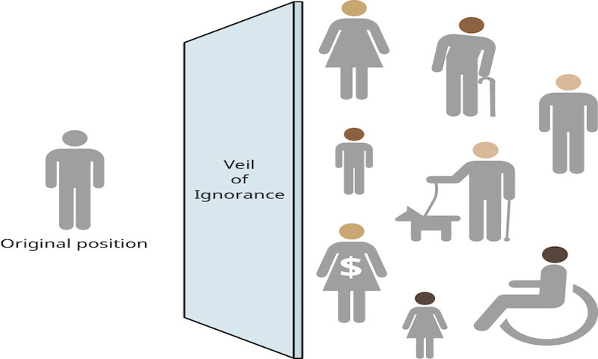

Slide 12
The Liberty Principle. Each person has an equal claim to a fully adequate scheme of equal basic rights and liberties, which scheme is compatible with the same scheme for all; and in this scheme the equal political liberties, and only those liberties, are to be guaranteed their fair value.
Social and economic inequalities are to satisfy two conditions:
Equality of Opportunity: (a) They are to be attached to positions and offices open to all under conditions of fair equality of opportunity;
The Difference Principle: (b), they are to be to the greatest benefit of the least advantaged members of society.

