Slide 1

<Automation Lab> <Fall 2024>
Heart Failure Data Set
Olivia R., Somto O., Zach G.

Slide 2
<Step 1> <Problem Definition>
Objective:
To understand what is causing a Death Event. By understanding what causes a Death Event it may help put a focus and emphasis on that specific issue. Understanding what causes Death Events can ultimately help reduce the number of Death Events.
Task:
We will perform a classification analysis to determine how the independent variables impact the dependent variable Death Event. We are doing this to determine what events determine the change of a death event.

Slide 3
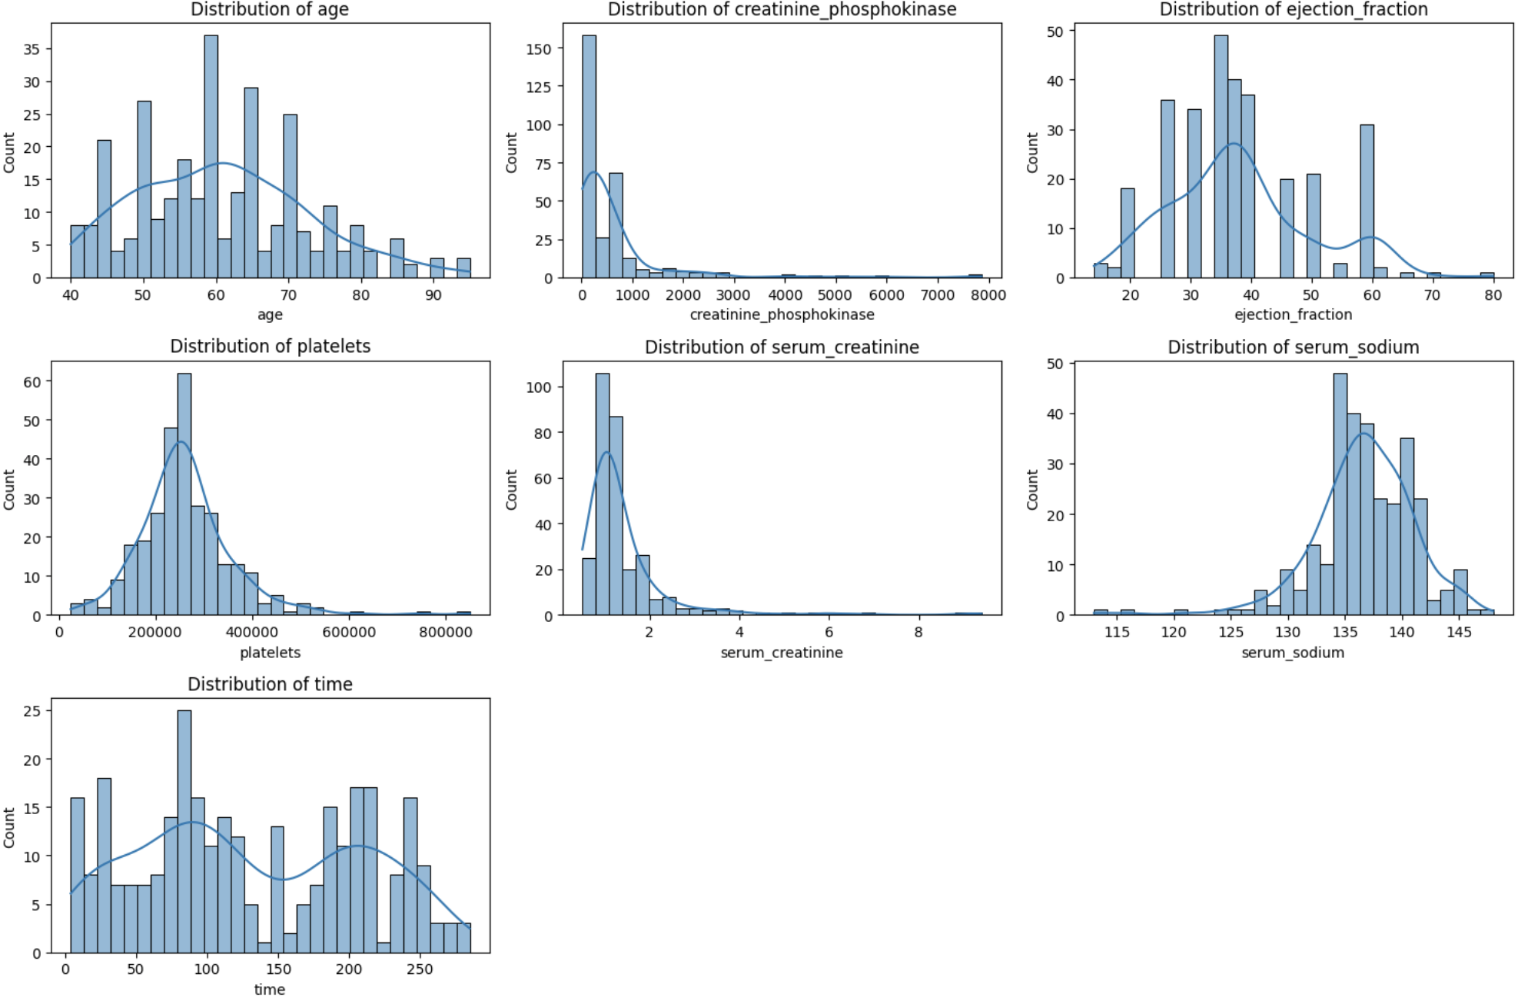
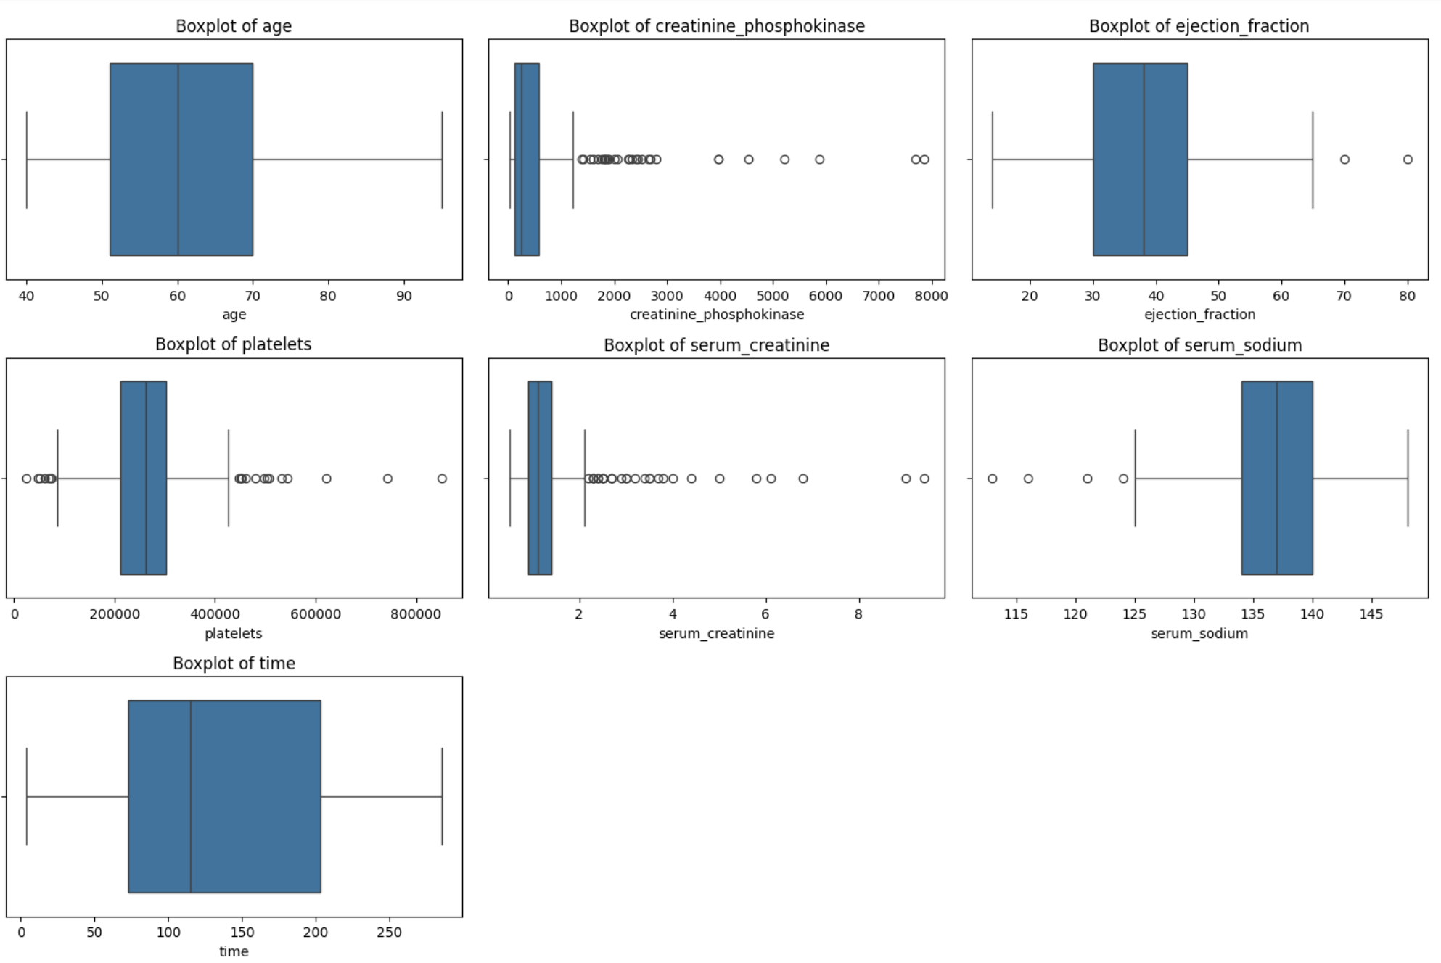
<Step 2> <Exploratory Data Analysis (EDA)>
Zero missing values detected
Creatinine Phosphokinase and Serum Creatinine have the most outliers and have a right skewed graph
Null Hypothesis (H₀): There is no significant relationship between the categories (features such as age, anaemia, creatinine phosphokinase, diabetes, etc.) and the likelihood of a Death Event.
Alternative Hypothesis (H₁): At least one of the categories (features) significantly impacts the likelihood of a Death Event.

Slide 4
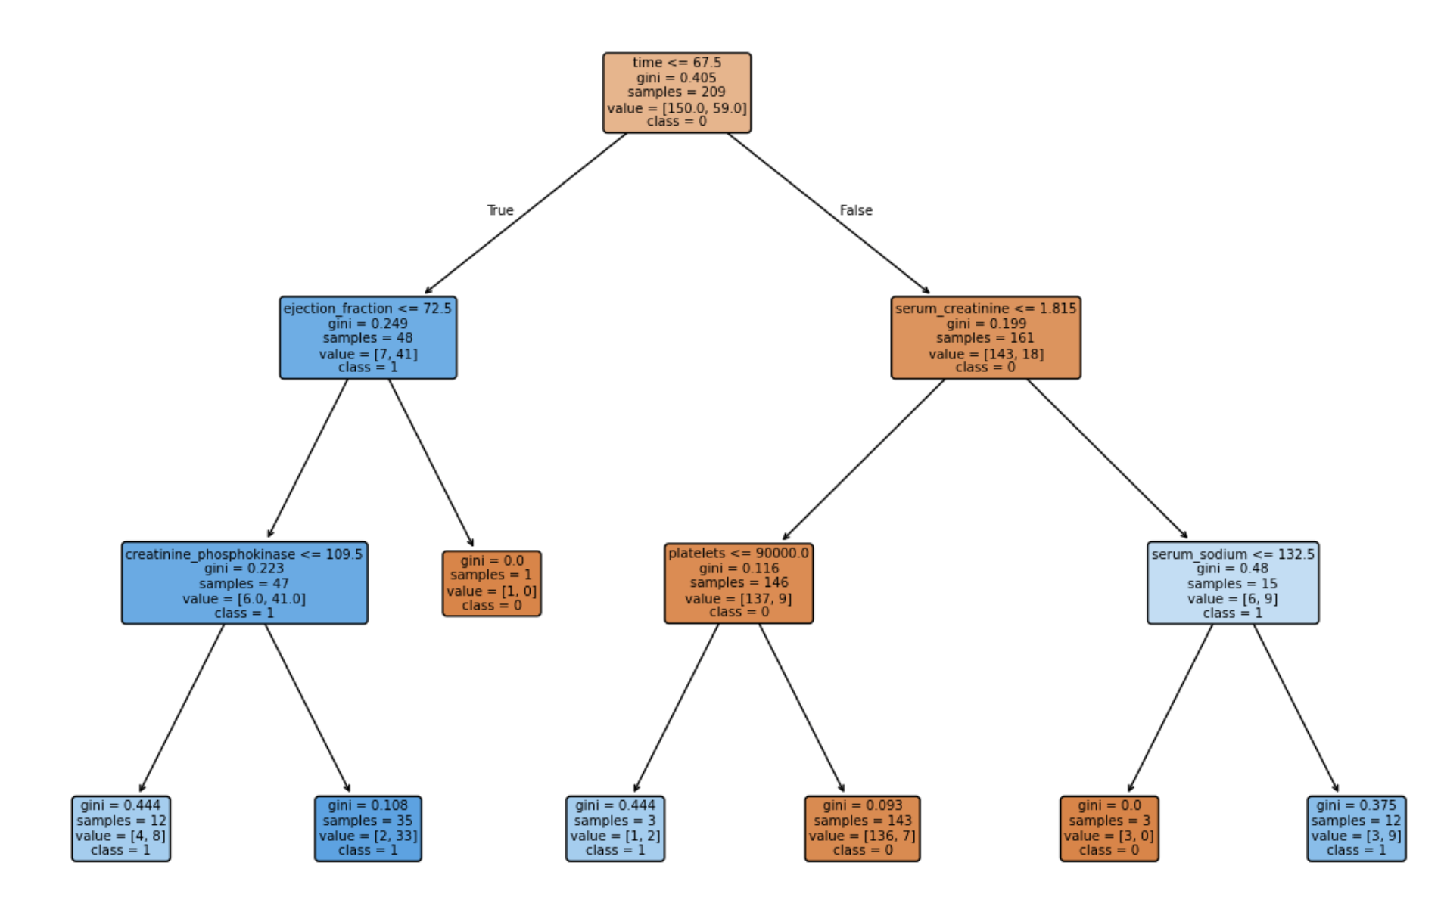
<Step 2> <Exploratory Data Analysis (EDA)>
If time ≤ 67.5, the samples are sent to the left branch.
If time > 67.5, the samples are sent to the right branch.
Left branch 1:
If ejection fraction ≤ 72.5, the samples are further split into the next level.
If ejection fraction > 72.5, only one patient is classified, with no death event (class 0).
Left branch 2:
If creatinine phosphokinase ≤ 109.5, the samples are split further.
If creatinine phosphokinase > 109.5, there is a strong majority of no death events (class 0)
Right branch 1:
If serum creatinine ≤ 1.815, the majority of patients experience no death events (class 0).
If serum creatinine > 1.815, there’s a higher proportion of death events, leading to further splits.
Right branch 2:
If platelets ≤ 90,000, the data splits again based on serum sodium.
If platelets > 90,000, the model predicts no death events (class 0) with very high confidence (low Gini index of 0.093).
Right branch 3:
If serum sodium ≤ 132.5, the risk of a death event (class 1) is high.
If serum sodium > 132.5, the risk of a death event is lower.

Slide 5
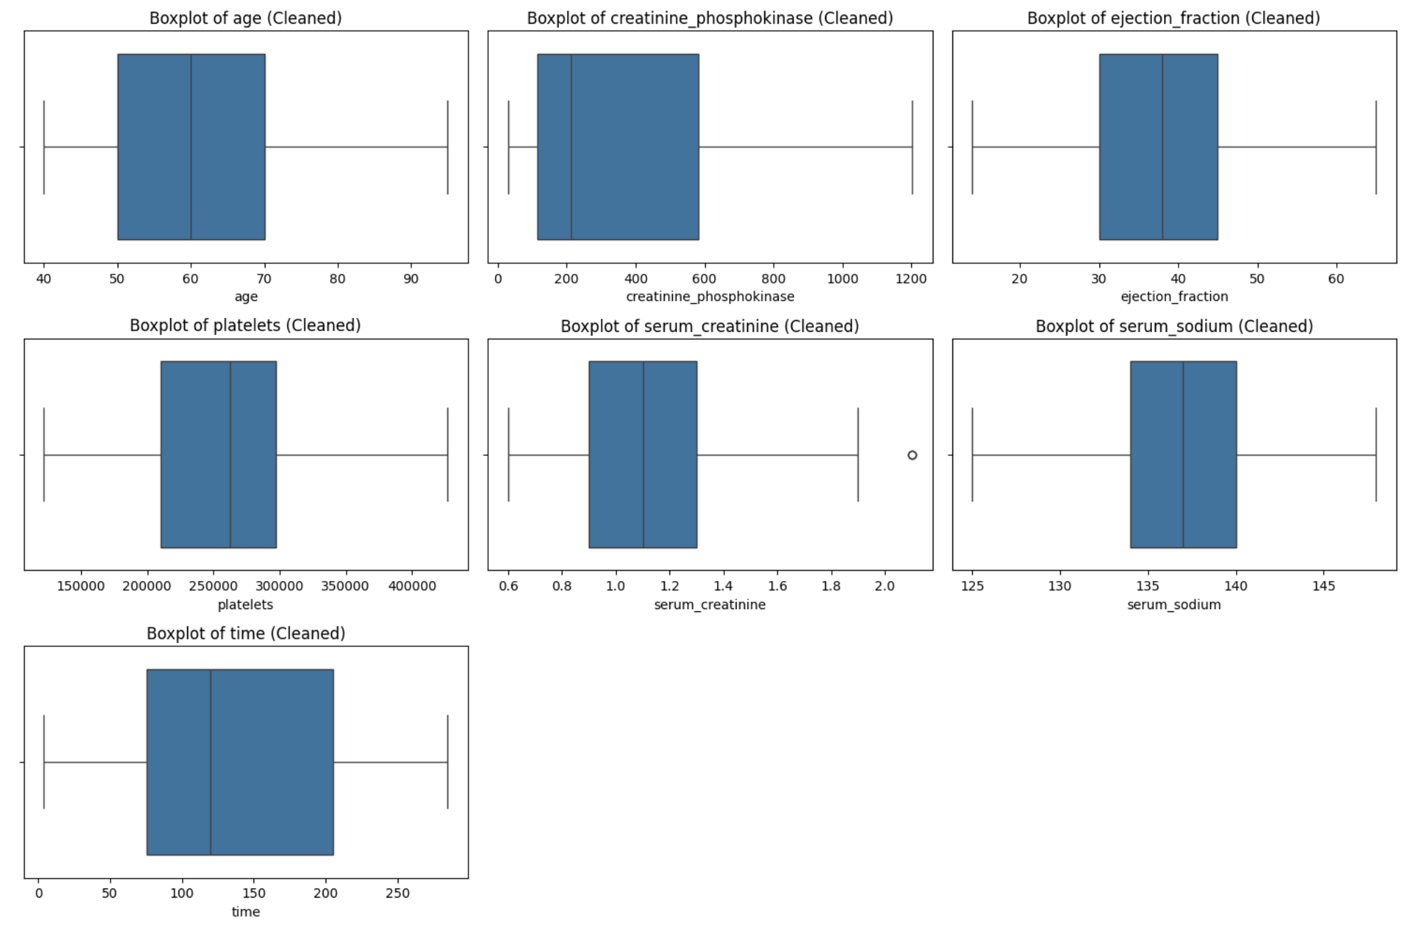
<Step 3> <Data Preprocessing>
Dropped any duplicates
Detected and handled outliers by removing them front the dataset
29 from creatinine_phosphokinase
2 from ejection_fraction
18 from platelets
23 from serum_creatinine
3 from serum_sodium
Check for Erroneous Data (negative values where not applicable)
Create a feature for age group

Slide 6
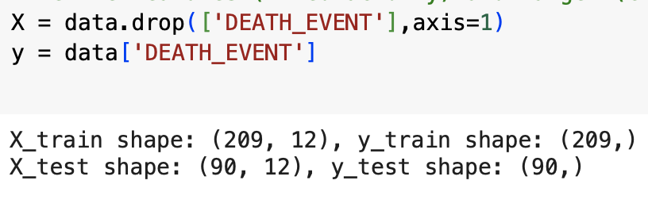
<Step 4> <Feature Selection>
Split Data into Features and Target
Features (X): All columns except DEATH_EVENT.
Target (y): The DEATH_EVENT column.
Dropped the Target Variable (DEATH_EVENT) from Features to avoid data leakage.
Used the train_test_split Function from sklearn.model_selection to separate data into training and testing sets.

Slide 7
<Step 5> <Modeling>
Data Splitting:
Divided the dataset into 70% training and 30% testing using train_test_split.
Maintained reproducibility with random_state=42.
Model Training:
Used a Decision Tree Classifier with a maximum depth of 3 to avoid overfitting.
Trained the model on the training set (X_train, y_train).
Model Visualization:
Plotted and visualized the Decision Tree, showing key splits and decision paths.
Prediction:
Predicted outcomes (y_pred) on the test set (X_test).
Model Evaluation:
Calculated model accuracy: {accuracy:.2f} (replace with the printed accuracy).
Generated a classification report to evaluate precision, recall, F1-score, and support for each class.

Slide 8
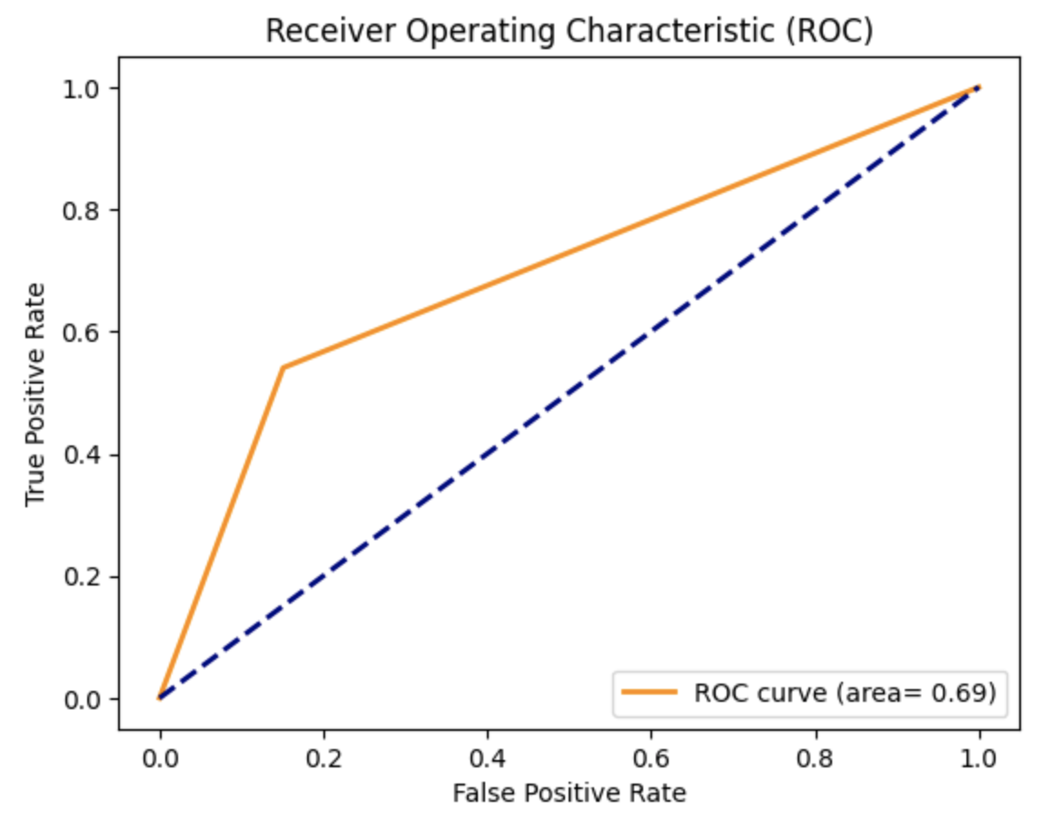
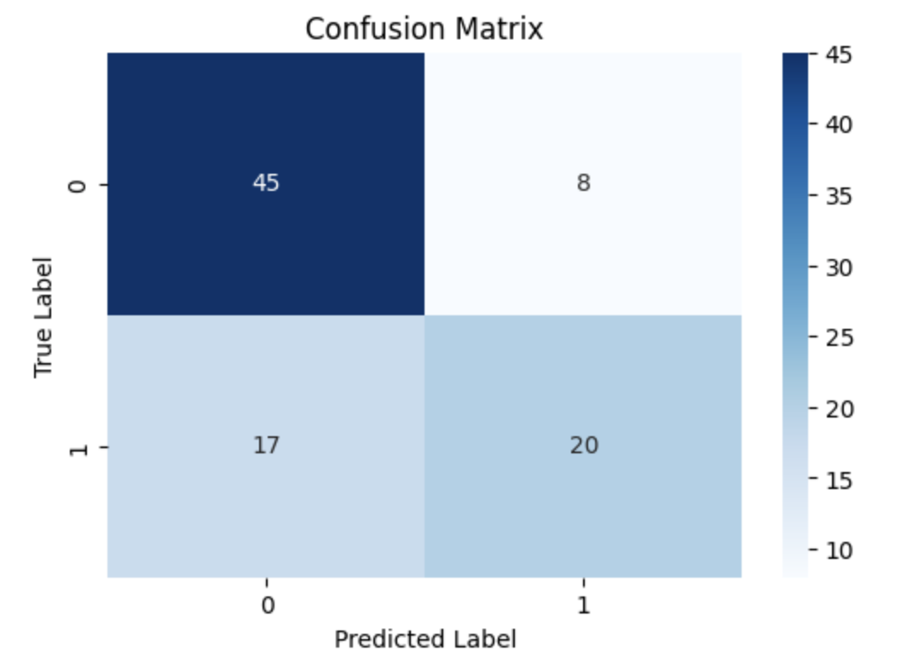
<Step 6> <Model Evaluation>
An ROC curve (area) of 0.69 indicates that the model is better than random guessing but still leaves room for improvement
For the confusion matrix:
False Negatives: The model misses 17 "Death" cases, highlighting low recall (54.1%) for the positive class, which is critical in high-stakes contexts.
False Positives: There are 8 incorrect "Death" predictions; while less critical, they could lead to unnecessary actions.
Class Imbalance: Likely skewed towards "No Death," affecting the model’s ability to detect minority cases.
Model Simplicity: A max depth of 3 limits the model's complexity, potentially causing misclassifications.

Slide 9
<Step 7> <Model Interpretation and Insights>
ROC AUC Score (0.69):
Moderate ability to discriminate between death and survival events.
Not sufficient for reliable predictions in high-stakes healthcare settings.
Confusion Matrix Insights:
17 false negatives, indicating missed death events.
Risks of not identifying patients needing critical intervention.
Key Features:
Serum creatinine and ejection fraction align with medical knowledge of heart failure.
Model captures some high-risk patterns but shows variability in platelets and serum sodium predictions.
Model Context:
False negatives are critical in healthcare; missing death events can have severe consequences.
Model conservatively identifies survival cases but risks overlooking critical patients.
Next Steps:
Focus on reducing false negatives for better detection.
Explore resampling or cost-sensitive methods to handle class imbalance.

Slide 10
<Thank You!>
Any Questions?

