Slide 1
What is LPDSRep

Slide 2
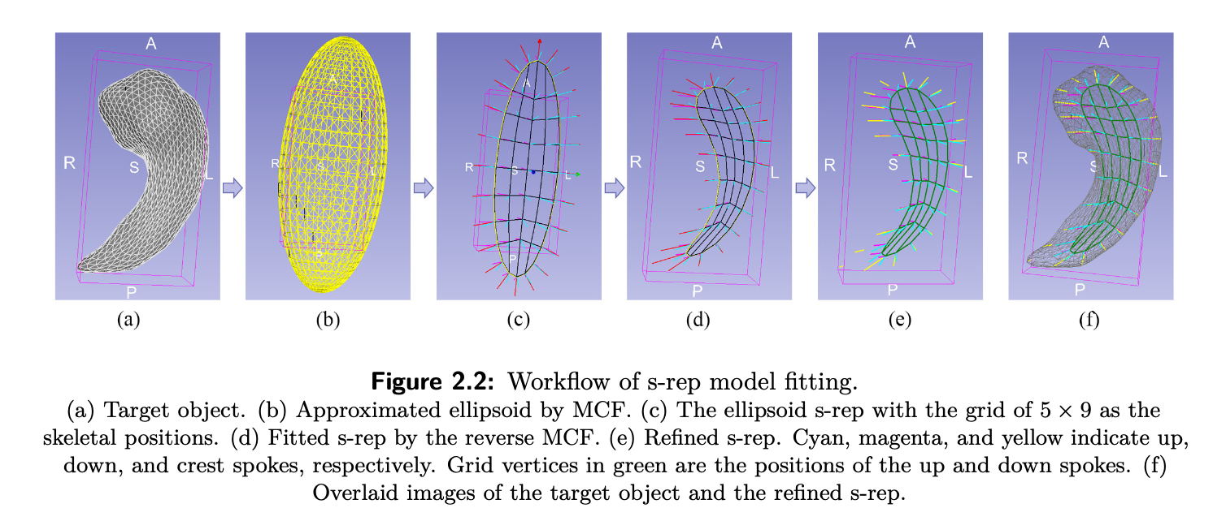
LPDSRep model fitting via mean curvature flow (MCF)

Slide 3
LPDSRep model fitting steps
Software
Meshmixer
ETRep R package
ETIA
SlicerSALT
Create artificial objects using ETRep R package
Convert *.obj to *.vtk files using SlicerSALT
What is ETRep?
Generate SPHARM-PDMs of the samples
Fit LPDSRep using the provided R code
Analysis
What is SPHARM-PDM?
What is LPDSRep?

Slide 4
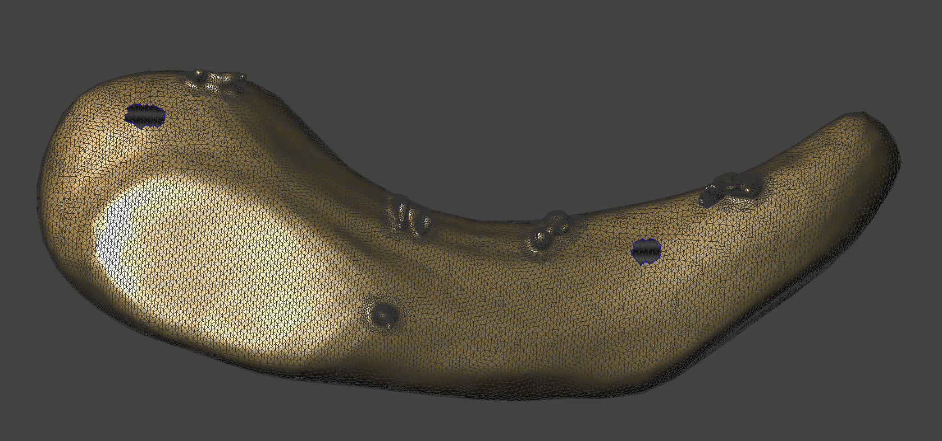
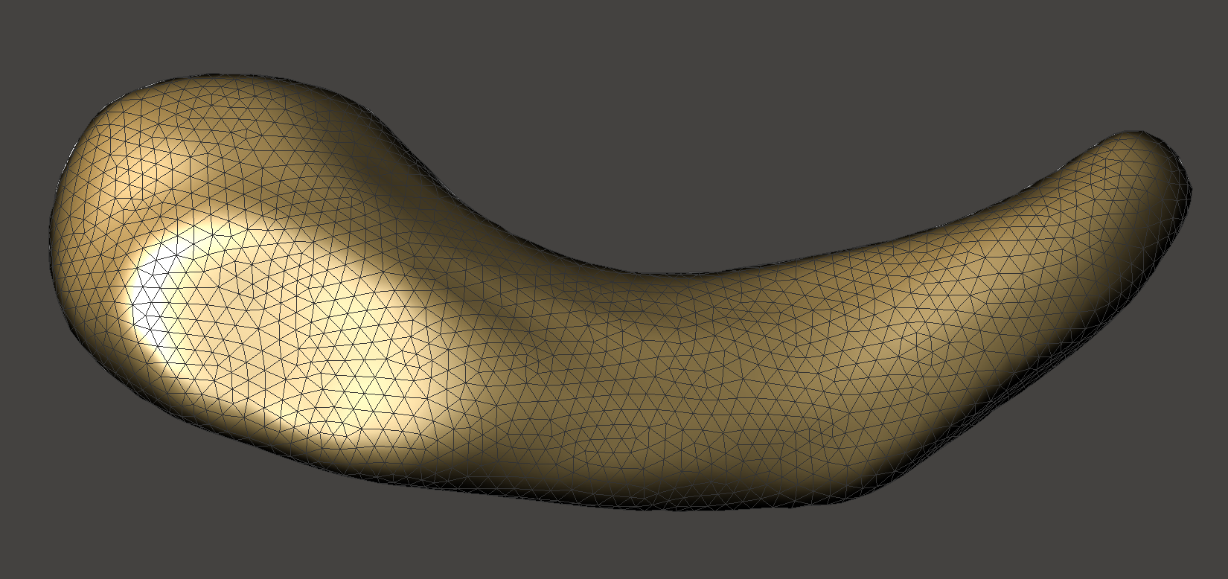
To fit SPHARM-PDM object must be diffeomorphic to a closed ball avoiding the below issues:
Holes and topological discontinuities → Violate the assumption of being homeomorphic to a closed ball.
Non-smooth with sharp protrusions → Obstruct the construction of a diffeomorphic mapping.
High boundary point density → Significantly increases the computational cost of SPHARM-PDM fitting.
Mitigation
Using software such as Meshmixer or 3D Slicer to:
Remove holes
Smooth the mesh surface
Reduce the number of triangles (mesh decimation)
Etc.

Slide 5
For the workshop we need object samples.
For that we can use elliptical tube simulation from the ETRep R package.
What is an elliptical tube?
Add the reference

Slide 6
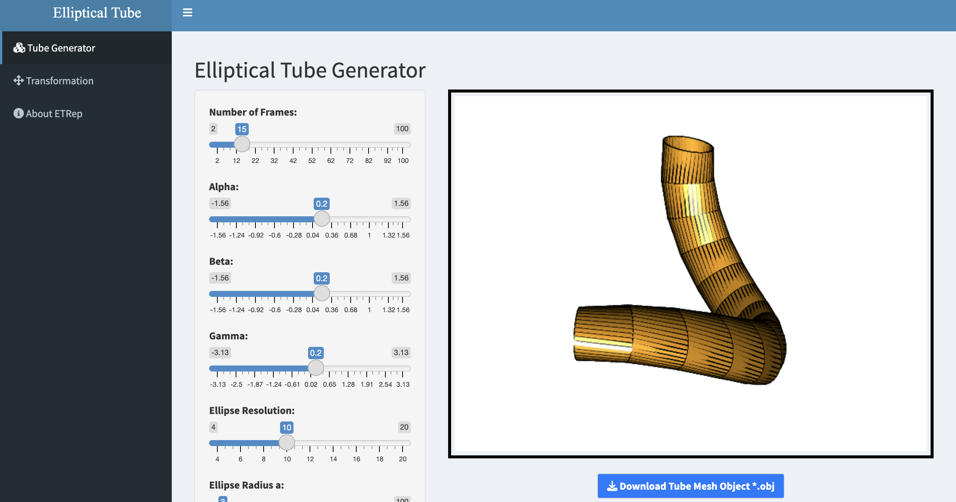
What is an elliptical tube?
https://cucsym-mohsen-taheri.shinyapps.io/etrep_shinyapp/
ETRep simulation

Slide 7
What is SPHARM-PDM?
Simillar to Fourier expansion of a function we can approximate and smooth closed smooth genus zero 3D surfaces using spherical harmonic functions. Then we use it for the registration.

Slide 8
For SPHARM-PDM registration we usually use VTK format.
SlicerSALT can be used to convert *.obj and *.nrrd to *.vtk

Slide 9
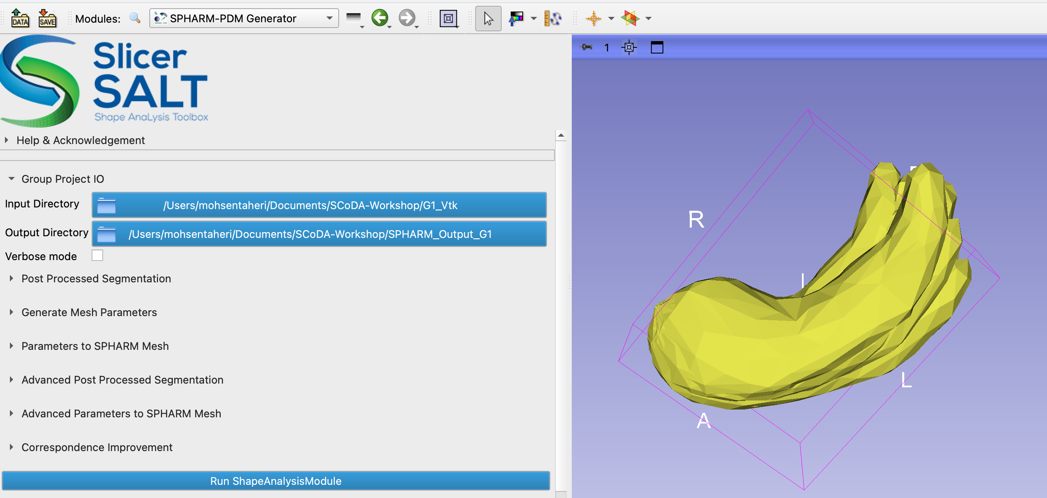
We need two directories The input directory where *.vtk files are located and an empty output directory

Slide 10
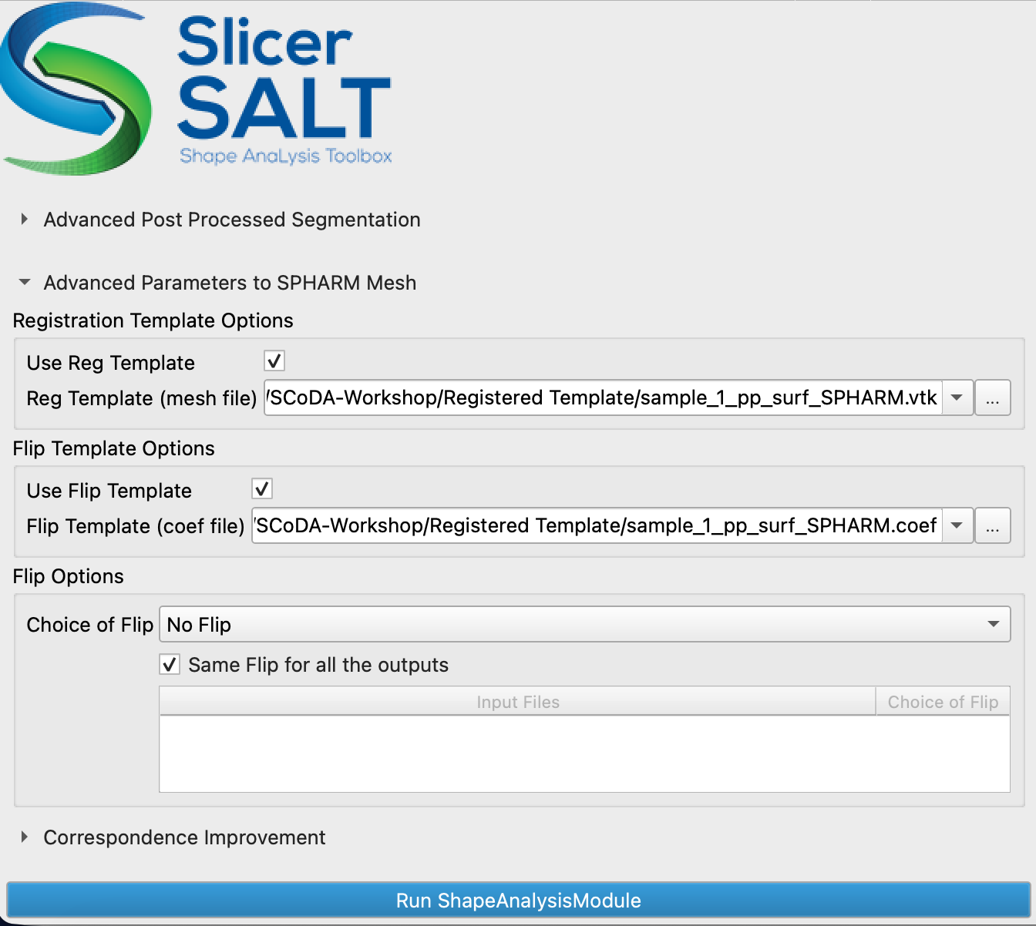
Make sure to use a registered template to obtain reliable point correspondence.
The template can simply be a sample from the dataset that has been processed and registered using SPHARM-PDM.

