Slide 1
PSYCH 3010 - 03 Research Methods in Psychology I Summer 2020 Online University of Missouri

Slide 2
Introduction to the Course
Syllabus is on the course website
Background on Me
Course Description and Materials
Learning Objectives
What to Expect from this Online Course
Course Structure
Policies and Resources

Slide 3
Background
Instructor: John E. Scofield, M.S.
Office: 125 Psychology Building
Office Hours: By appointment only (in person or Skype). Available continuously via email and will try to respond within the same day.
Email: jel7c5@mail.missouri.edu

Slide 4
Course Description and Materials
This course provides a comprehensive introduction to research methods in psychology.
A solid understanding of experimentation and the scientific method is absolutely essential in any field of psychology, including counseling, clinical, industrial/organizational, cognitive, biological, social, and more.
You will learn how to critically evaluate research studies as well as learn how to define research problems, identify variables, state hypotheses, select appropriate samples, design experimental and quasi-experimental studies, and communicate research findings.
Understanding and applying these concepts will not only prepare you for advanced undergraduate psychology courses (and graduate level courses), but will allow you to be a more critical consumer of information presented to you in the real world.

Slide 5
Course Description and Materials
Prerequisites
C or better in PSYCH 1000
C or better in STAT 1200 (or its equivalent) or concurrent enrollment in STAT 1200
If you have not met these requirements, please make an appointment with your academic advisor to discuss options. Please make sure to do this before the add/drop period ends.
Textbook
Research Methods in Psychology, 4th Edition.
This is a free, public domain textbook. You can download it as a pdf from Canvas, or from the original source at https://open.umn.edu/opentextbooks/textbooks/75. I hope that by assigning a free and immediately-available textbook I have made it easier for you to keep up with the assigned readings.

Slide 6
Learning Objectives
By the end of this course, you should be able to:
Identify various types of research claims made in both popular and scientific sources.
Understand ethical guidelines that apply to psychological research.
Identify different types of variables.
Assess the reliability and validity of measures.
Recognize different types of experimental and non-experimental approaches to research.
Differentiate between different sampling techniques.
Critically analyze scientific claims.
Design a basic experimental study to test a hypothesis.

Slide 7
What to Expect From this Course
While this course is administered online, it is NOT a self-paced course. It is an 8-week based course and the information will be presented similarly to that of a traditional semester-based course. Course material will be presented on a week-to-week basis.
The course is available at http://courses.missouri.edu. Under Login, select Canvas and enter your PawPrint.
If you have difficulty logging in to the course or you do not see the course listed, please contact the Mizzou IT Help Desk at helpdesk@missouri.edu or at 573-882-5000.

Slide 8
What to Expect From this Course
Online Course Etiquette
Please make sure class discussions are respectful and academically focused.
You are encouraged to comment, question, or critique an idea but are not allowed to attack an individual, a race, an ethnicity, or someone’s religious beliefs.
Also, please remember that sarcasm and humor can be misconstrued in online interactions and generate unintended disruptions. Working as a community of learners, we can build a polite and respectful course ambience.

Slide 9
What to Expect From this Course
Tips for success
Taking an online class gives you the flexibility to schedule your own time during the week to access the course and complete assignments. However, creating schedules to fulfill course requirements can be difficult for some people.
To ensure you do not fall behind or miss deadlines, I highly recommend that you schedule your work for this class as you might schedule your work for your in-person classes, employment, and/or appointments.
On your calendar, schedule several blocks of time throughout the week to work on this online class.
Visit the course site frequently (at least 3-4 times per week)

Slide 10
Course Structure
Course material will be presented on a week-to-week basis
Weeks will begin on Mondays and end on Sundays.
Each week you will have assigned readings, video lectures, homework assignments, discussion posts, and a weekly quiz.
Assigned readings: Book chapters, journal articles
Video lectures: similar in format to this video. Links placed on Canvas
Homework: Read and answer questions pertaining to course material.
Discussion Posts: Read prompts, post a response, and respond to another student’s post
Quiz: Timed (30 minutes) on Canvas. Will be a mix of multiple choice, matching, and free response questions.

Slide 11
Course Structure
Wednesdays (11:59 pm CST) – Initial Discussion board posts due
Fridays (11:59 pm CST) – Quizzes due
Sundays (11:59 pm CST) – Discussion post responses & Homework due
Exams – 3 exams. These will cover any material from the book, lectures, supplemental readings assigned.
50 questions (2 points each: 100 points total).
Timed on Canvas. 80 minutes.
Exams will be due on Sundays by 11:59 pm CST

Slide 12
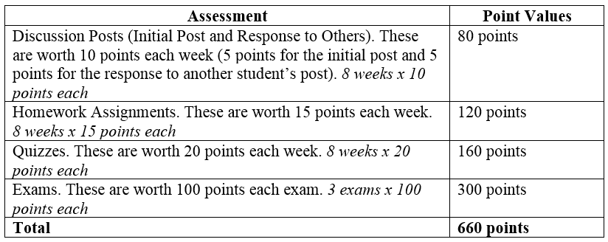
Grade Calculations
This class is point based. There will be no “rounding up”.
660 points.
For example, to receive an A minus, you will need no less than 594 out of 660 points. 593 points will not be counted as an A-, it will be counted as a B+

Slide 13
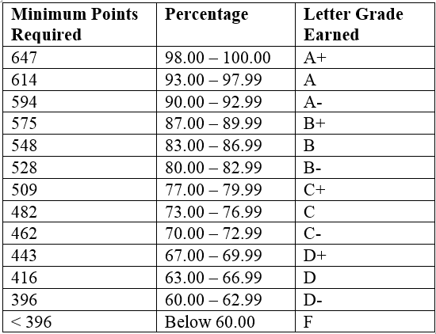
Grade Calculations

Slide 14
Grading Policies
All work must be completed by the deadlines provided. Late work will not be counted.
Please take this into consideration when creating your schedules to turn in your assignments on time.
I understand that internet connections can be weak, and computers can crash.
Therefore, I strongly encourage you to submit all assignments well before the deadline and to not wait until the last minute to submit assignments. Deadlines are at 11:59 pm CST. Work submitted at 12:00 am CST will not be considered.
Please note the time zone differences, and that the deadlines are in Central Standard Time.

Slide 15
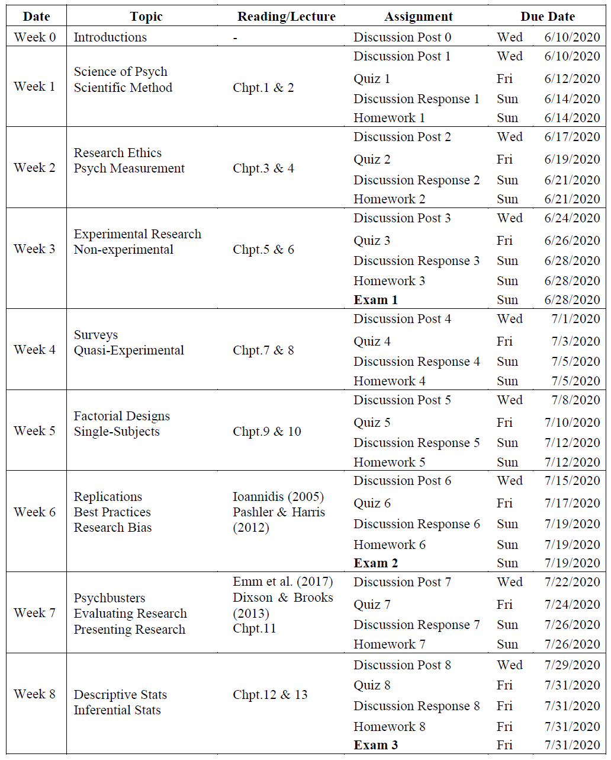
Tentative Schedule
Can change

Slide 16
Misc. Policies and Resources
See syllabus

