Slide 1
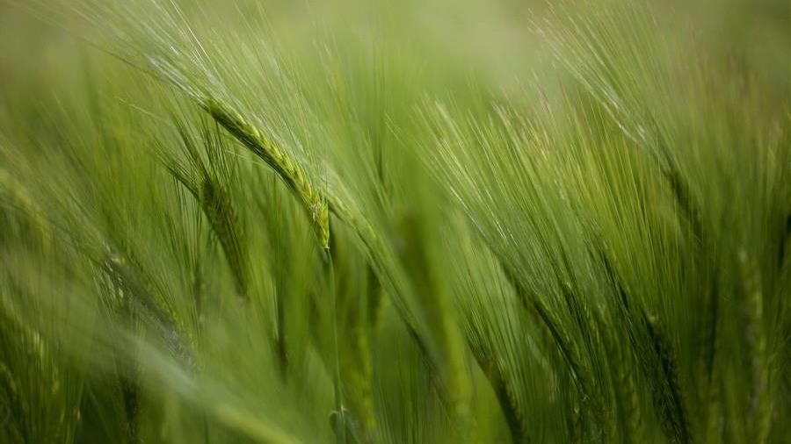
Native haven
Sean Coggeshall​​
American Military University
May 7, 2023

Slide 2
Home page
- Welcome to native haven!
- Logo and Navigation Menu (Home, planys, About, Application Prototype, Marketing, User Guide)
-Welcome to Native Haven, where we are committed to helping gardeners select and grow native plants that are beneficial to the environment and native pollinators. Our goal is to provide you with information and resources to help you create a beautiful, sustainable garden that supports local ecosystems. Explore our site to learn more about our mission, view our selection of plants, and discover helpful gardening tips. Start your journey towards a thriving, natural garden today!

Slide 3
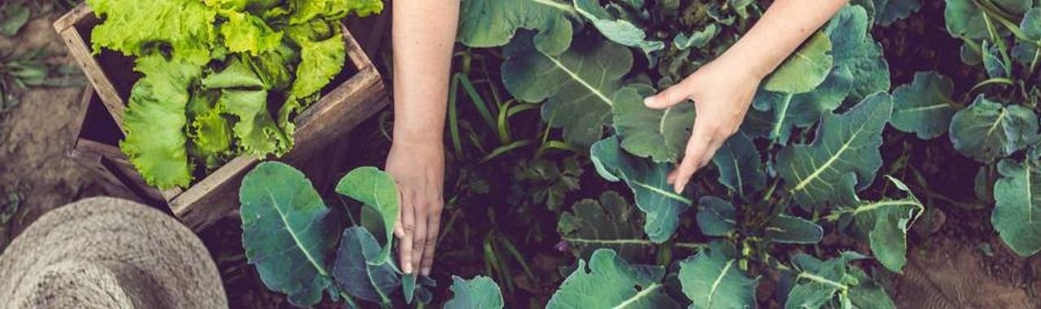
About us tab
At Native Haven, we are passionate about promoting sustainable gardening practices and empowering gardeners to make informed decisions. Our mission is to help gardeners select native plants that are not only beautiful and beneficial but also support the environment and native pollinators. We believe that by choosing native plants, we can create thriving ecosystems that are in harmony with nature. Our team of experts is committed to providing reliable information and resources to help gardeners make a positive impact on their local environment. Together, we can create a greener, healthier planet for generations to come.

Slide 4
Plants tab
The Plants tab on our website provides a comprehensive list of native plants that are best suited for your specific region. You can browse through the plants by categories such as flowering plants, shrubs, trees, and more. Each plant includes a detailed description of its characteristics, growth requirements, and benefits to the local ecosystem.

Slide 5
User guide tab
The User Guide tab provides helpful resources for users to learn how to navigate the Native Haven website and make the most out of their gardening experience. From step-by-step guides on how to use the website features to tips on planting and maintaining native plants, this tab is a valuable resource for both novice and experienced gardeners.

Slide 6
Marketing page tab
The marketing page tab provides information about Native Haven's mission and values, as well as details about upcoming events, promotions, and partnerships. It also highlights the benefits of using native plants in landscaping and gardening and provides resources and tips for promoting eco-friendly practices. As well as links to social media pages.

Slide 7
Application prototype
The application prototype page is where users can try out our software without the need for any downloads or installations. They can get a feel for how the application works and experience the benefits of using our product firsthand. This page is an opportunity for users to explore the key features of our software and see how it can help them in their gardening efforts.

Slide 8

summary
Native Haven is a website dedicated to helping gardeners select native plants for their gardens. Its key features include a comprehensive plant database, user-friendly search and filter options, informative articles and guides, and a community forum for exchanging tips and ideas. By using Native Haven, gardeners can create sustainable and wildlife-friendly gardens that benefit the environment and support native pollinators.
To start using Native Haven and enjoy its benefits, we encourage all users to create a free account. By creating an account, users can save their favorite plants, create and share plant lists, participate in the forum, and receive personalized recommendations based on their preferences and location. Signing up is quick and easy, so don't hesitate to join the Native Haven community today!
We value your feedback and are always available to answer any questions you may have. To get in touch with us, please visit our Contact Us section of our marketing page. We also invite you to follow us on social media to stay up-to-date on our latest news and updates. Thank you for choosing Native Haven!

