Slide 1

The 10/90 Rule
Sean F. Coggeshall
American Military University
WEBD122 B002 Winter 2025

Slide 2
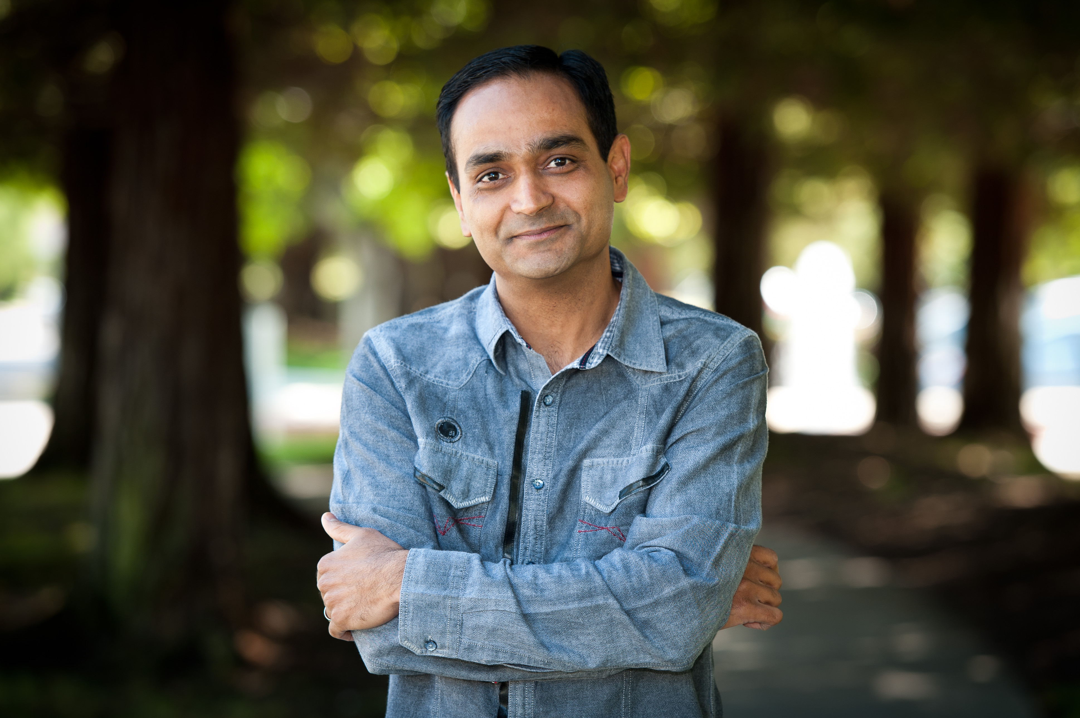
What is the 10/90 Rule?
Developed by Avinash Kaushik, a pioneer in web analytics.
10% of the budget should be spent on analytics tools.
90% of the budget should be allocated to skilled analysts.
Emphasizes actionable insights over raw data collection.

Slide 3

Why is the 10/90 Rule Important?
Ensures that tools are effectively utilized to derive meaningful insights.
Addresses the common issue of data overload with no actionable outcomes.
Promotes investment in human expertise to analyze, interpret, and act.
Aligns web analytics with business objectives and ROI.

Slide 4


How is the 10/90 Rule Implemented?
Invest in training and hiring skilled web analysts.
Use free or cost-effective tools like Google Analytics for data collection.
Prioritize actionable insights over excessive reporting.
Foster collaboration between IT and business teams for holistic strategies.

Slide 5

Benefits and Advantages
Maximizes ROI by leveraging existing tools effectively.
Drives better decision-making through skilled analysis.
Reduces wasteful spending on unused or underutilized tools.
Creates a scalable and sustainable web analytics framework.

Slide 6
SUMMARY
The 10/90 Rule emphasizes the value of people over tools in web analytics.
Actionable insights require skilled analysts to interpret complex data.
By adhering to the 10/90 Rule, organizations can achieve sustainable success.

Slide 7
References
Davenport, T. H., & Harris, J. G. (2007). Competing on Analytics: the new science of winning. https://ci.nii.ac.jp/ncid/BA8105303X
McGuirk, M. (2023). Performing web analytics with Google Analytics 4: a platform review. Journal of Marketing Analytics, 11(4), 854–868. https://doi.org/10.1057/s41270-023-00244-4
Kaushik, A. (2007). Web Analytics: An hour a day. http://ci.nii.ac.jp/ncid/BA87811899
Kaushik, A. (2023, April 26). Avinash Kaushik: Bio - Occam's Razor by Avinash Kaushik. Occam’s Razor by Avinash Kaushik. https://www.kaushik.net/avinash/bio/

