Slide 1
Web Analyst for Friends of Disaster Relief (FDR)
Sean F Coggeshall
American Military University
WEBD122: Intro to Web Analytics
Dr. Diane Stottlemyer
March 2, 2025
Notes:
Welcome everyone, today we will focus on the power of Web Analytics and how we can use these tools to further our efforts in disaster relief. Currently, we are not utilizing the data on visitor behavior, donation trends, and engagement. Without this, we’re guessing rather than making data-driven decisions. By using Google Analytics and Matomo, we can track key website metrics to optimize our donation funnel, improve engagement, and increase transparency (Joshmorrow, 2024). By the end, you’ll see the importance of Web Analytics and how we can use them to further our reach and drive engagement.

Slide 2
Introduction
Nonprofit websites must convert visitors into donors/supporters
Web analytics shows who’s visiting, from where, and what they do
Data-driven strategy beats guesswork
Objective: Increase donations, engagement, and mission impact
Notes:
In today's world an organizations website is the main point of attraction when working with customers. It is our gateway to the public, making it extremely important for driving donations and volunteer sign ups. Many non-profits don’t focus on Web Analytics, they go without tracking visitor behavior, missing out on meaningful data that can point to what works and what doesn’t
Web Analytics gives us the power to see how our users are responding when they come to our website. Whether from social media, email campaigns, or internet search, they all arrive to the same place, and we get to see how each user responded. For instance, if we learn that visitors from an email appeal are more likely to donate than those from Twitter, we can invest more heavily in email outreach. Data transforms gut feelings into measurable, evidence-based decisions. By applying analytics, FDR can optimize its site layout, enhance fundraising campaigns, and better serve disaster victims. In short, web analytics is a fundamental tool for achieving our organizational goals.

Slide 3
Current Challenges (No Analytics)
Zero visibility: Don’t know why donations lag
Missed opportunities: Not capturing visitor behavior data
Decision-making by hunch, not evidence
No metrics to show the board or donors
Inefficient use of time/budget
Notes:
Without analytics, we are essentially operating in the dark when it comes to our website. We can’t see which page is attacking to the most users or why certain campaigns fail to convert to donations while others succeed. This is leading us to guess work, when we make a change to our site there is no way to tell if it worked or not. That also means no clear metrics to show the board how the site is performing. We may even be wasting resources trying to fix things that are working perfectly fine.
A data-driven approach fixes this by tracking user journeys, identifying where we lose potential donors, and showing us which efforts yield genuine results. Ultimately, analytics helps us focus on what truly increases funds for disaster relief.

Slide 4
What Is Web Analytics & Why It’s Critical
Definition: Collecting and analyzing user interactions
Tools (Google Analytics, Matomo) use tracking code on site
Identifies traffic sources, user paths, and conversions
Why it matters: Informs improvements that boost donations
Notes:
Web analytics refers to gathering and examining data about how people use our site. This includes where visitors come from like emails or social media and which pages they view or ignore. Tools like Google Analytics (a free, widely-used option) or Matomo (open-source with strong privacy controls) place a small snippet of code on each web page. Whenever visitors arrive, the code records their interactions, such as pages clicked or donation forms started and can display it on a dashboard for easier digestion.
This takes real-time data and shows exactly what drives donations, letting us optimize everything from homepage design to campaign messages. For example, if we see a large drop-off on our donation page, we can test simpler forms or new calls-to-action. In short, analytics pinpoints successes and problem areas, giving us a clear roadmap for increasing donations.

Slide 5
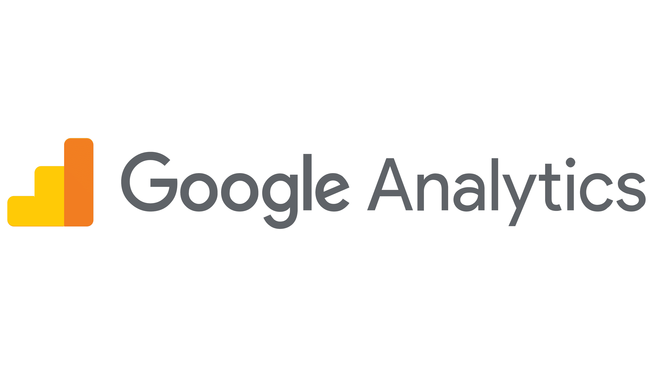
Overview of Google Analytics
Free, dominant analytics tool
Tracks traffic, user behavior, conversions
GA4: event-based, cross-device tracking
Easy to set up, rich dashboards
Perfect for nonprofits starting out
Notes:
Google Analytics is the leading tool when it comes to web analytics. It comes with a standard free version, making it budget friendly. By utilizing it we can measure user behavior, including what pages lead to donations and users signing up. Google Analytics focuses on events rather than just pageviews, letting us get exactly what we're looking for, like someone hitting the “Donate” button or viewing a specific video. This helps us identify conversion rates, traffic sources, and areas where users drop off. For instance, if we discover that visitors from a specific Facebook post donate at a higher rate, we’d invest more in that channel. This gives us an immediate way to gather data and turn it into actions that boost engagement and giving.

Slide 6
Overview of Matomo
Open-source, privacy-focused solution
Self-hosted or cloud option
Complete data ownership and GDPR compliance
Similar metrics to GA, plus extras like heatmaps
Notes:
Matomo is a strong alternative for organizations looking to keep full control of their analytics data due to it being open source. Unlike Google Analytics, which stores data on Google’s servers, Matomo can be self-hosted or used via a dedicated cloud service. It also offers optional plugins for heatmaps and form analytics, helpful in spotting donation form drop-offs. By managing the data on our own server, we maintain donor privacy, a potential plus for supporters concerned about personal information.
Although it involves more setup, many nonprofits find Matomo’s privacy first approach aligns well with building trust and transparency into their operations.

Slide 7
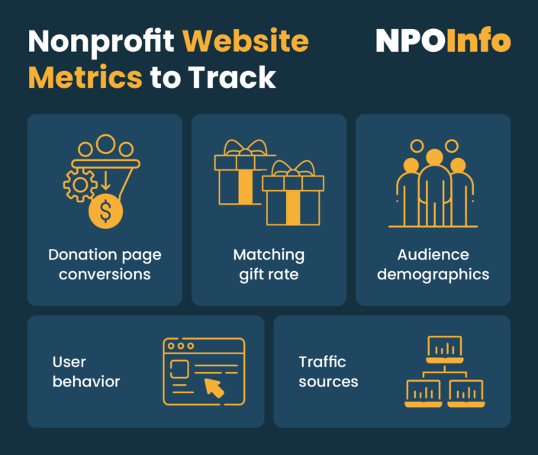
Key Metrics to Track
Donation Conversion Rate
Traffic Sources
User Behavior
New vs. Returning Visitors
Demographics
Notes:
Tracking the right metrics is crucial for a nonprofit organization. The donation conversion rate demonstrates how effectively the organization converts visitors into donors (NPOInfo, 2024). For example, if 100 people visit the website and 5 of them donate, the conversion rate is 5%. Analyzing traffic sources reveals which channels, such as Facebook, email campaigns, or direct URL visits, drive website traffic and lead to donations. If email campaigns consistently yield better conversion rates, the organization can prioritize those channels.
User behavior metrics, like bounce rate or average time on page, can identify potential issues or successes on the website. A high bounce rate on the homepage might indicate poor messaging, while a long session duration suggests engaged visitors. Monitoring new versus returning visitors helps the organization gauge supporter loyalty, as returning visitors may be prime candidates for recurring donations. Basic demographic data can reveal where supporters live and their interests, guiding content and outreach strategies that resonate more effectively with the target audience.

Slide 8
Implementation Steps
Donation Conversion Rate: % of visitors who donate
Traffic Sources: Where visitors come from (email, social)
User Behavior: Pages per visit, bounce rate, time on site
New vs. Returning Visitors: Indicator of loyalty
Demographics: Location, interests (for targeted outreach)
Notes:
The first step is also one of the most important steps in Web Analytics and that is to have clear goals with defined benchmarks. We can track everything that we want, but if you don’t know what direction we’re trying to go then it really won’t lead us to success. Our goals for the website should align with our business objectives, such as donation or volunteer signup completions.
Second, install the tracking code. Google Analytics 4 offers a script to insert on our site; Matomo does similarly if we self-host. Then, configure conversions so each completed donation triggers a “Goal” or “Event” in our analytics. ([GA4] Rename and Generate New Events - Analytics Help, n.d.)
After the technical infrastructure is in place, the team will be trained on interpreting essential reports, such as traffic sources, conversion rates, and user flow. Implementing a monthly reporting cycle will keep everyone informed on the key metrics, enabling the team to identify trends and adapt their strategies in a timely manner.
Once we have understood our reports the organization will engage in continuous refinement, using the data to optimize donation funnels, test new calls-to-action, and simplify forms. Over time, these iterative improvements will compound, leading to measurable and sustainable increases in donations and user engagement.

Slide 9
Addressing Privacy & Data Protection
Donor PII and payment data (PCI-DSS) are highly sensitive
GDPR/CCPA compliance for EU/California visitors
Cookie consent banners or cookieless tracking (Matomo)
Transparent privacy policy builds trust
Notes:
Because FDR processes credit card donations, we must also ensure compliance with the Payment Card Industry Data Security Standard (PCI DSS). This involves strict safeguards for encrypting and handling donor payment information, in addition to protecting personal details (PII). We will not store credit card data or other sensitive fields in analytics—both Google Analytics and Matomo can anonymize IP addresses and exclude potentially identifying information. These measures support GDPR/CCPA compliance for visitors from regions with strong data protection laws. We would need a clear and accessible privacy policy explaining what data we collect and why helps build donor confidence, so that we remain both legally compliant and ethically responsible in our data practices.

Slide 10
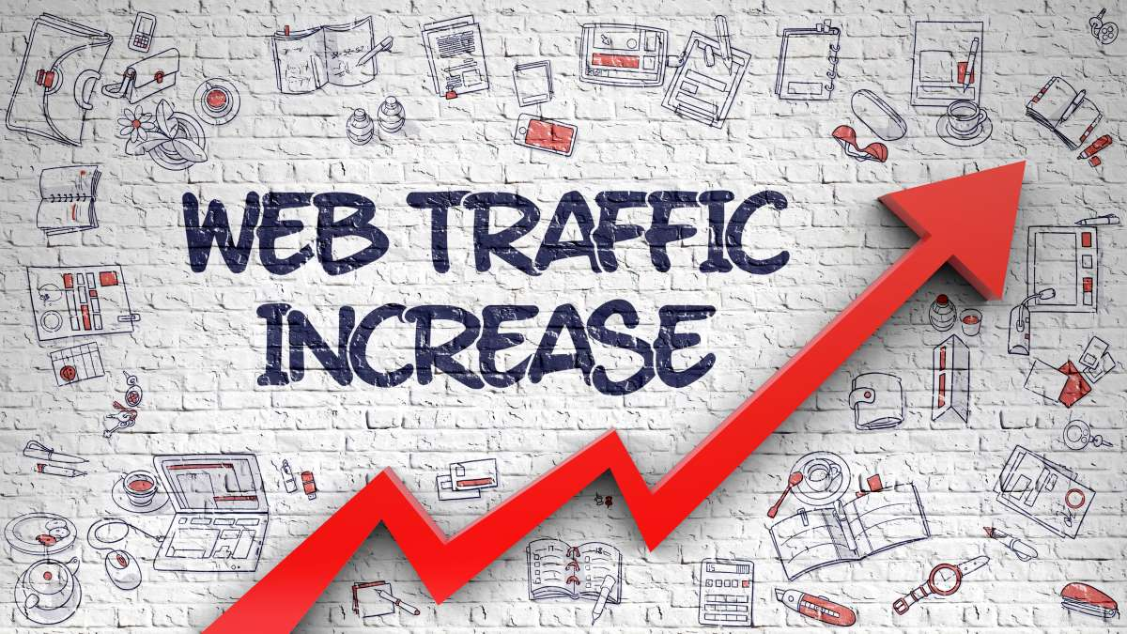
Case Studies & Expected Impact
Nonprofits using analytics often see higher online donations
Identifying friction:
Expected outcomes for FDR: More donations, improved engagement, efficient marketing
Notes:
Real-world examples demonstrate the significant impact that web analytics can have on nonprofit fundraising efforts. Charity: Water, for instance, collaborated with Thrive Digital to refine its storytelling and engagement strategy. By employing A/B testing and data-driven creative optimization, they experimented with different ad formats, messaging styles, and visual elements to determine what resonated most with potential donors.
Through analyzing conversion rates and audience interactions, they were able to fine-tune their digital campaigns, resulting in a 66% reduction in cost per one-time donation. This data-driven approach allowed them to maximize their outreach while ensuring donor contributions were used more efficiently (Charity: Water Case Study | Thrive Digital, n.d.).
For FDR, tactics such as testing donation page layouts, simplifying user journeys, and tailoring social media strategies based on analytics can help increase donations and supporter retention. We can use data to eliminate obstacles and optimize engagement driving long-term fundraising success.

Slide 11
Next Steps & Conclusion
Green-light the plan and assign an Analytics Champion
Train staff, configure goals, and start monthly reporting
Foster a data-driven culture; test and refine continuously
Conclusion: Analytics = clarity, better fundraising, and stronger impact
Notes:
To move forward, FDR should formally adopt Google Analytics and/or Matomo, assigning a Web Analyst to oversee setup, reporting, and optimization. This person will make sure our data is interpreted correctly and used to inform strategic decisions. Once live, analytics will highlight weak spots, allowing for us to improve donation forms, simplify navigation, or strengthen calls to action. For example, if we see a high exit rate before donations, we can refine the page to improve completions.
Over time, a data-driven culture will create continuous improvement. Routine monthly reporting will track progress, guiding ongoing refinements. Now is the time to commit. The sooner we implement these tools, the sooner we optimize our efforts and amplify our impact. Let’s move forward with confidence in a data driven future.

Slide 12
References
  NPOInfo. (2024, January 3). Web Analytics for Nonprofits: A mini guide for the New Year. NPO Info. https://npoinfo.com/web-analytics-for-nonprofits/
  [GA4] Rename and generate new events - Analytics Help. (n.d.). https://support.google.com/analytics/answer/10085872?hl=en
  Spencer, J. (2021, September 29). 3 reasons why your organization should track analytics. Let’s Fundraise Together! https://blog.donately.com/3-reasons-why-your-organization-should-track-analytics/
  charity: water case study | Thrive Digital. (n.d.). https://thrivedigital.com/case-study/charity-water/

