Slide 1
AMU PRESENTATION 1
SEAN F. COGGESHALL
MANAGEMENT INFORMATION SYSTEMS INFO331
DR. MARIO MISSAKIAN

Slide 2
PURPOSE OF NYT INFORMATION SYSTEM
Sharing News Content
Supporting Digital Journalism
Offering Subscription Services
Personalized Experiences
User Entertainment

Slide 3

USERS OF THE NYT
Readers – The primary audience, they can be a casual reader or a dedicated follower.
Journalists/Editors – Use the system to create, edit, and publish content.
Advertisers – Use the platform to marketing, ad creation, campaign management, and performance tracking.
Subscribers – Readers who have opted for premium content. More services and less ads.

Slide 4

SERVER-SIDE HARDWARE
Google Cloud Platform (GCP): The NYT leverages Google Cloud Platform (GCP) for its server infrastructure.
High-Performance Servers: GCP utilizes powerful servers with robust CPUs, extensive RAM, and significant storage capacity to handle massive data volumes.
Geographically Distributed Servers: These servers are located across different regions for redundancy. This creates high availability and minimizes disruptions for users worldwide in case of server outages in any one location.

Slide 5
SERVER-SIDE SOFTWARE
Google Kubernetes Engine (GKE): An open-source platform that automates the deployment, scaling, and management of containerized applications. This takes some workload responsibility away from the NYT and lets Google handle it.
Google Cloud Data Platform: Collects data on user behavior, like what articles are being read and how much time is being spent on an article. NYT analysts can leverage this data for an in-depth analysis to better understand user preferences.
Google Tag Manager: A tag management system (TMS) that allows for quick and easy updates to measurement codes and related code fragments collectively known as tags on the website or mobile app.

Slide 6
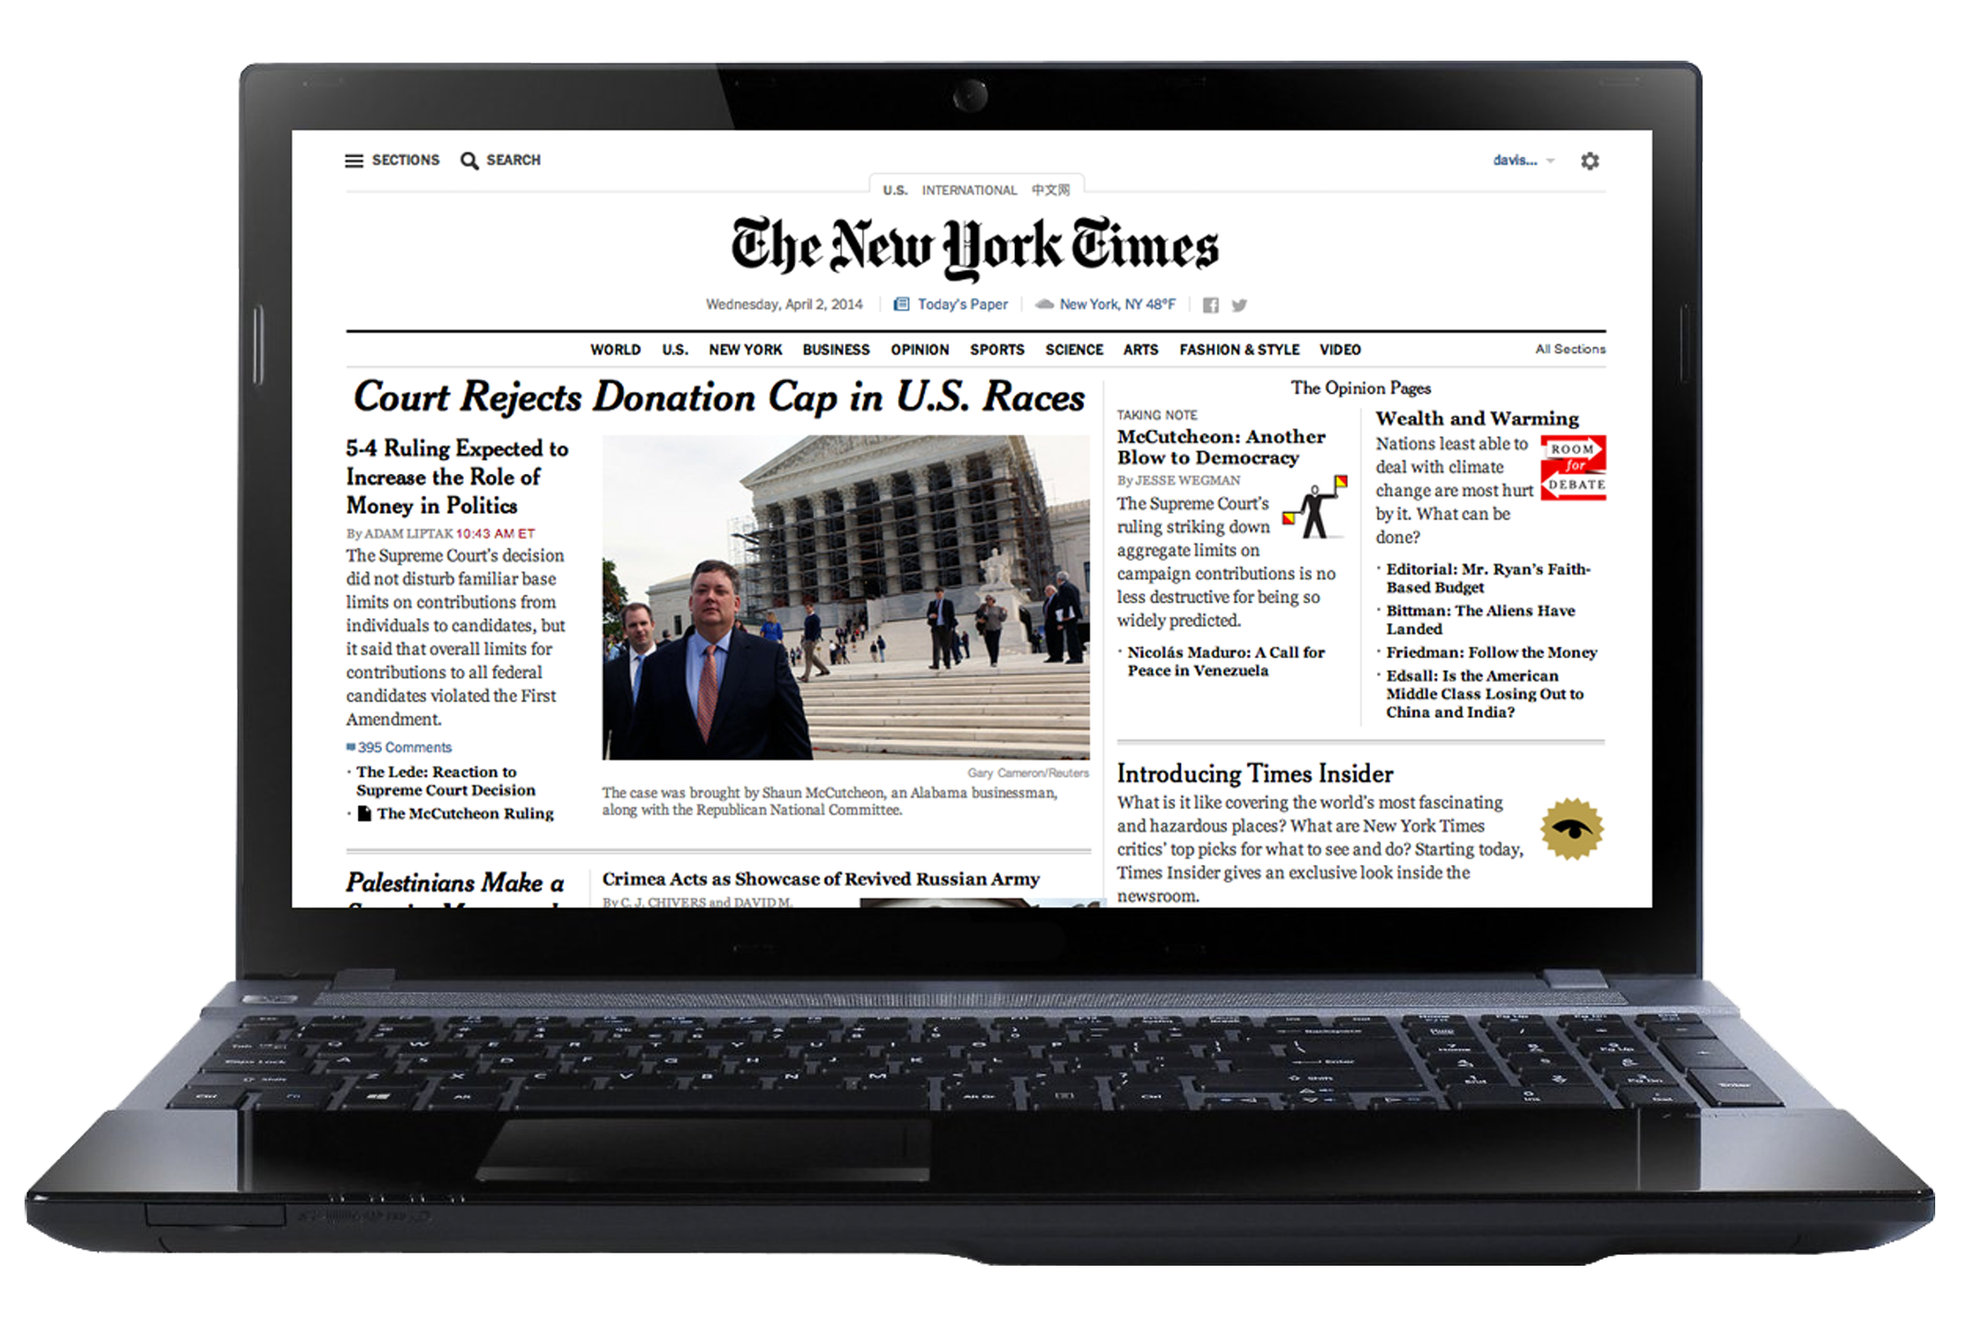
CLIENT-SIDE HARDWARE
Components:
  User Devices: Smartphones, tablets, laptops, desktops.
Functions:
  Provide end-users with access to the NYT platform.
  Ensure compatibility and performance across various devices.
Examples:
  Smartphones: iPhone, Android devices.
  Tablets: iPad, Android tablets.
  Computers: MacBooks, Windows PCs.

Slide 7
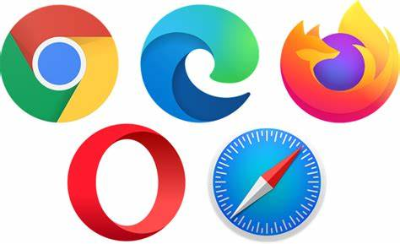
CLIENT-SIDE SOFTWARE
Software:
  Web Browsers: The NYT recommends using the latest version of Google Chrome, but it should still work in modern browsers like Firefox, Safari, and Edge.
  Mobile Apps: For the mobile app, they recommend having the latest operating system installed and having the latest version of the application installed.

Slide 8
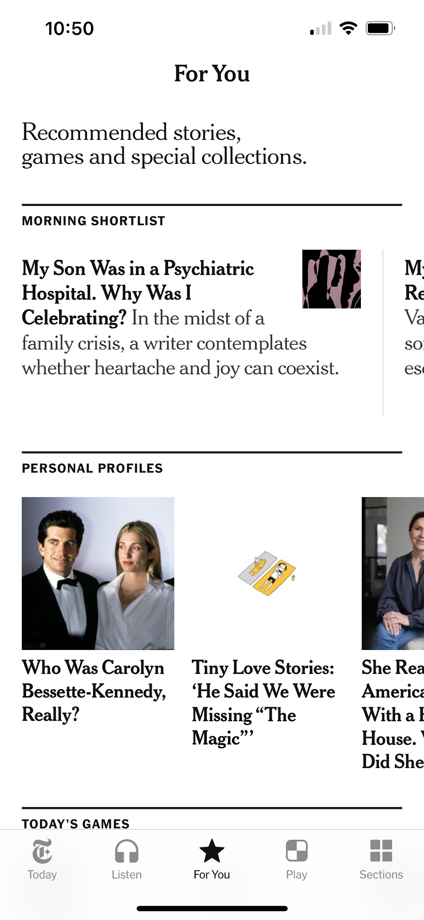
MAIN FUNCTION 1: CONTENT DELIVERY
Input Data:
  Articles, videos, images, and other multimedia content.
  Metadata such as tags, categories, publication dates.
Processing:
  Formatting and optimizing content for different devices.
  Using Content Delivery Networks (CDNs) to cache and distribute content.

Slide 9
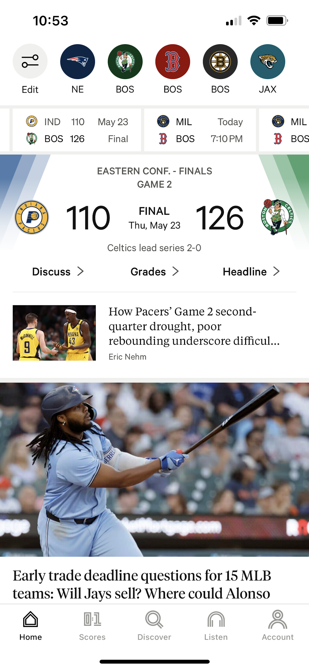
MAIN FUNCTION 2: USER PERSONALIZATION
Input Data:
  User Credentials and Profile Information: Users input their username and password to log in to the system. They can also provide profile information, such as their interests and preferences.
  Browsing History and User Preferences: The system collects data on user behavior, such as the articles they read and the topics they are interested in.
Output Data:
  Personalized Content Feed: The system generates a personalized content feed for each user. This feed is based on the user’s interests and behavior.
  Improved User Engagement: By providing personalized content and recommendations, the system improves user engagement. This leads to increased user satisfaction and loyalty.

Slide 10
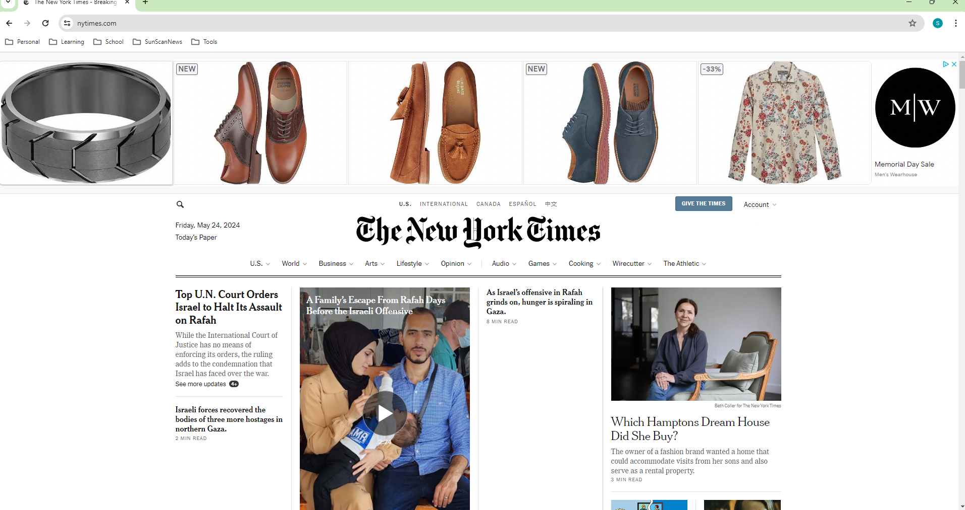
MAIN FUNCTION 3: ADVERTISING AND ANALYTICS
Input Data:
  Advertisement data (campaign details, targeting criteria).
  User interaction data (clicks, views, engagement metrics).
Output Data:
  Displaying targeted ads to users.
  Detailed reports on ad performance and engagement metrics.

Slide 11
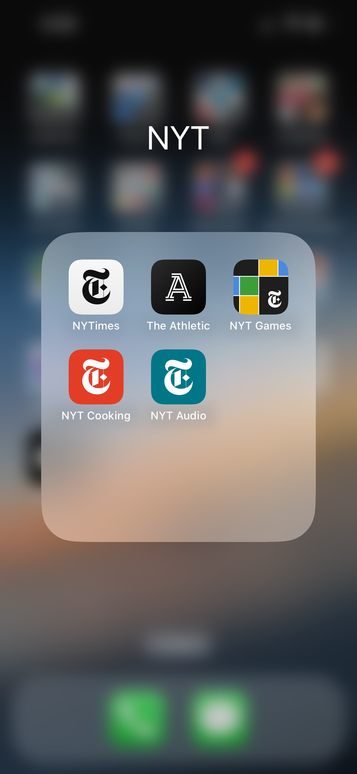
Suggested Improvements:
One Mobile App Vs Multiple
Current State: If the New York Times has multiple apps for different purposes (e.g., news, games, cooking), this can lead to a fragmented user experience.
Recommendation: Consolidate all features into one comprehensive mobile app. This would provide a unified and seamless user experience, making it easier for users to access all the content and features they love in one place.

Slide 12
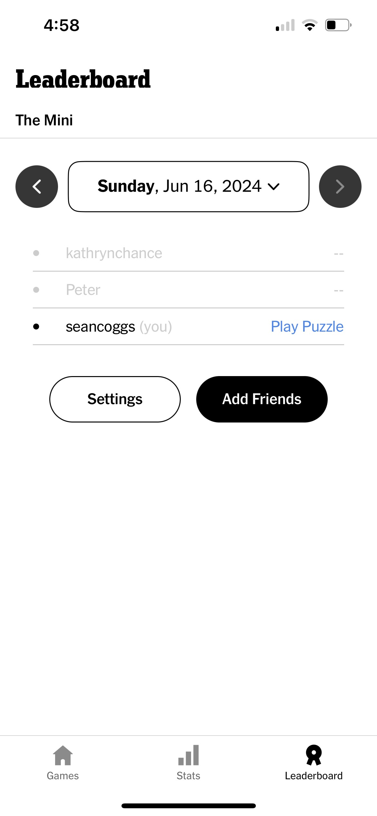
Suggested Improvements:
Improved Friends
Current State: If the New York Times has any games or interactive content, the social aspect might be limited.
Recommendation: Improve the “Friends in Games” feature by allowing users to connect with friends, see what articles they’re reading or games they’re playing, and even challenge them in games. This could also include a leaderboard to foster friendly competition.

Slide 13
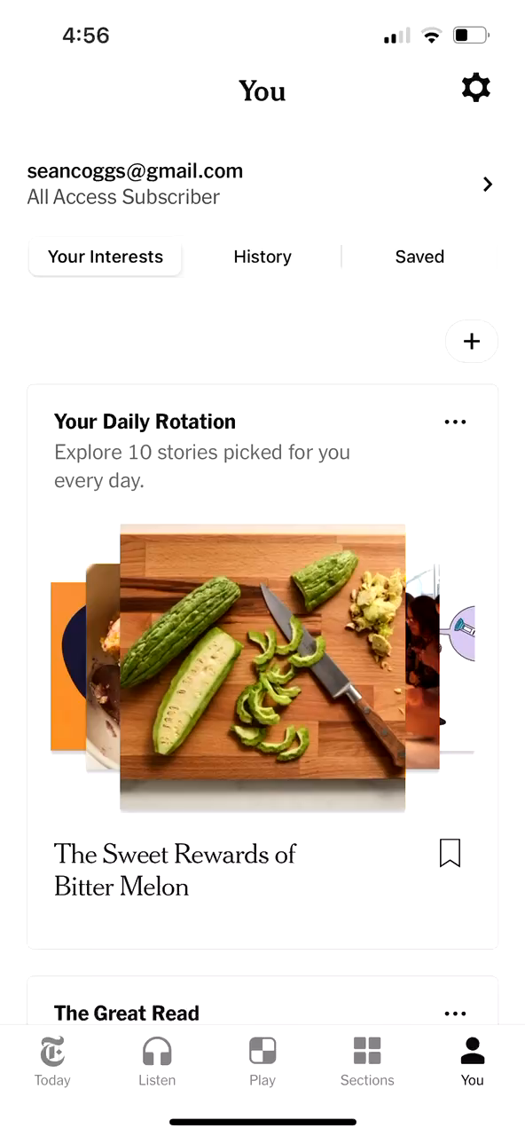
Suggested Improvements:
Scroll Section
Current State: The current system presents articles in a traditional list or grid format.
Recommendation: Implement a scroll section similar to TikTok’s interface. This would allow users to scroll vertically through articles, with each swipe presenting a new piece of content. This could be particularly effective for shorter articles or summaries.

Slide 14
REFERENCES
Web troubleshooting. (n.d.). Help. https://help.nytimes.com/hc/en-us/articles/4403549704468-Web-troubleshooting
Team, N. O. (2018, March 24). Continuous Deployment to Google Cloud Platform with Drone. Medium. https://open.nytimes.com/continuous-deployment-to-google-cloud-platform-with-drone-7078fe0c2eaf
New York Times case study. (2020, November 20). Kubernetes. https://kubernetes.io/case-studies/newyorktimes/
Fernandes, E., Moro, S., & Cortez, P. (2023). Data Science, Machine learning and big data in Digital Journalism: A survey of state-of-the-art, challenges and opportunities. Expert Systems With Applications, 221, 119795. https://doi.org/10.1016/j.eswa.2023.119795
Team, N. O. (2021, December 24). To serve better ads, we built our own data program - NYT Open. Medium. https://open.nytimes.com/to-serve-better-ads-we-built-our-own-data-program-c5e039bf247b
Podojil, E. (2021, January 28). How the New York Times build an end-to-end cloud data platform. Google Cloud Blog. https://cloud.google.com/blog/products/data-analytics/how-the-new-york-times-build-an-end-to-end-cloud-data-platform
(Turn) Off the Press: The New York Times is Winning with Digital - Digital Innovation and Transformation. (2020, February 11). Digital Innovation and Transformation. https://d3.harvard.edu/platform-digit/submission/turn-off-the-press-the-new-york-times-is-winning-with-digital/

