Slide 1
AMU PRESENTATION 2
SEAN F. COGGESHALL
MANAGEMENT INFORMATION SYSTEMS INFO331
DR. MARIO MISSAKIAN

Slide 2
PURPOSE OF NYT INFORMATION SYSTEM
Sharing News Content
Supporting Digital Journalism
Offering Subscription Services
Personalized Experiences
User Entertainment

Slide 3

Network Components
Network Infrastructure:
  High-speed fiber-optic connections for swift and dependable data transmission.
  Redundant network paths to reduce downtime and guarantee uninterrupted availability.
Data Centers:
  Establish geographically dispersed data centers to boost reliability and facilitate disaster recovery.
Content Delivery Network (CDN):
  Utilize CDNs to store content near end-users, decreasing latency and enhancing load times.
  Collaborate with for worldwide coverage.

Slide 4

Communication Components
E-Mail Systems:
  Adopt enterprise-level email solutions such as Google Workspace or Microsoft 365 for secure and dependable communication.
  Set up spam filters and encryption to safeguard email communications.
Collaboration Tools:
  Incorporate tools like Slack, Microsoft Teams, or Google Chat for messaging and collaboration.
  Utilize video conferencing tools like Zoom or Google Meet for virtual meetings and webinars.
Customer Support Systems:
  Use CRM (customer relationship system) systems like Salesforce or Zendesk for managing customer interactions and support tickets.
  Set up live chat features on the website for real-time customer assistance.

Slide 5

Security Components
Authentication and Authorization:
  Apply multi-factor authentication (MFA) for user access.
  Adopt role-based access control (RBAC) to ensure users have suitable permissions.
Data Encryption:
  Encrypt data at rest and in transit using industry-standard protocols like AES and TLS.
  Regularly refresh encryption keys and protocols to maintain security.
Threat Detection and Response:
  Install security information and event management (SIEM) systems for real-time threat monitoring.
  Use automated incident response tools to promptly address security breaches.
Compliance and Auditing:
  Ensure adherence to data protection regulations such as GDPR and CCPA.
  Carry out regular security audits and vulnerability assessments to identify and mitigate risks.

Slide 6

Impact on the Organization
Enhanced Efficiency:
  Streamlined workflows and automated processes decrease manual tasks and boost productivity.
  Real-time data access and analytics aid in better decision-making.
Improved User Experience:
  Personalized content delivery and user-friendly interfaces enhance user satisfaction.
  Quicker load times and reliable access improve overall user engagement.
Cost Savings:
  Cloud-based infrastructure eliminates the need for on-premises hardware and maintenance.
  Efficient resource utilization reduces operational costs.

Slide 7
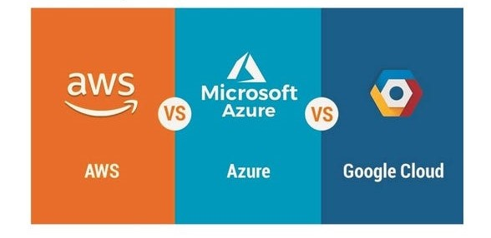


Competitive Analysis
Strengths:
  Robust infrastructure with GCP, ensuring high availability and scalability.
  Advanced data analytics for personalized content and advertising.
Weaknesses:
  High dependency on third-party services like GCP could pose risks.
  Limited social features compared to competitors with integrated social media elements.
Opportunities:
  Expanding multimedia content and interactive features can attract new users.
  Enhancing mobile app functionality and user interface to boost engagement.
Threats:
  Intense competition from other news platforms and social media giants.
  Rapid technological changes requiring continuous upgrades and innovations.

Slide 8
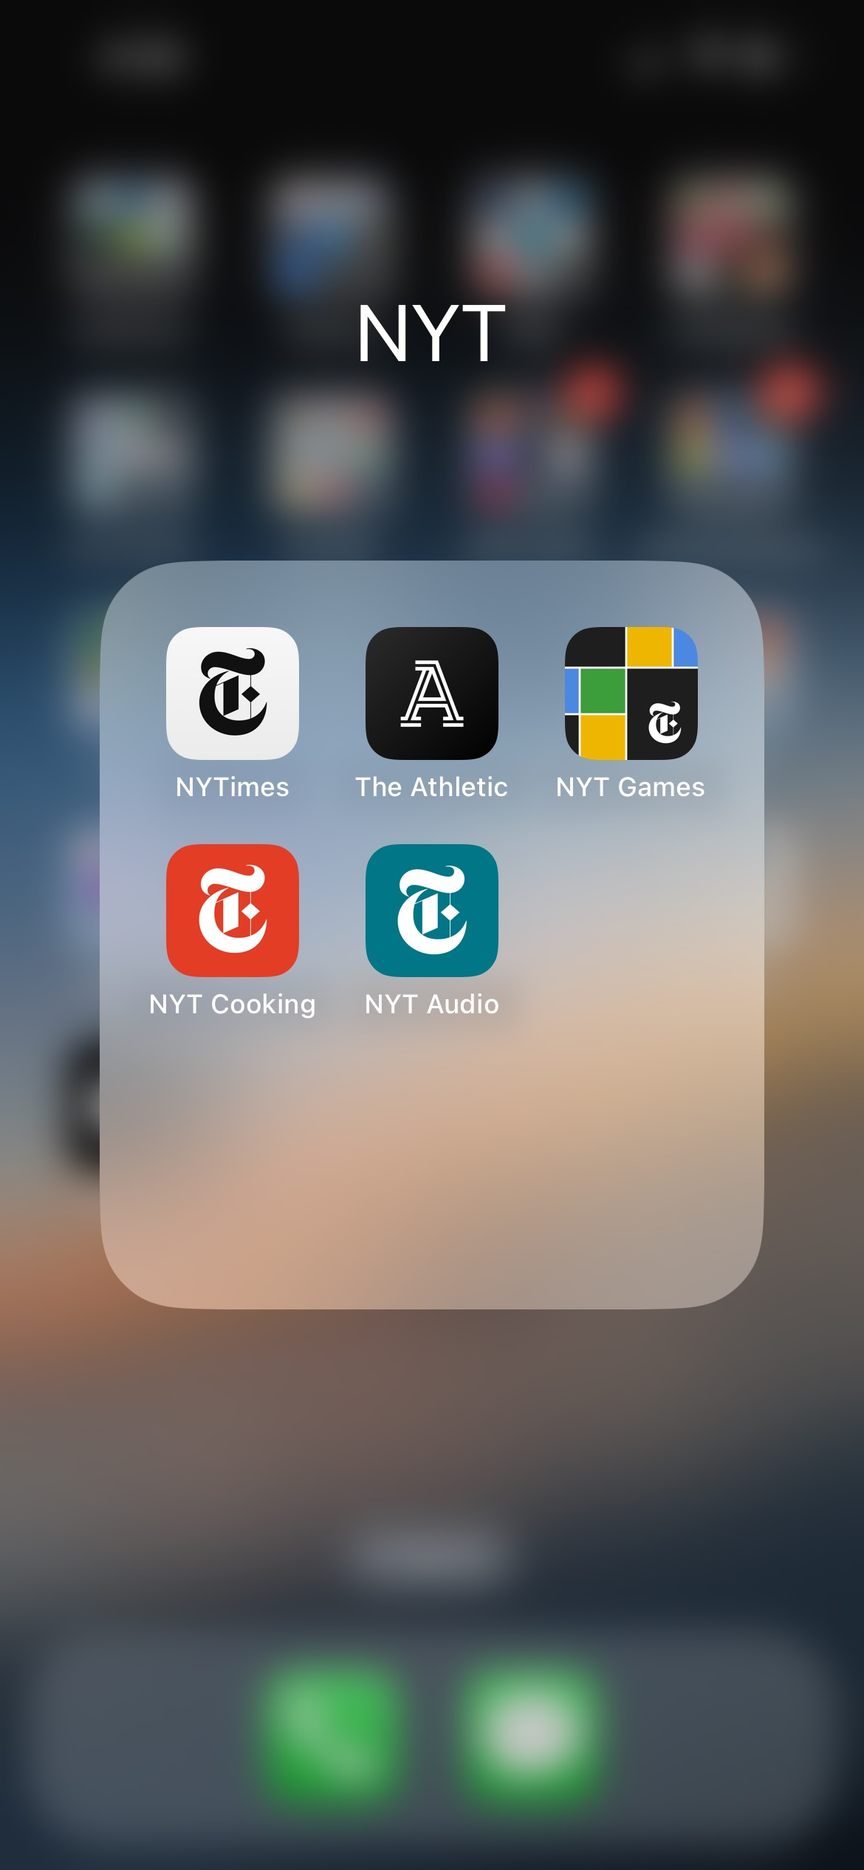
Suggested Improvements:
One Mobile App Vs Multiple
Current State: If the New York Times has multiple apps for different purposes (e.g., news, games, cooking), this can lead to a fragmented user experience.
Recommendation: Consolidate all features into one comprehensive mobile app. This would provide a unified and seamless user experience, making it easier for users to access all the content and features they love in one place.

Slide 9
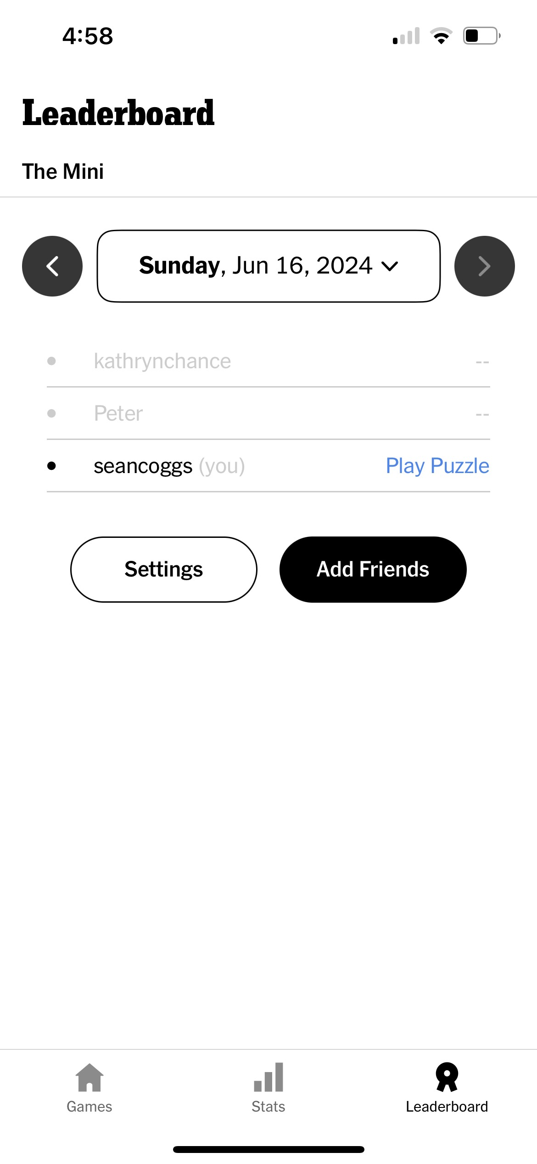
Suggested Improvements:
Improved Friends
Current State: If the New York Times has any games or interactive content, the social aspect might be limited.
Recommendation: Improve the “Friends in Games” feature by allowing users to connect with friends, see what articles they’re reading or games they’re playing, and even challenge them in games. This could also include a leaderboard to foster friendly competition.

Slide 10
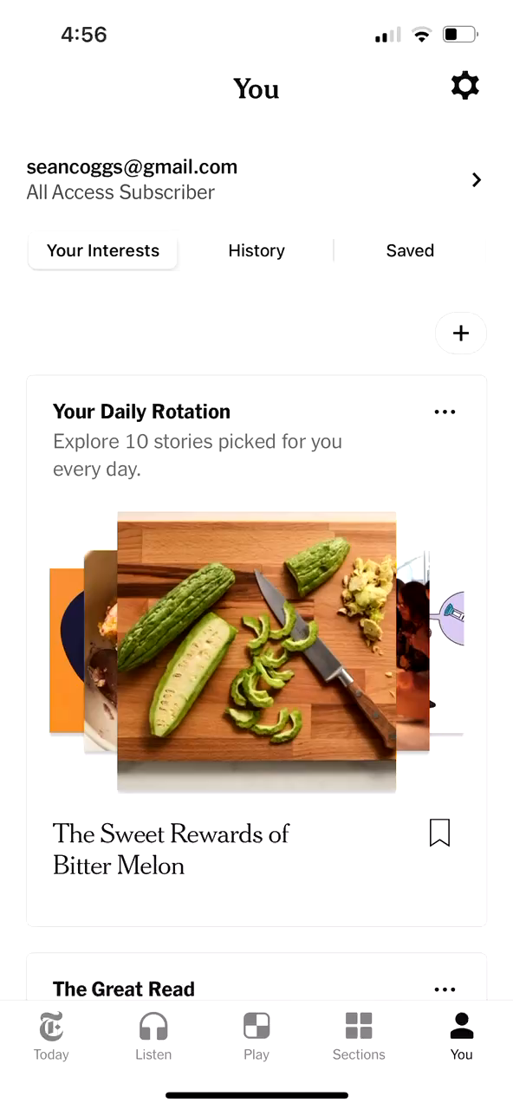
Suggested Improvements:
Scroll Section
Current State: The current system presents articles in a traditional list or grid format.
Recommendation: Implement a scroll section similar to TikTok’s interface. This would allow users to scroll vertically through articles, with each swipe presenting a new piece of content. This could be particularly effective for shorter articles or summaries.

Slide 11
REFERENCES
(Turn) Off the Press: The New York Times is Winning with Digital - Digital Innovation and Transformation. (2020, February 11). Digital Innovation and Transformation. https://d3.harvard.edu/platform-digit/submission/turn-off-the-press-the-new-york-times-is-winning-with-digital/
Team, N. O. (2018, March 24). Continuous Deployment to Google Cloud Platform with Drone. Medium. https://open.nytimes.com/continuous-deployment-to-google-cloud-platform-with-drone-7078fe0c2eaf
Team, N. O. (2021, December 24). To serve better ads, we built our own data program - NYT Open. Medium. https://open.nytimes.com/to-serve-better-ads-we-built-our-own-data-program-c5e039bf247b
Duo Security. (n.d.). Continuous identity security by duo [Video]. Cisco Duo. https://duo.com/
Workspace, G. (n.d.). Google Workspace | Business Apps & Collaboration Tools [Video]. Google Workspace. https://workspace.google.com/

