Slide 1

ENTD120 Week 2 Assignment
Sean F. Coggeshall
American Military University

Slide 2
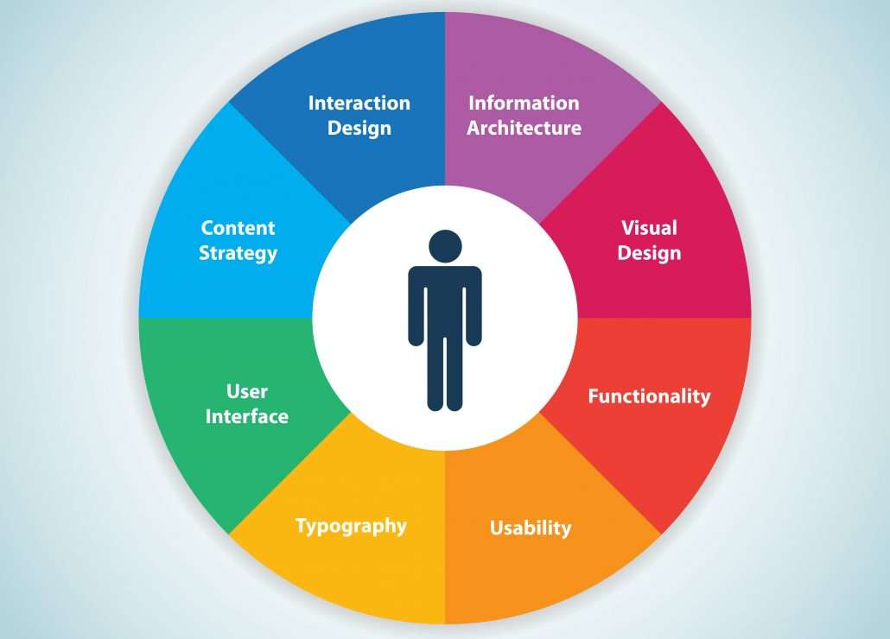
Intro
eCommerce Website Development
UX Design Process

Slide 3

Discovery & Planning
Objective: Identify client goals and their requirements
Includes:
  Research the market and target audience
  Define the project scope, timelines, and all resources.

Slide 4

Project proposal
Objective: Present project proposals to stakeholders
Includes:
Provide a timeline and budget estimates.
Align with client vision and secure approvals.

Slide 5

UX Strategy
Objective: Align business goals with the user experience
Includes:
  Understand client business and competitors.
  Identify customer problems and opportunities.

Slide 6
UX research
Objective: Gain insights into user behavior
Includes:
  Quantitative Research
  Qualitative Research
Quantitative Research:
  Data-driven, web analytics
Qualitative Research:
  Focus Groups, surveys

Slide 7
Analysis
Competitive Analysis & Use Cases
Objective:
Analyze competitors and define user scenarios.
Study Competitor Websites
Create use cases and user flows

Slide 8

Design phase
Initial sketches and design concepts
Create wireframes and prototypes

Slide 9
development
UX Engineers create the product
Involves a full team working together.

Slide 10

Production
Monitor key metrics
Identify and resolve bugs
Provide ongoing customer support and updates.

Slide 11
summary
Discovery and Planning
UX Strategy
UX Research
Analysis
Design
Production

Slide 12
Thank you
ENTD120 Week 2 Assignment
Sean F. Coggeshall
American Military University

