Slide 1
Fine-Tuning Pretrained Models for ICD-10 Coding
Self-Learning Tutorial
AI in Health Course
Scott Goldin
GitHub Repository: https://github.com/scogold/ICD-10-Classifier
Notes:
https://github.com/scogold/ICD-10-Classifier

Slide 2
The Goal: Fine-tune a model to automatically assign ICD-10 labels to free-text notes in the MIMIC-IV dataset

Slide 3


Understanding ICD-10 Coding
A00-B99
Z00-Z99
PCS
Standardized Diagnosis
Provides a universal system for classifying injuries, diseases, and causes of death across healthcare providers worldwide.
Enables consistent tracking of epidemiological trends and public health metrics.
High Granularity
Consists of over 70,000 diagnostic codes, allowing extreme specificity in patient encounters.
Captures laterality, severity, etiology, and anatomical location to improve clinical documentation quality.
Billing & Automation
Forms the core structure for medical billing, health insurance processing, and reimbursement operations.
Highly suitable target for automated NLP and fine-tuned AI modeling to reduce administrative burden.

Slide 4
Costs of Manual ICD-10 Billing
OVERHEAD
ACCURACY
EFFICIENCY
High Labor Expenses
Requires dedicated teams of certified medical coders, driving up operational overhead significantly as patient chart volume grows.
Claim Denials & Errors
Human fatigue and code complexity lead to frequent claim rejections, delayed cash flows, and resource-intensive re-appeals.
Scaling Bottlenecks
Manual coding creates severe documentation backlogs during peak patient encounters, limiting health system throughput and agility.

Slide 5
Challenges of ICD-10 Coding
VOLUME
VARIETY
ACCURACY
70,000+ Codes
An immense classification space requiring coders to navigate tens of thousands of highly specific diagnosis codes.
High Granularity
Extremely subtle distinctions in clinical documentation result in a vast array of potential code combinations.
Precision Demands
Maintaining high accuracy consistently is difficult due to human error, leading to claim rejections and delays.

Slide 6
What Is Fine-Tuning?
PROCESS
ADVANTAGE
Downstream Adaptation
Fine-tuning is the process of taking a pretrained model and completing further rounds of training to adapt it to a downstream task.
Resource Efficiency
This allows pretrained weights to be repurposed for new tasks without the need to train a new model from scratch, which can be very expensive.

Slide 7
Advantages of Pretraining & Fine-Tuning
COST & LATENCY
PRECISION
CONTROL
Resource Efficiency
Fine-tuned smaller models require significantly lower computational power, dramatically reducing inference latency and cloud hosting costs compared to massive LLMs.
Domain Specificity
By training on specialized datasets (e.g., medical ICD-10 coding), small models achieve higher domain accuracy and fewer hallucinations on focused downstream tasks.
Privacy & Deployment
Compact models can easily be deployed on local machines, preserving patient privacy. This is important when considering the restrictions of the MIMIC-IV dataset and of healthcare data as a whole.

Slide 8
Pretrained Model Selection
Our Choice
BERT Base
Domain: General English text (Wikipedia, Books)
Context: 512 tokens max sequence length
Architecture: Standard Transformer encoder
BioClinical BERT
Domain: MIMIC-III clinical notes & PubMed
Context: 512 tokens max sequence length
Architecture: Specialized medical vocabulary adaptation
ModernBERT
Domain: Massive updated general corpora
Context: Extended 8k+ token context window
Architecture: FlashAttention-2 & Rotary Embeddings (RoPE)
BioClinical ModernBERT
Domain: Modern clinical records & medical research
Context: Native 8k long context for full patient charts
Architecture: Modernized encoder + medical vocabulary

Slide 9
Hugging Face Transformers & Trainer API
CORE FRAMEWORK
EFFICIENT TRAINING
Hugging Face Transformers
Provides thousands of pretrained models to perform text, vision, and audio tasks with unified architectures.
• Model Hub Integration: Instant access to SOTA pretrained checkpoints like BERT, RoBERTa, and ModernBERT.
• Tokenization & Pipelines: High-performance tokenizers matching model vocabularies seamlessly.
• Framework Interoperability: Seamless support across PyTorch, TensorFlow, and JAX.
The Trainer Class
A feature-complete training loop for PyTorch models, optimized for Hugging Face architectures.
• Simplified Loops: Abstracts away boilerplate code for training, evaluation, and gradient accumulation.
• Built-in Optimizations: Native support for Mixed Precision (fp16/bf16), DeepSpeed, and multi-GPU distributed setups.
• Evaluation & Logging: Seamless integration with custom metrics, evaluation strategies, and monitoring tools.

Slide 10
Outline of the Approach
STEP 01
STEP 02
STEP 03
Generate Synthetic Data
Create a dataset for robust testing & future publication requirements.
Preprocess Data
Clean, tokenize, and format data for model ingestion and training.
Configure Parameters
Set learning rates, batch sizes, and optimization hyperparameters.
STEP 04
STEP 05
STEP 06
Train Model
Initialize the fine-tuning process on the prepared clinical dataset.
Run Experiments
Execute experimental runs to test model configurations and evaluate the setup.
Reflections
Analyze results, document key findings, and identify areas for improvement.

Slide 11
Part 1: Synthetic Data Generation

Slide 12
Why Generate Synthetic Data?
REASON 01
REASON 02
REASON 03
System Testing & Validation
Synthetic data is crucial for testing and verifying that the system pipeline works end-to-end effectively.
Repository Compliance
Publishing requires sample data for users, but real MIMIC-IV datasets cannot be included due to strict terms of use.
Agentic AI Security
IDE-integrated agentic coding tools scan full repos; actual patient data must not be exposed during active development.

Slide 13
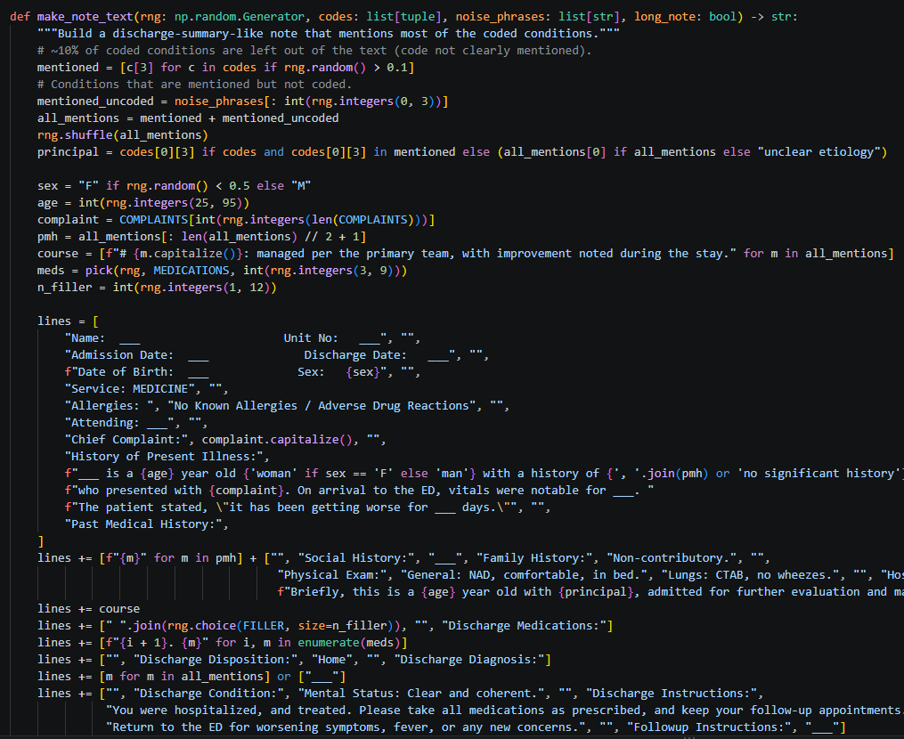
The Process
GENERATION SCRIPT
GitHub Link to Generation Script
An LLM was used to generate fake medical notes
The script combines various preprogrammed sections of a medical note into a complete fake note
Matching ICD-10 code rows for each hospital admission are included in the generated diagnoses_icd.csv

Slide 14
Example Synthetic Notes 1
Admission Date: ___ Discharge Date: ___
Date of Birth: ___ Sex: M
Service: MEDICINE
History of Present Illness:
___ is a 34 year old man with a history of upper respiratory infection, hypertension, type 2 diabetes mellitus, hyperlipidemia, remote tobacco use, former smoker, acute kidney injury, atrial fibrillation, hypertensive chronic kidney disease, who presented with cough. On arrival to the ED, vitals were notable for ___. The patient stated, ""it has been getting worse for ___ days.""
Past Medical History:
upper respiratory infection
hypertension
type 2 diabetes mellitus
hyperlipidemia
remote tobacco use, former smoker
acute kidney injury
atrial fibrillation
hypertensive chronic kidney disease
Social History:

Slide 15
Example Synthetic Notes 2
# Lung cancer: managed per the primary team, with improvement noted during the stay.
Laboratory studies were reviewed daily, including a basic metabolic panel, complete blood count, and magnesium level. An electrocardiogram showed no acute changes compared with the prior tracing, and telemetry was unremarkable. Physical therapy evaluated the patient, and recommended a short course of rehabilitation, ""as tolerated"" per protocol. Case management arranged outpatient follow-up, and transportation was confirmed with the family prior to discharge. An electrocardiogram showed no acute changes compared with the prior tracing, and telemetry was unremarkable. An electrocardiogram showed no acute changes compared with the prior tracing, and telemetry was unremarkable. The patient was seen and examined by the primary team, and the plan was discussed with the family at the bedside. Laboratory studies were reviewed daily, including a basic metabolic panel, complete blood count, and magnesium level. An electrocardiogram showed no acute changes compared with the prior tracing, and telemetry was unremarkable. Imaging was obtained, and the radiology read was reviewed with the consulting service, who agreed with the plan.
Discharge Medications:
1. Atorvastatin 40 mg PO QPM
2. Tamsulosin 0.4 mg PO QHS
3. Lisinopril 10 mg PO DAILY
4. Apixaban 5 mg PO BID

Slide 16
Example Synthetic diagnoses_icd
6712572,27232402,1,I10,10
16712572,27232402,2,J189,10
16712572,27232402,3,E785,10
16712572,27232402,4,Z87891,10
16712572,27232402,5,I4891,10
16712572,27232402,6,I2510,10
16712572,27232402,7,N179,10
16712572,27232402,8,Z8673,10
16712572,27232402,9,E119,10
16712572,27232402,10,J45909,10
16712572,27232402,11,I5032,10
16712572,27232402,12,E871,10
13164631,23554850,1,I10,10
13164631,23554850,2,E785,10
13164631,23554850,3,N179,10
13164631,23554850,4,I2510,10
13164631,23554850,5,E119,10
13164631,23554850,6,J189,10
13164631,28388386,1,I2510,10

Slide 17
Privacy Tip
If you are using an agentic coding tool like Claude Code or Codex to modify this project, it can still read the MIMIC data even if you keep the MIMIC directory outside the working directory. To prevent this, set a permission that blocks the agent from reading outside the working directory.
To do this in Claude Code, for example, open the claude.md file and add:
"permissions": {
"blockReadsOutsideWorkingDirectories": true
}

Slide 18
Part 2: Preprocess the Data

Slide 19
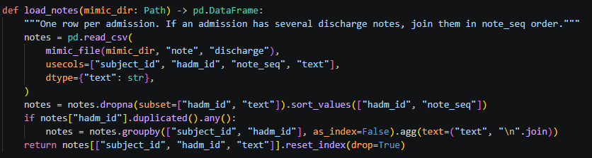
Load the MIMIC Notes - Script dataset.py
This reads in the relevant CSV files and returns them as a pandas DataFrame
Note: the only required MIMIC-IV files in the directory are “diagnoses_icd.csv” and “discharge.csv”
Downloading the full dataset is not recommended, as downloads from PhysioNet are very slow
Notes:
https://github.com/scogold/ICD-10-Classifier/blob/main/src/icd10/data/dataset.py

Slide 20
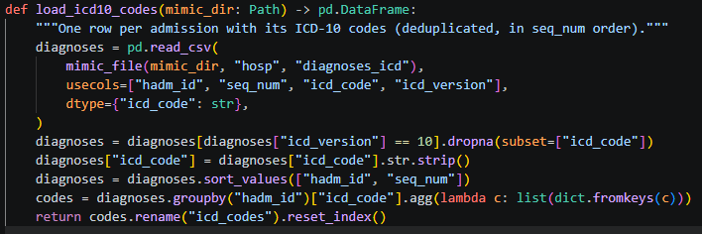
Load ICD-10 Codes - Script dataset.py
This reads from the “diagnoses_icd.csv” file
Preprocesses the data
Creates a pandas DataFrame
Notes:
https://github.com/scogold/ICD-10-Classifier/blob/main/src/icd10/data/dataset.py

Slide 21
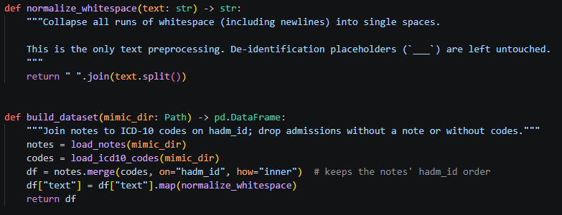
Build the Dataset - Script dataset.py
This function builds out the dataset

Slide 22
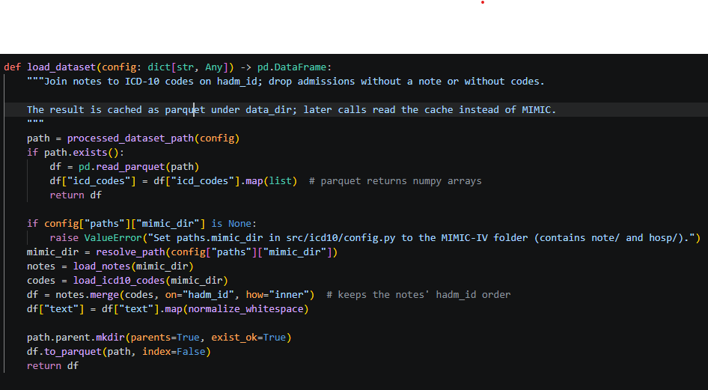
Build the Dataset - Script dataset.py
If the dataset already exists in processed form, reuse that dataset
If not, use the previously defined methods to construct the processed dataset
Datasets are saved to Parquet files for quicker read/write access during fine-tuning
Normalize whitespace is a helper method that handles the de-identification gaps in MIMIC

Slide 23
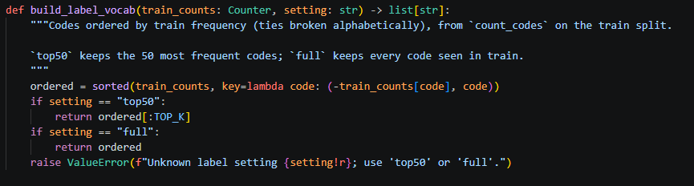
Build the Label Vocab - Script labels.py
Two settings are available: full code classification or just the top 50 codes
Selects the codes to be used in the vocab

Slide 24


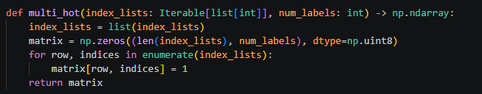
Label helper functions - Script labels.py
Count codes counts the number of times each code appears in the data
Codes to indices returns the index of each code for processing
Multi-hot encodes multi-label examples in a [1, 0, 1, 0, 0] format for classification. Each 1 marks a label that is present in the note.

Slide 25
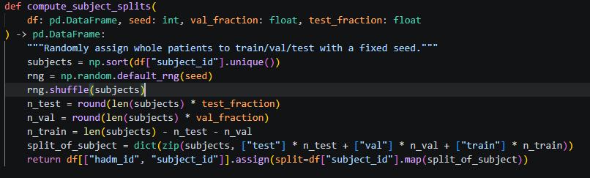
Split data - Script splits.py
Randomly splits data into test, train, and validation sets for fine-tuning

Slide 26
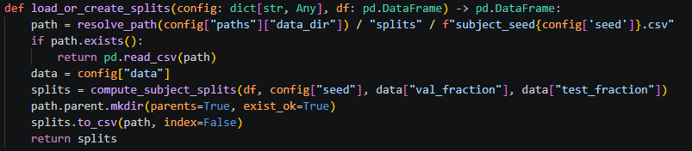
Split data - Script splits.py
Loads the split if it has already been computed; otherwise, it creates a new split

Slide 27
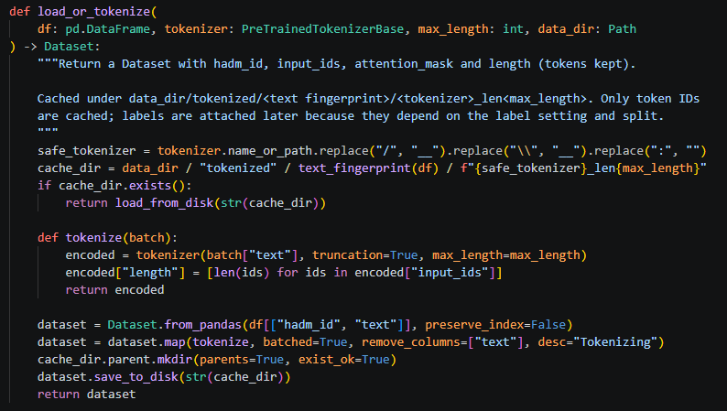
Prepare data for fine-tuning - Script prepare.py
If a tokenized version of the dataset exists, use that
If not, tokenize the dataset and save the file

Slide 28

Prepare data for fine-tuning - Script prepare.py
Create a unique hash to determine whether the data has changed and needs to be tokenized again

Slide 29
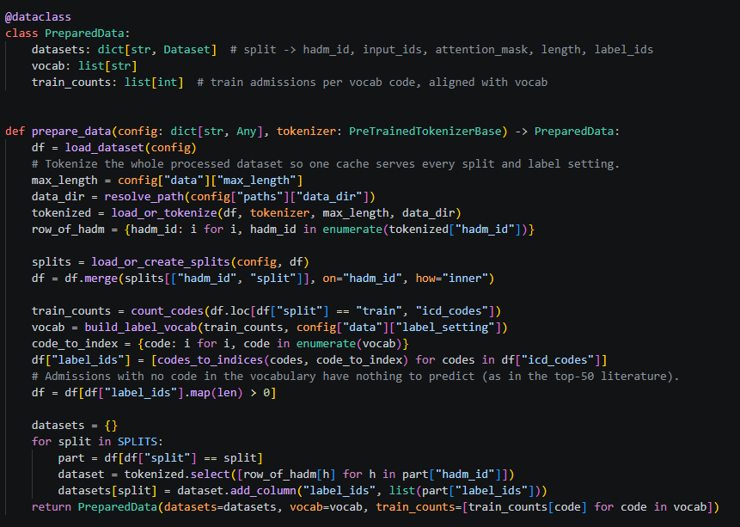
Prepare data for fine-tuning - Script prepare.py
Hugging Face Transformers expects data to be provided in a data class
This uses the previously defined tokenization methods to format the data for Hugging Face Transformers

Slide 30
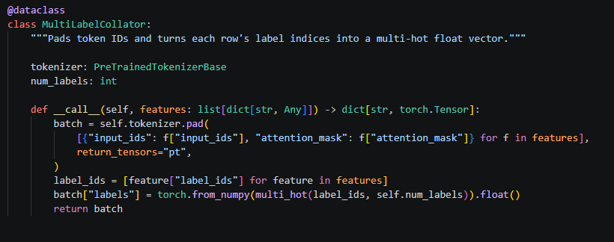
Prepare data for fine-tuning - Script prepare.py
This data class exists to allow classification on a tensor of labels instead of a single label
This is what allows for multi-label classification to occur

Slide 31
Part 3: Training the Model

Slide 32
Configuring Hyperparameters
The success of fine-tuning depends heavily on the chosen hyperparameters. The hyperparameters vary by type of experiment. The project supports 6 types of experiments.
Full Base: train a classifier to work on all 70,000 ICD-10 codes
Top 50 Base: train a classifier to work on the top 50 most common ICD-10 codes
Top 50 Large: train a classifier on the top 50 most common ICD-10 codes with a larger ModernBERT model
Synthetic: train a classifier on the included synthetic data
Smoke: a test setting used exclusively for debugging

Slide 33
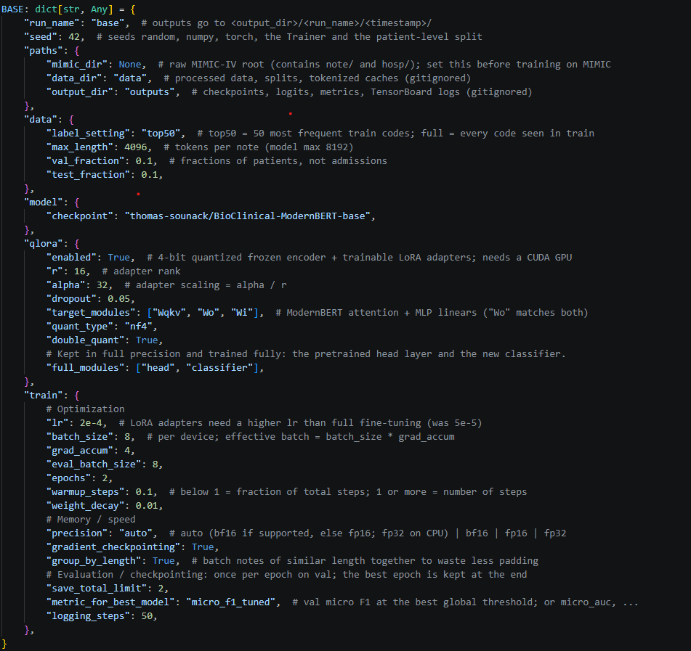
Base Hyperparameters - Script config.py
These are the default hyperparameters. Each experiment overrides certain hyperparameters for its own needs. The most important ones are highlighted here.
mimic_dir: the local path to the MIMIC data (for security, do not fill this in while using AI assistance)
label_settings: how many labels to attempt to classify
max_length: maximum tokens per note
checkpoint: the Hugging Face directory of the pretrained model
QLoRA: settings for QLoRA training, a method that freezes the base weights and trains a quantized “adapter” matrix with a lower rank. This makes fine-tuning very large models possible on limited hardware.
r: the rank of the QLoRA matrix
Quant_type: the datatype of the QLoRA matrix

Slide 34
Base Hyperparameters (continued) - Script config.py
lr: the rate of parameter updates
batch_size: the number of examples to evaluate at once
grad_accum: number of batches to accumulate gradients over; this improves training stability
epochs: the number of passes through the data during fine-tuning
warmup_steps: number of steps at the start of training during which the learning rate gradually ramps up.
weight_decay: decrease in the magnitude of weights at each step; helps prevent overfitting
gradient_checkpointing: a setting that stores intermediate gradients and recomputes the others from them. This drastically reduces memory requirements.
(Side note: I would highly recommend the “Advances in Deep Learning” course by Professor Philipp Krähenbühl. It provides excellent coverage of deep learning methods and all of these hyperparameters.)

Slide 35
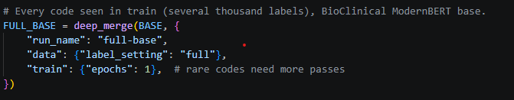
Hyperparameters for FULL_BASE experiment - Script config.py
These settings configure the experiment to run on the full ICD-10 dataset
It is compute-intensive, but a large number of epochs is required to achieve decent classification scores

Slide 36
Hyperparameters for TOP50_BASE experiment - Script config.py
These settings configure the experiment to classify the 50 most common ICD-10 codes
This uses the base hyperparameters exactly as they are

Slide 37
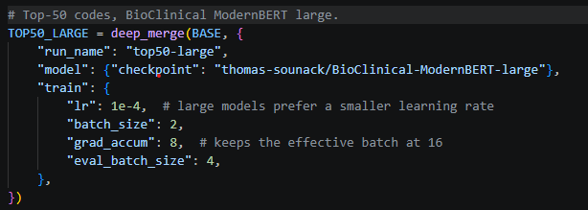
Hyperparameters for TOP50_Large experiment - Script config.py
These settings configure the experiment to classify the top 50 most common codes
The larger BioClinical-ModernBERT-large model is used, which should lead to better performance

Slide 38
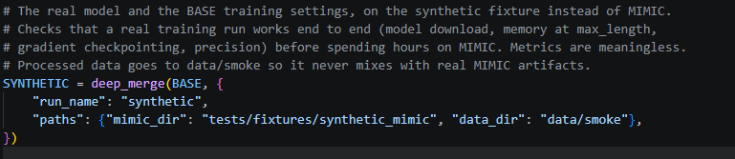
Hyperparameters for SYNTHETIC experiment - Script config.py
These settings configure the experiment for fine-tuning on the synthetic LLM-generated data
This is useful for testing and publication when the actual MIMIC-IV data is not available

Slide 39
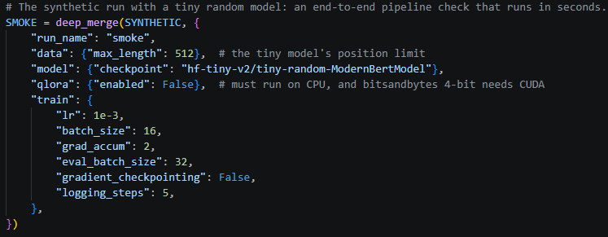
Hyperparameters for SMOKE experiment - Script config.py
The smoke experiment exists exclusively for debugging
This uses a very small model and very small amounts of data
This makes debugging much quicker and avoids using larger models for debugging

Slide 40
Hyperparameters for FULL_BASE experiment - Script config.py
These settings configure the experiment to run on the full ICD-10 dataset
It is compute-intensive, but a large number of epochs is required to achieve decent classification scores

Slide 41
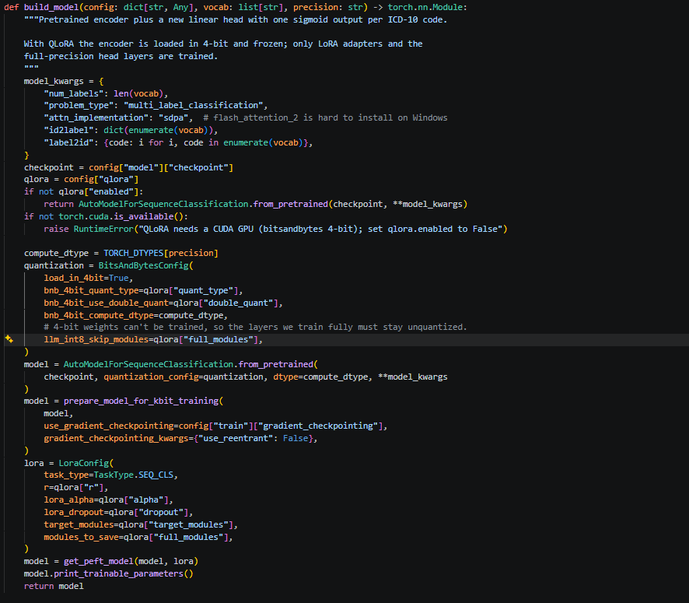
Building the model - Script train.py
This function takes the defined hyperparameters from the config and builds out a model
The core of the model is a neural network initialized with the weights of the pretrained model
A linear classification layer is added to perform ICD-10 classification from the word embeddings

Slide 42
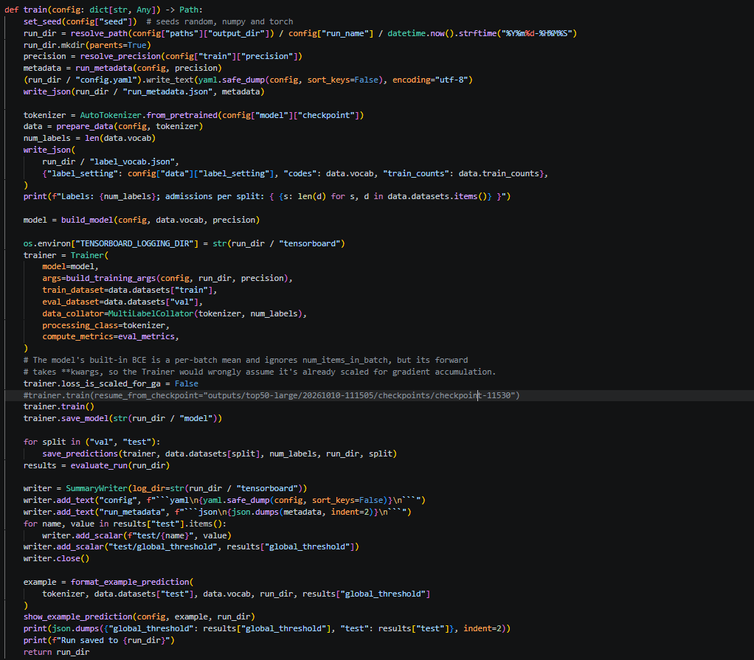
Training the model - Script train.py
This is the actual training loop that fine-tunes the model
Data is prepared and tokenized first
The model is built out using the previous script
The Hugging Face Trainer is instantiated
The model is fine-tuned
The fine-tuned model is then evaluated
Finally, the model is saved

Slide 43
Part 4: Evaluating the Model

Slide 44
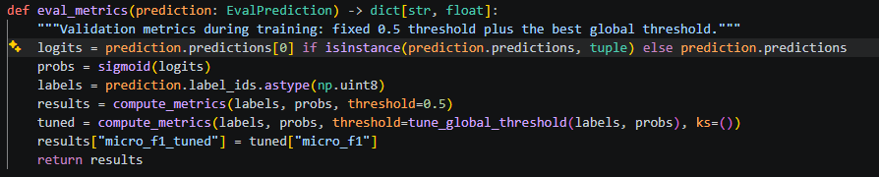
The training script calls the metrics script - Script train.py
Calls the compute metrics function to evaluate the accuracy of the results

Slide 45
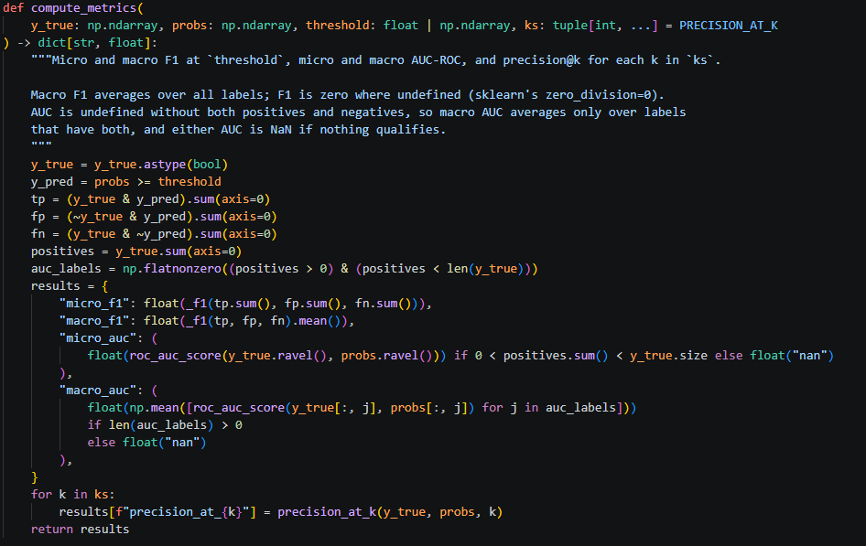
Compute metrics - Script metrics.py
Compute metrics calculates a suite of metrics on the model’s performance
F1 is a metric that combines precision and recall
Macro averages the score across labels
Micro averages across all predictions
Macro reflects rare codes; micro reflects overall performance

Slide 46
Compute metrics (continued) - Script metrics.py
Precision at k measures the precision of the k most confident labels
AUC: area under the curve, measures how likely the model is to score a positive example higher than a negative one
The compute metrics method can alternatively be called from the command line using evaluate.py

Slide 47
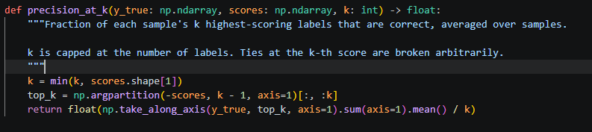
Precision at k calculation - Script metrics.py
This helper method computes the precision for the k most confident labels

Slide 48
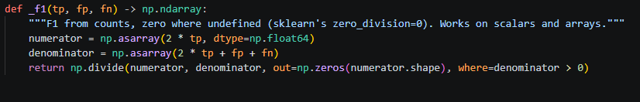
F1 calculation - Script metrics.py
This helper method computes F1 scores
F1 scores measure both precision and recall in one metric

Slide 49
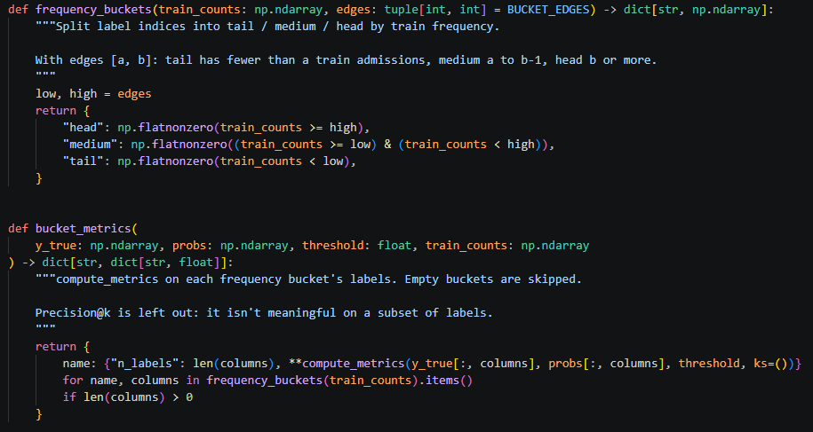
Frequency bucket metrics - Script metrics.py
The frequency metrics evaluate how well the model performs on labels grouped by how often they appear in the training data
This is used in the full_base training experiments

Slide 50
Frequency bucket metrics - Script metrics.py
The frequency metrics evaluate how well the model performs on labels grouped by how often they appear in the training data
This is used in the full_base training experiments

Slide 51
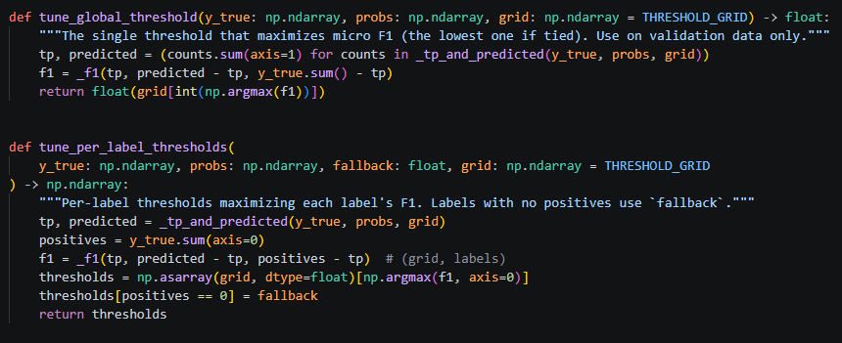
Tuning prediction thresholds - Script metrics.py
The prediction thresholds determine how high a score must be for the model to count a label as predicted
There are both global and per-label thresholds
Picking a good threshold ensures a well-performing model

Slide 52
Part 5: Experiments and Results

Slide 53
Experiment 1:
Full Base
Ran on a local desktop:
Nvidia 5080 GPU
16 GB VRAM
Approximately 14 hours of training time
2-epoch experiment
Evaluating a classifier over all 70,000 ICD-10 codes
Used 331,794 discharge notes as a training corpus

Slide 54
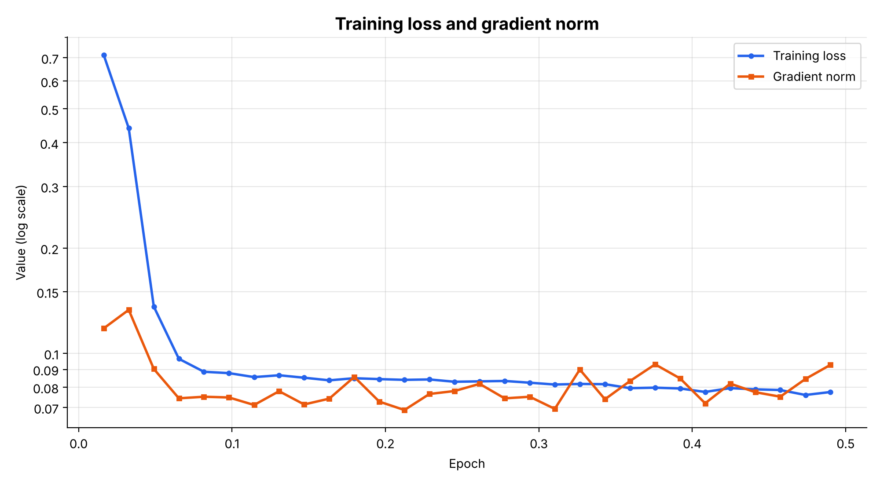
Epoch 0.5 Stats
Time ~3 hours
"micro_f1": 0.0780199731834734,
"macro_f1": 0.0011948689551967793,
"micro_auc": 0.9538264129018218,
"macro_auc": 0.5004821238692923,
"precision_at_5": 0.04816933638443936,
"precision_at_8": 0.05042497548218372,
"precision_at_15": 0.0518252152119429
Sample notes not included due to MIMIC privacy concerns, sample notes are produced when run locally
Notes:
{'loss': '0.7134', 'grad_norm': '0.1179', 'learning_rate': '1.591e-05', 'epoch': '0.01634'}
{'loss': '0.4403', 'grad_norm': '0.1332', 'learning_rate': '3.214e-05', 'epoch': '0.03267'}
{'loss': '0.1361', 'grad_norm': '0.0903', 'learning_rate': '4.838e-05', 'epoch': '0.04901'}
{'loss': '0.09651', 'grad_norm': '0.07441', 'learning_rate': '4.837e-05', 'epoch': '0.06535'}
{'loss': '0.08861', 'grad_norm': '0.07518', 'learning_rate': '4.655e-05', 'epoch': '0.08169'}
{'loss': '0.08782', 'grad_norm': '0.07483', 'learning_rate': '4.473e-05', 'epoch': '0.09802'}
{'loss': '0.08556', 'grad_norm': '0.07121', 'learning_rate': '4.292e-05', 'epoch': '0.1144'}
{'loss': '0.0866', 'grad_norm': '0.07798', 'learning_rate': '4.11e-05', 'epoch': '0.1307'}
{'loss': '0.08521', 'grad_norm': '0.07146', 'learning_rate': '3.929e-05', 'epoch': '0.147'}
{'loss': '0.08377', 'grad_norm': '0.07425', 'learning_rate': '3.747e-05', 'epoch': '0.1634'}
{'loss': '0.08493', 'grad_norm': '0.08567', 'learning_rate': '3.566e-05', 'epoch': '0.1797'}
{'loss': '0.08443', 'grad_norm': '0.07281', 'learning_rate': '3.384e-05', 'epoch': '0.196'}
{'loss': '0.08402', 'grad_norm': '0.06889', 'learning_rate': '3.203e-05', 'epoch': '0.2124'}
{'loss': '0.08425', 'grad_norm': '0.07657', 'learning_rate': '3.021e-05', 'epoch': '0.2287'}
{'loss': '0.08297', 'grad_norm': '0.07807', 'learning_rate': '2.84e-05', 'epoch': '0.2451'}
{'loss': '0.08319', 'grad_norm': '0.08184', 'learning_rate': '2.658e-05', 'epoch': '0.2614'}
{'loss': '0.08341', 'grad_norm': '0.07439', 'learning_rate': '2.476e-05', 'epoch': '0.2777'}
{'loss': '0.08246', 'grad_norm': '0.07518', 'learning_rate': '2.295e-05', 'epoch': '0.2941'}
{'loss': '0.08148', 'grad_norm': '0.06941', 'learning_rate': '2.113e-05', 'epoch': '0.3104'}
{'loss': '0.0818', 'grad_norm': '0.08993', 'learning_rate': '1.932e-05', 'epoch': '0.3267'}
{'loss': '0.08166', 'grad_norm': '0.07395', 'learning_rate': '1.75e-05', 'epoch': '0.3431'}
{'loss': '0.07955', 'grad_norm': '0.08335', 'learning_rate': '1.569e-05', 'epoch': '0.3594'}
{'loss': '0.07981', 'grad_norm': '0.09304', 'learning_rate': '1.387e-05', 'epoch': '0.3758'}
{'loss': '0.07938', 'grad_norm': '0.08481', 'learning_rate': '1.206e-05', 'epoch': '0.3921'}
{'loss': '0.0776', 'grad_norm': '0.07201', 'learning_rate': '1.024e-05', 'epoch': '0.4084'}
{'loss': '0.07957', 'grad_norm': '0.08195', 'learning_rate': '8.424e-06', 'epoch': '0.4248'}
{'loss': '0.07894', 'grad_norm': '0.07747', 'learning_rate': '6.609e-06', 'epoch': '0.4411'}
{'loss': '0.07857', 'grad_norm': '0.0752', 'learning_rate': '4.793e-06', 'epoch': '0.4574'}
{'loss': '0.07606', 'grad_norm': '0.08452', 'learning_rate': '2.977e-06', 'epoch': '0.4738'}
{'loss': '0.07756', 'grad_norm': '0.09275', 'learning_rate': '1.162e-06', 'epoch': '0.4901'}

Slide 55
Epoch 1
Time ~7 hours
'eval_loss': '0.06239'
'eval_micro_f1': '0.1621'
'eval_macro_f1': '0.009035'
'eval_micro_auc': '0.9742'
'eval_macro_auc': '0.7569'
'eval_precision_at_5': '0.2451'
'eval_precision_at_8': '0.2168'
'eval_precision_at_15': '0.1812'
'eval_micro_f1_tuned': '0.2097'

Slide 56
Epoch 2
Time ~14 hours
"micro_f1": 0.06222175794137874,
"macro_f1": 0.00133397808567831,
"micro_auc": 0.9303573061722333,
"macro_auc": 0.5021372688491077,
"precision_at_5": 0.038754494932984634,
"precision_at_8": 0.040658711997384765,
"precision_at_15": 0.042366786531546255

Slide 57
2 Epoch Results
Overall results on the 2-epoch test were poor. This is likely due to the ratio of ~331,000 data points to 70,000 labels; it is unlikely that every label appears in the training set. Additionally, 2 epochs of training were likely not enough, as they did not give the model enough exposure to rare labels.

Slide 58
Experiment 2:
Top 50 Large
Ran on a local desktop:
Nvidia 5080 GPU
16 GB VRAM
Approximately 22 hours of training time
2-epoch experiment
Evaluating a classifier over the top 50 codes
Used 331,794 discharge notes as a training corpus

Slide 59
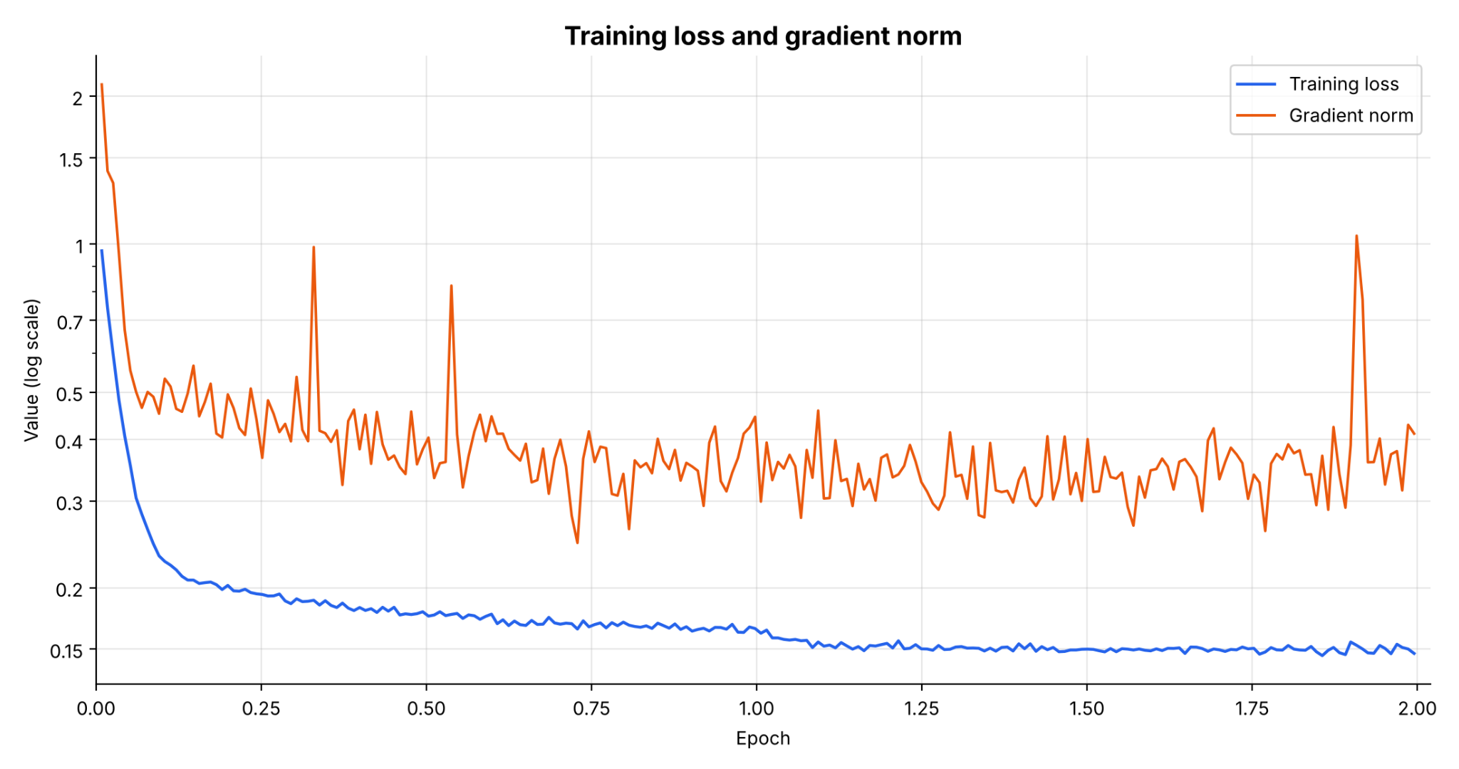
Epoch 2 - Top 50
"micro_f1": 0.2082395470977423,
"macro_f1": 0.146480300980808,
"micro_auc": 0.5755216465545117,
"macro_auc": 0.497933040843909,
"precision_at_5": 0.1790241361347456,
"precision_at_8": 0.16718397291196388,
"precision_at_15": 0.14630433524338715
Sample notes not included due to MIMIC privacy concerns, sample notes are produced when run locally

Slide 60
2 Epoch Results
Overall results on the 2-epoch test were better in the top 50 experiment. The F1 across all the data (micro F1) was around 20%. This is reasonable considering there were only 2 epochs of training. Additionally, multi-label classification is a more difficult task. More epochs would likely improve this.

Slide 61
Part 6: Reflection

Slide 62
Areas for Improvement
Overall, neither of the two experiments was ideal
My biggest mistake, which I would correct in future iterations, was classifying based on the tag IDs rather than the tag names. If I had used the tag names, I could have preserved the contextual information stored in the word vectors of the pretrained weights.
Additionally, to build a production-ready system, I would need many more epochs to allow the model to see rare codes more frequently

Slide 63
Another Possible Experiment
Another possible way to improve the project would be to change the architecture to a decoder-only transformer.
This would generate tags instead of classifying them.
This could potentially leverage the existing word embeddings of the tag names.

Slide 64
Generative AI Disclosure
Citation as per syllabus guidelines
Agentic AI tools were used in the development of the repository, subject to human direction, planning, and oversight.
Diligent steps were taken to avoid exposing MIMIC-IV data to any LLMs (see references throughout the presentation)
Specific models used
  Claude Opus 5.5
  Claude Sonnet 5.5

